Slide 1

OUTCOMES RESEARCH Consortium
Providing the evidence for evidence-based medicine©

Slide 2
Perioperative Thermoregulation
Daniel I. Sessler, M.D.
Vice-President for Clinical and Outcomes Research
Professor of Anesthesiology
UTHealth, Houston
Dr. Sessler occasionally consults for temperature-related companies; all fees are donated to charity
www.OR.org DS@OR.org

Slide 3
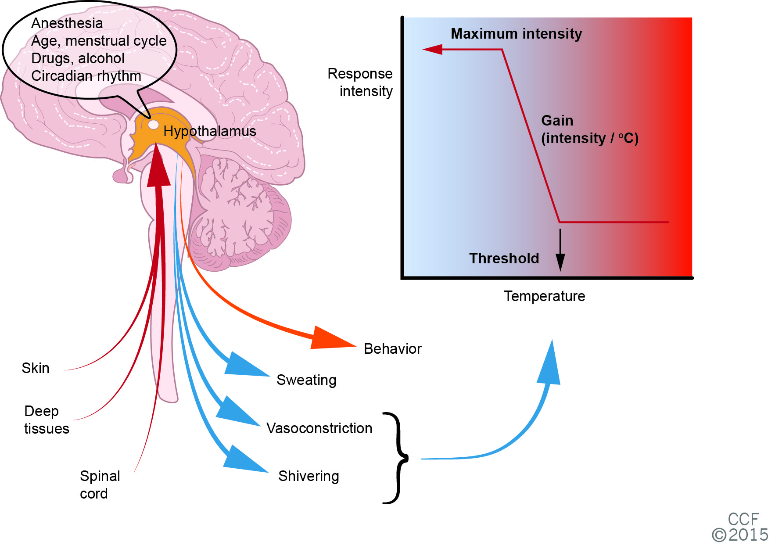
Thermoregulatory Model

Slide 4
Normal Thermoregulation
Sessler, Lancet 2016

Slide 5
Anesthesia Impairs Regulation
Annadata, Anesthesiology 1995
Kurz, Anesthesiology 1995
Talke, Anesthesiology 1997
Matsukawa, Anesthesiology 1995

Slide 6
Summary: General Anesthesia
Central thermoregulatory inhibition
  Little effect on warm defenses
  Dose-dependent increase in interthreshold range
Similar in infants, children, and adults
Impaired in the elderly

Slide 7
Central Inhibition During Neuraxial Anesthesia
Kurz, A&A 1993

Slide 8
Reduced Shivering Gain & Maximum
Control
Epidural
Kim, Anesthesiology 1998

Slide 9
Behavioral Inhibition
Sessler, Anesthesiology 1980

Slide 10
Sympathectomy Prevents Plateau
Joris, Anesthesiology 1994

Slide 11
Summary: Neuraxial Anesthesia
Central regulatory inhibition
  Increased inter-threshold range
Peripheral sympathetic and motor block
  Reduced shivering gain and max intensity
Behavioral inhibition
  Hypothermia fails to trigger cold sensation
Hypothermia
  Comparable to general anesthesia
  Worst when general and regional combined

Slide 12
Hyperthermia
Excessive warming in extreme environments
  High temperatures and humidity
  Chemical-weapon suits
Moderate warming with regulatory failure
  Active warming during anesthesia
  Drug-induced inhibition: i.e., atropine prevents sweating
Excessive heat production
  Heat stroke, malignant hyperthermia
  Neuroleptic malignant syndrome

Slide 13
Fever
Regulated increases in thresholds (“setpoint”)
Mediated by endogenous pyrogens
  Interleukins 1 and 6; tumor necrosis factor; etc.
  Via prostaglandin E₂
Common perioperative causes
  Infection and non-infectious inflammation
  Allergic reactions: drugs, mis-matched blood transfusions
  Blood in the fourth cerebral ventricle
  Deep-vein thrombosis, pulmonary emboli

Slide 14
Desflurane Inhibits Fever
Negishi, Anesthesiology 1998

Slide 15
Alfentanil Inhibits Fever
Negishi, Crit Care Med 2000

Slide 16
Treatment of Fever
Treat underlying cause * P < 0.05
Give antipyretics
Avoid actively cooling patients
Control
Cooling
Warming
.
6.0 ± 1.6
5.7 ± 2.2
6.4 ± 1.2
Integrated Core Temp (degree h)
VO
(ml / min )
330 ± 50
430 ± 40*
310 ± 30
2
Duration of Shivering (min )
11 ± 18
224 ± 35*
None
Blood Pressure (mmHg)
90 ± 4
98 ± 6*
86 ± 6
Integrated NE Conc. (nM/ml )
1.0 ± 0.4
1.4 ± 0.7*
1.1 ± 0.5
Severe Cold Sensation (% of time)
27
89*
11

Slide 17
Summary: Perioperative Hyperthermia
Fever
  Regulated hyperthermia
  Mediated by pyrogens
Anesthesia and opioids centrally impair fever
Treatment of fever:
  Antipyretics
  Identify and treat underlying cause
  Active cooling may worsen situation

Slide 18
Intraoperative Hypothermia
Kurz, NEJM 1996

Slide 19
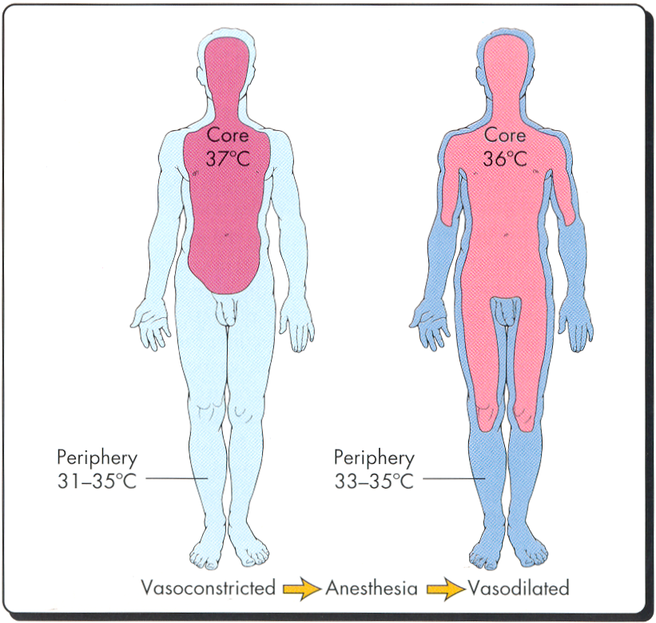
Redistribution Hypothermia

Slide 20
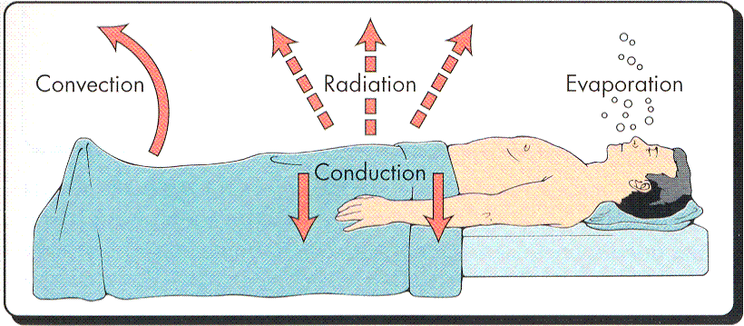
Intraoperative Heat Transfer

Slide 21
Hypothermia During Anesthesia
Kurz, NEJM 1996

Slide 22
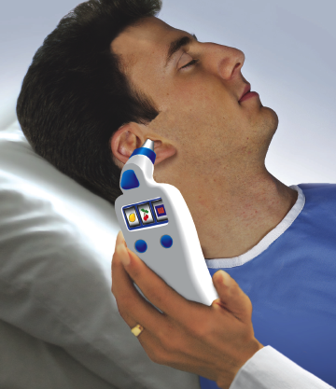
Temperature Monitoring
Core Sites
  Pulmonary artery
  Distal esophagus
  Nasopharynx
  Tympanic membrane thermocouple
Other generally-reliable sites
  Mouth
  Axilla
  Bladder
  Zero-heat flux
Sub-optimal
  Forehead skin
  Infrared “tympanic”
  Infrared “temporal artery”
  Rectal
Anesth Analg 2008

Slide 23
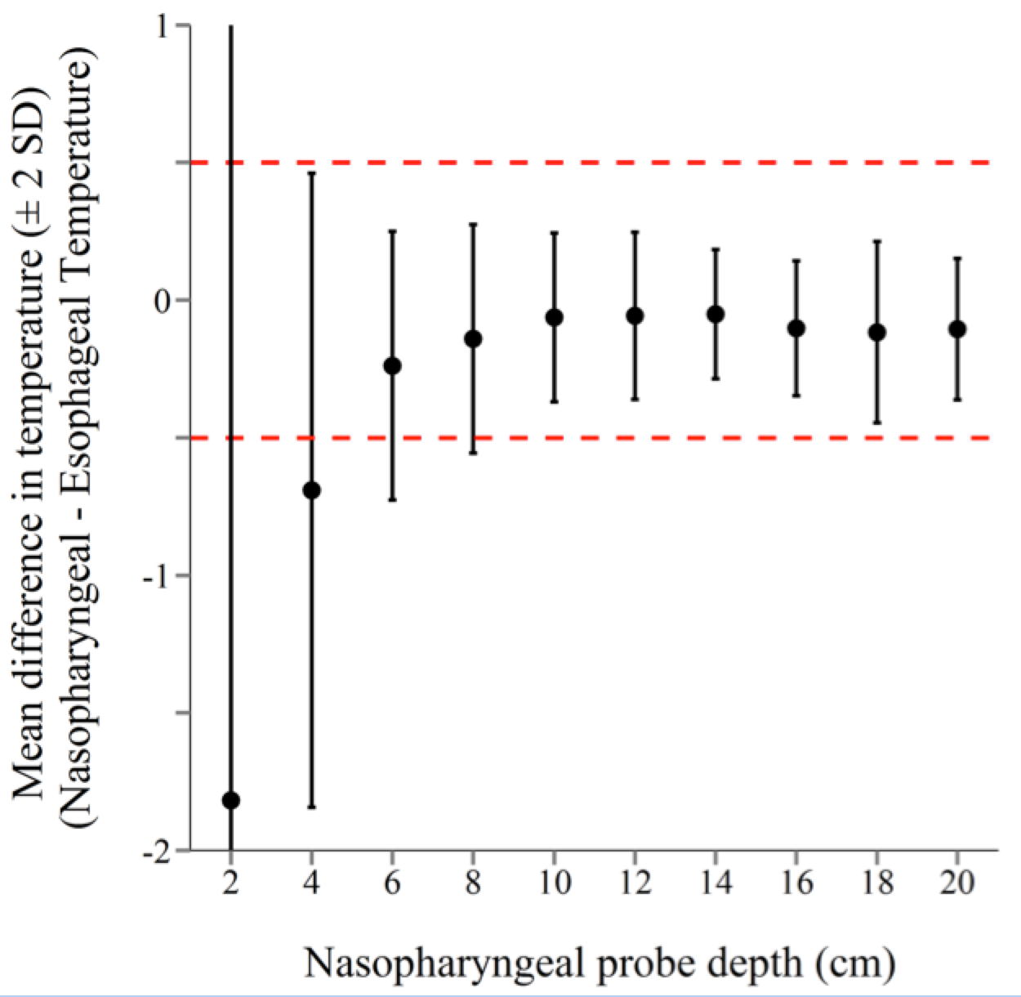
Nasopharyngeal Temperatures
Even infants <6 months old need probes inserted ≥6 cm
Reliable
Wang, A&A 2016

Slide 24


Zero-heat Flux Thermometry
This point is the same temperature…
...as this point
Cool Skin
Heater
Insulator
Isothermal tunnel
Warm Core

Slide 25
Malignant Hyperthermia
Hyperthermia is an early sign of MH, and lack of temperature monitoring is the strongest predictor of death from MH
Iaizzo, A&A 1996

Slide 26
Consequences of Hypothermia
Benefits
  Improved neurologic outcomes after neonatal asphyxia
Minor complications
  Decreased drug metabolism
  Prolonged recovery duration
  Shivering and thermal discomfort
Potential major complications
  Promotes bleeding and increases transfusion requirement
  Increased risk of wound infections and prolongs hospitalization
  Morbid myocardial outcomes

Slide 27
Thermal Discomfort
34.5 versus 36.5 at T=0

Slide 28
Duration of Vecuronium
Heier, Anesthesiology 1991

Slide 29
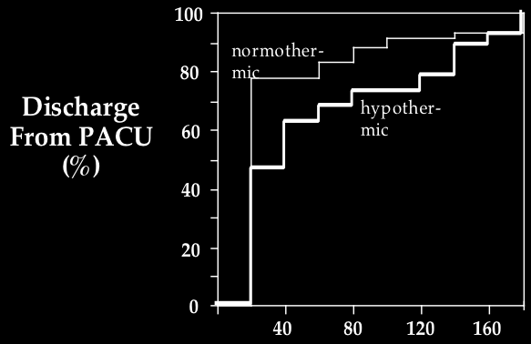
Recovery Duration
Lenhardt, Anesthesiology 1997
Time (min)

Slide 30
PROTECT Trial, Lancet 2022
5,056-patient multicenter randomized trial
  Major noncardiac surgery >2 hours
  Age ≥45 years, at least one cardiovascular risk
Randomization
  Target core temperature 35.5°C
  Target core temperature 37.0 °C
Outcomes
  Primary: composite of myocardial injury, arrest, & death
  Secondary: surgical site infection, transfusions

Slide 31
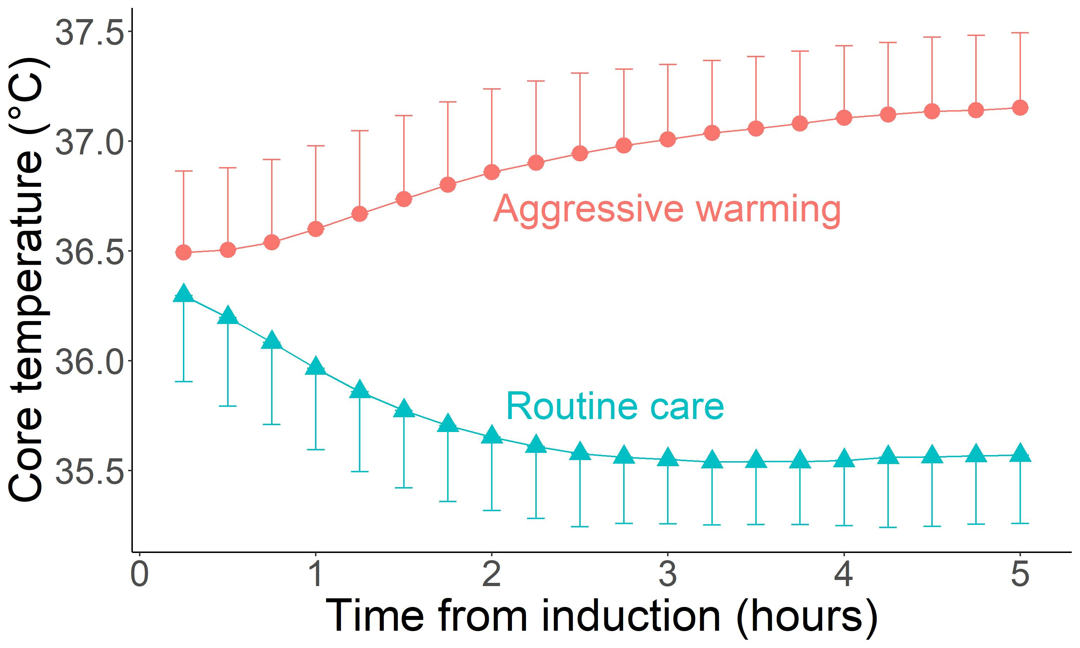
Excellent Thermal Management
>99% 30-day follow-up
Average duration

Slide 32
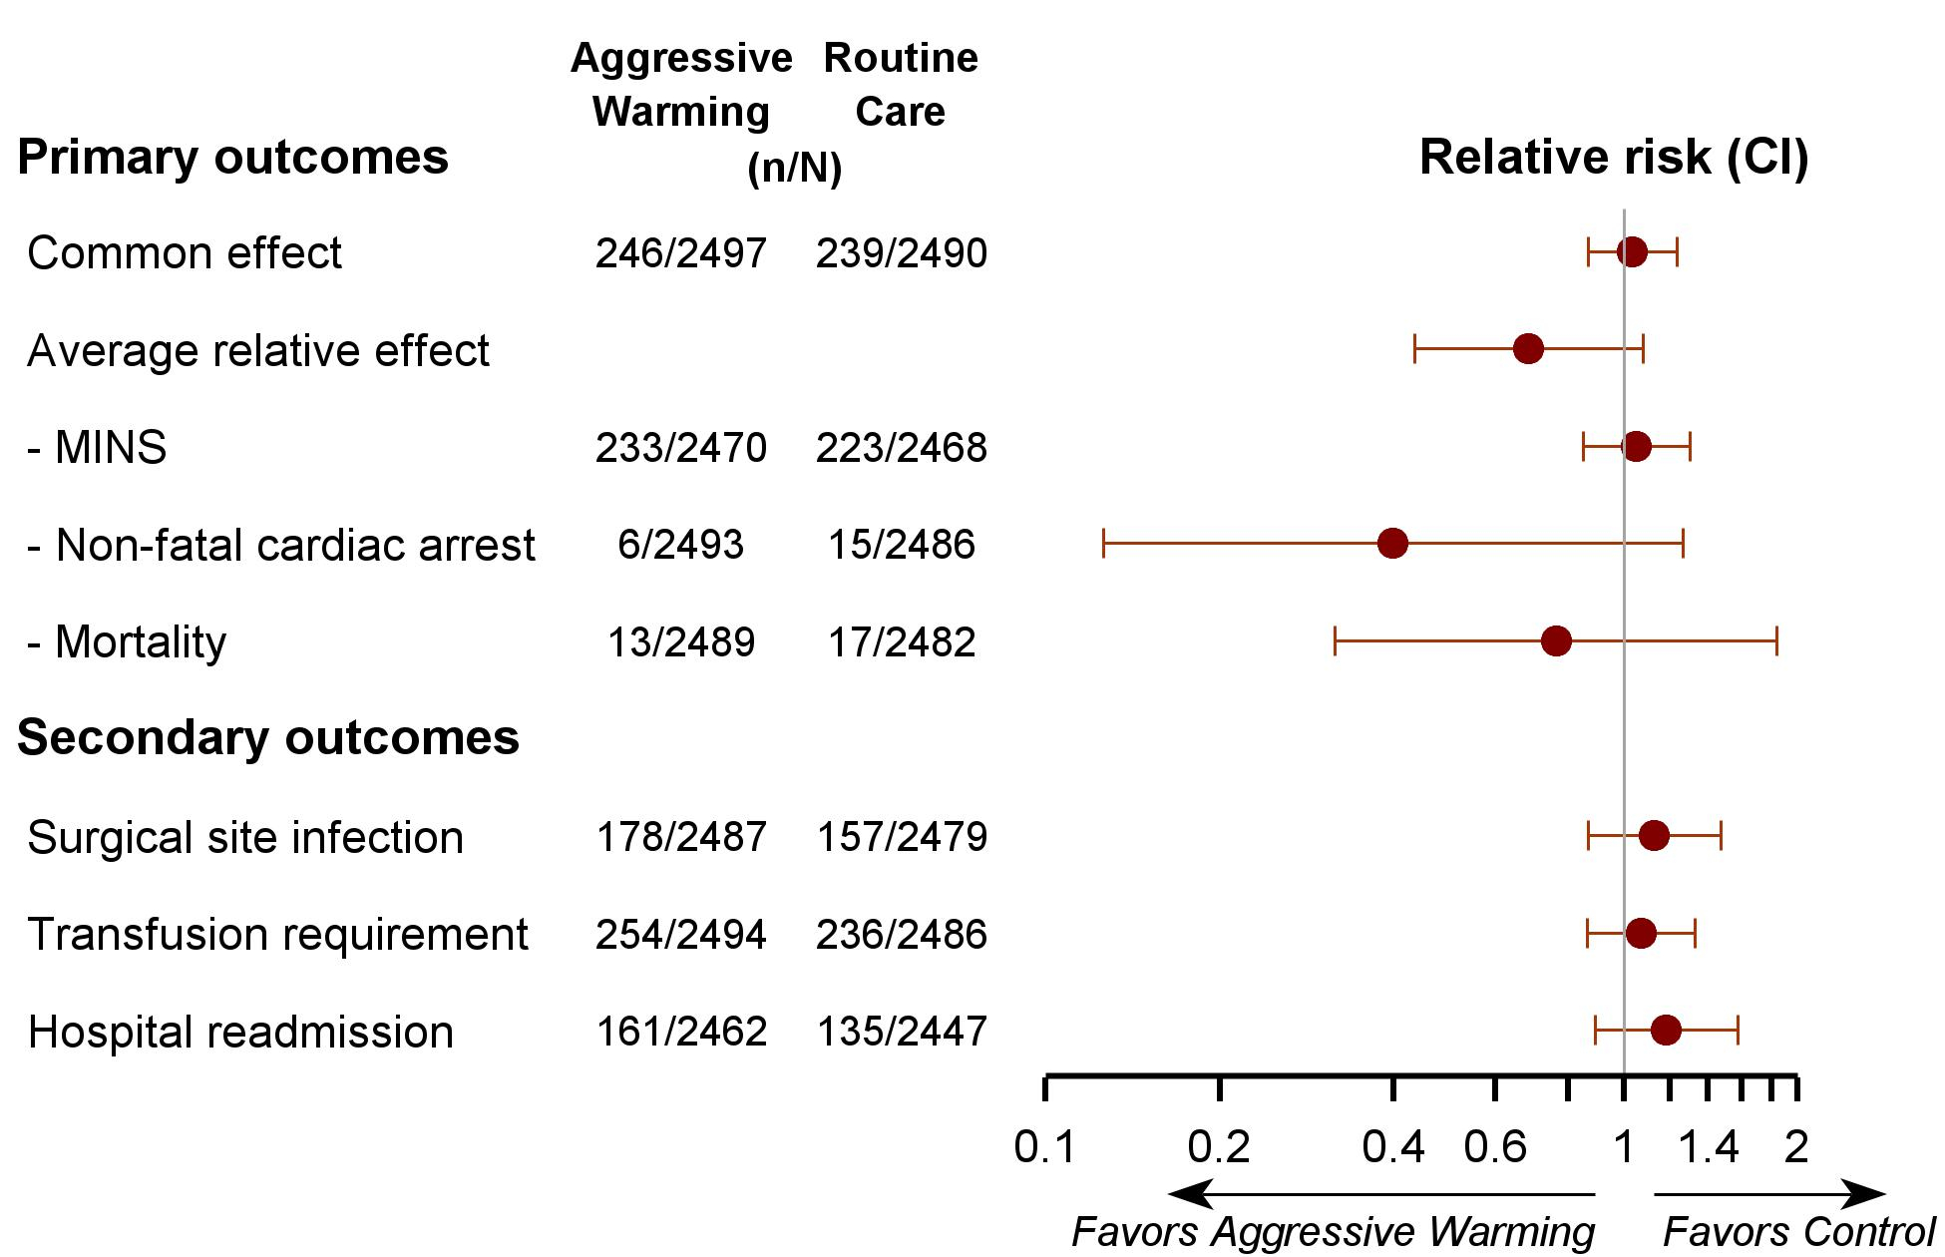

Slide 33
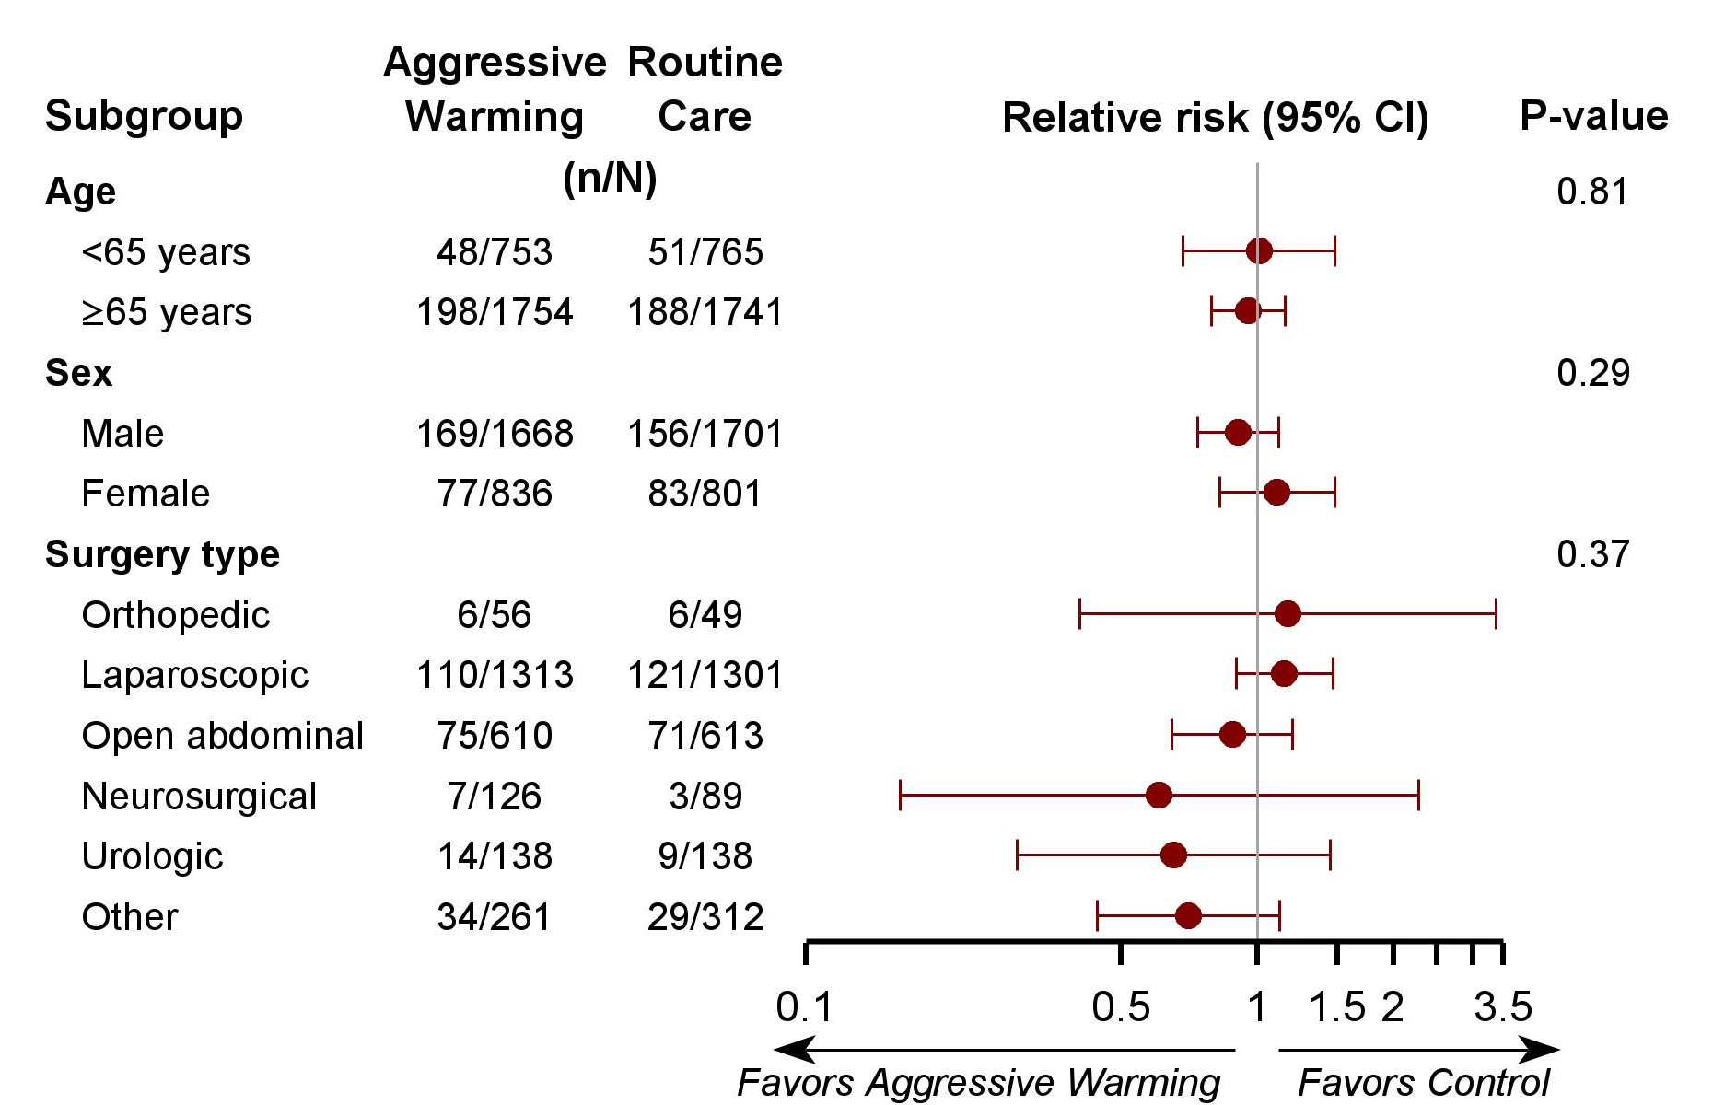
Primary outcome

Slide 34
Randomization to 37 v. 35.5°C Core Temp
Does not reduce cardiovascular complications
  Individually only powered for myocardial injury
Does not reduce
  Surgical site infections
  Transfusion requirement
  Duration of hospitalization or readmissions
Not tested: thermal comfort, shivering, delirium
Intraop temps ≥35.5°C appear to be safe

Slide 35
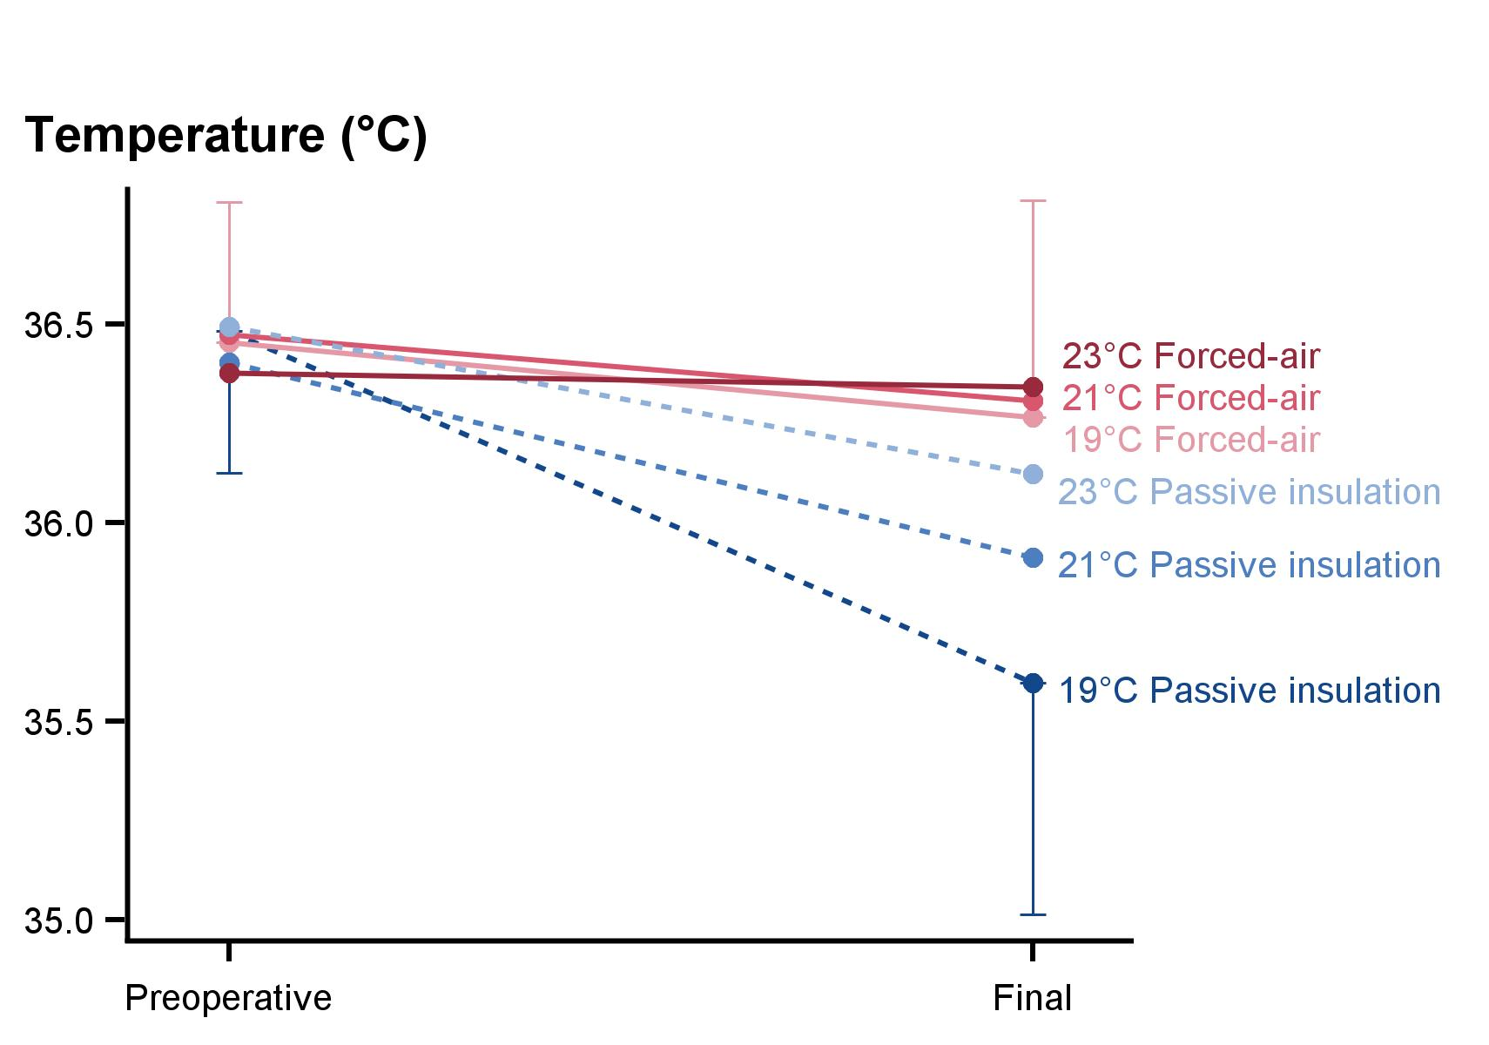
Maintaining Normothermia
Pei, Anesthesiology 2018

Slide 36
Insulating Covers
Sessler, Anesthesiology 1990

Slide 37
Forced-Air vs. Circulating-Water
Hynson, JCA 1992

Slide 38
All tested forced-air warmers are highly effective — and similarly so
Rodriguez-Patarroyo, Anesthesiology 2025

Slide 39
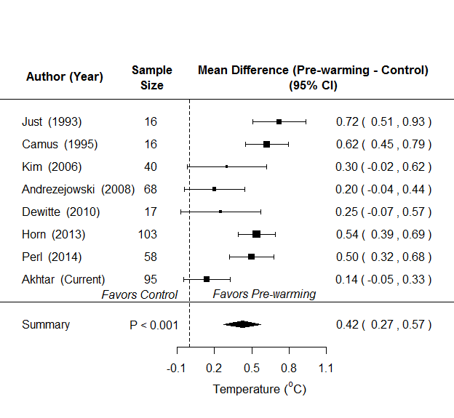
Pre-warming Meta-analysis

Slide 40
Fluid Warming
Cooling by intravenous fluids
  0.25°C per liter crystalloid at ambient temperature
  0.25°C per unit of blood from refrigerator
Fluid warming does not prevent hypothermia!
  Most core cooling from redistribution
  80% of heat loss is from anterior skin surface
Cooling prevented by warming solutions
  Type of warmer usually unimportant

Slide 41
The Rule: Monitor & Warm to ≥35.5°C
Monitor core temperature
  General anesthesia >30 minutes
  Large procedures under neuraxial anesthesia
Maintain normothermia: core temp ≥35.5°C
Forced-air heating
  Good combination of efficacy, cost, ease-of-use, and safety
  But any effective and safe method(s) are fine

Slide 42
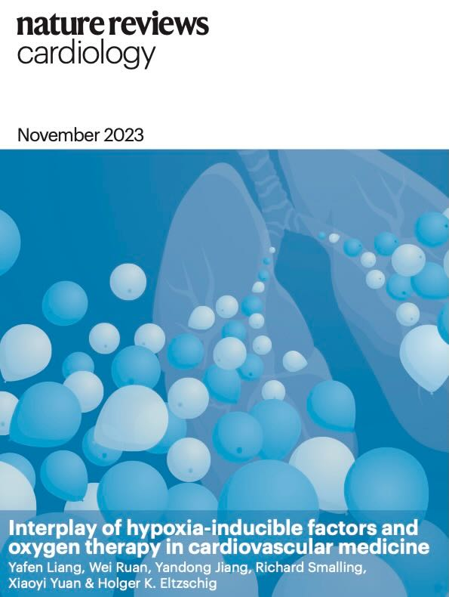
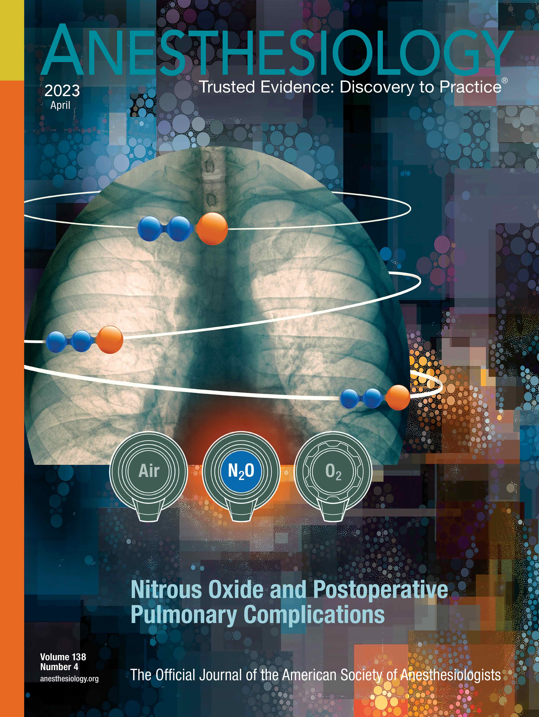
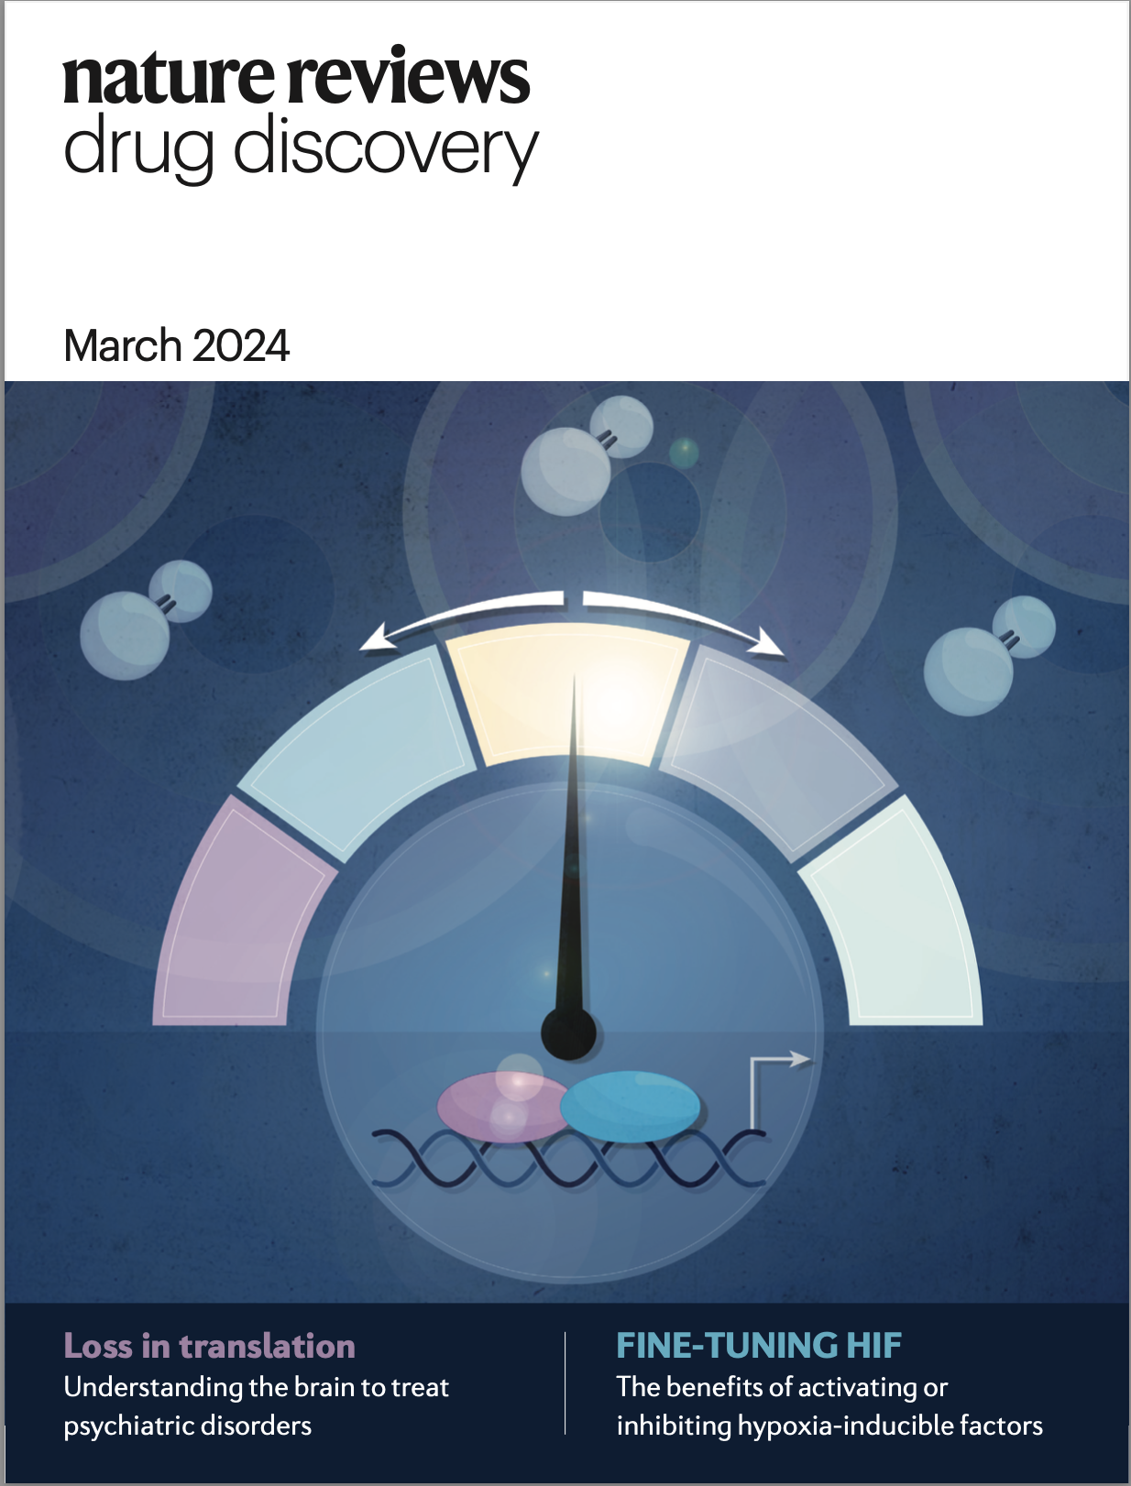
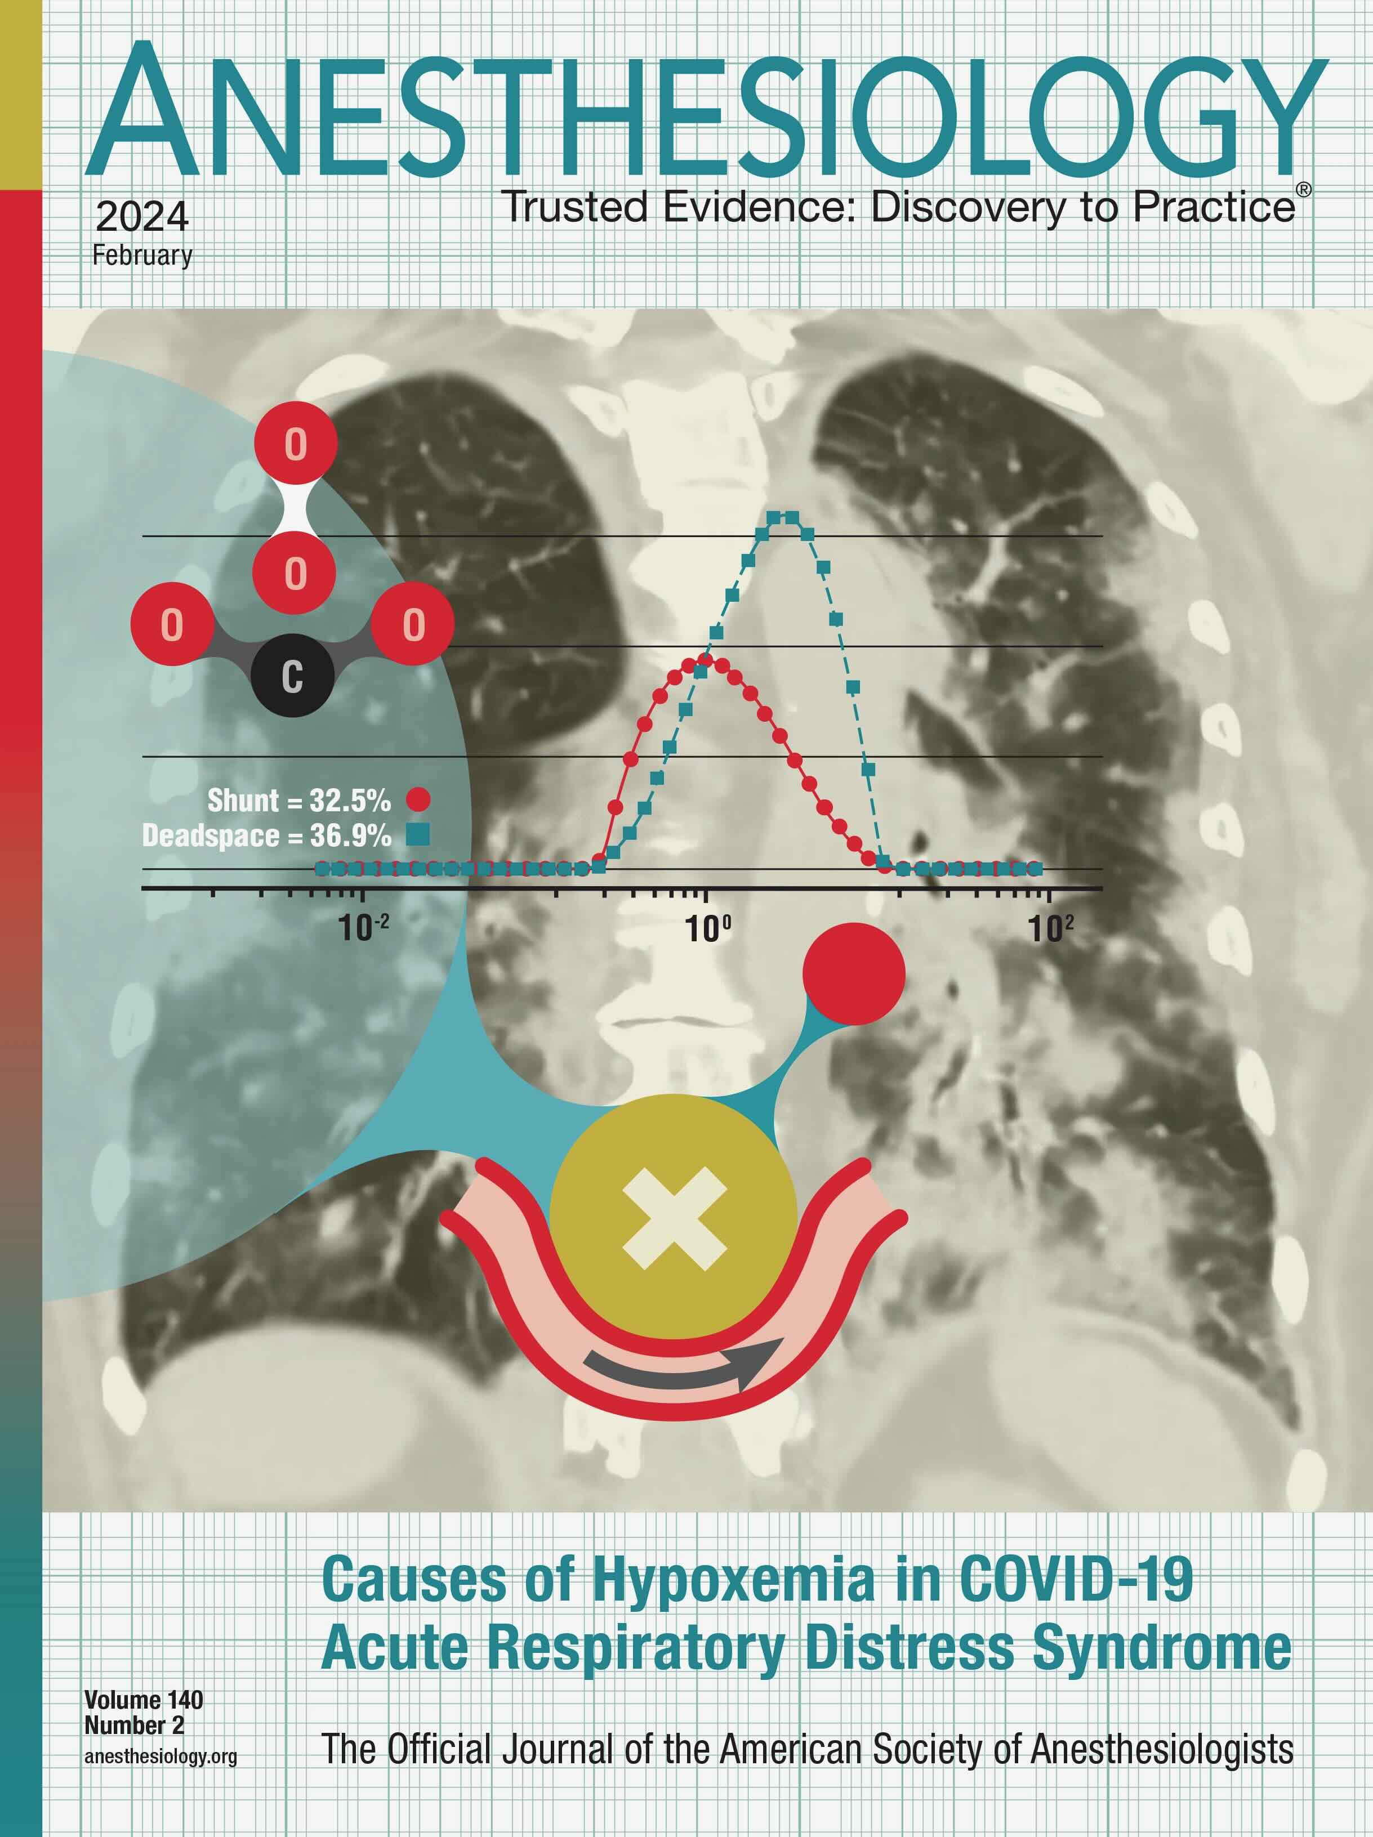
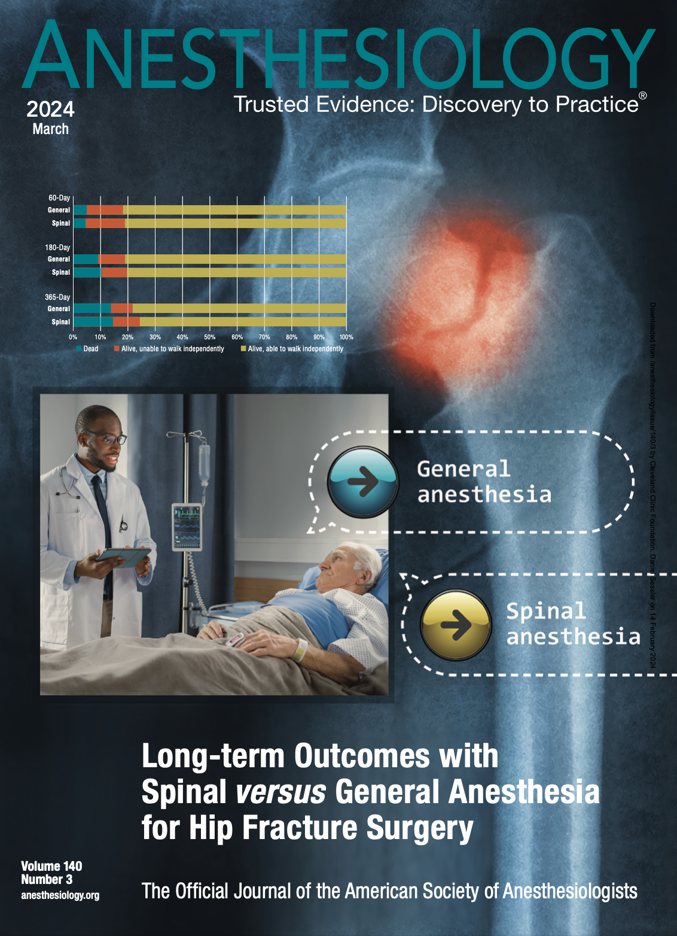
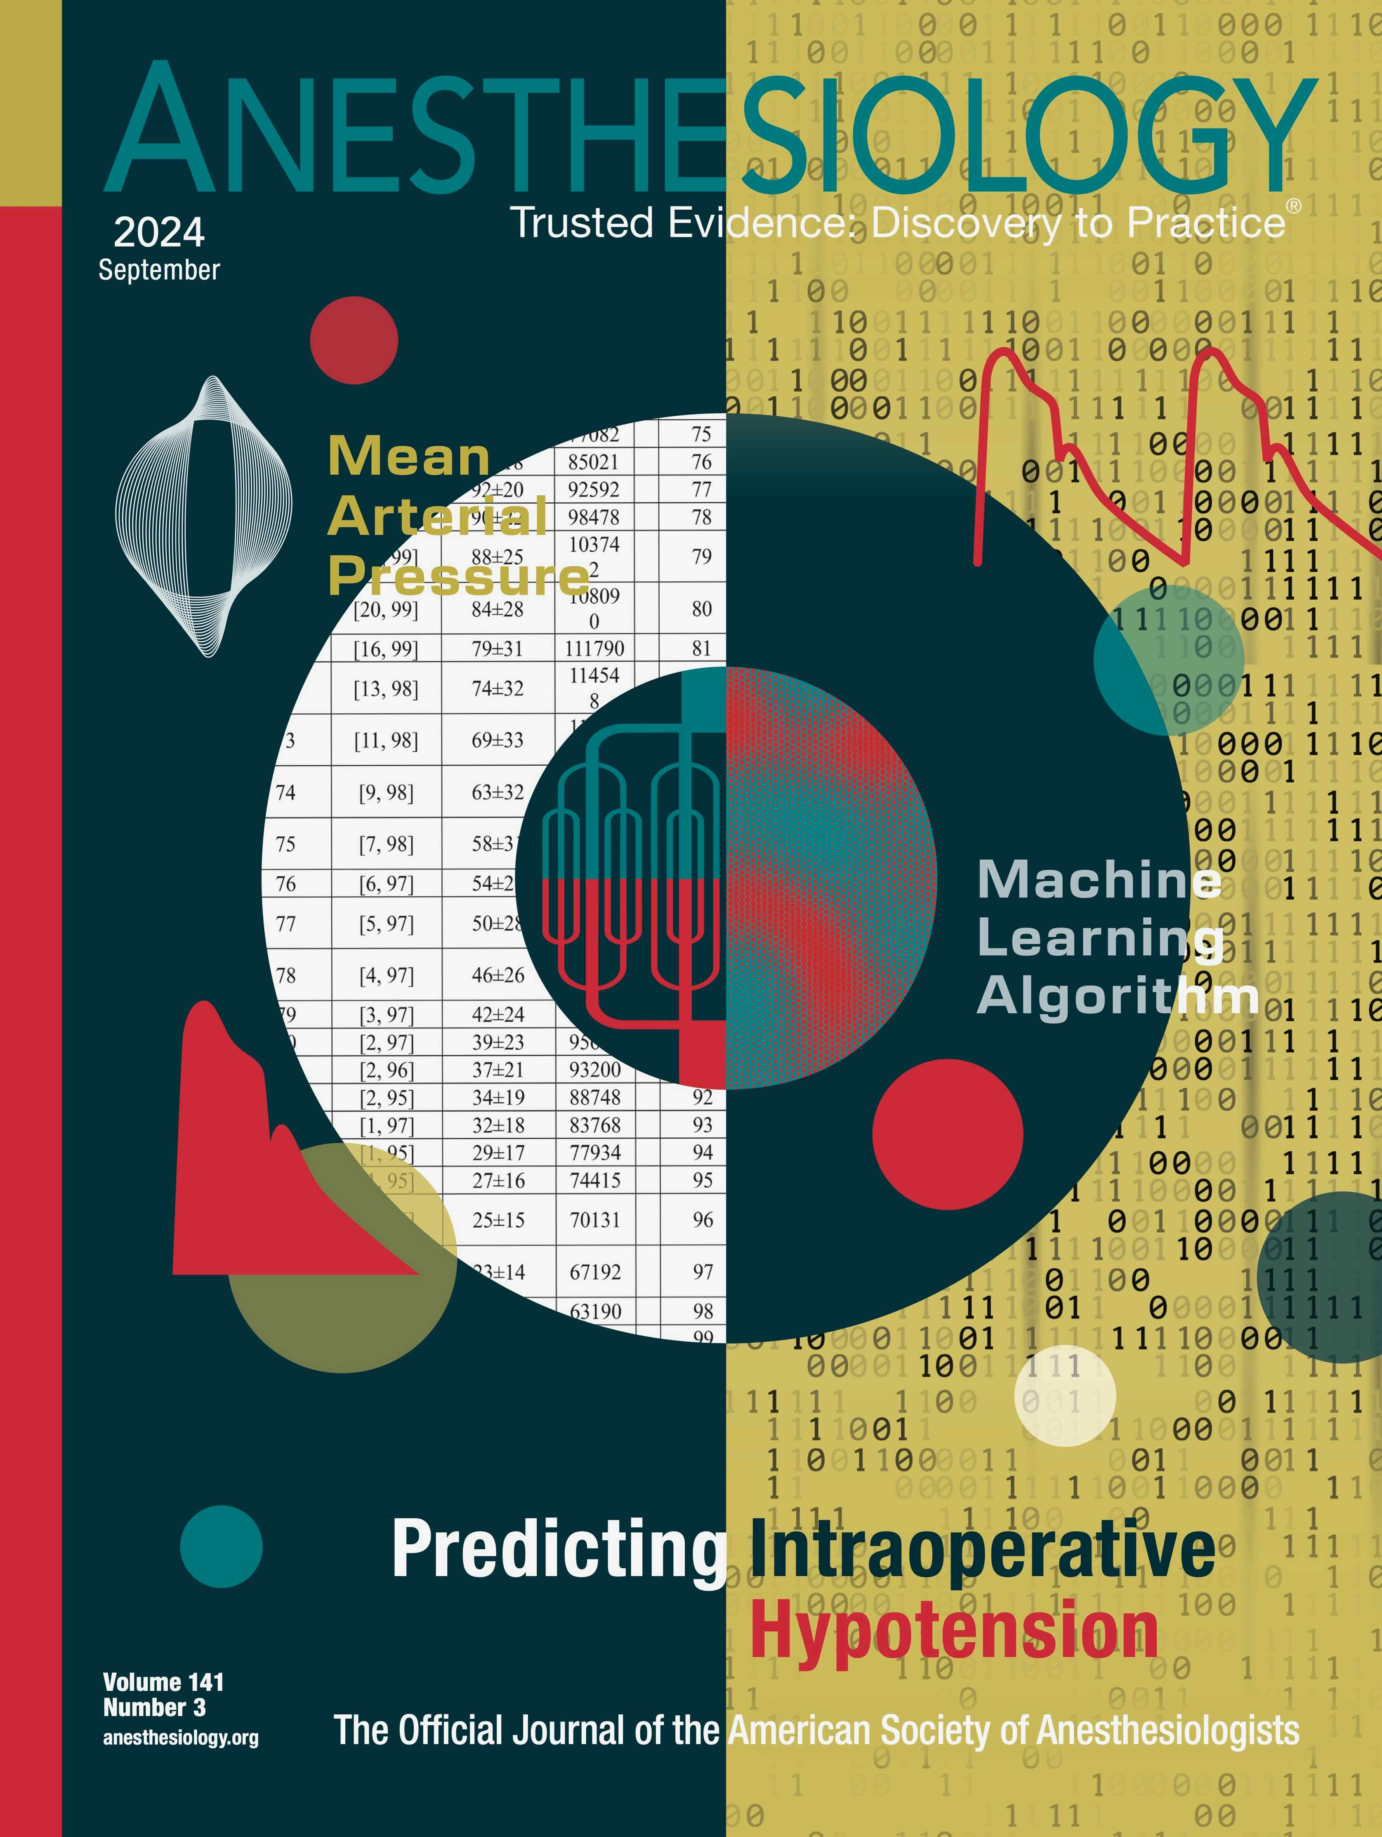
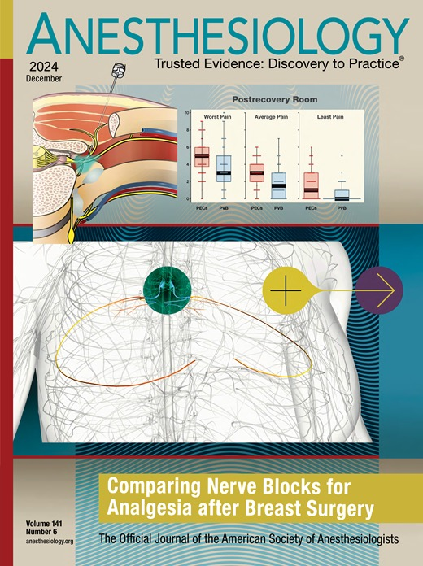
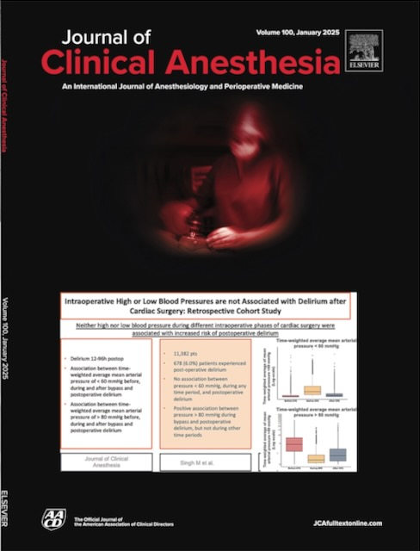
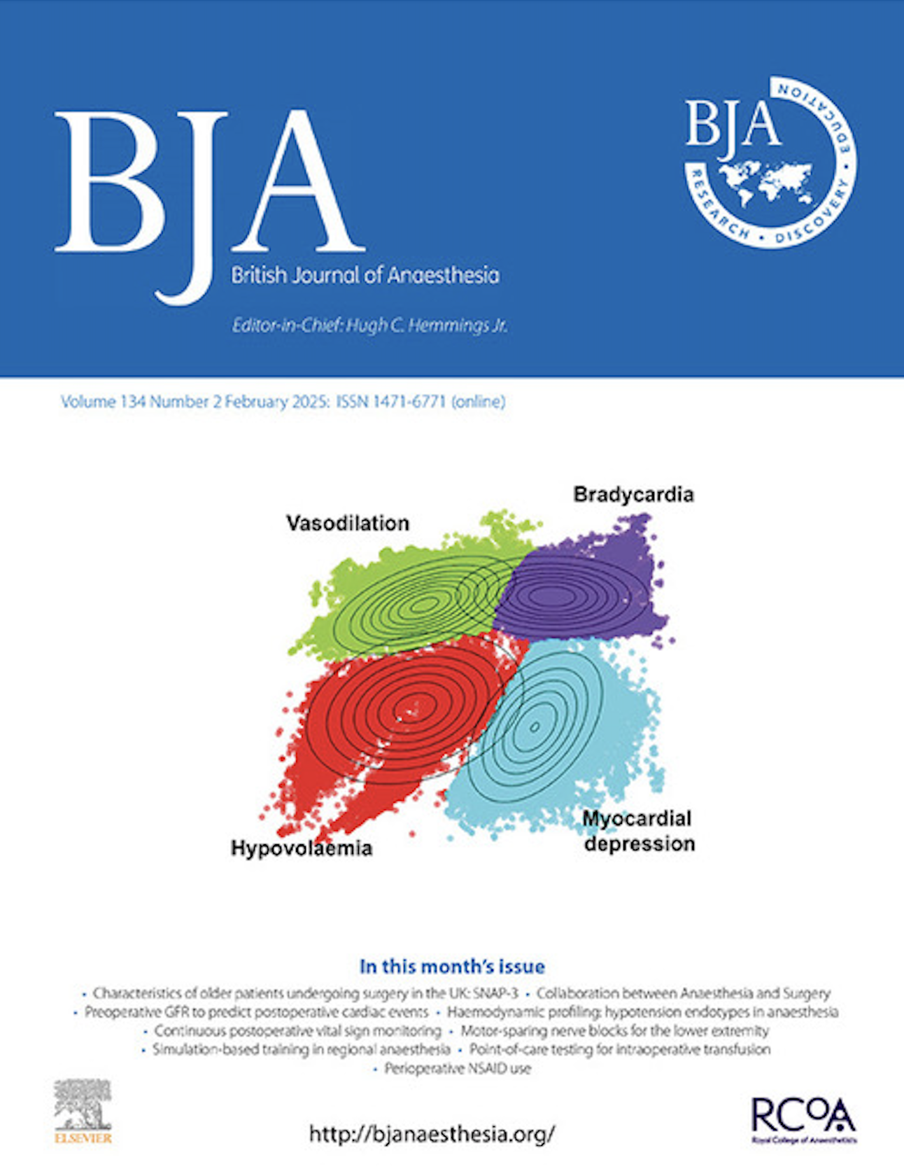
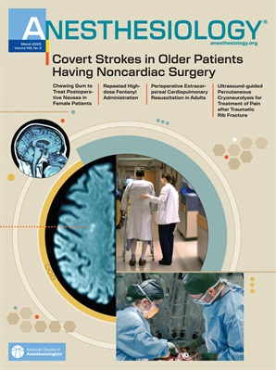
And that’s all folks…
Selected OUTCOMES RESEARCH covers since 2023

Slide 43
Vasoconstriction in Infants and Children

Slide 44
Regulation Impaired in the Elderly

Slide 45
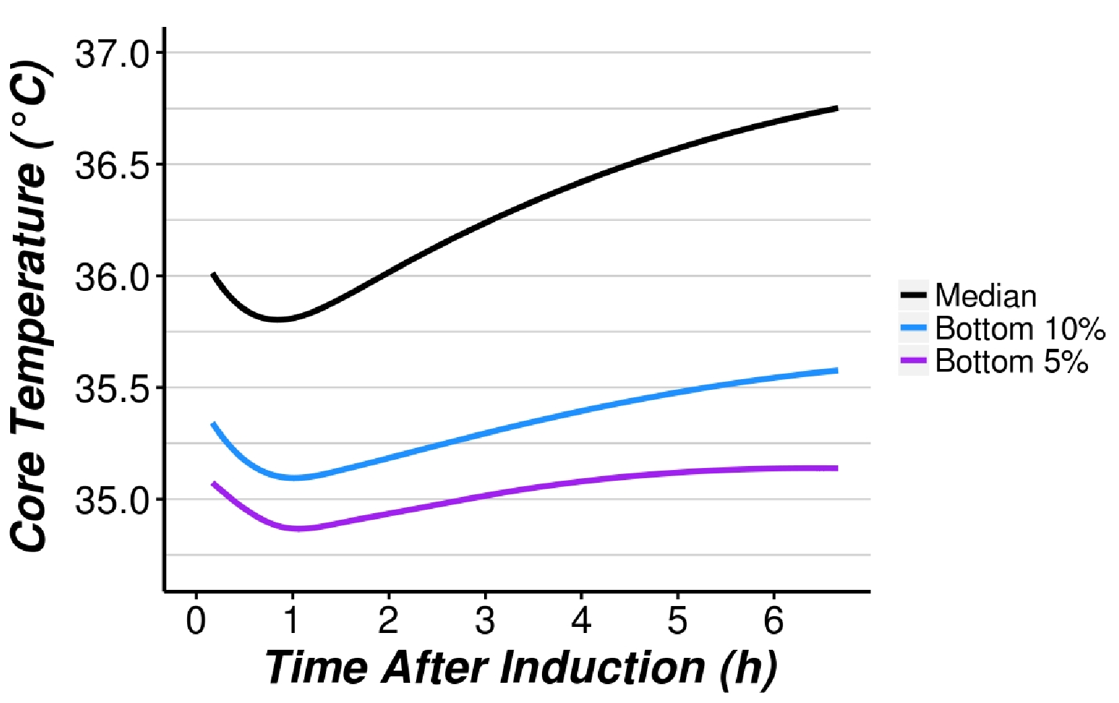
Intraoperative Hypothermia is Common

Slide 46
Transfusion Requirement
22% less blood loss (95% CI 3-37%, P = 0.03)

Slide 47
Canadian Anaesthesia Society 2022
“Continuous monitoring of patient core temperature is required during cases of general anesthesia lasting 30 minutes or longer. Monitoring is strongly recommended during cases of neuraxial anesthesia lasting 30 minutes or longer. Control of the operating room ambient temperature, and other methods, should be used to target a central core temperature of 36–37°C.“

Slide 48
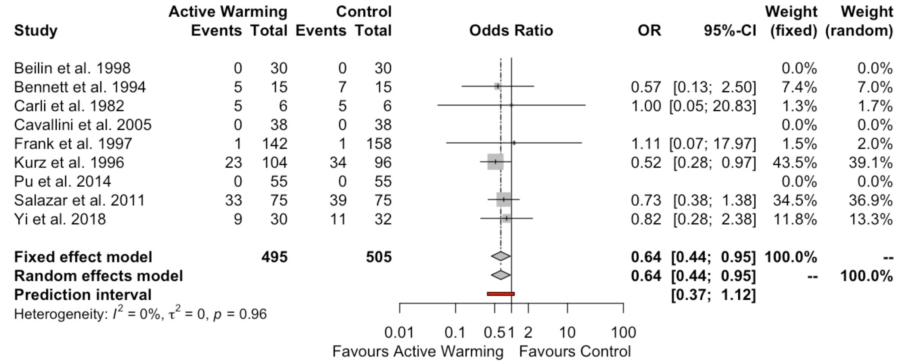
Transfusions
Balki, A&A 2020

Slide 49
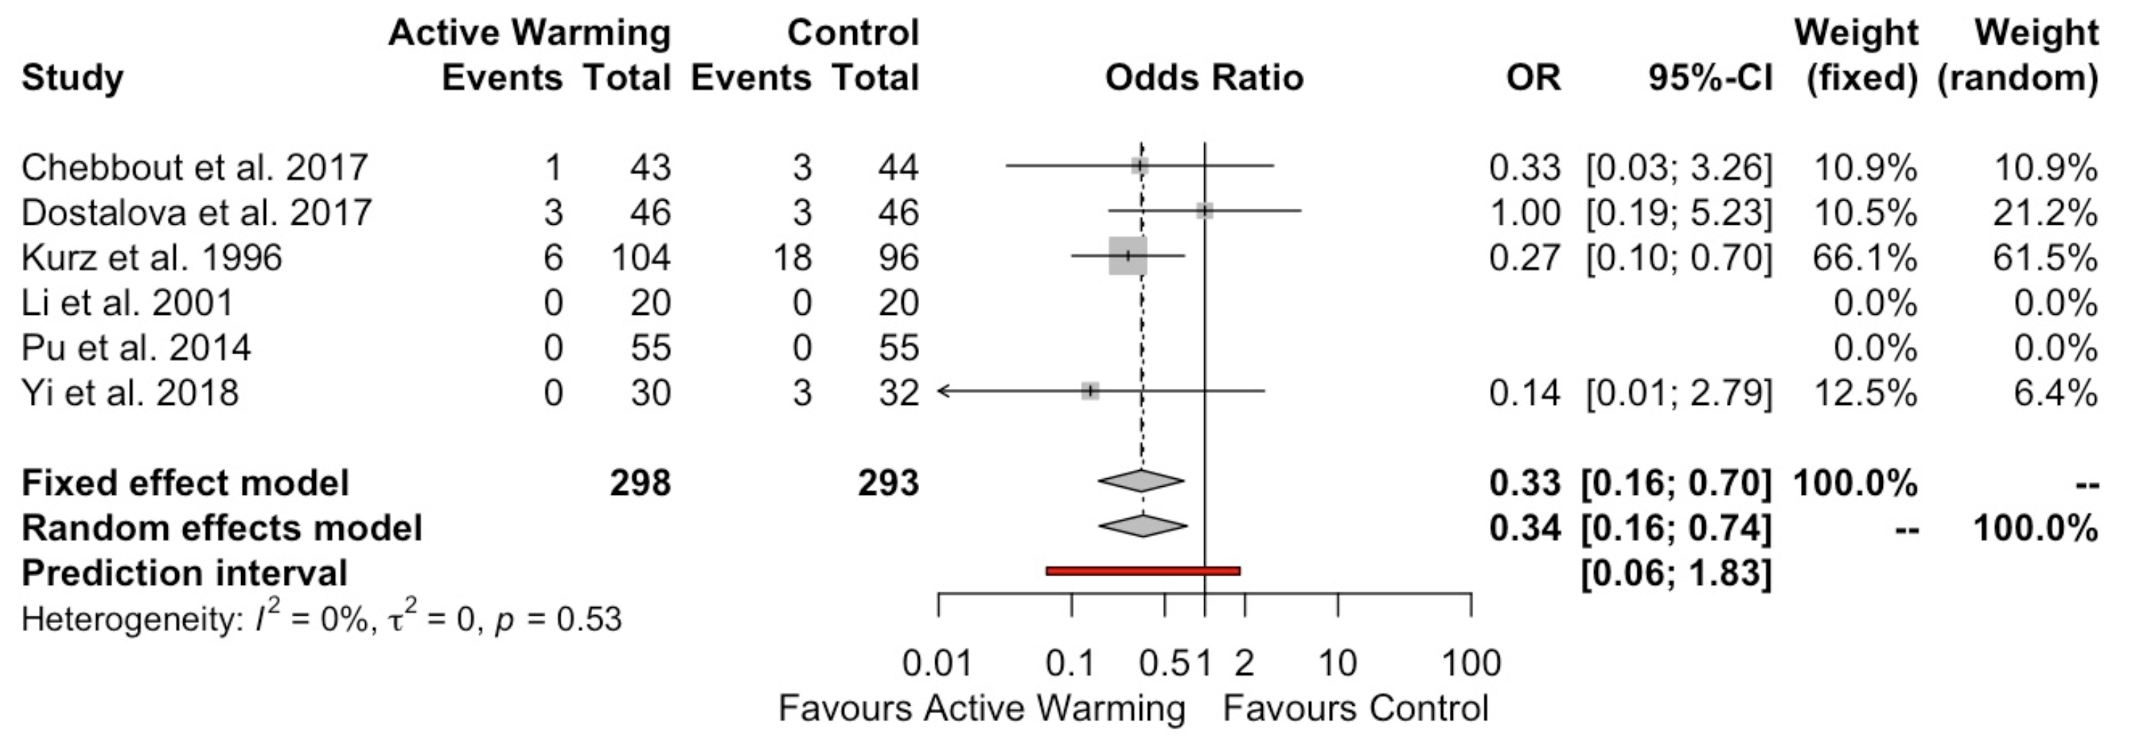
Wound Infections
Balki, A&A 2020

