Slide 1

OUTCOMES RESEARCH Consortium
Providing the evidence for evidence-based medicine©

Slide 2
Surgical Site Infections (SSIs)
Daniel I. Sessler, M.D.
Vice-president for Clinical and Outcomes Research
Professor of Anesthesiology
UTHealth, Houston
No relevant conflicts
Providing the evidence for evidence-based medicine

Slide 3
Large Burden on the Healthcare System
Common
  Most common nosocomial infection
  Estimated 2-4% incidence overall; ≈10% after colon surgery
  ≈500,000 surgical site infections per year in US
Costly
  $3.5-10 billion annually in the United States
  3.7 million excess hospital days yearly in the States
Serious
  Doubles ICU admission and mortality
  Prolongs hospitalization 3+ days
  Significant impact on patient-reported outcomes

Slide 4
Complex Nature of SSI Development
“Whether an SSI occurs depends upon a complex interaction among numerous factors, including the nature and number of organisms contaminating the surgical site, antimicrobial prophylaxis, the health of the patient, and surgical technique”
Modified from CDC Guidance 1999

Slide 5
Risk Factors for Healing & Infection
Malnutrition
Diabetes
Immunosuppressive therapy
Cigarette smoking
Old age
Vascular disease
Obesity

Slide 6
Decisive Period
All wounds become contaminated
Infections established within 2 h of contamination
Progression to infection determined by
  Prophylactic antibiotics
  Host defense
  Degree of contamination

Slide 7
Prophylactic Antibiotics
Most effective during the decisive period
  Subsequent administration useless (or harmful)
Should be given within 2 hours before incision
  Repeat after 4-6 hours for long operations
  Discontinue within 24-48 hours
Various guidelines for type of antibiotic
  Surgeons choose antibiotics; our mission is to give them

Slide 8
Timing of Prophylactic Antibiotics
Data adapted from Classen et al., NEJM 1992

Slide 9
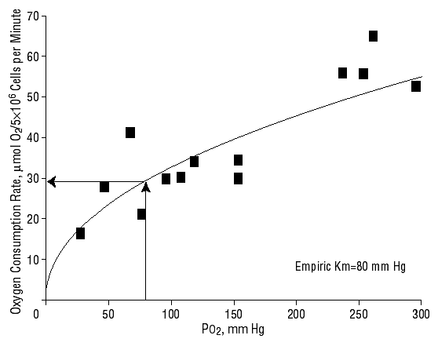
Host Defense
Oxidative killing by neutrophils
  Primary defense against surgical pathogens
Oxygen is transformed to superoxide radical
  Killing determined by tissue oxygen
Oxygen also
  Promotes angiogenesis
  Improves scar formation

Slide 10
Tissue Oxygen Correlates with Infection
Adopted from Hopf, Arch Surg 1997
(n=130)
N=130
Hopf, et al., 1996, Arch Surg

Slide 11
Supplemental Oxygen
Easy to provide
  Inexpensive
Recent utilization
  Usually 30% in Europe
  Essentially random concentrations in the States
Rationale for various concentrations unclear
Recommended by WHO and CDC in 2017

Slide 12
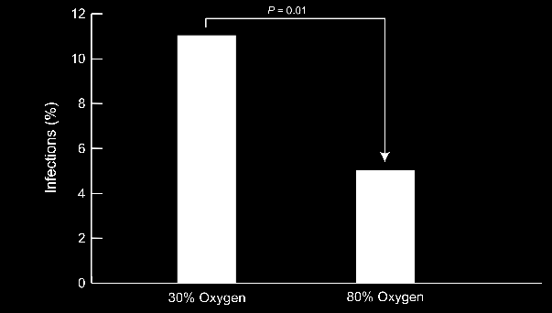
Oxygen & Wound Infection
Grief, NEJM 2000 (n=500)

Slide 13
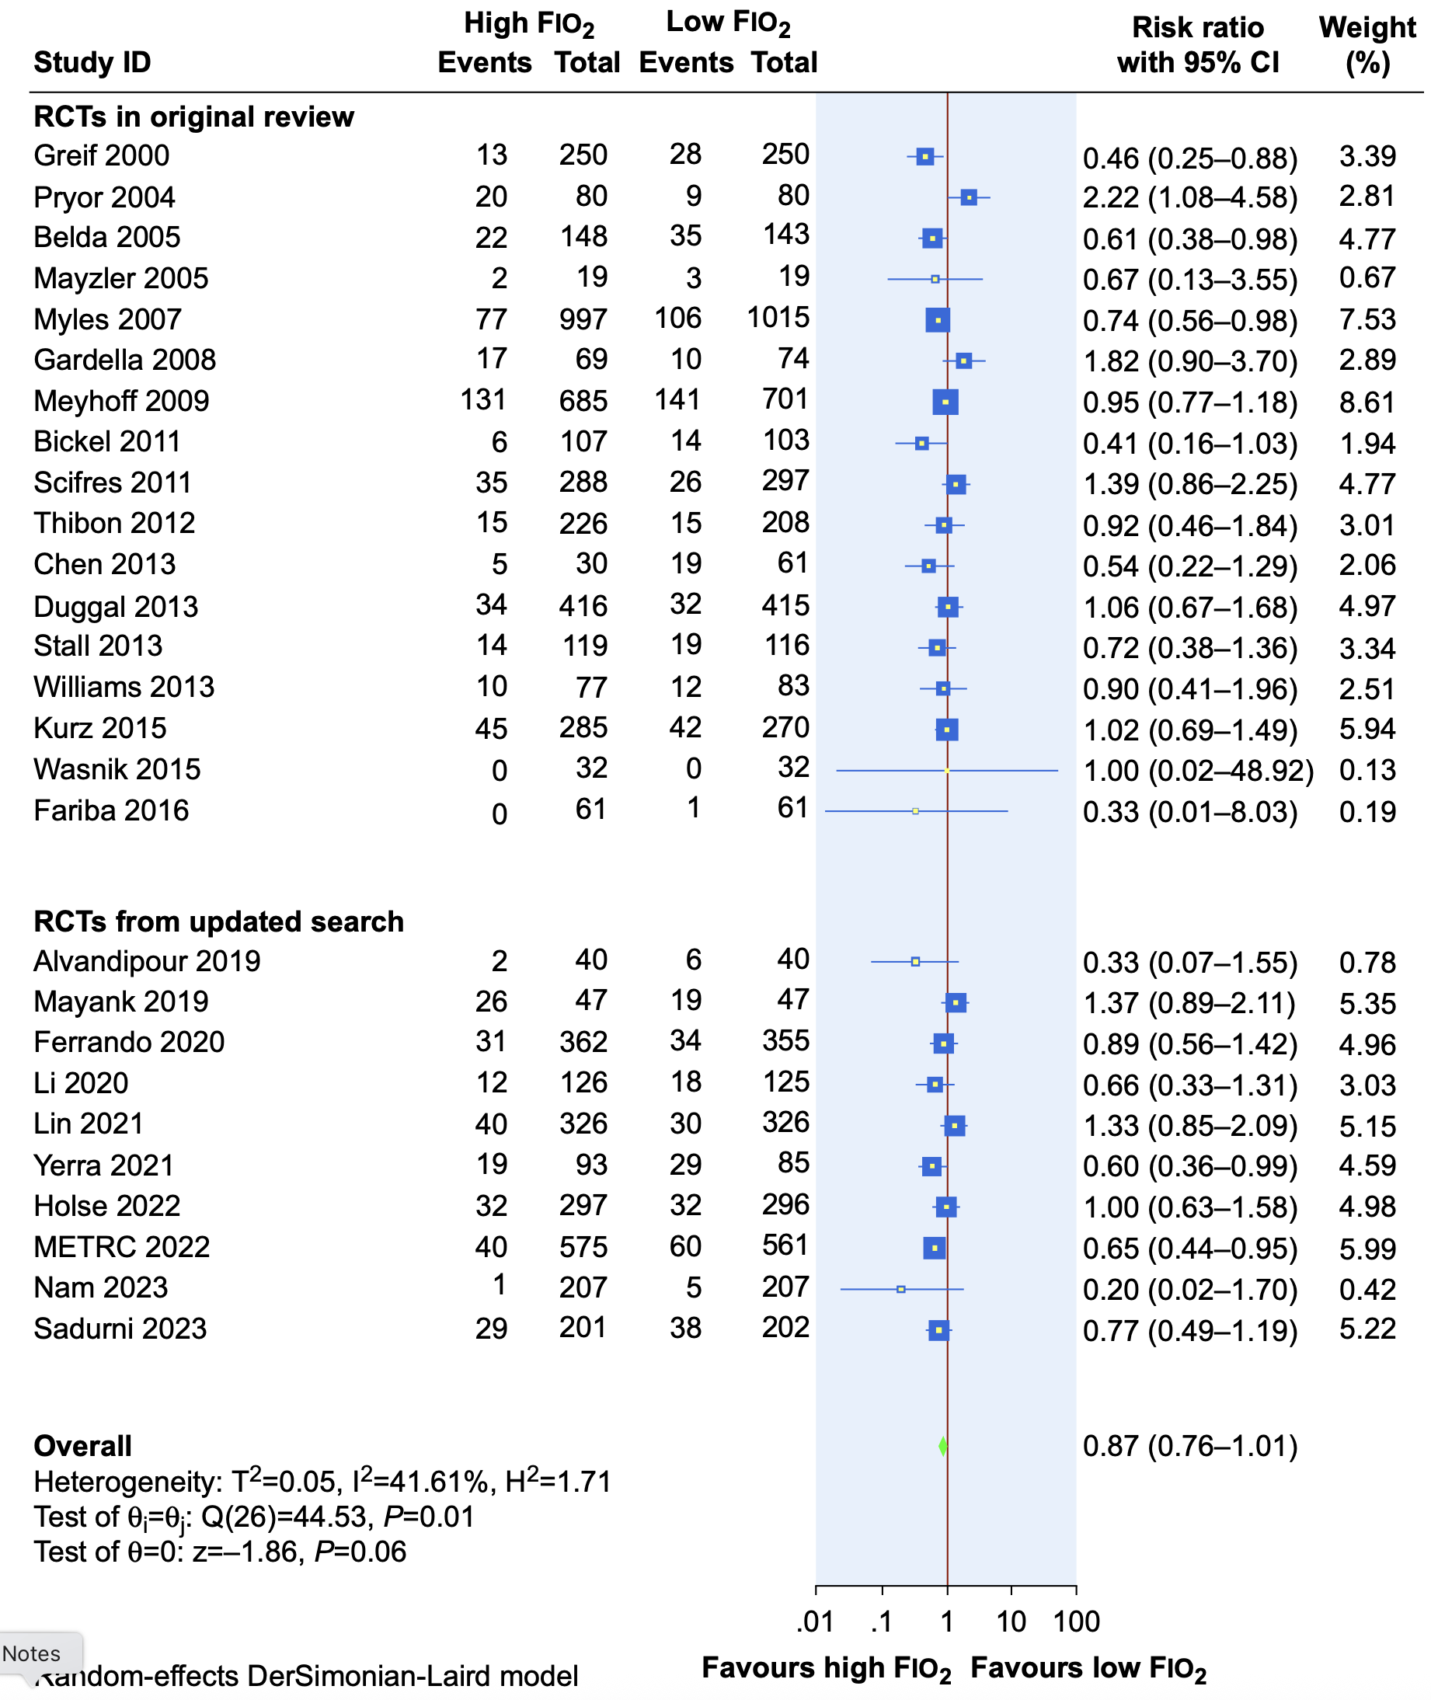
Supplemental oxygen
Elfeky, BJA 2025

Slide 14
Largest Supplemental Oxygen Trial
Cluster cross-over trial
N=5749l
Kurz, BJA 2018

Slide 15
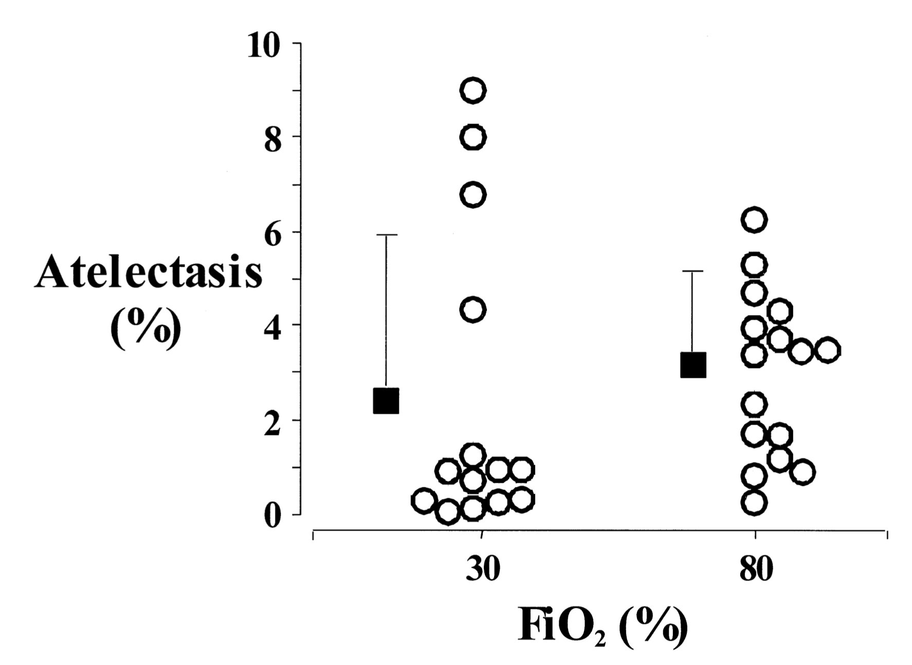
80% Oxygen Does Not Provoke Atelectasis
N=30 randomized patients
Elective colon surgery
Lung CT scan first postoperative day
Akça, Anesthesiology 1999

Slide 16
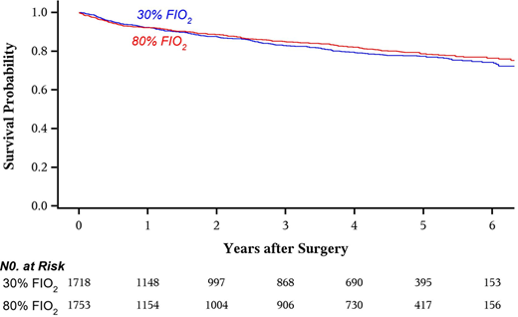
Similar Mortality with 80% & 30% Oxygen
N=3471 randomized patients
Jiang, Anesthesiology 2021

Slide 17
Summary: Supplemental Oxygen
80% inspired intraoperative oxygen
  No effect on primary composite of SSI and healing-related complications
  Does not provoke atelectasis
  Does not worsen long-term mortality
Meta-analysis and Kurz et al
  No significant benefit
Perioperative use of 80% FiO₂ does not reduce SSI — but also appears harmless

Slide 18
Smoking and Infection Development
Tissue oxygen decreases: 65 to 44 mmHg
  Jensen, Arch Surg 1991
Tissue oxygen 40-50 mmHg —> infection
  Hopf, Arch Surg 1997
"Pack-a-day" smokers mostly hypoxic

Slide 19
Smoking and Infectious Complications
Effect of perioperative cessation remains unclear
Turan, Anesthesiology 2011

Slide 20
PROTECT Trial
5,056-patient multicenter randomized trial
  Major noncardiac surgery >2 hours
  Age ≥45 years, at least one cardiovascular risk
Randomization
  Target core temperature 35.5°C
  Target core temperature 37.0 °C
Outcomes
  Primary: composite of myocardial injury, arrest, & death
  Secondary: surgical site infection, transfusions
Sessler, Lancet 2022

Slide 21
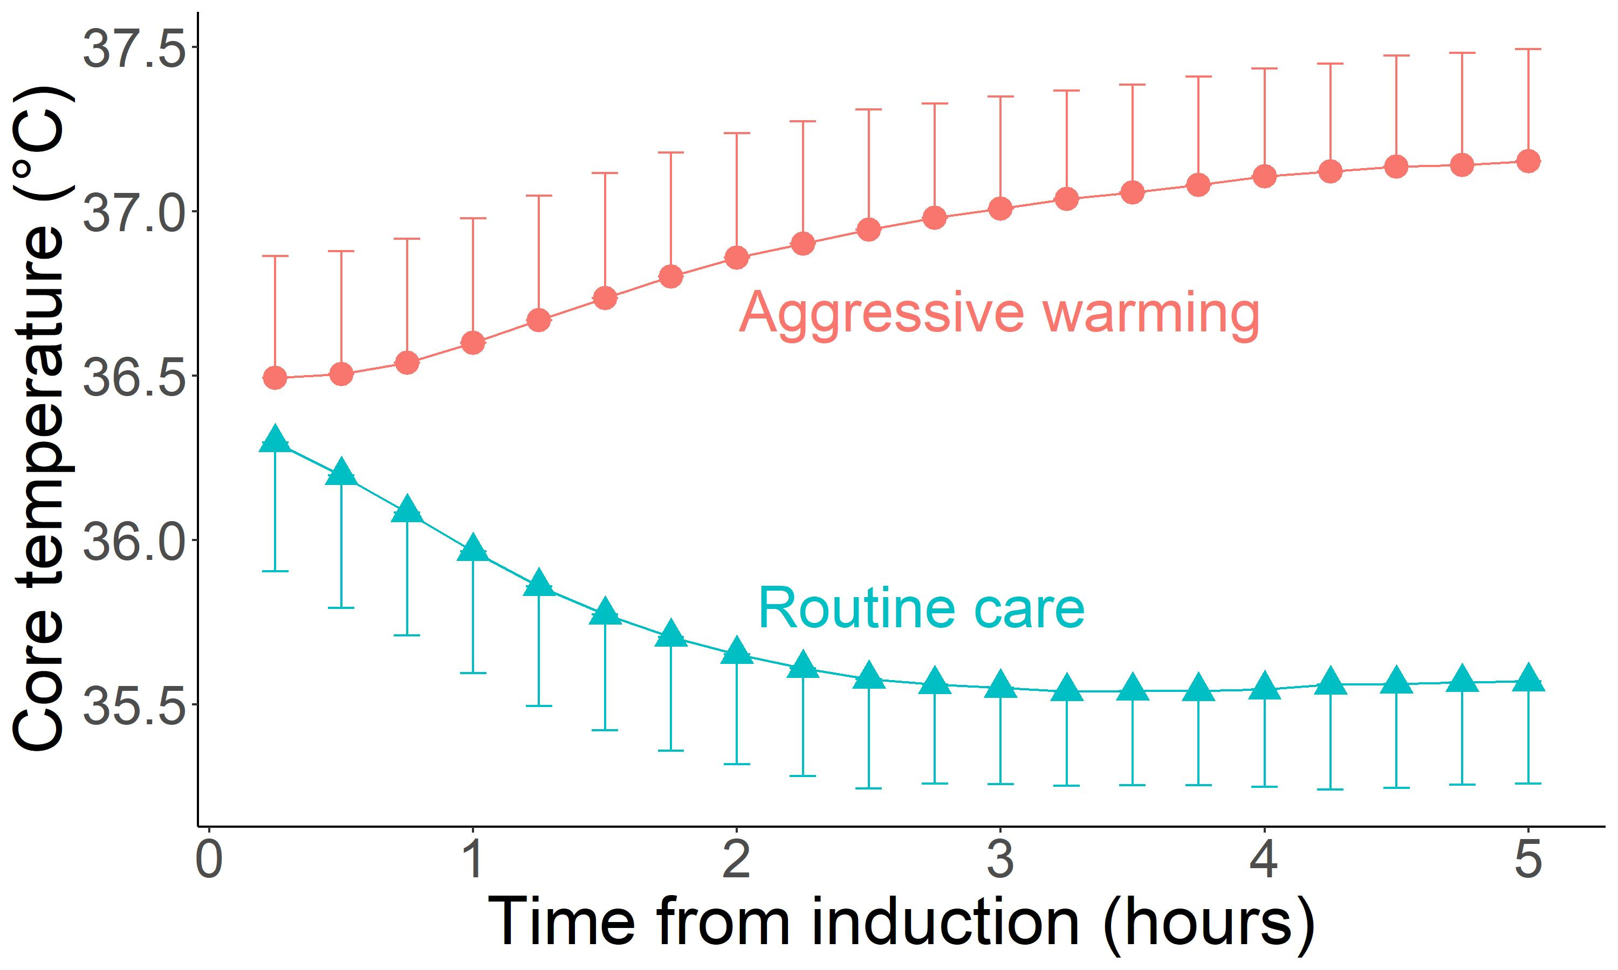
Excellent Thermal Management
>99% 30-day follow-up
Average duration

Slide 22
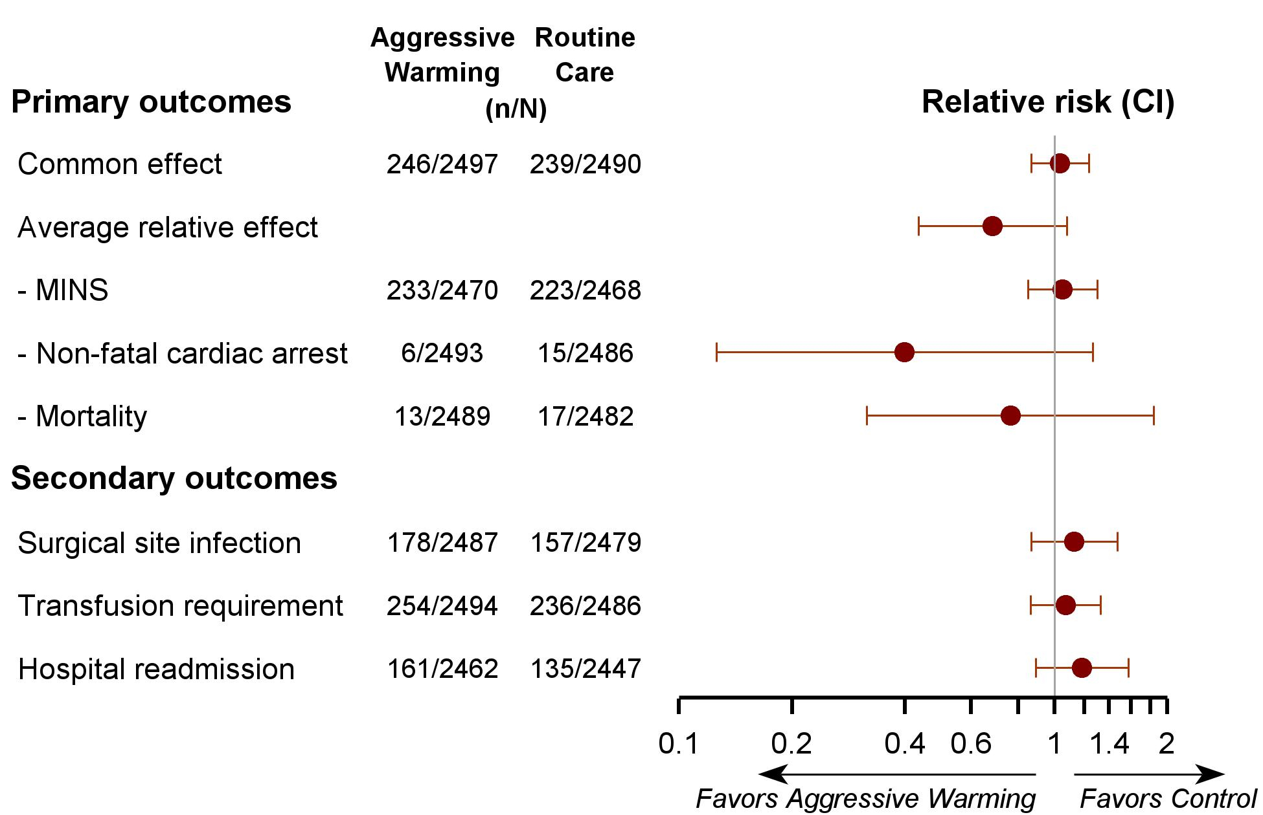

Slide 23
Fluid Management: RELIEF Trial
3,000 high risk abdominal surgery patients
Randomized to:
  Restrictive fluid, 3.7 L / 24 hours
  Liberal fluid, 6.1 L / 24 hours
Liberal preferable
  Fewer surgical site infections: 13.6% vs. 16.5% (P=0.02)
  Less AKI: 5.0% vs. 8.6% (P<0.001)
Myles, NEJM 2018 (n=3000)

Slide 24
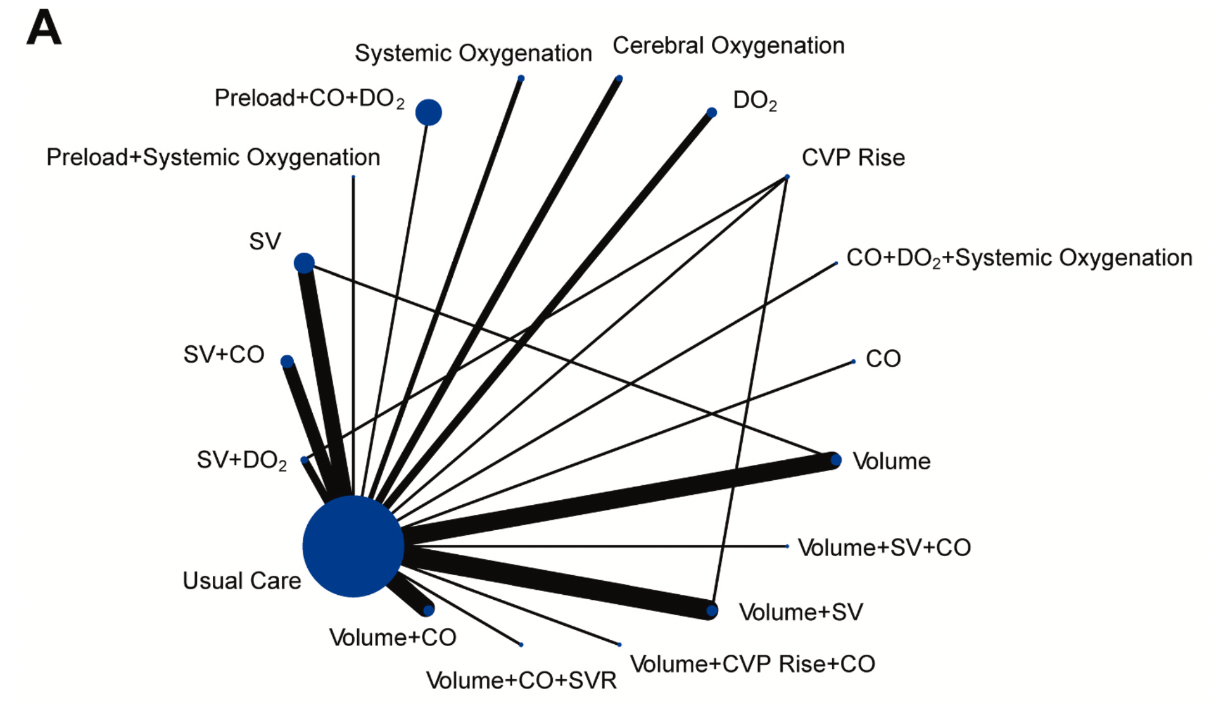
Guided fluid management
Network meta-analysis
Zhao, J JCA 2020

Slide 25
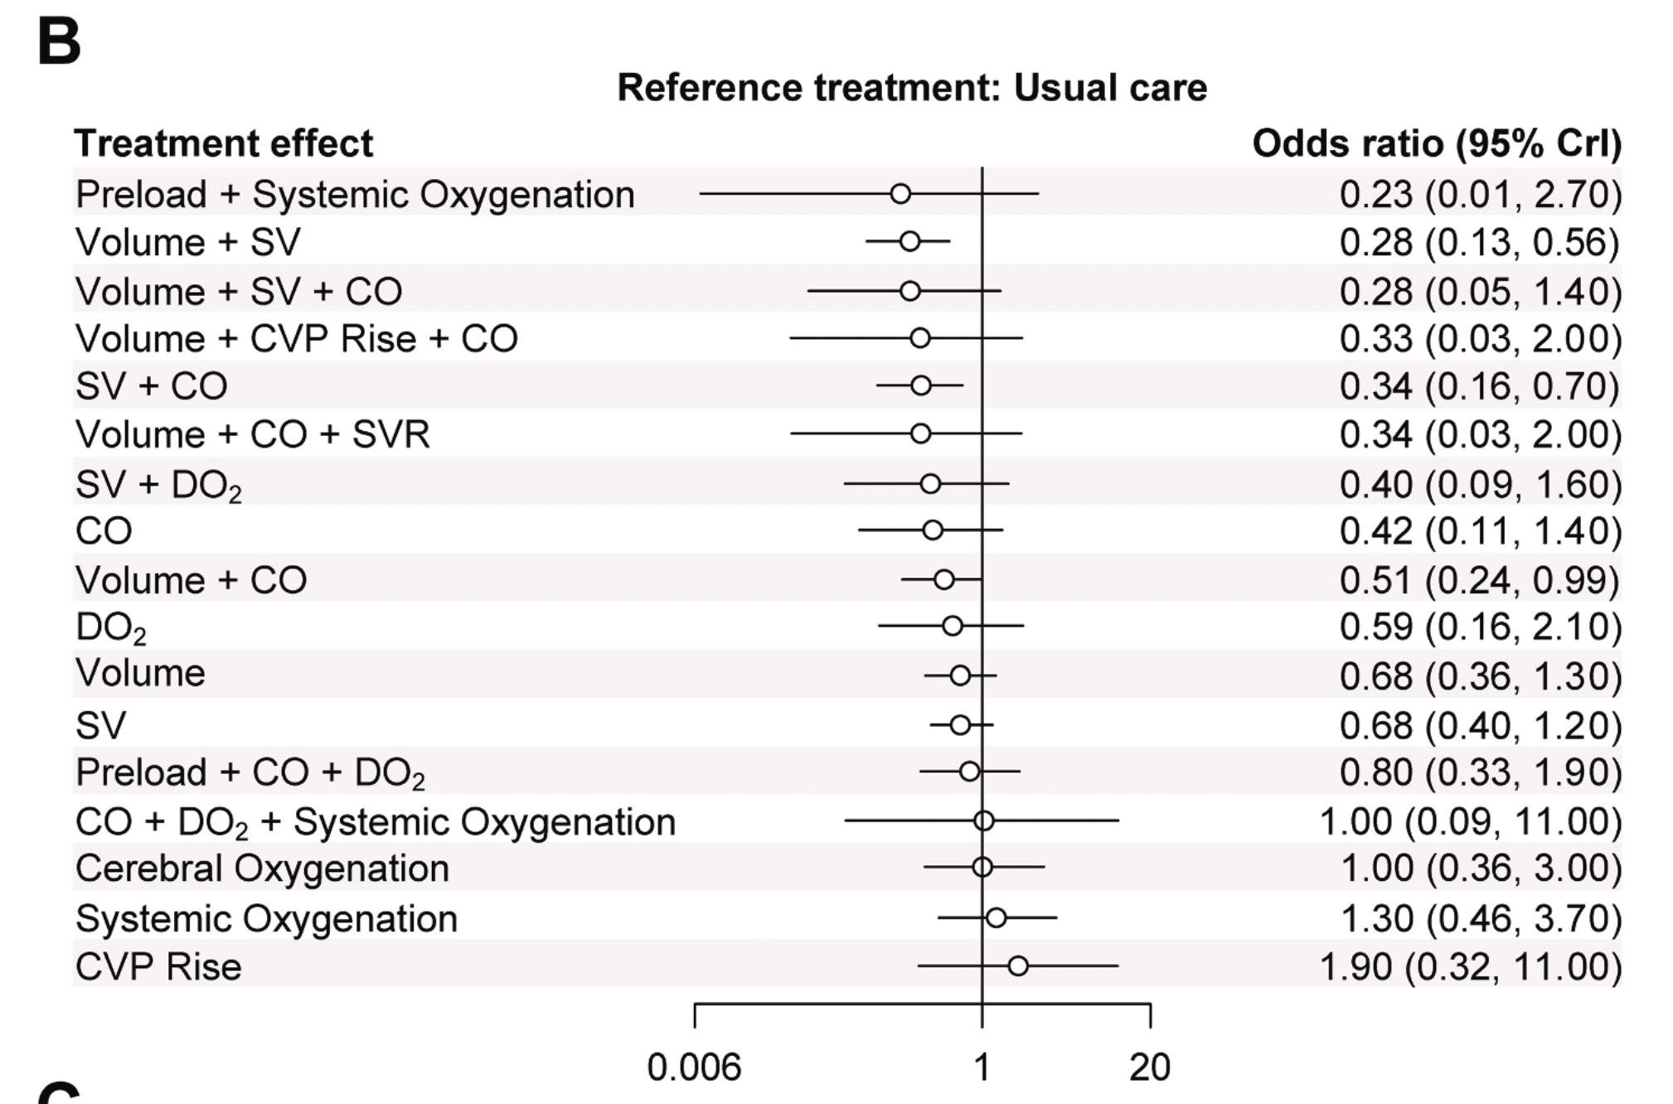
Network Meta-analysis Forest Plot
OPTIMIZE-2 not included in meta-analysis
≈3,000 patients
Neutral results

Slide 26
Hyperglycemia
Tight control of glucose improves immunity
  Gallacher, Diabet Med 1995
Glucose control maintains neutrophil phagocytosis
  Athos, Anesth Analg 1999
Mortality reduced by intensive insulin therapy in ICU
  Van Den Berghe, NEJM 2001
  Several large trials failed to replicate this finding

Slide 27
Intraoperative Hyperglycemia and SSI
Severe intraoperative hyperglycemia (> 200 mg/dL) doubled the odds of surgical site infection after liver transplantation, observational analysis
N=680
Park, Transplantation 2009

Slide 28
Intraoperative Glucose Control
Randomized trial
N=1439
Two sites with divergent results
Duncan, Anesthesiology 2018

Slide 29
Other Control Measures to Prevent SSIs
Sterile technique
  Rescrubbing does not reduce SSI incidence
S. aureus decolonization of patients
  Little benefit
Limit operating room traffic
  Possibly helpful, but no convincing evidence

Slide 30
Alcohol as Good as Traditional Prep
Hand-Scrubbing: 4% povidone iodine or chlorhexidine
Hand-Rubbing: 75% aqueous alcoholic solution (propanol)
Parienti, JAMA 2002 (n=4387)

Slide 31
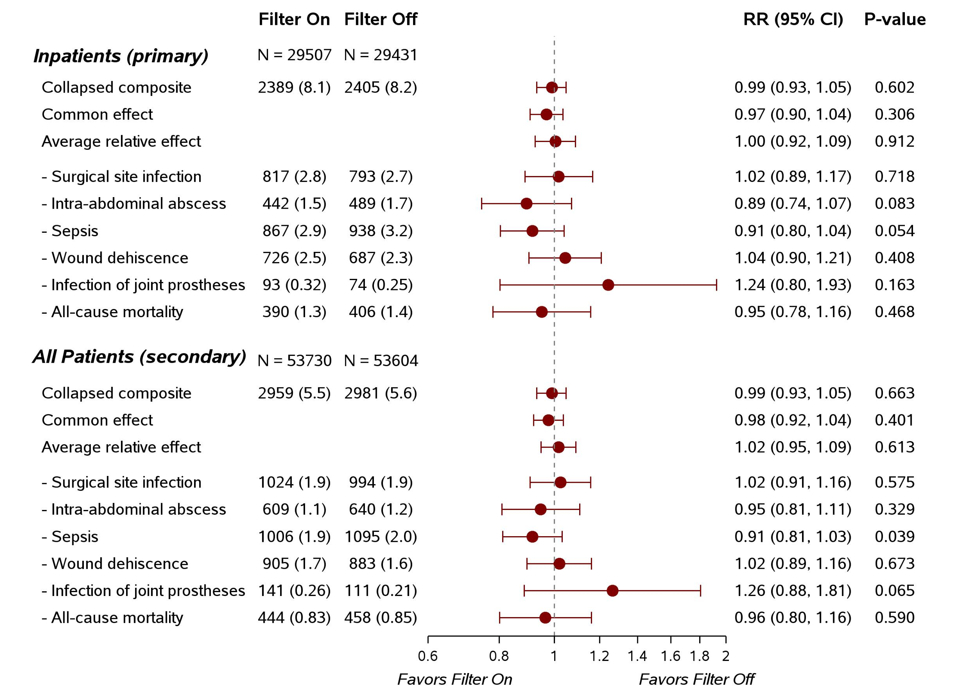
Supplemental OR Air Filtration and sterilization
Cluster cross-over trial
Randomized & fully blinded
N=110,00
Unpublished, confidential

Slide 32
Summary
SSI are common and serious
Interventions that do not reduce risk
  Supplemental oxygen
  Maintaining normothermia
  Guided fluid management
  Supplemental OR air filtration
Interventions that apparently help
  Prophylactic antibiotics given 0-2 hours before incision
  Liberal fluid administration
  Clean your hands! Alcohol foam works well

Slide 33

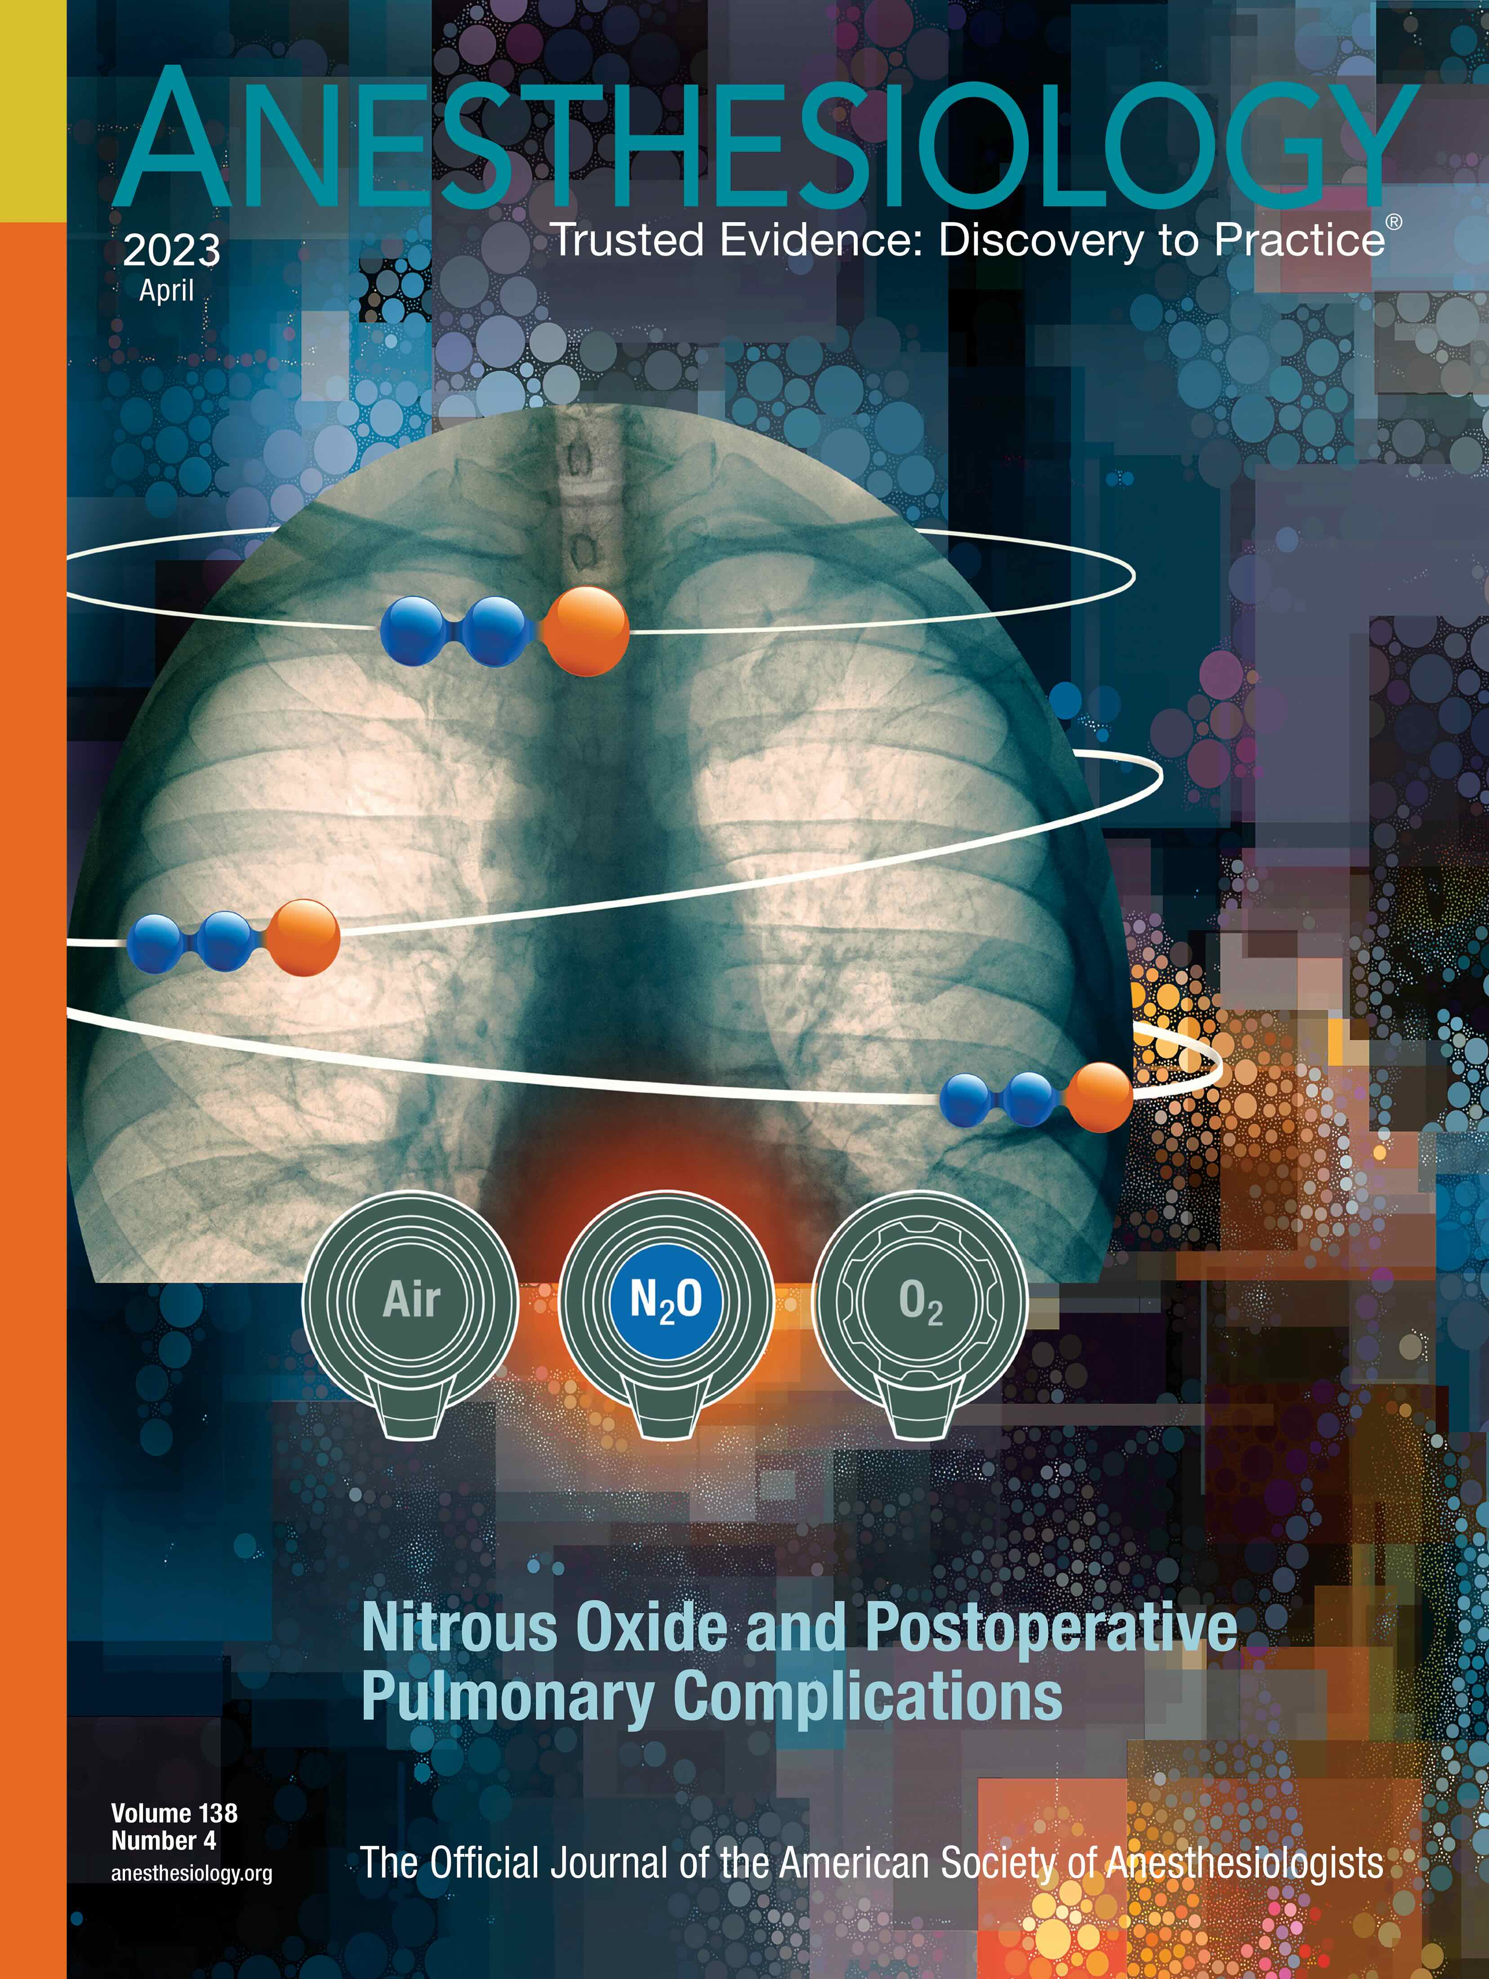

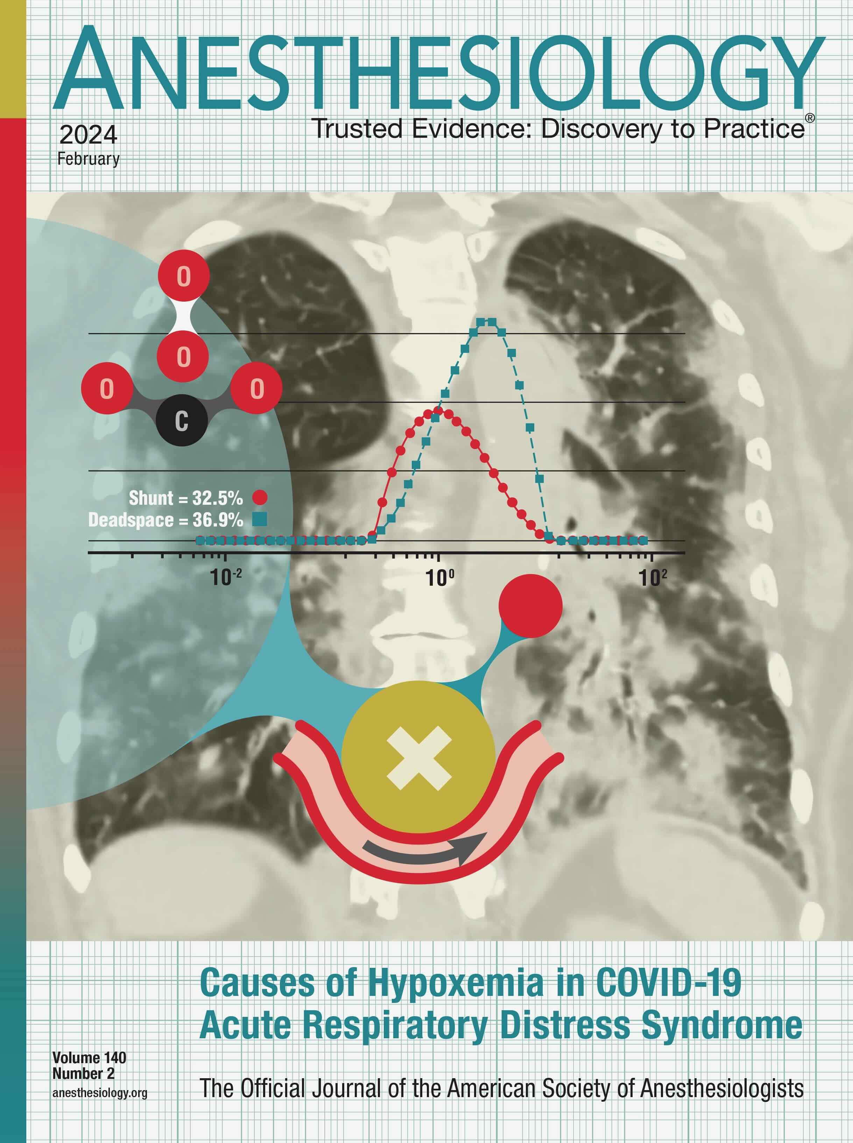
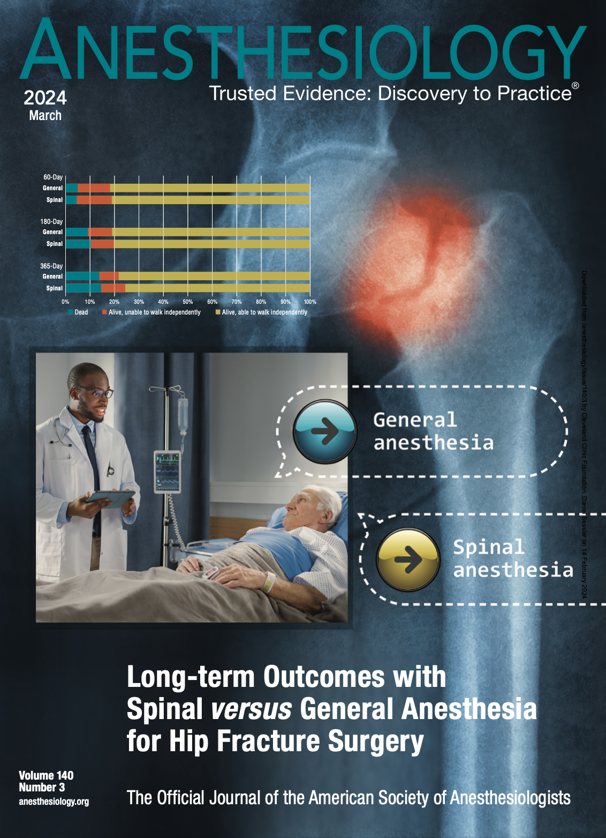

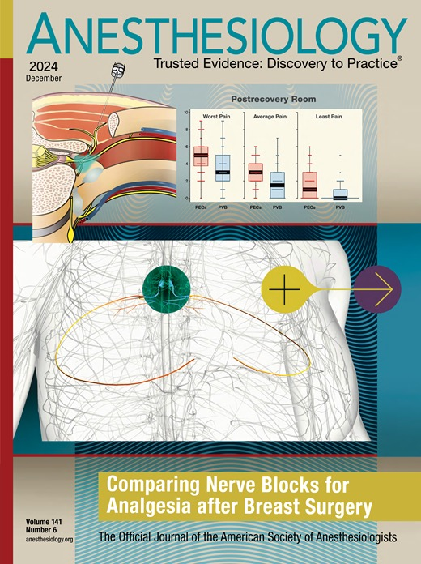
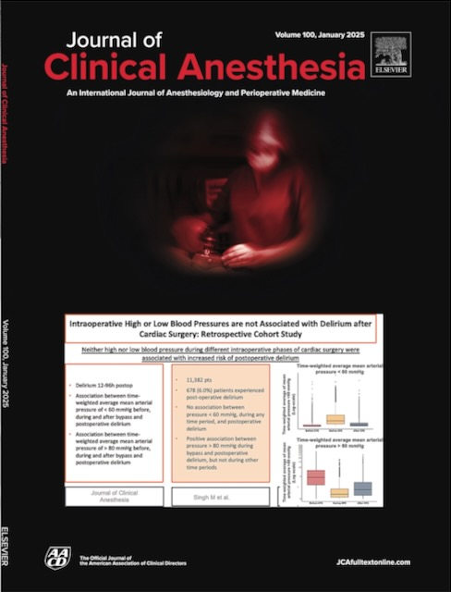
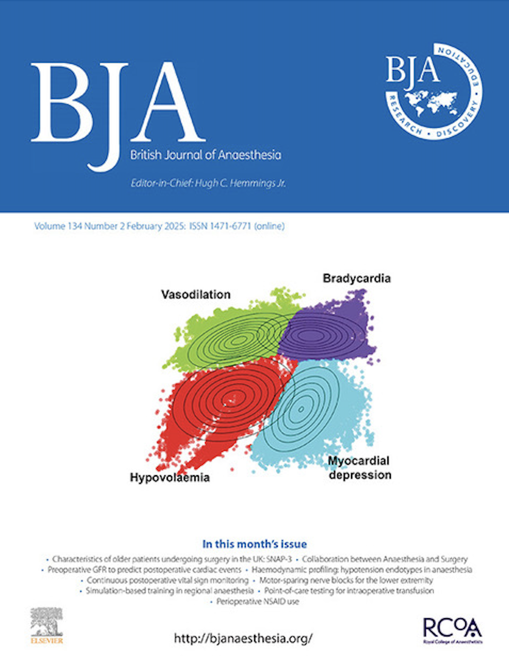
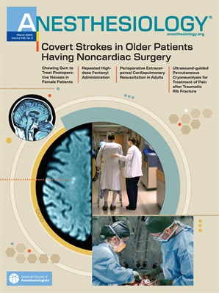
And that’s all folks…
Selected OUTCOMES RESEARCH covers since 2023

