Slide 1

OUTCOMES RESEARCH Consortium
Providing the evidence for evidence-based medicine©

Slide 2
Postoperative Respiratory Depression
Daniel I. Sessler, M.D.
Vice-president for Clinical and Outcomes Research
Professor of Anesthesiology
UTHealth, Houston
No relevant conflicts
www.OR.org DS@OR.org

Slide 3
Voltaire, 1760
  Physicians “poured drugs of which they knew little, for diseases of which they knew less, into humans of which they knew nothing.”

Slide 4
Oliver Wendell Holmes, 1860
  “If all our drugs could be sunk to the bottom of the sea, it would be all the better for humans — and all the worse for the fishes.”
Notes:
Factor of a 100 reduction in the next century, and another factor of 100 since the French Society of Anesthesia founded in 1934. (Or factor of 10 since FAER founded in 1986.)

Slide 5
Perioperative Mortality
Intraoperative mortality rare
  10-fold reduction in 3 decades
Thirty-day postoperative mortality
  2% for inpatients ≥45 years old
    Same as 1-year mortality in a 65-year-old
    8-fold greater than a similar non-operative month
  70% during initial hospitalization
  >100-fold more than intraop mortality
Notes:
“Myocardial Injury after Non-cardiac Surgery” = MINS

Slide 6
Causes of Perioperative Mortality
Myocardial infarction is leading cause
Respiratory events contribute
  ≈45,000 US pts/yr need emergency ventilation
  40% die before discharge
  More common cause of morbidity
  Most are probably preventable
40% of in-hospital cardiac arrests on wards
  78% lethal
Notes:
“Myocardial Injury after Non-cardiac Surgery” = MINS
Anderson et al, Resuscitation 2016
Perman, J Am Heart Assoc 2016
Khan et al, J Gen Intern Med. 20016

Slide 7
Pathophysiology of PPCs
Obstruction
Respiratory muscle weakness, including residual blocks
Reduced ventilation, often from pain
Impaired respiratory control
And…

Slide 8
Opioid-induced Respiratory Depression
Closed-claims analysis
  77% of episodes = death or severe brain injury
  88% within 24 hours of anesthesia
97% deemed preventable
  42% within 2 hours of last nursing check
Potential causes
  Multiple prescribers
  Potentiating non-opioid sedatives
  Inadequate nursing assessment/response
Lee et al, Anesthesiology 2015
Notes:
357 acute pain malpractice claims that occurred between 1990 and 2009 – 92 judged as respiratory depression

Slide 9
PRODIGY-Identified Risk Factors
Cohort study
  To validate risk prediction for respiratory depression
  1335 patients receiving parenteral opioids
46% of patients experienced 1+ respiratory depression events
Predictive factors included: age ≥60, sex, opioid naivety, sleep disorders, and chronic heart failure
  However, low sensitivity and specificity of predictive tool indicates poor individual risk prediction
Khanna et al, A&A 2020
Notes:
Khanna et al 2020
respiratory depression episode was defined as respiratory rate ≤5 breaths/min (bpm), oxygen
saturation ≤85%, or end-tidal carbon dioxide ≤15 or ≥60 mm Hg for ≥3 minutes; apnea episode
lasting >30 seconds; or any respiratory opioid-related adverse event.
Intermediate risk – sensitivity .86, specificity, .39
High risk – sensitivity .52, specificity .77
Often coughing fit/bronchospasm, not necessarily clinically relevant
Conclusion – cannot reliably predict risk in individuals. Not a great predictive tool, but could be useful at a population

Slide 10
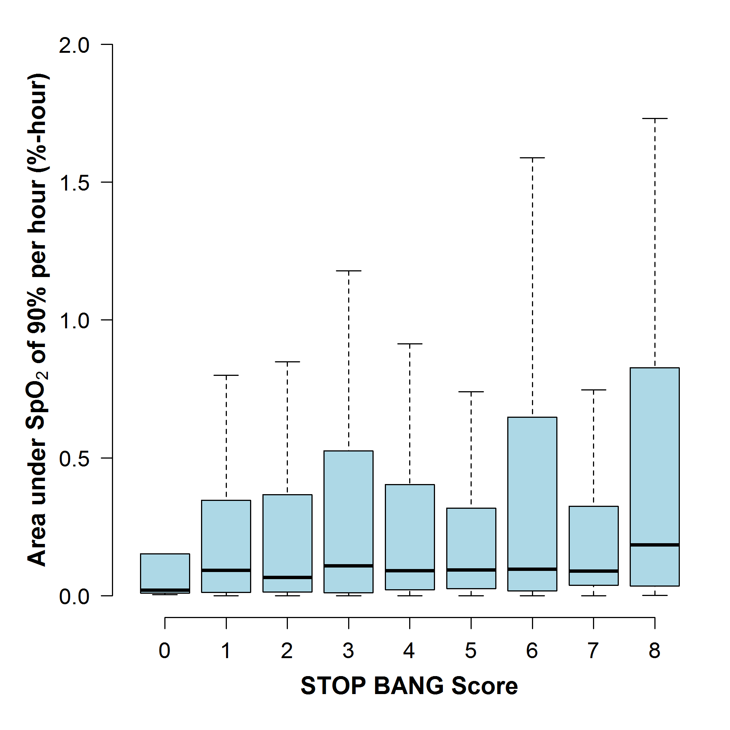
STOP-BANG Scores & Hypoxemia
Postoperative hypoxemia cannot be accurately predicted
Khanna et al, BJA 2016
Notes:
Explain stop-bang score – sleep apnea propensity score
Boxplot of Area under SpO2 of 90% per h for each STOP-BANG score category. No significant association was found between the STOP-BANG score and the median area under SpO2 of 90% per h, with a multivariable slope coefficient of 0.002 (95% CI: −0.01, 0.01; P=0.76) %-h for a unit increase in the score.
we proposed our hypothesis that higher STOP-BANG scores (more predictive of OSA), would also predict worse desaturation in OSA patients postoperatively

Slide 11
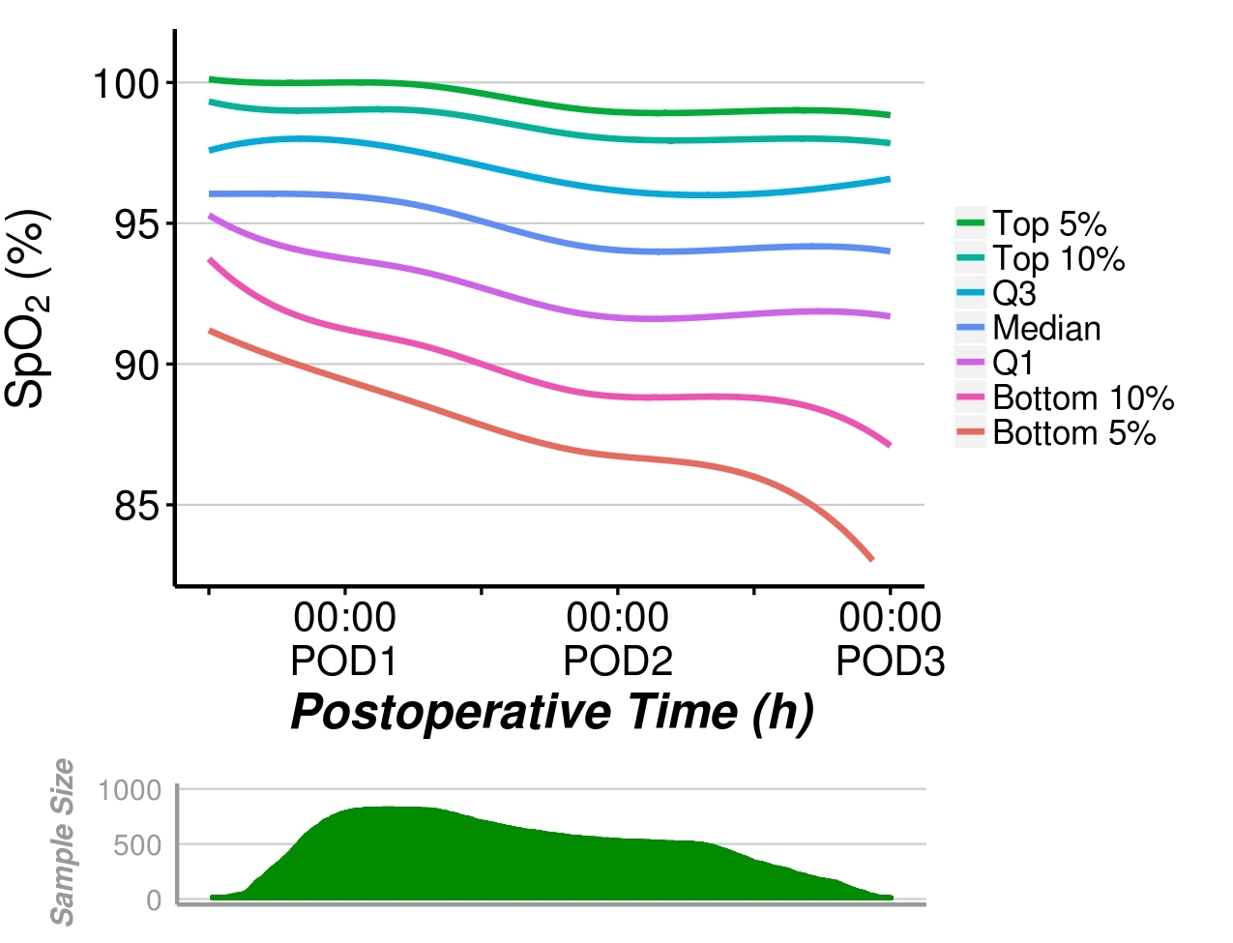
Blinded Saturation Over Time
Sun, A&A 2015
Notes:
patients >45 years old for up to 48 hours after noncardiac surgery in 1250 patients from Cleveland Clinic Main Campus and 250 patients from the Juravinski Hospital.
Just instantaneous measurements – distribution of saturations at function of time after surgery
Healthy patients attrition bias –
Individuals getting better over time

Slide 12
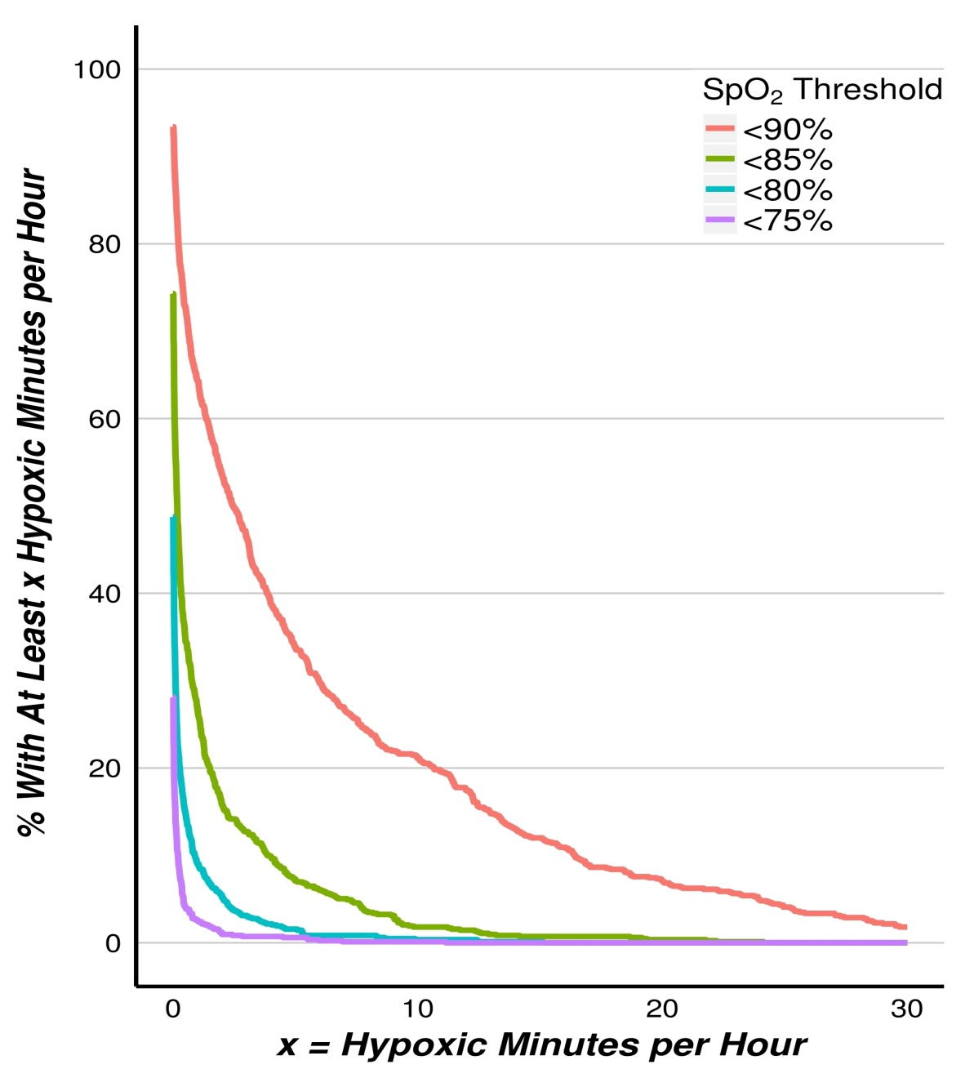
Minutes/hour of Hypoxemia
Nurses missed 90% of patients who had 1 continuous hour of saturation <90%
Notes:
12
Average minutes/hour of hypoxemia for 48 hour period –
Twenty-one percent (95% confidence interval, 18%–24%] of
patients averaged at least 10 minutes per hour with raw Spo2
values <90%, and 8% (6%–10%) of patients averaged at least
20 minutes per hour. Likewise, approximately 8% (6%–10%)
of patients averaged at least 5 minutes per hour with raw Spo2
<85%

Slide 13
Vital Sign Abnormalities Often Missed
Nursing vital signs Q4 hours in 782 patients
  Blinded continuous saturation monitoring
37% of patients had 2,893 episodes of SpO₂ <90% lasting ≥30 min
  83% were not within ±10 minutes of nursing assessments
Negligible improvement during assessments
  Nurses don’t arouse patients sufficiently to increase SpO₂
Missed desaturation is not the nurses’ fault
  This is a system failure
Saab et al, Anesthesiology 2021
Notes:
considered recorded times as approximate and used a 10-minute window before and after recorded time in our analyses
why nurses missed hypoxemia – happen b/w 4 hours or nurses wake patients
Happen in between nursing assessments
Additional support for continuous monitoring
Typically vital signs taken in 4-8 hour intervals – or even longer at some hospitals
Unchanged for half a century – nobody over 60, relatively small operations, week or long postoperative stay
Have not been updated
Interesting to characterize continuous monitoring

Slide 14
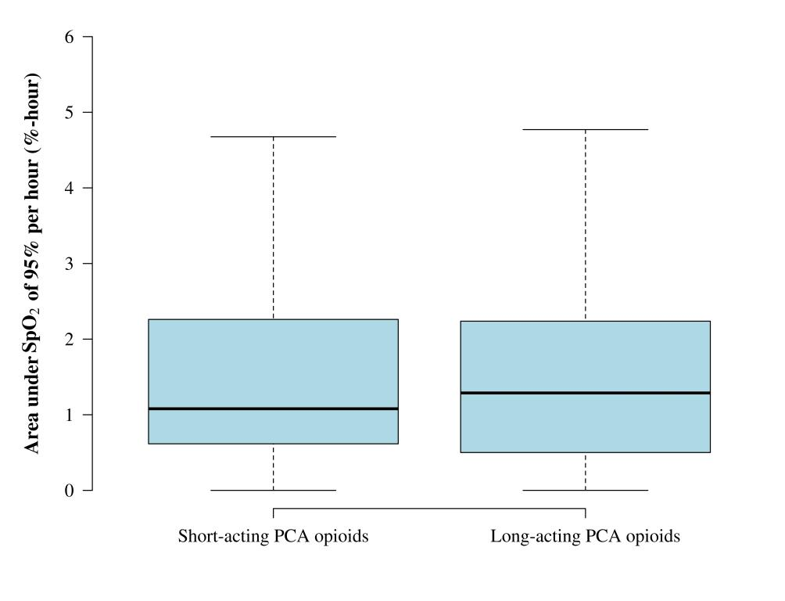
Short-acting PCA Opioids do not Help
Short-acting
Long-acting
Belcher, A&A 2016

Slide 15
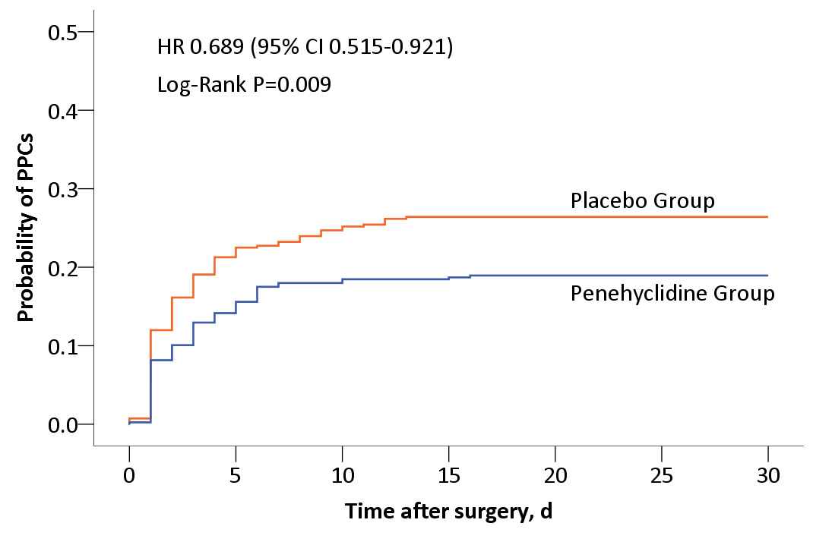
Penehyclidine Inhalation
RCT, N=826
Penehyclidine (anti-cholenergic) inhalation BID for 2 days
19% v. 26%, NNT = 13
Yan, Anesthesiology 2022

Slide 16
Ineffective Treatments, Trial Results
Saline v. balanced salt in surgical patients (N=8,616)
Crystalloid v. colloid (N=1,057)
Avoiding nitrous oxide (N=7,112)
30% v. 80% oxygen (N=5,056)
TV 6 v 10 ml and/or PEEP 5 v 8 cm H₂O (N=2,860)

Slide 17
Sugammadex v. Neostigmine
Observational results inconsistent
  Some show benefit, others harm
  All probably highly confounded by indication
Trial evidence shows no benefit
  Togioka, BJA 2020
  Alday, Can J Anesth 2019
  Ledowski, BJA 2021

Slide 18
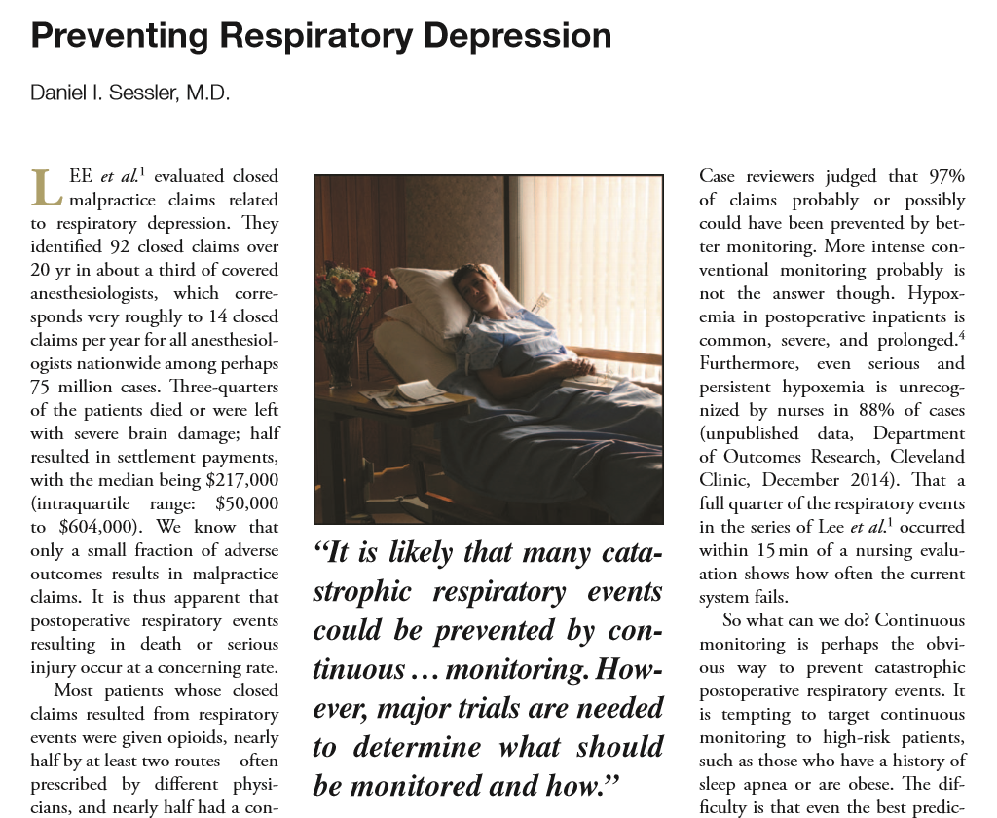


Continuous Ward Monitoring

Slide 19
Continuous Ward Monitoring Helps
Continuous ward monitoring
  Pager notification to nurses
    Saturation <80%, heart rate <50 or >140 beats/min
Before-and-after analysis (weak)
Reduced emergent rescue events
  3.4 (2-5) → 1.2 (0.5-2) per 1000 patients
Reduced ICU transfers
  5 (4-7) → 3 (1-4) per 1000 patients
Taenzer et al, Anesthesiology 2010
Notes:
Additional studies – before and after as well
Bellomo R, Ackerman M, Bailey M, Beale R, Clancy G, Danesh V, Hvarfner A,
Jimenez E, Konrad D, Lecardo M, et al. A controlled trial of electronic
automated advisory vital signs monitoring in general hospital wards. Crit
Care Med. 2012;40(8):2349–61.
Subbe CP, Duller B, Bellomo R. Effect of an automated notification system
for deteriorating ward patients on clinical outcomes. Crit Care. 2017;21(1):52.
Brown H, Terrence J, Vasquez P, Bates DW, Zimlichman E. Continuous
monitoring in an inpatient medical-surgical unit: a controlled clinical trial.
Am J Med. 2014;127(3):226–32.

Slide 20
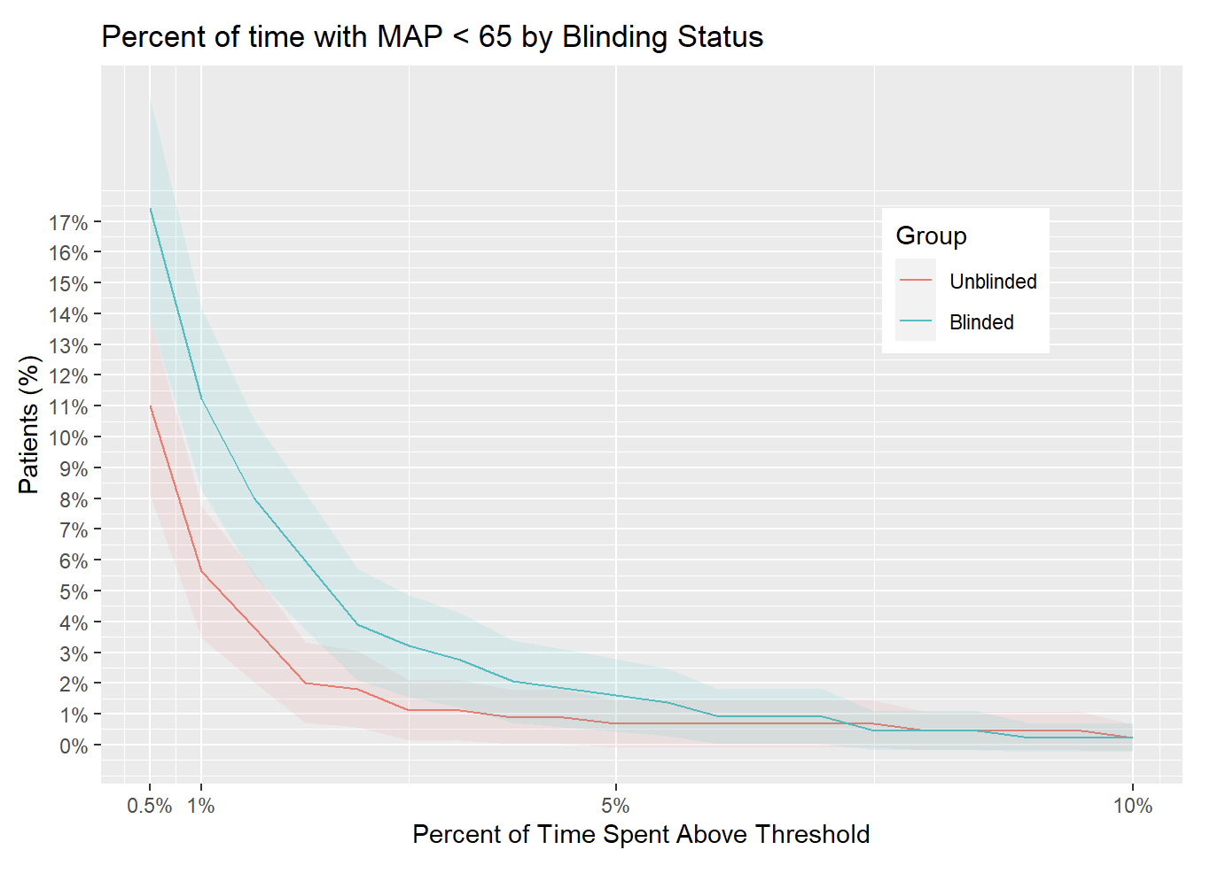
Randomized: Blinded v. Unblinded
909 patients
Continous monitoring
Khanna, et al
Wake Forest

Slide 21
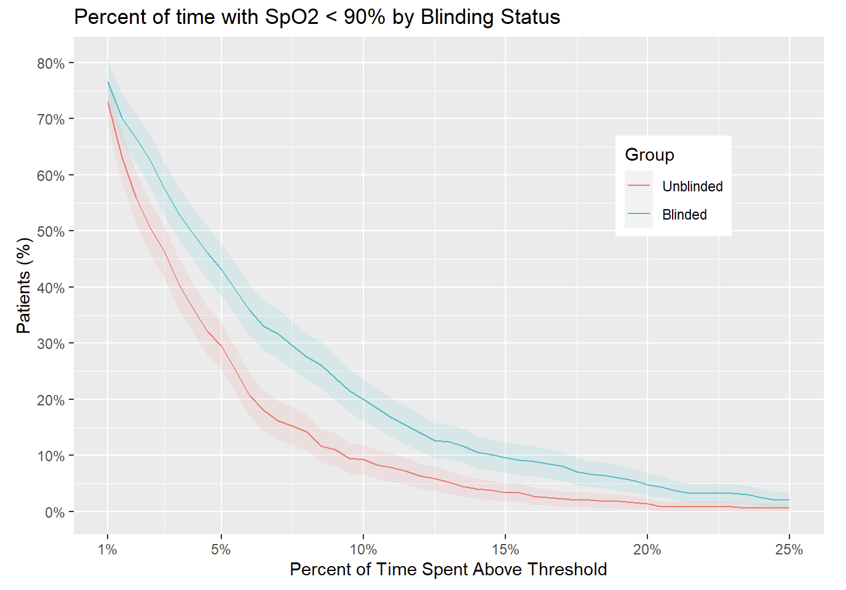
Randomized: Blinded v. Unblinded
909 patients
Continuous monitoring
Khanna, et al
Wake Forest

Slide 22
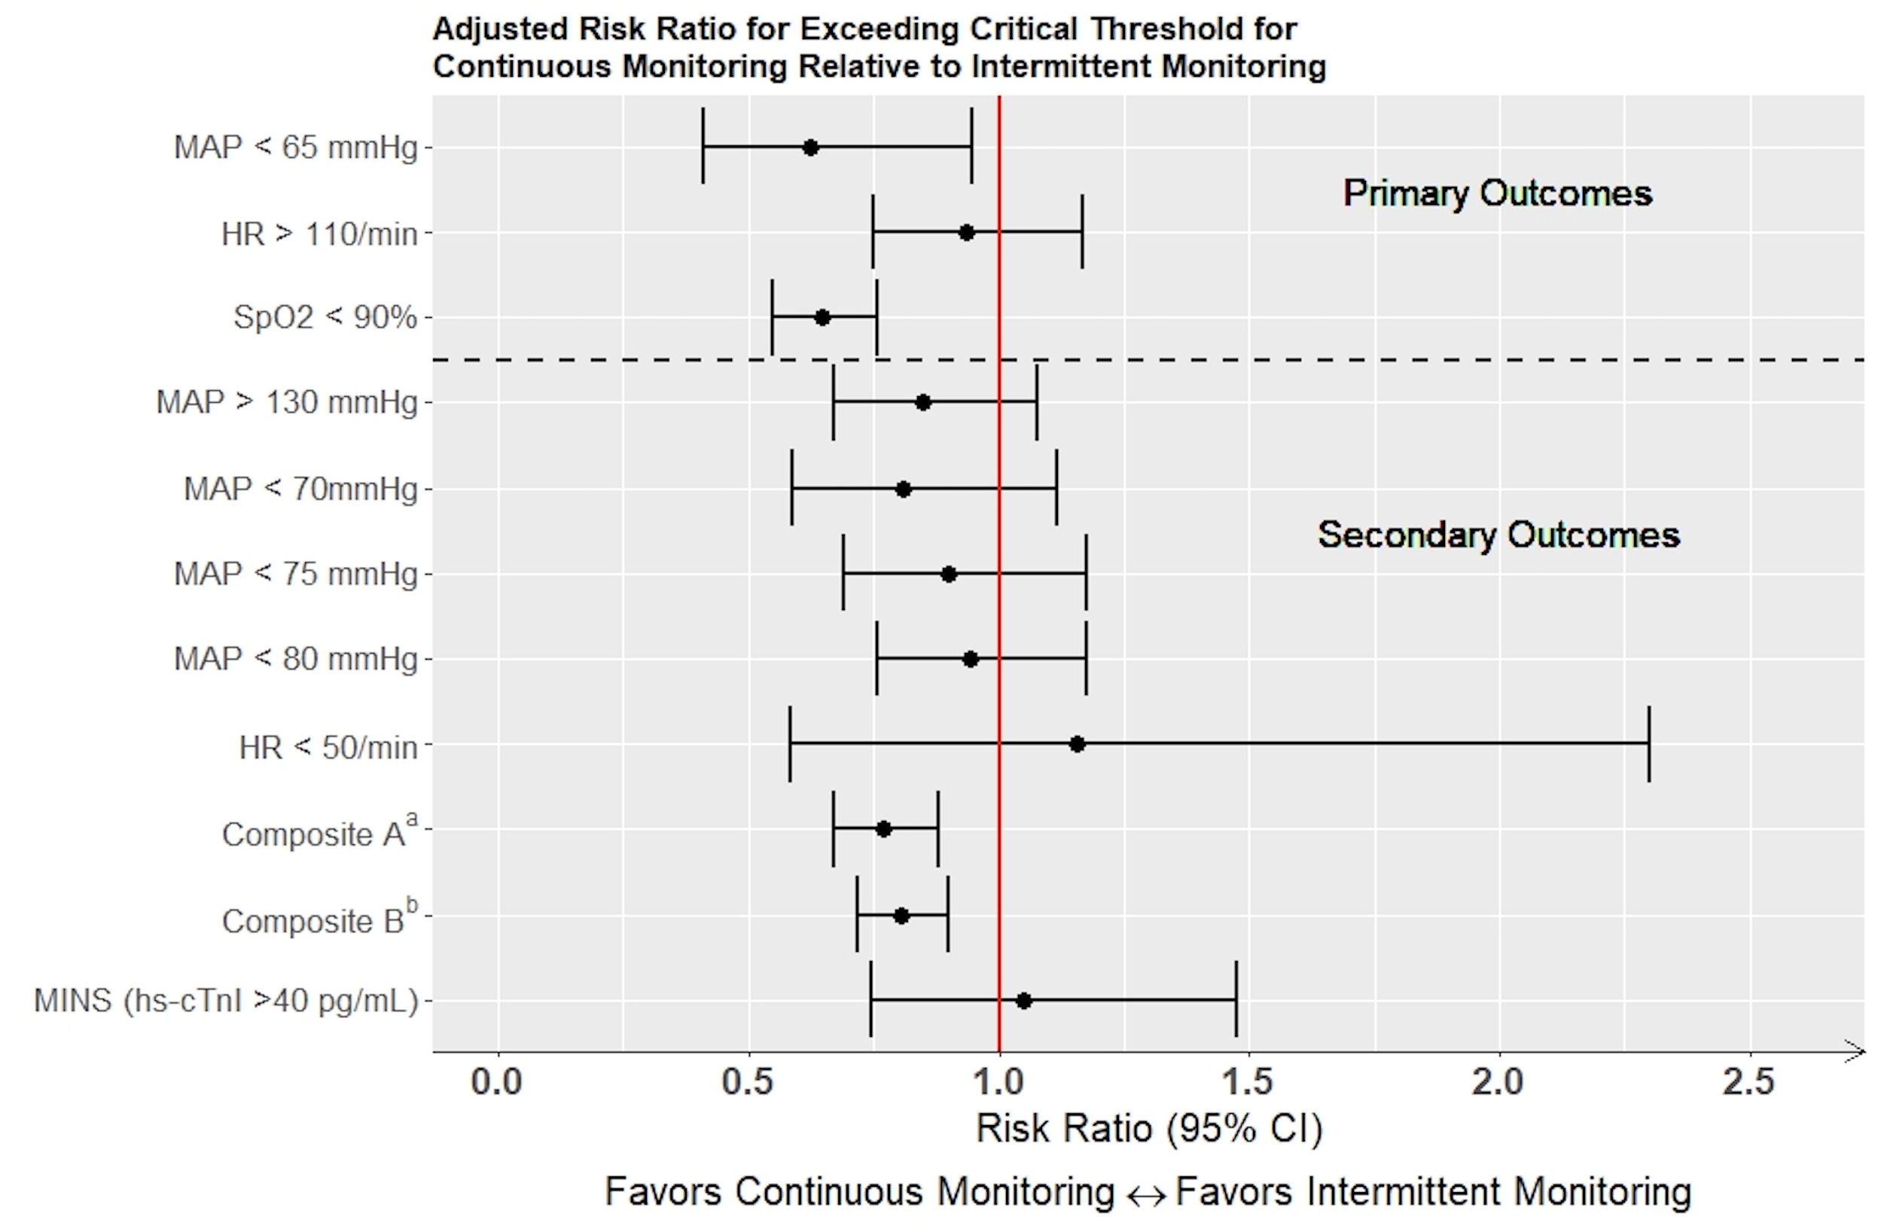
Randomized Trial, N=909 Patients
Blinded v. unblinded continuous MAP and saturation monitoring
Much less hypotension and desaturation with unblinded monitoring
Khanna, unpublished

Slide 24
So far…
Hypoxemia is common, profound, & prolonged
  Cannot be reliably predicted or prevented
Continuous ward monitoring likely to help
  Everyone, all the time!
  Saturation ± ventilation, BP when possible
Smart systems to identify at-risk patients
  Intervene before cardiorespiratory events
Much postoperative mortality is probably preventable

Slide 25
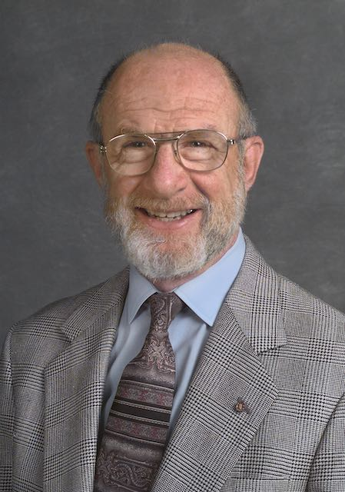

Notes:
Background and how my parents met. Accomplishments matter.

Slide 26
On Shakespeare, John Milton (1630)
What needs my Shakespear for his honour’d Bones,
The labour of an age in piled Stones,
Or that his hallow’d reliques should be hid
Under a Star-ypointing Pyramid?
Dear son of memory, great heir of Fame,
What need’st thou such weak witness of thy name?
And so Sepulcher’d in such pomp dost lie,
That Kings for such a Tomb would wish to die.

Slide 27

Gladys Sessler 1925-2000, R.I.P.
Kings
for such
a tomb…

Slide 28
Epitaph of Sir Edward Stanely’s Tomb
Not monumentall stones preserves our Fame;
Nor sky-aspiring Piramides our name;
The memory of him for whom this standes
Shall outlive marble and defacers hands.
Attributed to Shakespeare by Sir Edmund Chambers

Slide 29
Accomplishments Define Legacy
Not just for individuals!
What will anesthesia’s legacy be?
Depends when we look…

Slide 30
What Will Our Legacy Be?
Depends when we look…
  Credit for solving intraoperative mortality
  Little effort or progress on ward mortality
Postoperative mortality is the big problem
  Current monitoring dates back a half-century
  Inadequate for current patient acuity
Continuous ward monitoring is essential
  Will soon be standard-of-care

Slide 31
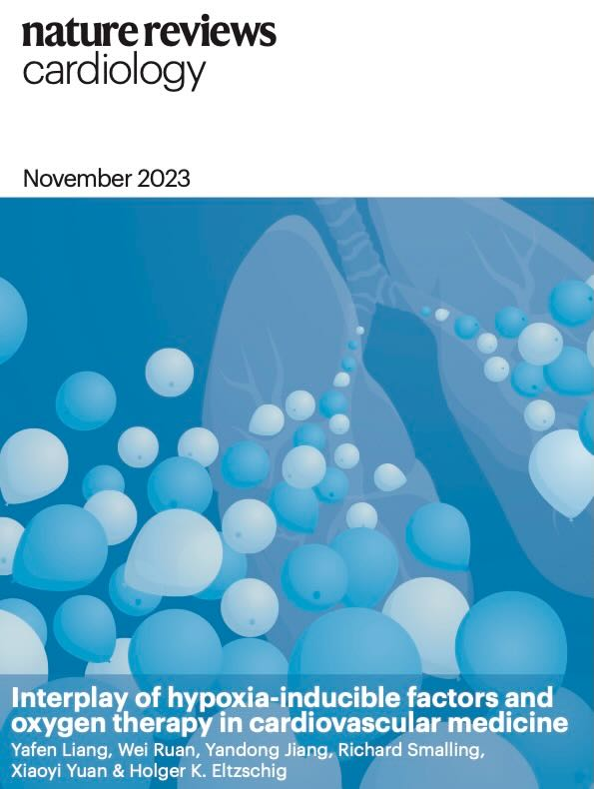
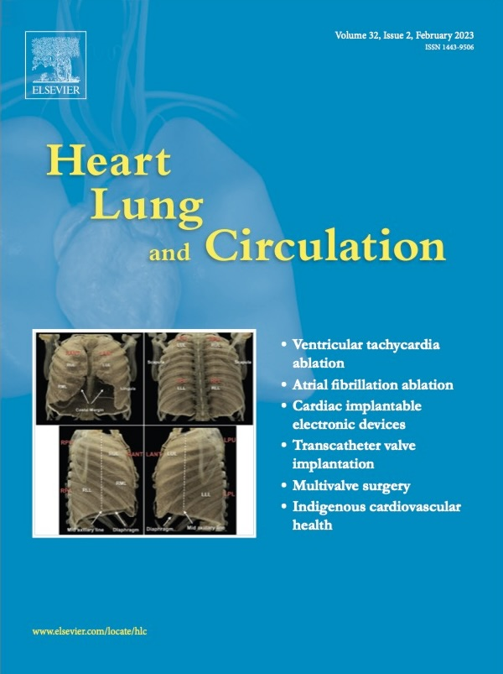
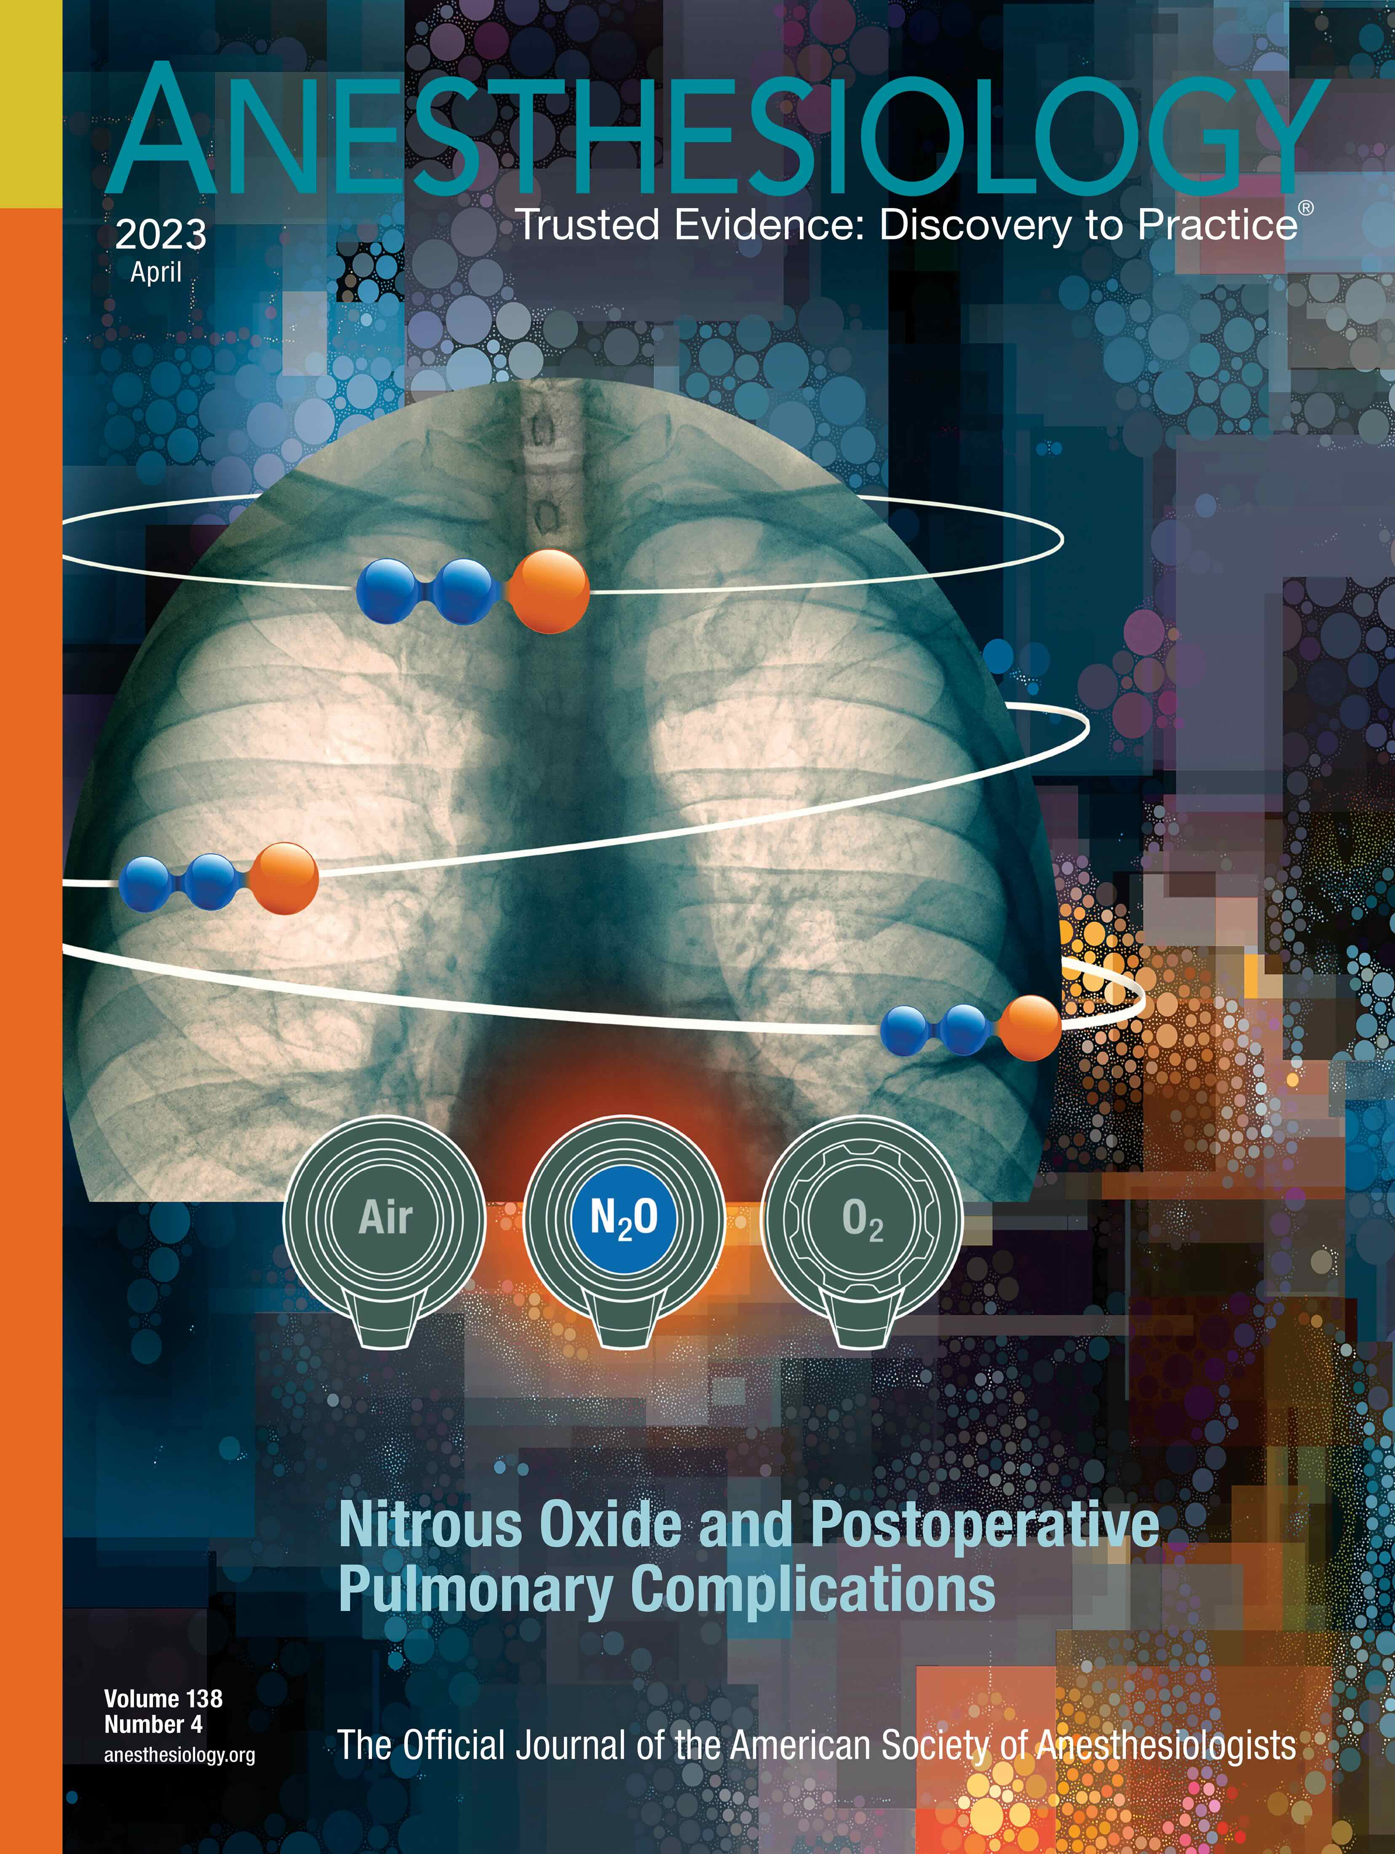
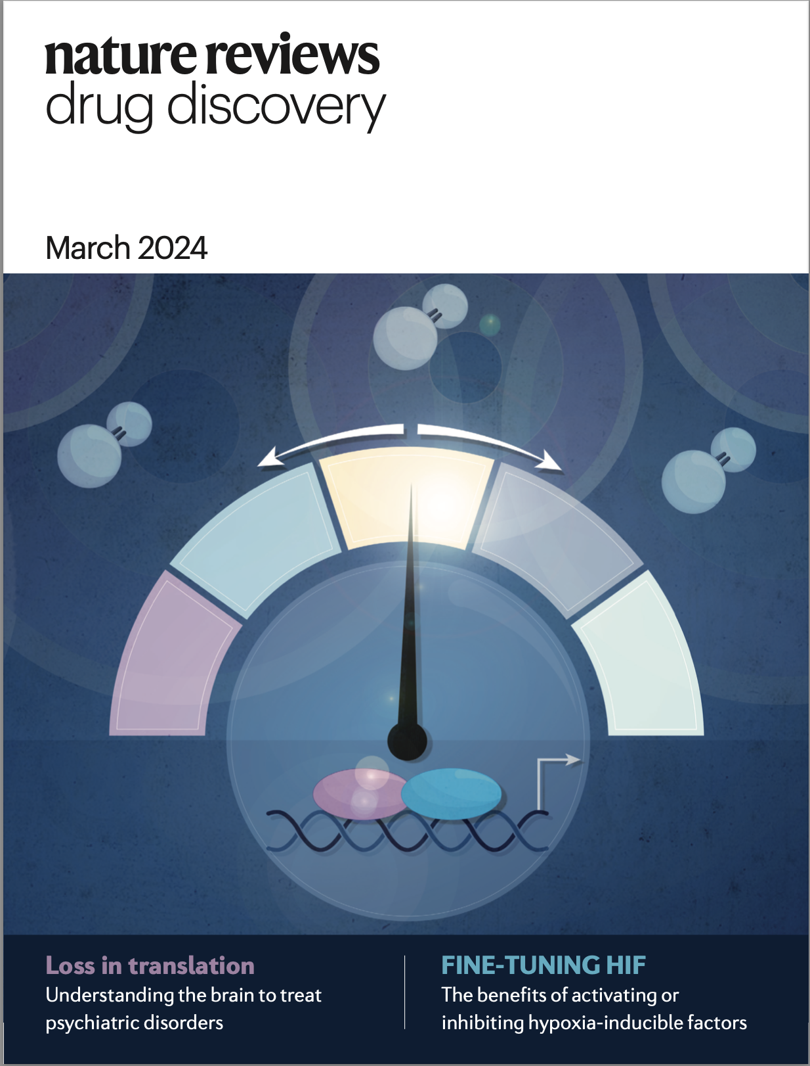
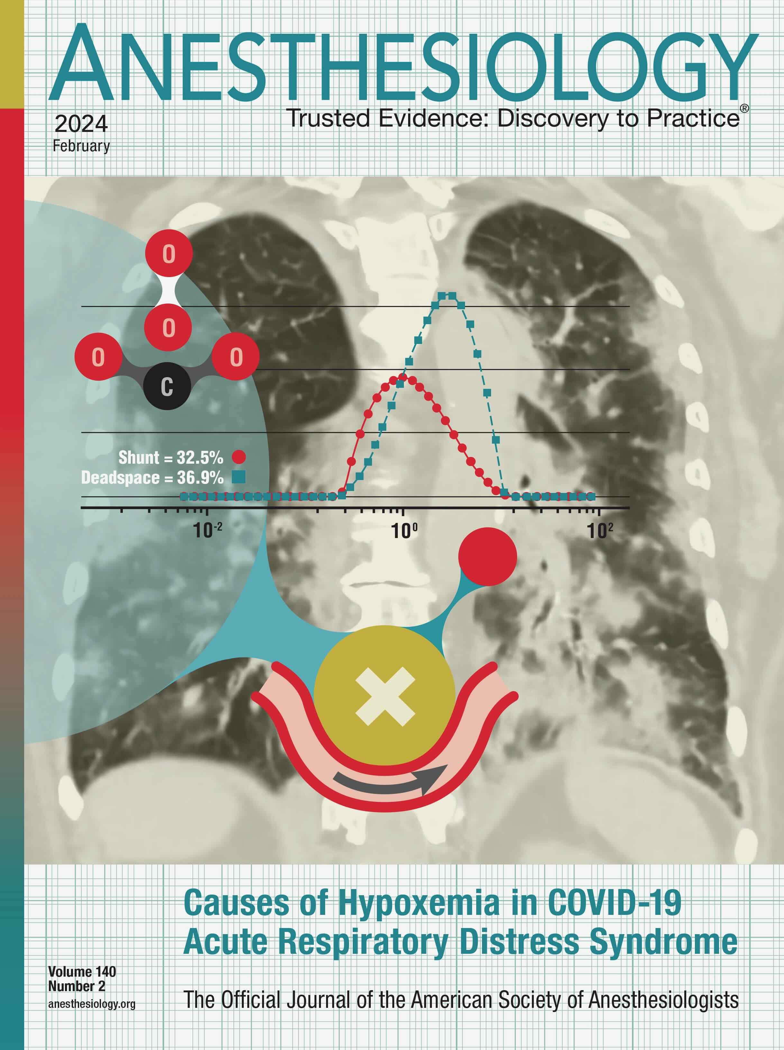
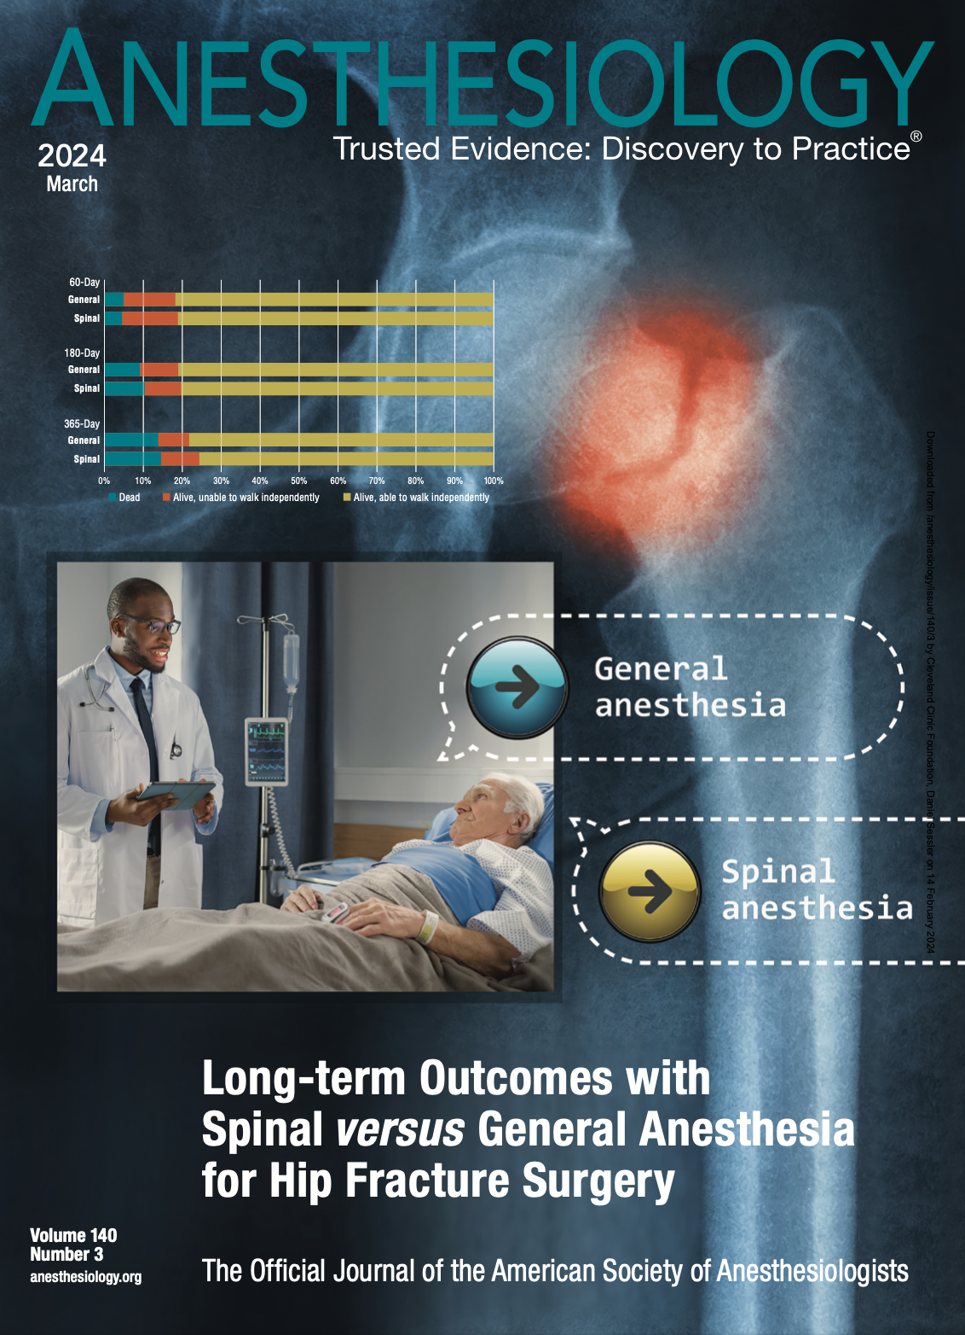

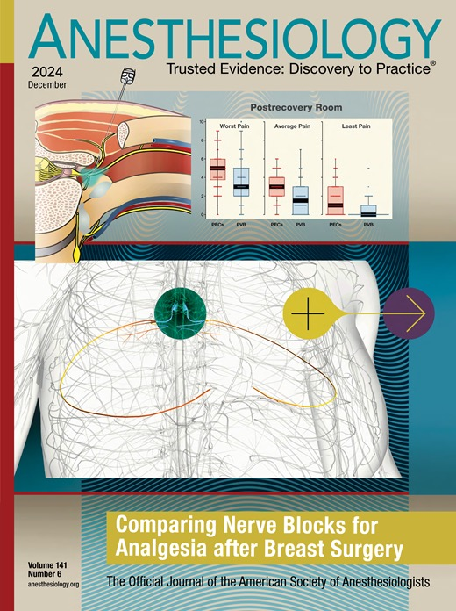
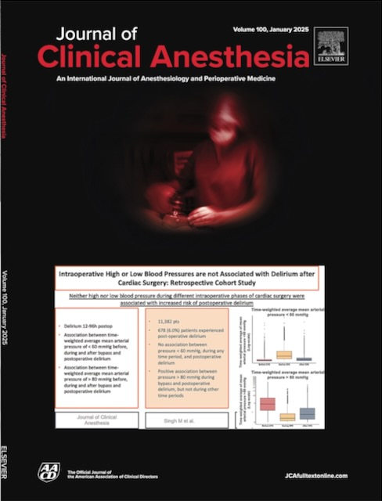
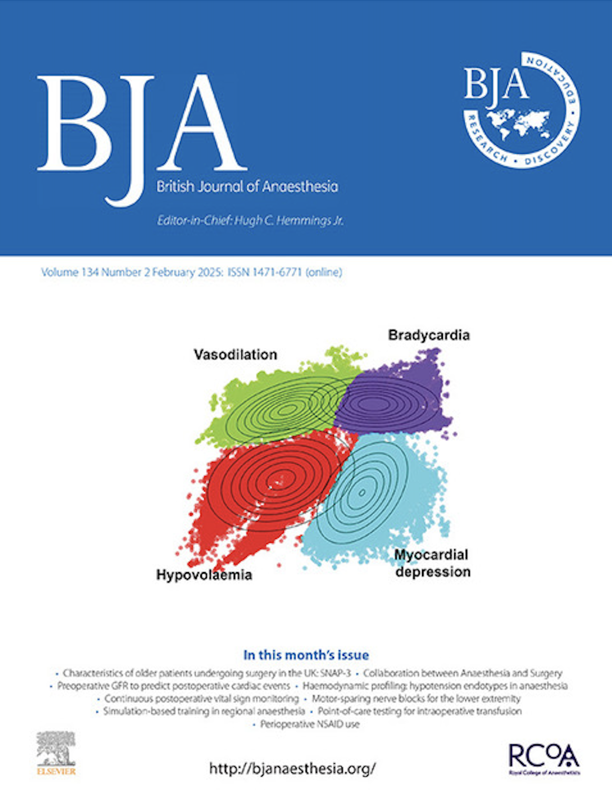
And that’s all folks…
Selected OUTCOMES RESEARCH covers since 2023

Slide 32

Carpe Diem

