Slide 1

OUTCOMES RESEARCH Consortium
Providing the evidence for evidence-based medicine©

Slide 2
Observational Research and
Sources of Error
Daniel I. Sessler, M.D.
Vice-president for Clinical and Outcomes Research
Professor of Anesthesiology
UTHealth, Houston
Notes:
Historically considered something clinicians did in their spare time -- and not very well. Patient-based research h is now respected as its own specialized field.

Slide 3
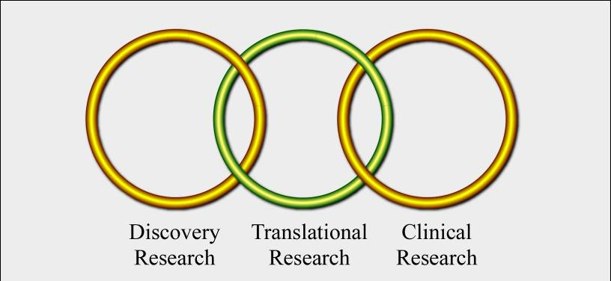
Evidence-based Practice
Voltaire
  Early physicians “poured drugs of which they knew little, for diseases of which they knew less, into humans of which they knew nothing”
Evidence-based medicine is best
  Evidence only rarely available
  “Providing the evidence for evidence-based practice”
Clinical research provides the evidence
  Humans are a poor model for rats!
  The pleural of anactode is not data

Slide 4
Electronic Records ≠ Useful Data
Electronic records are now ubiquitous
  Many are text-based rather than using discrete elements
  Most proprietary with limited ability to modify locally
Linking to other electronic outcomes challenging
  Relevant preoperative data, lab values, etc.
  Duration-of-hospitalization and complications
  Important outcomes such as patient satisfaction often missing
  Vital status is surprisingly hard to obtain
Converting electronic records to usable data is:
  Difficult and expensive
  Requires considerable skill

Slide 5
Hypotheses
The essential starting point for any study
Present-tense statement of fact
  Avoid null and alternate hypothesis; simply specify what you believe
Elements
  Population
  Exposure
  Outcome
  Time frame
  Expected direction
  Minimum clinically meaningful difference
Example
  Tight intraoperative blood pressure control reduces a composite of serious complications by at least 10% during the 30 days following major noncardiac surgery

Slide 6
Types of Studies
Case-control and retrospective cohort
  May be only option for rare conditions
Cross-sectional, for prevalence
Screening & diagnostic test validation
Economic and health services
Prospective observational cohorts — sometimes followed for decades
Randomized trials
  Strongest design; gold standard
  First major example: streptomycin for treatment of tuberculosis in 1948

Slide 7
Types of Registry Questions
Outcome prediction
  Association of characteristics and outcomes
Health services
  Risk-adjusted trends, comparisons, and rankings
Rare diseases
  Anaphylactic reactions, malignant hyperthermia
Hypothesis generation
  Estimate treatment effect to guide sample-size for trials

Slide 8
Case-Control Studies
Identify cases & matched controls
Look back in time and compare on exposure
Exposu
r
e
Case Group
Control Group
Time

Slide 9
Cohort Studies
Identify exposed & matched unexposed patients
Look forward in time and compare on disease
D
i
sease
Exposed
Unexposed
Time

Slide 10
Timing of Cohort Studies
RETROSPECTIVE COHORT STUDY
AMBIDIRECTIONAL COHORT STUDY
PROSPECTIVE COHORT STUDY
Time
Initial exposures
Disease onset or diagnosis

Slide 11
Case-control or Cohort?
Observation of a group of melanoma patients (cases), to see how their mortality compares to the mortality of a group of control patients without melanoma (controls).

Slide 12
Case-control or Cohort?
A study in which mothers of victims of Sudden Infant Death Syndrome (SIDS) (cases) and mothers of infants hospitalized with pneumonia (controls) answer questions about the sleeping habits of these children.

Slide 13
Case-control or Cohort?
A hospital-based study of elderly pneumonia victims, in which the recovery times of those receiving a new antibiotic (cases) are compared to the recovery times of those receiving a conventional therapeutic regimen (controls).

Slide 14
Case-control or Cohort?
Retrospective follow-up of government workers exposed to radiation during the course of the Manhattan Project in which the atomic bomb was developed (cases), to see whether they had subsequently experienced higher rates of cancers than Manhattan Project workers who had not been exposed to radiation (controls).

Slide 15
Study Type?
Blood pressure is measured in everyone living in a small town to determine the incidence of hypertension.

Slide 16
Before-after Comparisons
Practically the worst design
Subject to 3 types of bias
  Time-dependent confounding
    Healthcare improves over time; later results thus usually better
    Even if intervention is ineffective
  Regression to the mean
    Outcomes in studies started at extremes will return to baseline
    Even if intervention is ineffective
  Hawthorne effect
    Attention to an outcome usually improves it
    Even if intervention is ineffective

Slide 17
Sources of Error
There is no perfect study
  All are limited by practical and ethical considerations
  It is impossible to control all potential confounders
  Multiple studies required to prove a hypothesis
Good design limits risk of false results
  Statistics at best partially compensate for systematic error
Major types of error
  Selection and measurement bias
  Confounding
  Chance

Slide 18
Statistical Association
E = exposure
D = disease or outcome
Notes:
These errors seem obvious and easy to avoid. They are not!

Slide 19
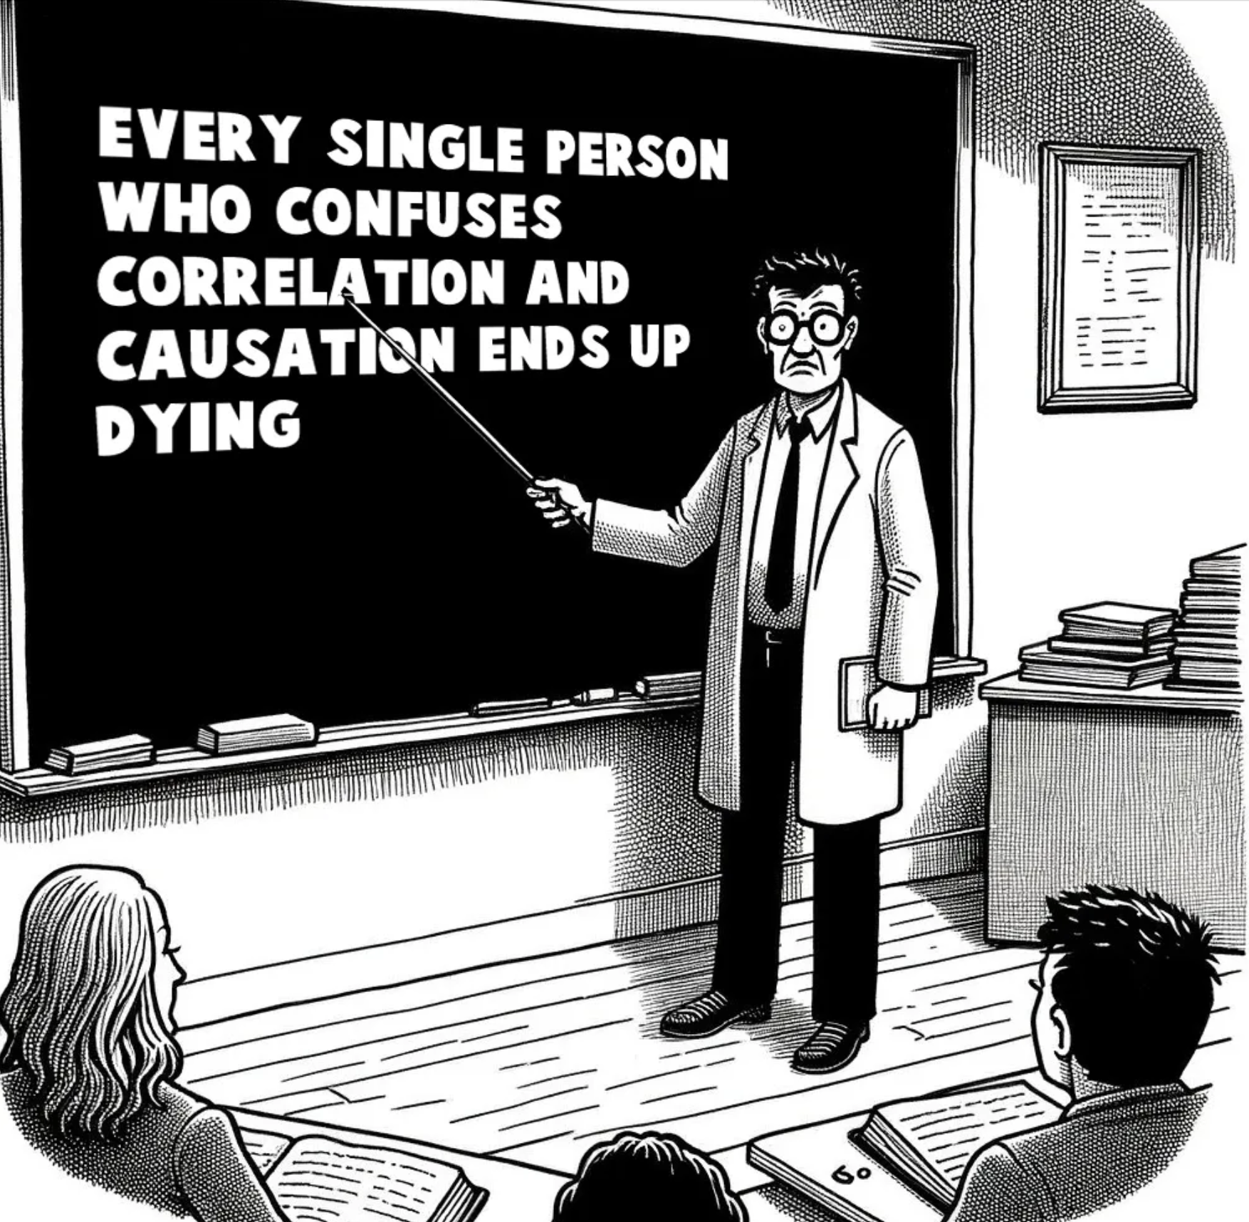
Correlation
≠
Causality

Slide 20
Selection Bias
Non-random selection for exposure, inclusion, or treatment
Treatments assigned to patients most likely to benefit
  Or least likely to experience complications
Patients non-randomly select specific treatment
Example
  Health-sophisticated patients may demand a newer treatment
Largely prevented by randomization

Slide 21
Measurement Bias
Quality of measurement varies non-randomly
Quality of records generally poor
  Not necessarily randomly so
Patients given new treatments watched more closely
Subjects with disease may better remember exposures
  Benefit may be over-estimated
  Complications may be under-estimated
Largely prevented by blinding

Slide 22
Example of Measurement Bias
Reported parental history | Arthritis (%) | No arthritis (%)
Neither parent | 27 | 50
One parent | 58 | 42
Both parents | 15 | 8
From Schull & Cobb, J Chronic Dis, 1969
P = 0.003

Slide 23
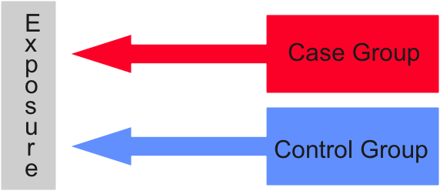
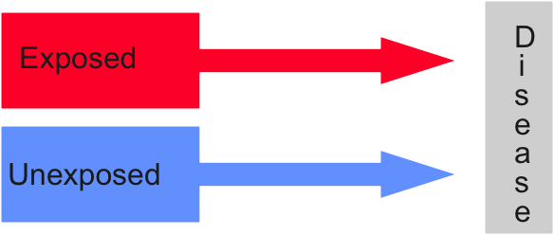
Measurement & Selection Bias
Selection Bias
(groups poorly matched)
Measurement Bias
(outcomes inaccurately characterized)

Slide 24
Confounding
Association between two factors caused by third factor
For example, mortality greater in Florida than Alaska
  But average age is much higher in Florida
  Increased mortality results from age, rather than geography of FL
For example, transfusions are associated with mortality
  But patients having larger, longer operations require more blood
  Increased mortality may be a consequence of larger operations
Largely prevented by randomization
Notes:
Counfounding is a problem with the data; goal is to prevent confounding (I.e., randomization) or adjust for it. Effect modification is when the association truly varies as a function of some third factor (I.e., drug that saves women and kills men); this is real and means results should be stratified by modification factor. Can be intrinsic to the situation (as in these examples) or consequent to selection or measurement bias.

Slide 25
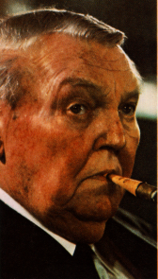

Confounding
Lung
Cancer
Strong association

Slide 26
Propensity Scores & Matching
Identify potential confounding factors
  Regression of characteristics predicting exposure
Score then used to:
  Adjust for baseline risk in multivariable regression
  Match exposure groups (1:N)
Advantages
  Usually more reliable than multivariable regression
  No limit on propensity regression variables

Slide 27
Confounding versus Mediation
Confounder
Type of surgery
Regional
Analgesia
Exposure
Outcome
Complications
Mobilization
Mediator

Slide 28
Summary: Observational Research
Faster and less expensive than prospective research
  May be the only option for rare conditions or outcomes
Subject to
  Selection bias
  Measurement bias
  Confounding
Careful analysis limits risk of false results
Generates associations that may or may not be causal

Slide 29


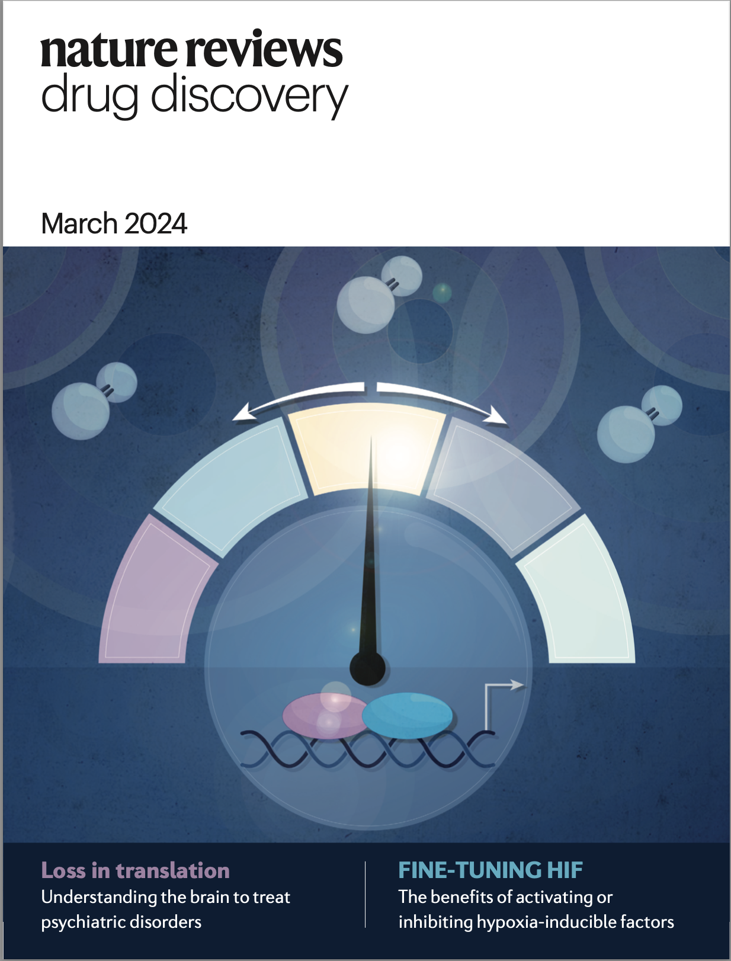
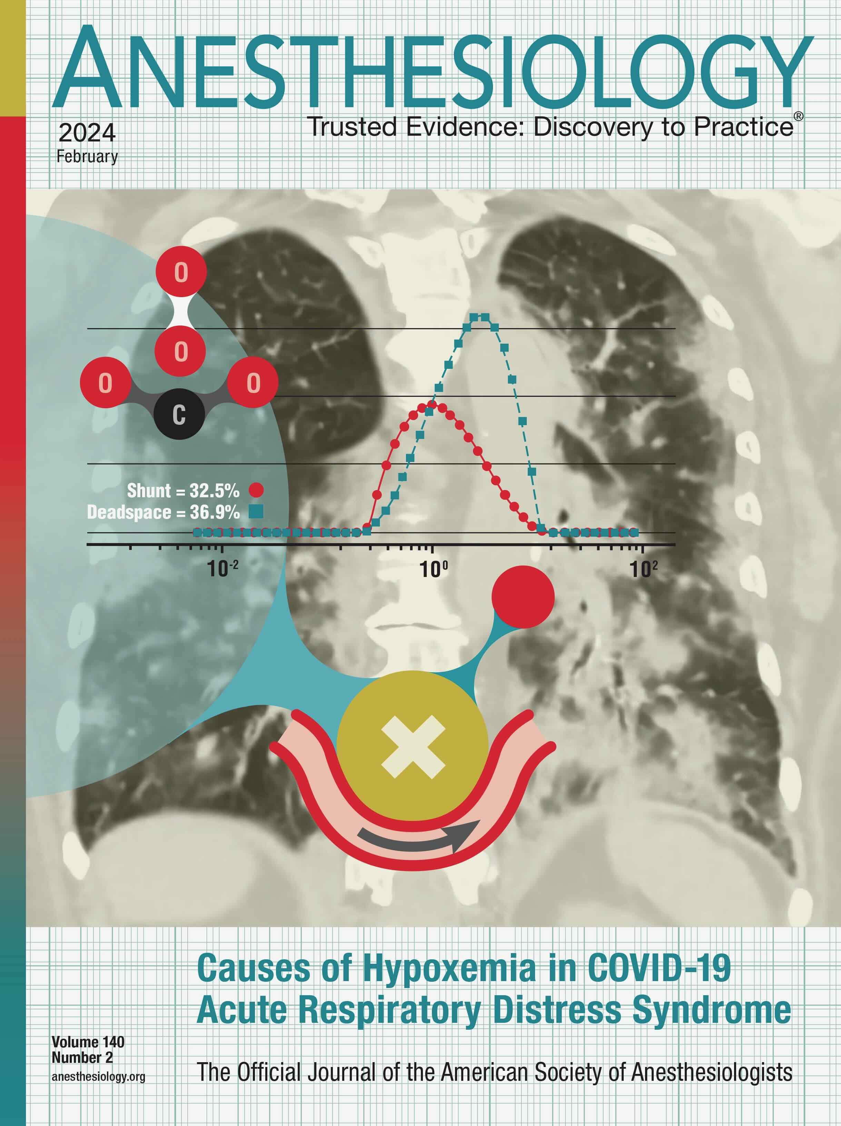
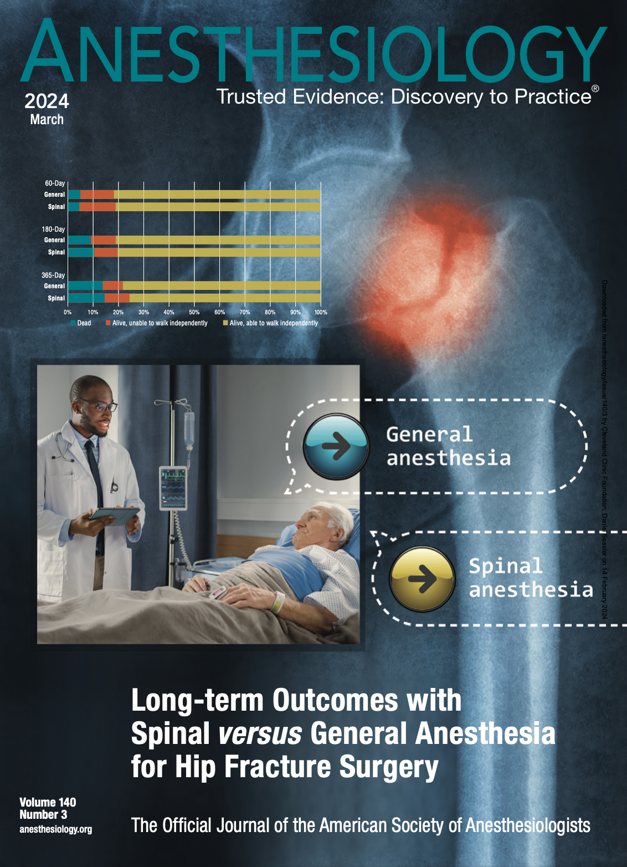

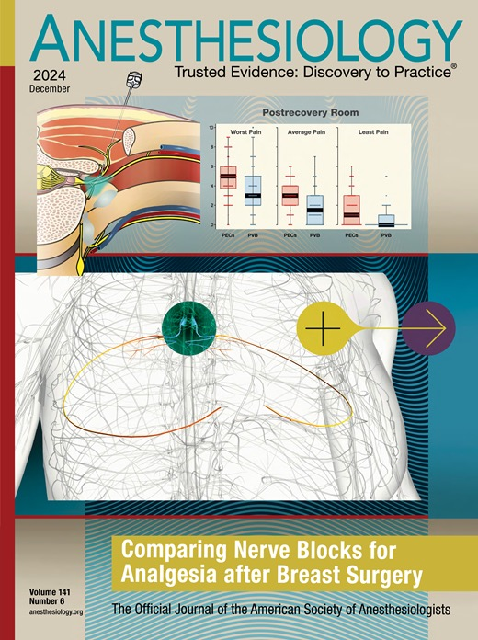


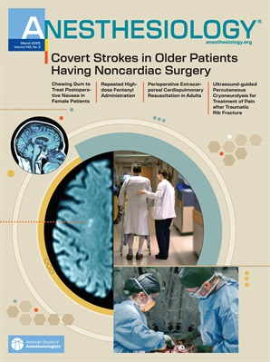
And that’s all folks…
Selected OUTCOMES RESEARCH covers since 2023

Slide 30
Confounding and Mediation Example
Transfusion
Post-operative anemia
Pre-operative anemia
Myocardial injury
Supply-demand mismatch

Slide 31
Confounding versus Mediation Example
Type of Surgery
Pain
Mobilization
Complications
Exposure
Exposure
Outcome
Mediator

Slide 32
Matching Quantification
Age
Sex
BMI
Cancer
Previous MI
Before matching
After matching
0.1
0.2
0.3
Absolute standardized difference

Slide 33
Interactions & Effect Modification
≥65 years
≥65 years
All patients
Mortality
<65 years
Troponin

