Slide 1

OUTCOMES RESEARCH Consortium®
Providing the evidence for evidence-based medicine©

Slide 2
Perioperative Myocardial Injury
Daniel I. Sessler, M.D.
Vice-president for Clinical and Outcomes Research
Professor of Anesthesiology
UTHealth, Houston
Dr. Sessler is a consultant for Perceptive Medical
www.OR.org DS@OR.org

Slide 3
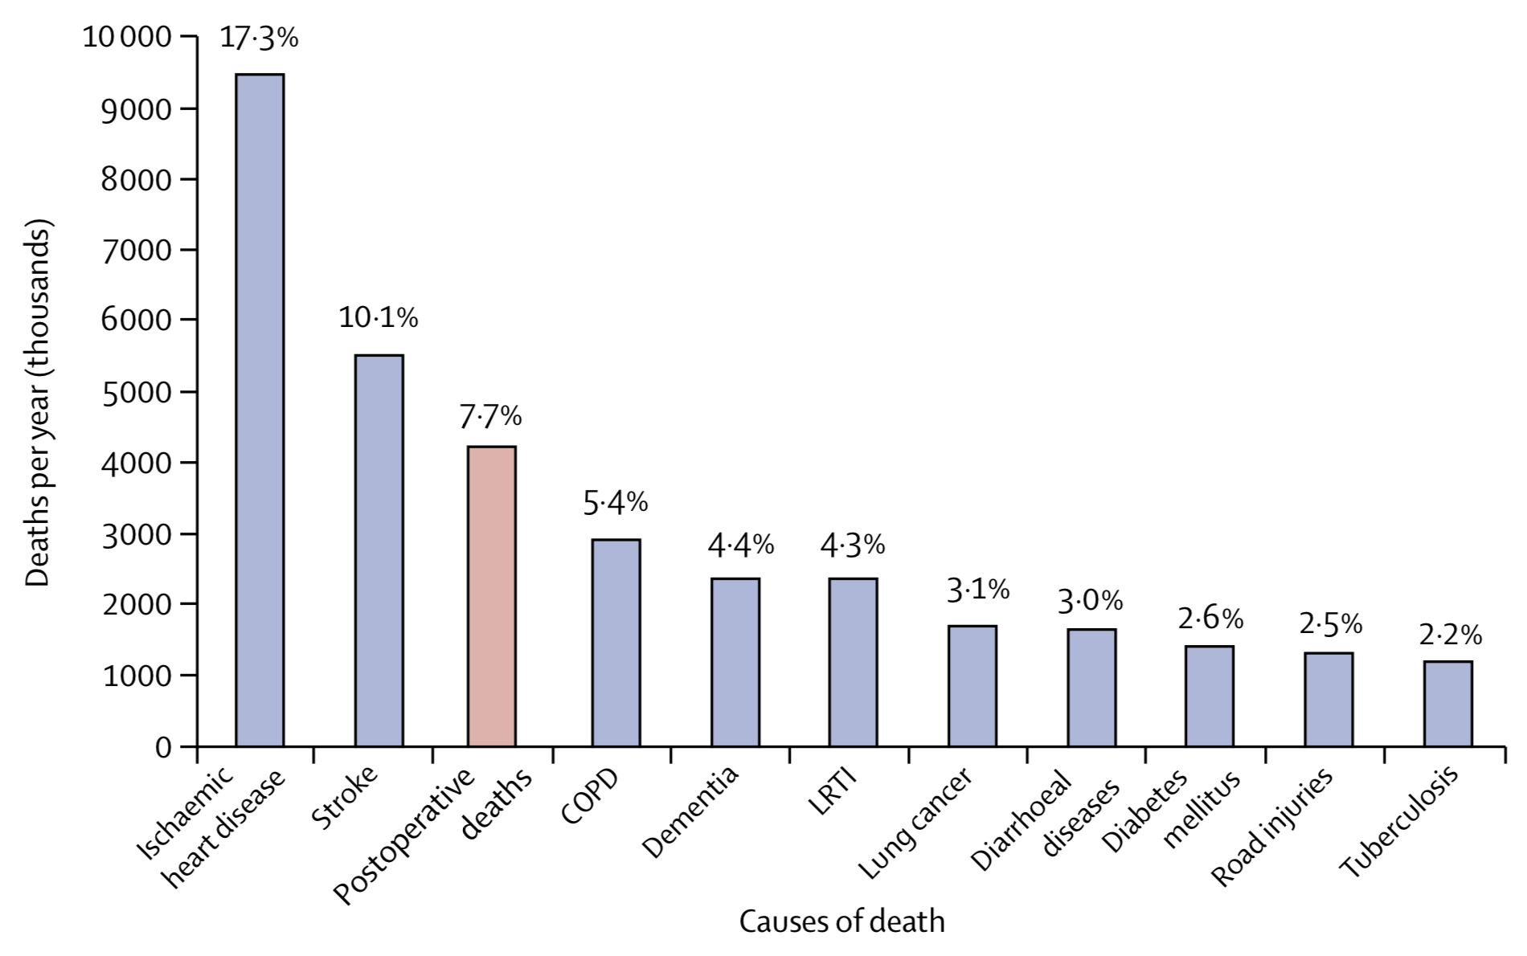
30-day Postoperative Mortality
Nepogodiev, Lancet 2019

Slide 4
Most Deaths are Postoperative
Intraoperative mortality is rare
  10-fold reduction in recent decades
Postoperative mortality remains common
  1-3% for inpatients ≥45 years old
    100-fold greater than intraoperative mortality
    8-fold greater than a similar non-operative month
  Two-thirds occur during initial hospitalization
  ≈90% of deaths follow urgent or emergent surgery
Notes:
“Myocardial Injury after Non-cardiac Surgery” = MINS

Slide 5
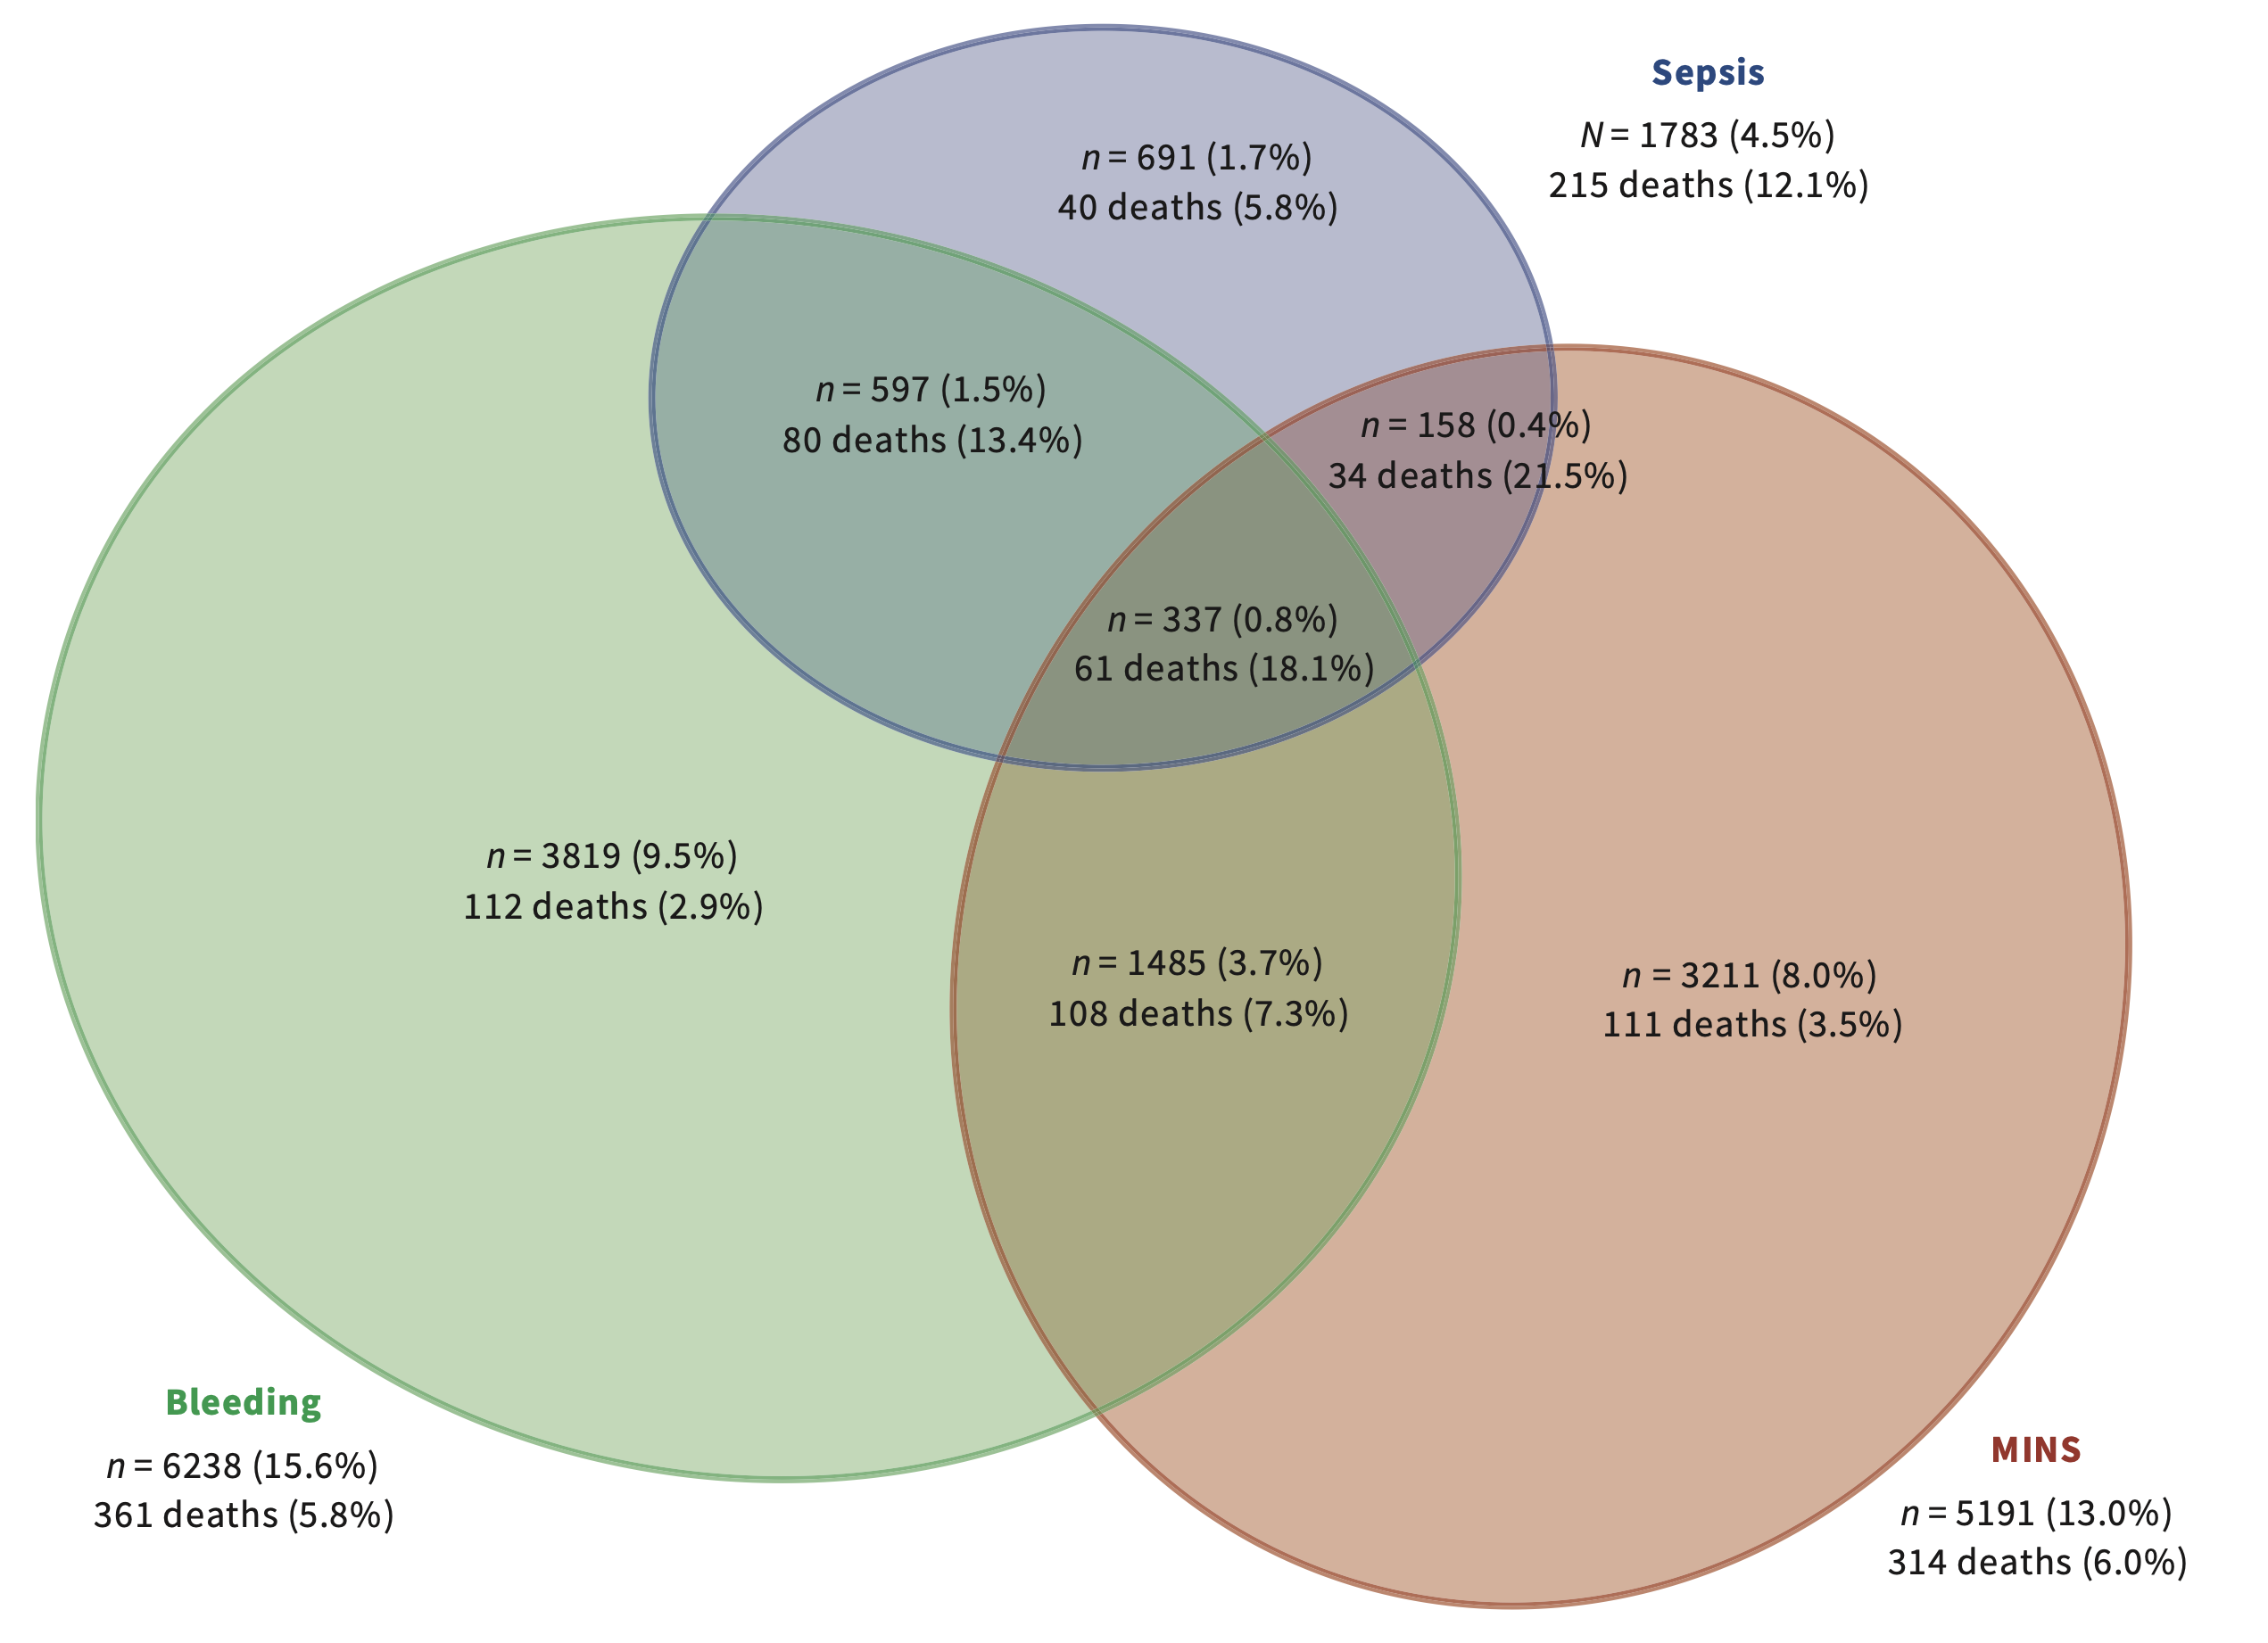
Causes of Perioperative Mortality
Attributable risk
  Bleeding 17%
  Myocardial injury 16%
  Sepsis 12%
VISION Investigators CMAJ 2019

Slide 6
MINS: Common, Silent, and Deadly
MI incidence 4% among inpatients >45 years
Myocardial Injury after Non-cardiac Surgery (MINS)
  93% without symptoms
  Typically Type-2 events (supply-demand mismatch)
It’s not just “troponitis”
  20% readmitted within 30 days
  8.5% have MI, cardiac arrest, or death in 30 days
  1 in 7 has a major vascular event within 16 months
Notes:
Outcomes more than twice as bad a non-operative
Arterial events 10 times as common as venous ones

Slide 7
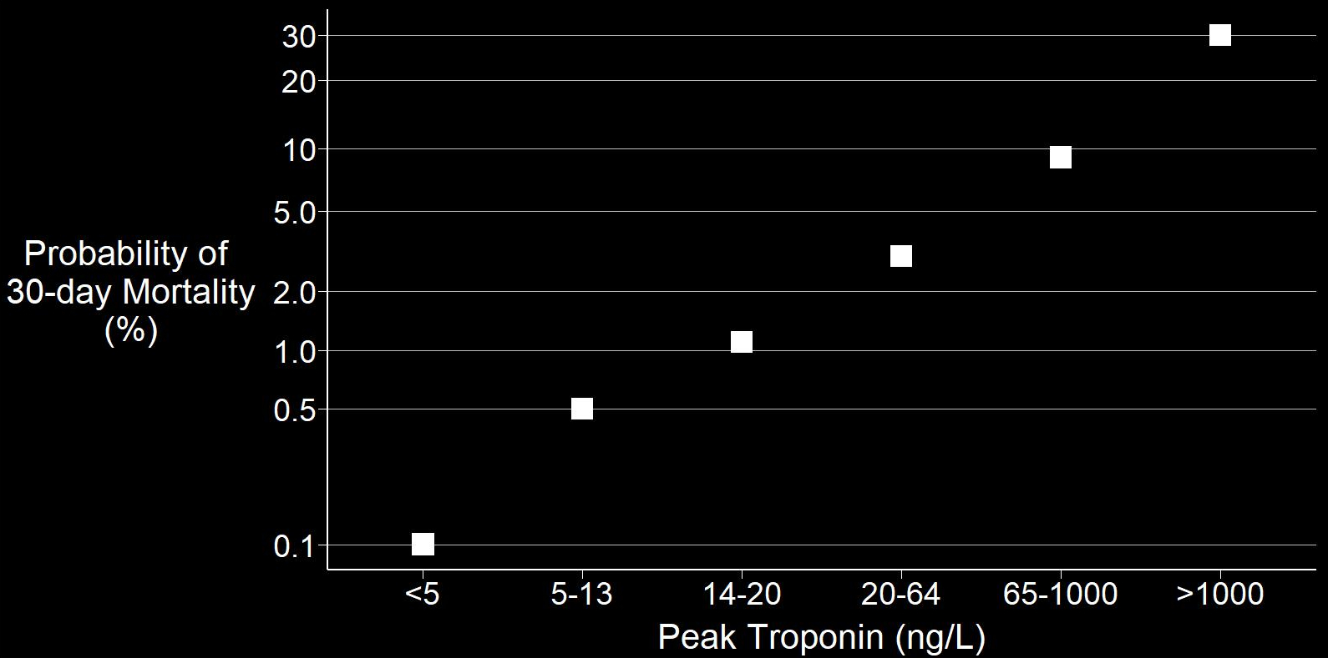
High-sensitivity Troponin T
Only 22% met Universal Definition of MI — but they still died
VISION, JAMA 2017
Notes:
Population attributable risks: Age – 40%, MINS – 34%, and sepsis – 30%. Mortality increase by squares: 2, 3, 5, 8, 15.

Slide 8
Post-Op Troponin & Long-term Death
Beattie, JACC 2017

Slide 9
Professional Society Guidance
Canadian Cardiovascular Society, 2017
  “Daily troponin measurements for 2-3 days in patients with moderate cardiovascular risk”
4th Universal Definition of MI, 2018
  “Postoperative troponin surveillance is recommended for high-risk individuals”
American Heart Association, 2021
  “High-risk individuals should have serial cTn measurements during the first 48 to 72 hours post-operatively”
European Society of Cardiology, 2022
  Patients with cardiovascular risk including age >65 years should have troponin assessed for medium- and high-risk surgery

Slide 10
Troponin Monitoring
Who: inpatient surgery and:
  Age >45 years and ≥1 risk cardiovascular risk factor
  Age >65 years
When
  Preoperatively
    18% elevated preoperatively, mostly chronically
  First 3 postoperative mornings while hospitalized
Response thresholds
  Fourth-generation troponin T: >0.03 ng/ml
  HS troponin T: increase >5 ng/L and postoperative >20 ng/L
  HS troponin I (Abbott): >60 ng/L
  HS troponin I (Siemens): >75 ng/L

Slide 11
Elevated Troponin?
Consult cardiology, medicine, hospitalists
  Only occasional patients need catheterization ± angioplasty
Aspirin (22% secondary reduction) ± statins or ACEIs
Heart rate and hypertension control
Lifestyle
  Smoking cessation
  Healthful diet
  Exercise
Anticoagulation: 28% hazard reduction

Slide 12
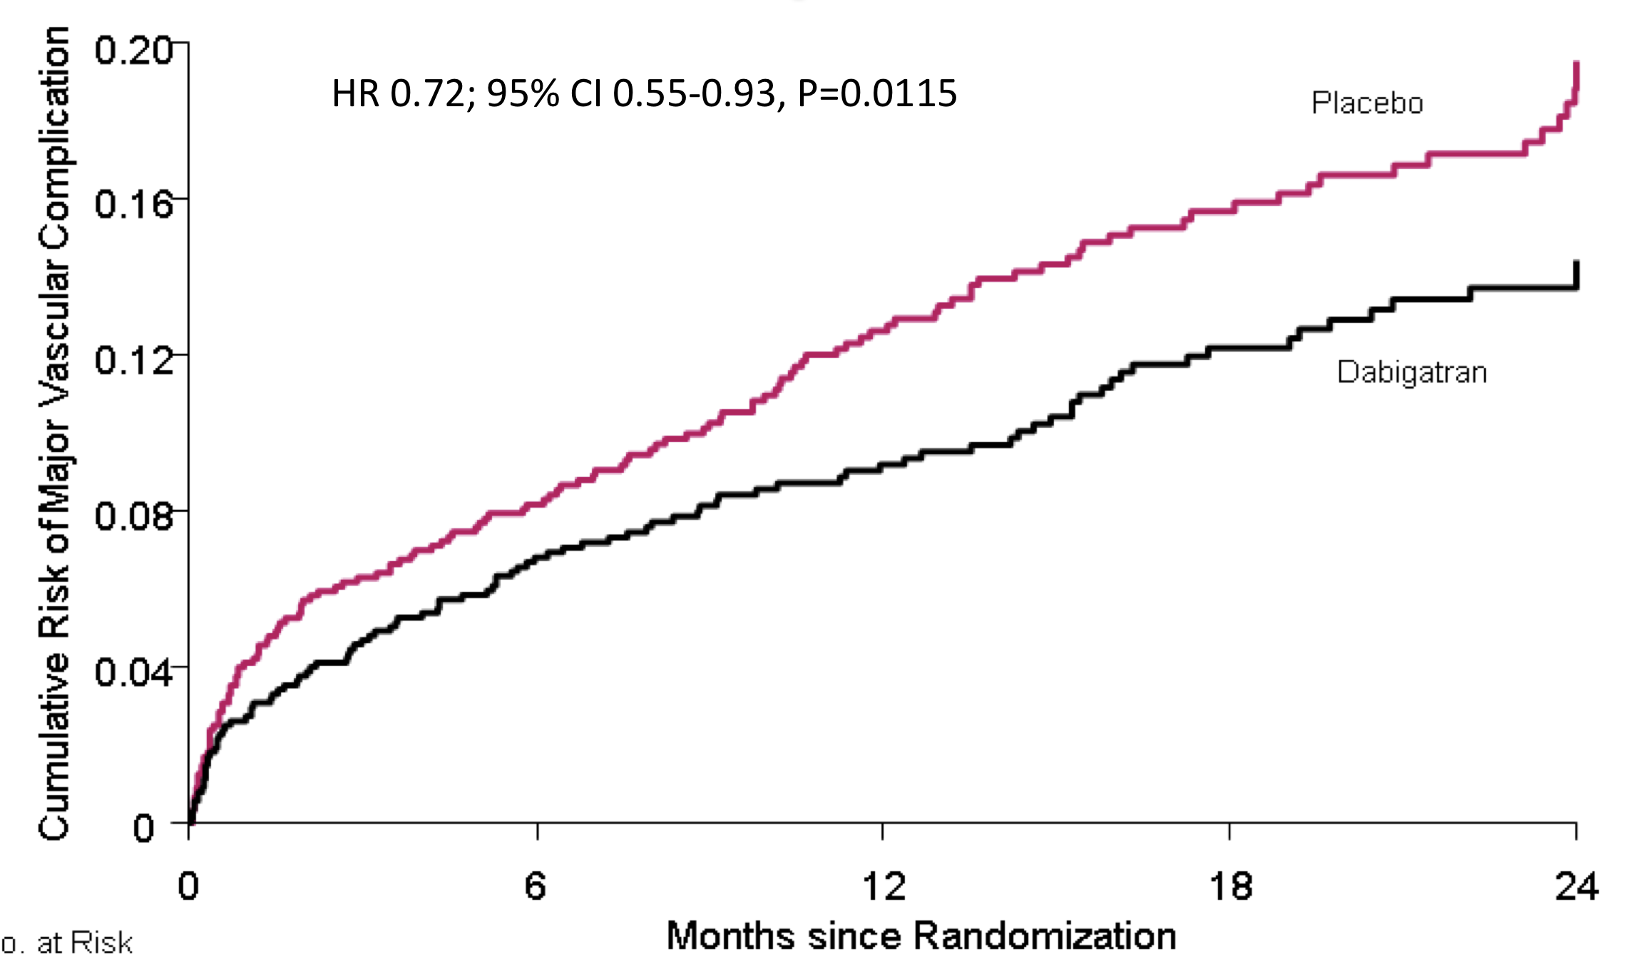
MANAGE Trial (n=1,754)
Adults with MINS
Dabigatran v. placebo for up to 2 years
Primary: major vascular complications
Hazard ratio 28%: NNT=24
No increase in major bleeding
Devereaux, MANAGE
Lancet 2018

Slide 13
Risk Prediction
Exercise tolerance
  Patient estimates are sensitive, but not specific
  Even formal cardiopulmonary exercise testing is not predictive
Stress echo and CT angiography
  Over-estimates risk
  Worsens clinical risk assessment
Revised Cardiac Risk Index
  Under-estimates risk of MI by 25%
  Assigns ≈50% patients to “intermediate risk”

Slide 14
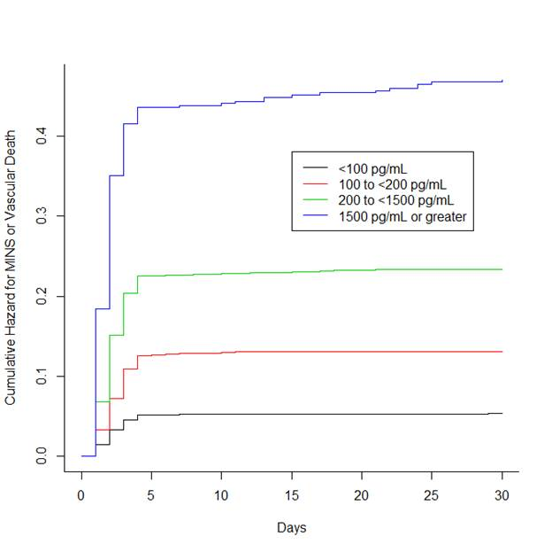
Preoperative NT-ProBNP & MINS
Vascular death
<1,500 pg/ml
<200-1,500 pg/ml
100-200 pg/ml
<100 pg/ml
Duceppe, Ann Int Med 2020
Days

Slide 15
B-type Natiuretic Protein
NT-proBNP is better than Revised Cardiac Risk Index
  Correctly identifies 16% more high-risk patients
  Correctly identifies 15% more low-risk patients
Rodseth, J Am Coll Card, 2014
BNP (ng/L) | MI or Death
<100 | 5%
>250 | 27%
NT-proBNP (ng/L) | MI or Death
<300 | 5%
901-3000 | 26%
>3000 | 40%
Optimal ng/mL threshold is BNP <92 or NT-proBNP <300

Slide 16
No Safe Prophylaxis for MI
POISE-1: Beta blockers
  Decrease myocardial infarctions by 30%
  Cause devastating strokes and death
ENIGMA-2
  Nitrous oxide has no effect on MI
POISE-2
  Aspirin does not reduce MI; life-threatening bleeding
    Except in patients with prior stents, in whom risk is halved
  Clonidine doesn’t reduce MI; bradycardia & hypotension
POISE-3 TXA
  Tranexamic acid reduces bleeding and transfusions, but not myocardial injury

Slide 17
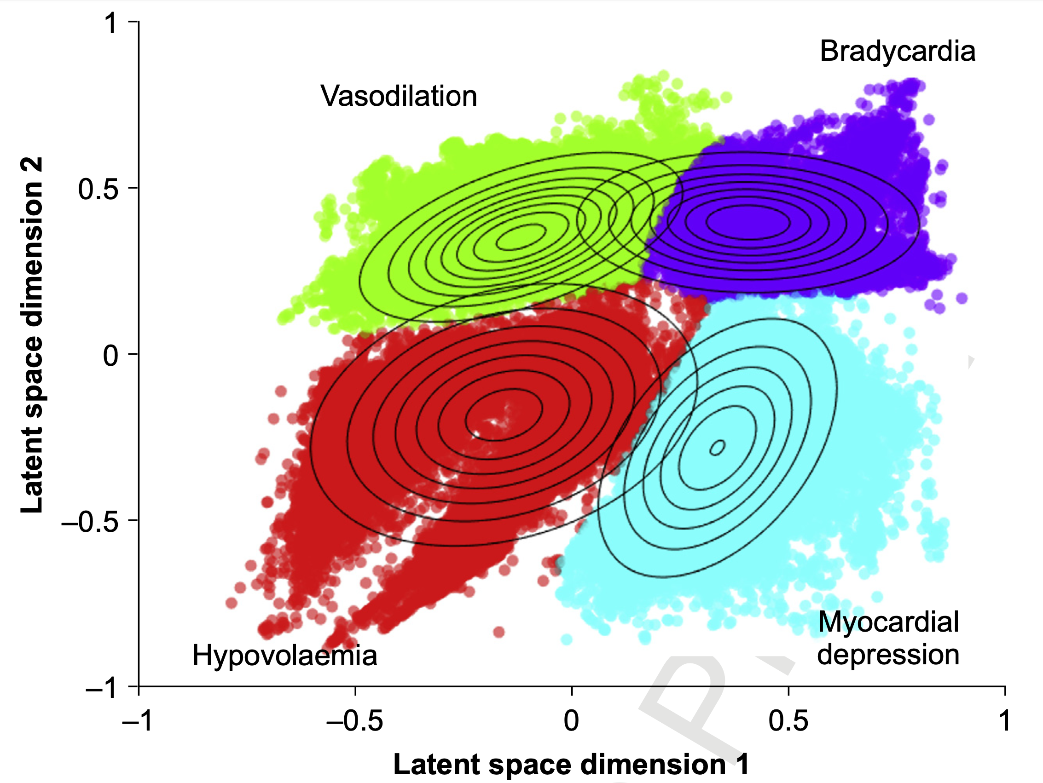
Causes of Hypotension
35%
22%
11%
32%
Jian, BJA 2025

Slide 18
Hypotension & Myocardial Injury
Adjusted for baseline risk
Results nearly identical for AKI
Salmasi, Anesthesiology 2017

Slide 19
Neutral Intraoperative BP Trials
Wanner (J Am Coll Card, 2021)
  ≈450 moderate-risk patients
POISE-3 blood pressure (Ann Int Med 2023)
  ≈7,500 moderate-high-risk patients
BP-CARES (J Am Coll Card, 2025)
  ≈1,500 moderate-high-risk patients
  Randomized to MAP >65 or 80 mmHg
IMPROVE-Multi (JAMA 2025)
  ≈1,100 moderate-high-risk patients
  Randomized to routine management v. target of mean nighttime MAP
PRETREAT
  3247 patients randomized to tight v. routine pressure management
MAP ≥65 mmHg appears safe even in high-risk patients
At some level, hypotension causes organ injury. Harm threshold is probably <60 mmHg
Trials with lower pressures are in progress.

Slide 20
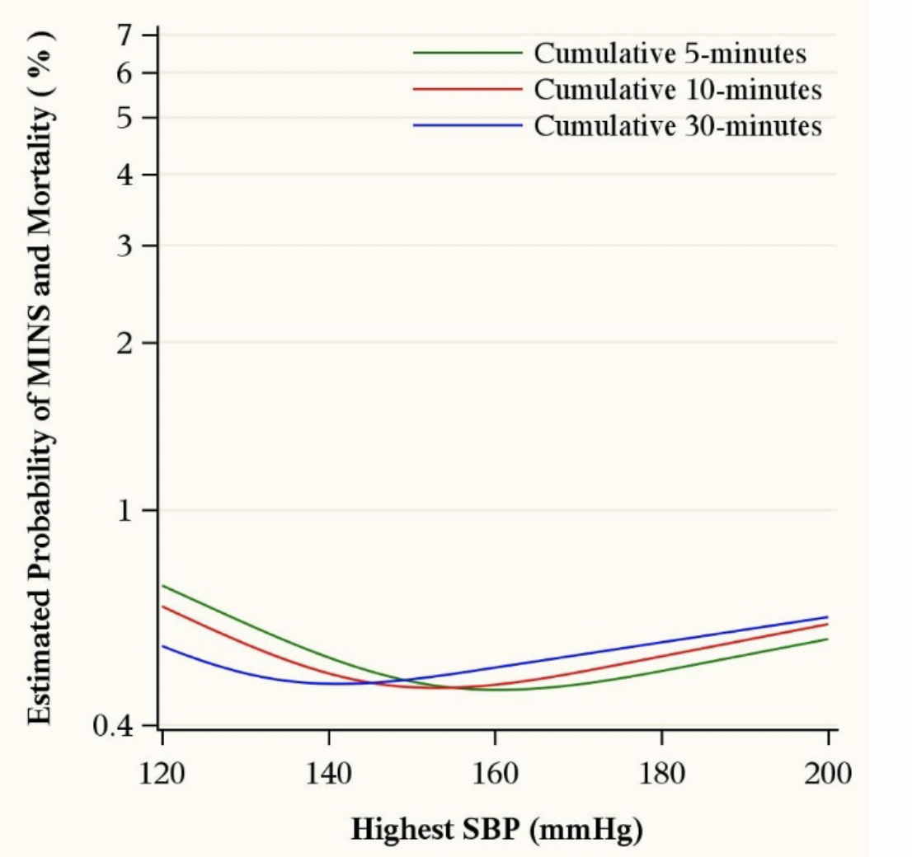
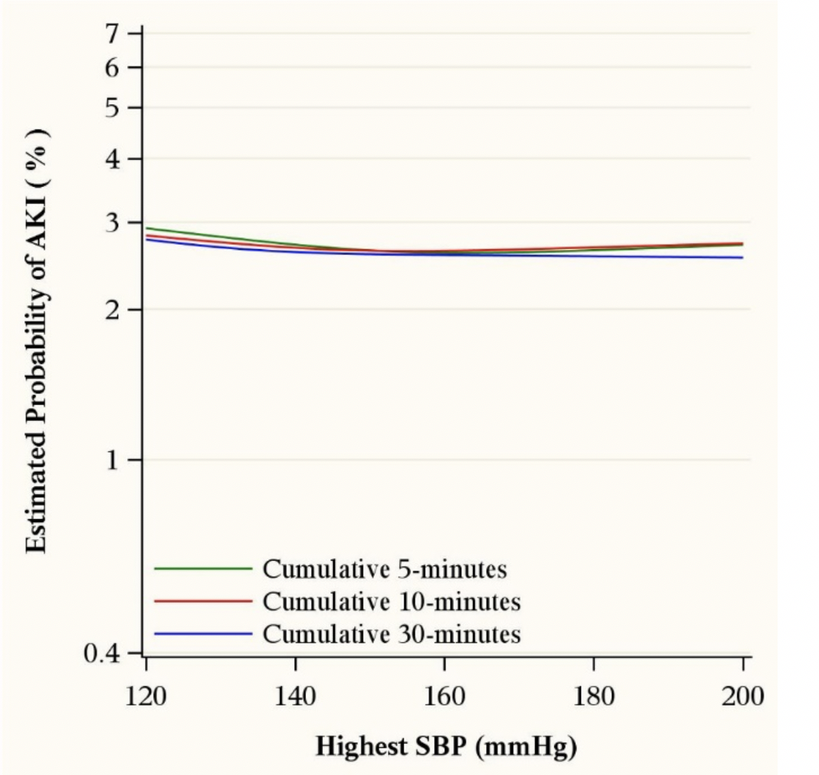
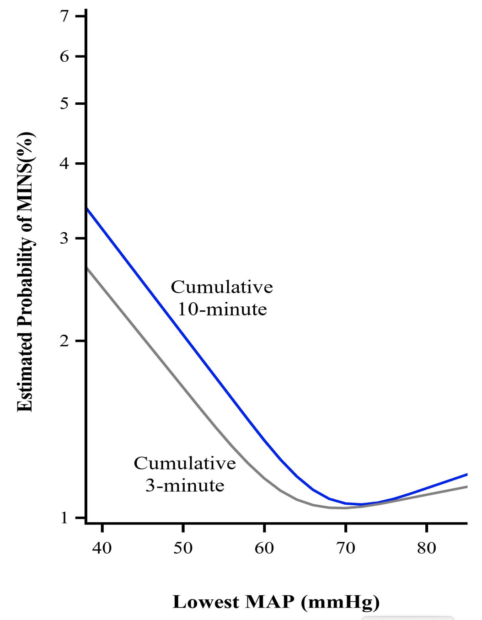
Intraop Hypertension Hardly Matters
Shimada, EJA 2022
Hypotension

Slide 21
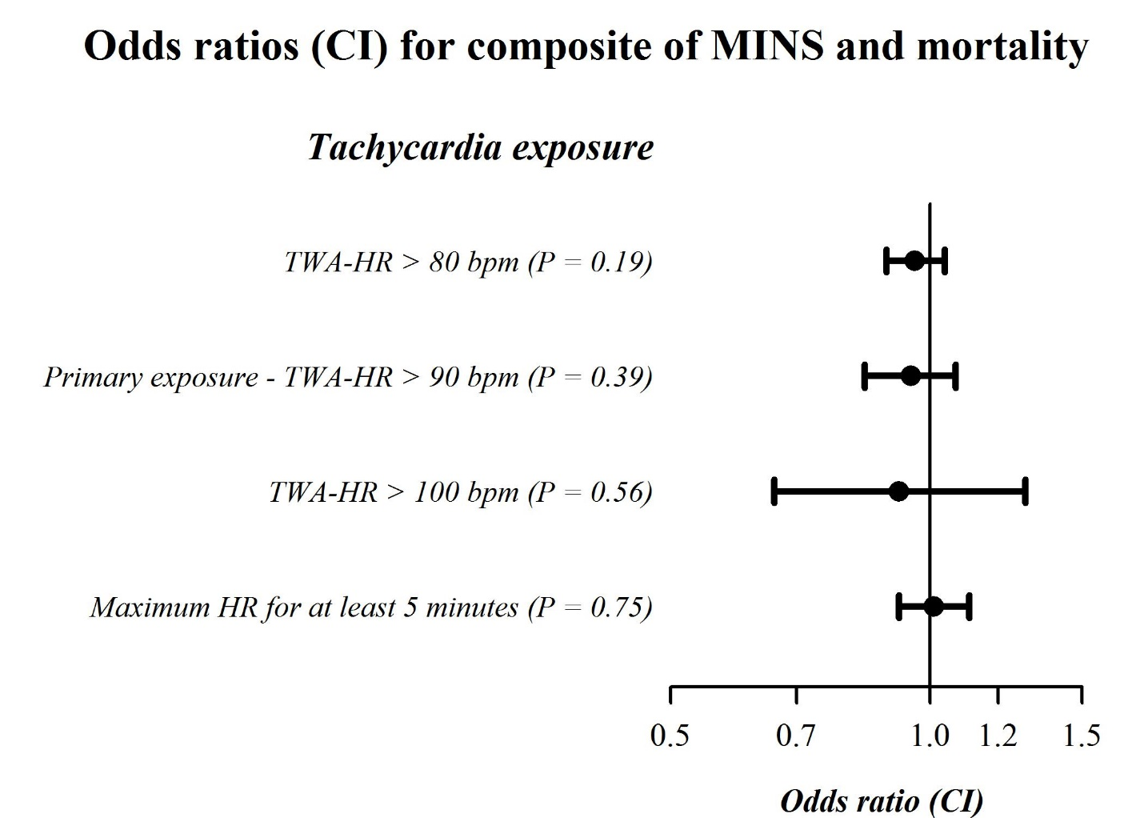
Intraop Tachycardia Hardly Matters
Ruetzler, EJA 2019
Abbott reports increased MINS & MI with heart rate >96 b/min; BJA 2016

Slide 22
High Risk on Surgical Wards
Heart attacks occur postoperatively
  94% within two days
  30% of deaths during initial hospitalization
Ward hypoxemia and hypotension
  Common, profound, and prolonged
  Cannot be reliably predicted

Slide 23
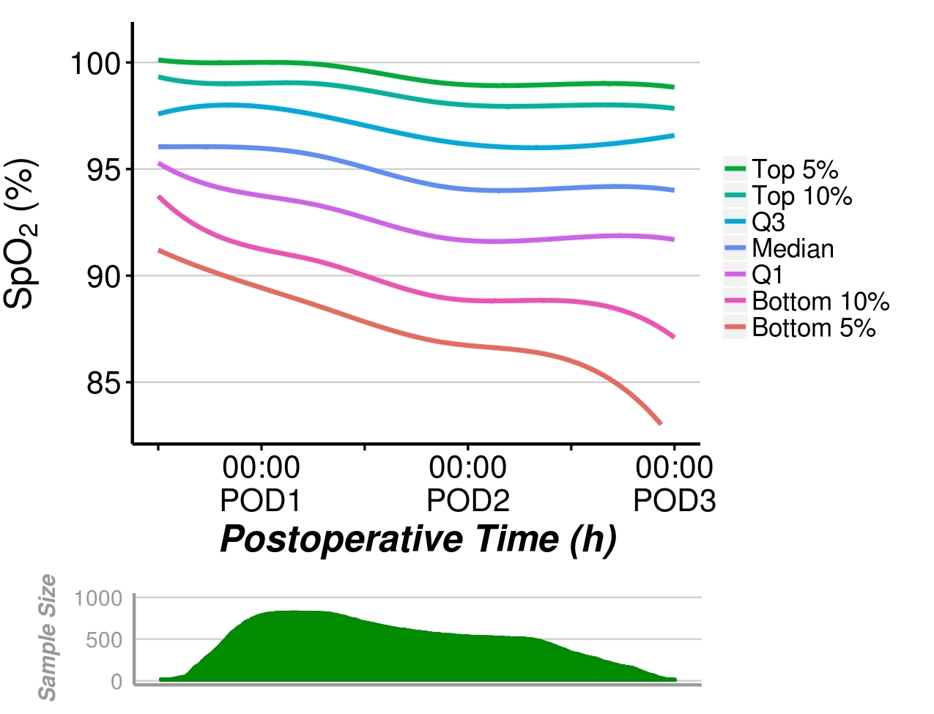
Blinded Saturation Over Time
Nurses missed 90% of patients who had 1 continuous hour of saturation <90%
Sun, A&A 2015

Slide 24
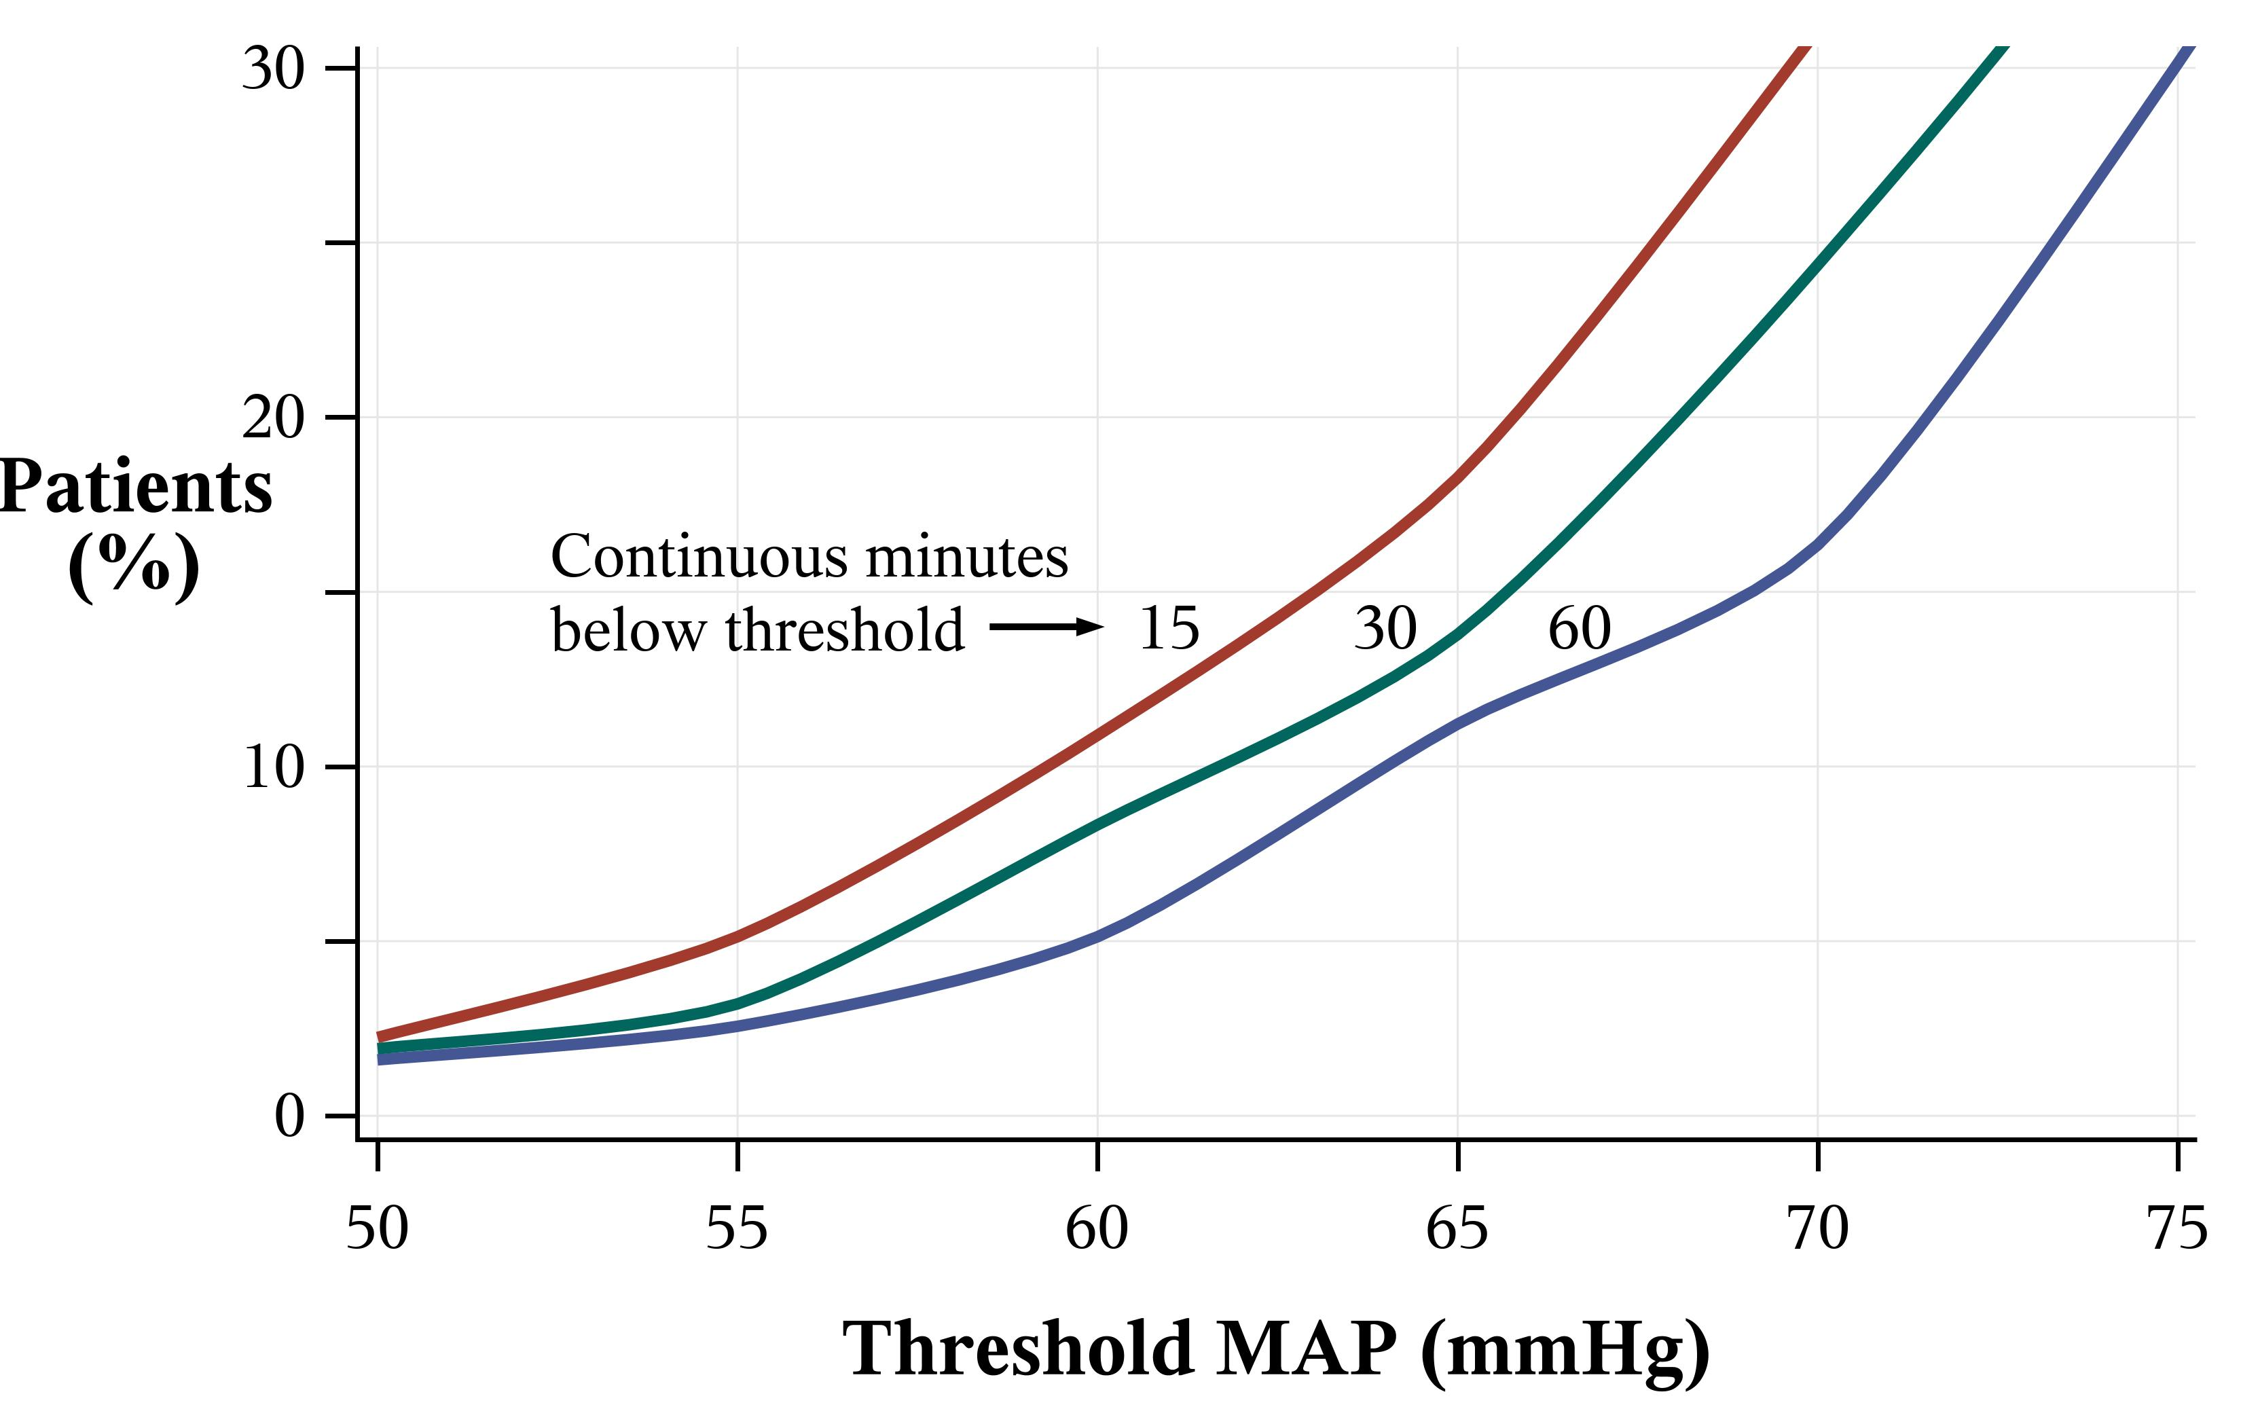
Continuous Ward Hypotension (n=312)
Routine vital signs missed half the patients with MAP <65 mmHg for 15 minutes
Turan, Anesthesiology 2019

Slide 25
Postop Hypotension Matters
Adjusted for baseline risk and hypotension in previous periods
From Sessler Anesthesiology, 2018
Similar results from Liem et al, Anesthesiology 2020

Slide 26
Summary
Myocardial injury is common, deadly, and mostly silent
Monitor troponin
  Inpatients >45 years at risk, & all inpatients >65 years
  Preoperatively and first two postoperative days while hospitalized
Risk stratification
  RCRI, NT-Pro-BNP, and preoperative troponin all help
No known safe prophylaxis
Avoid prolonged intraoperative & postoperative hypotension
  Probably prudent to keep MAP >60 mmHg

Slide 27
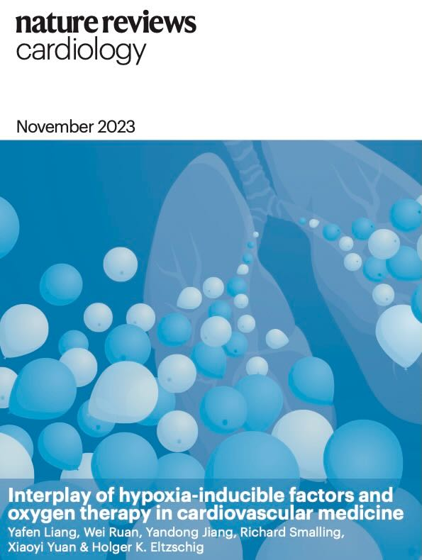
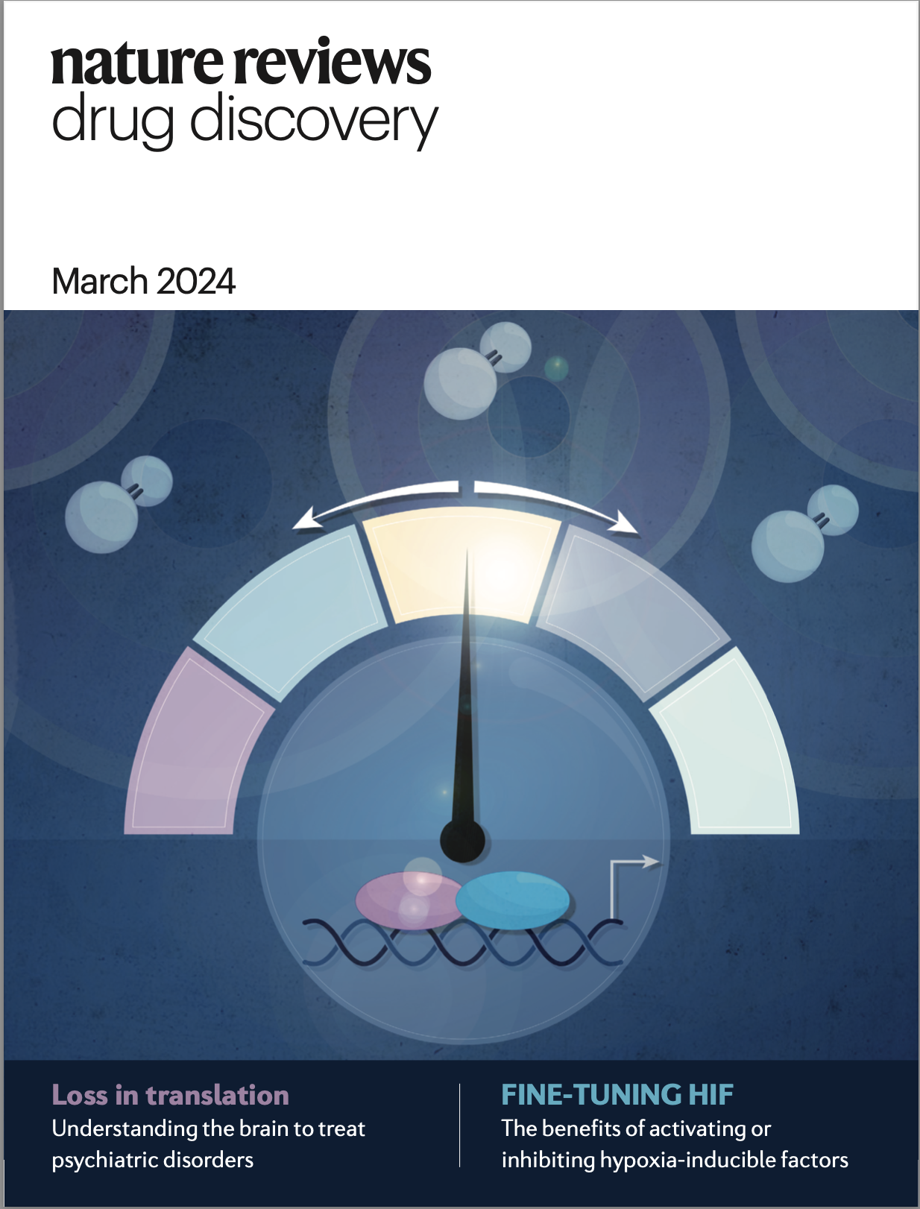
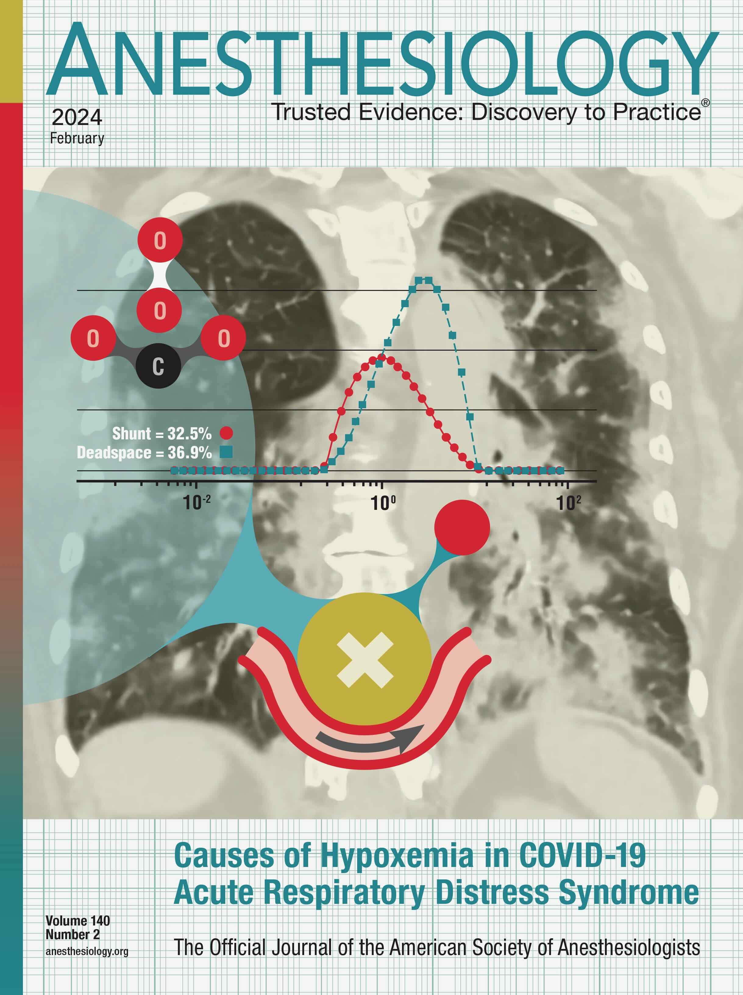
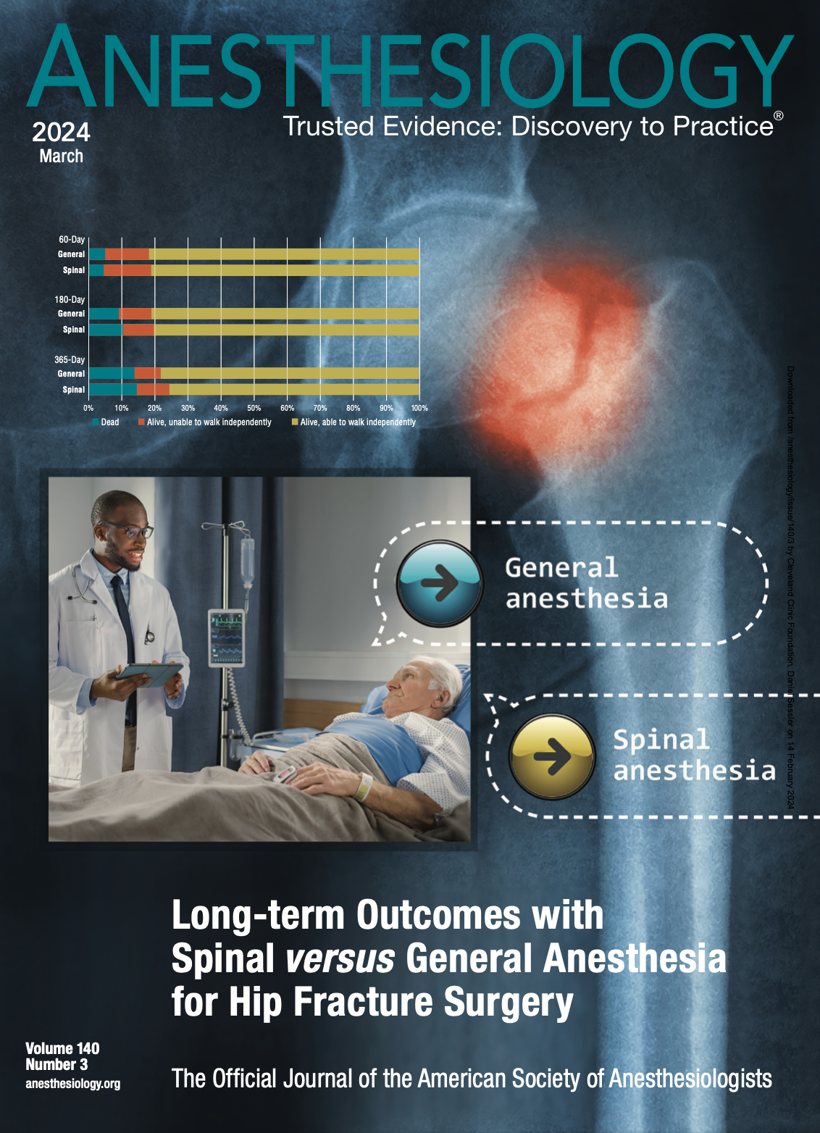
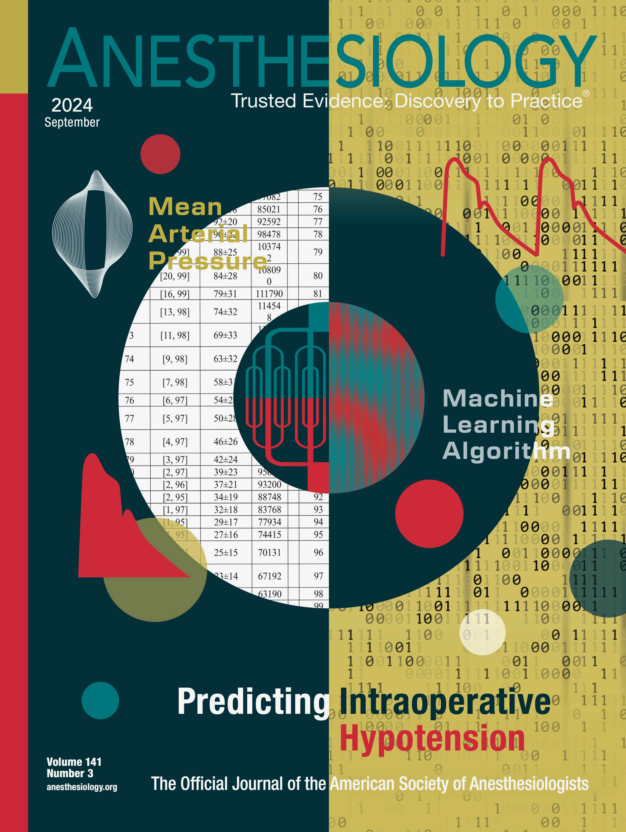
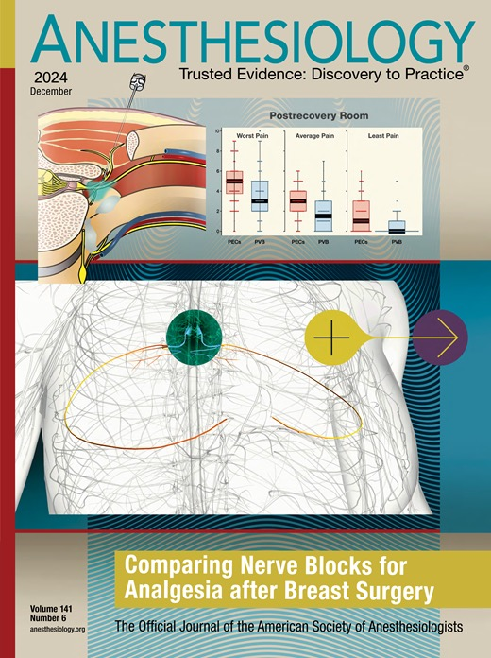
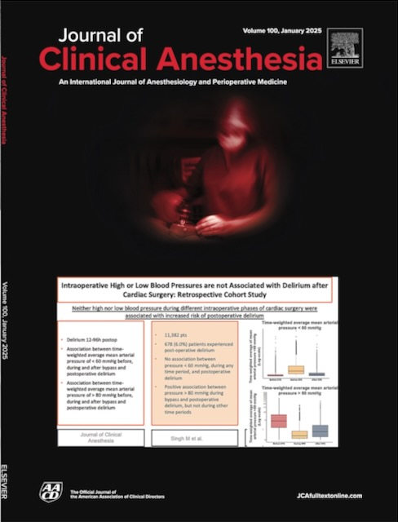
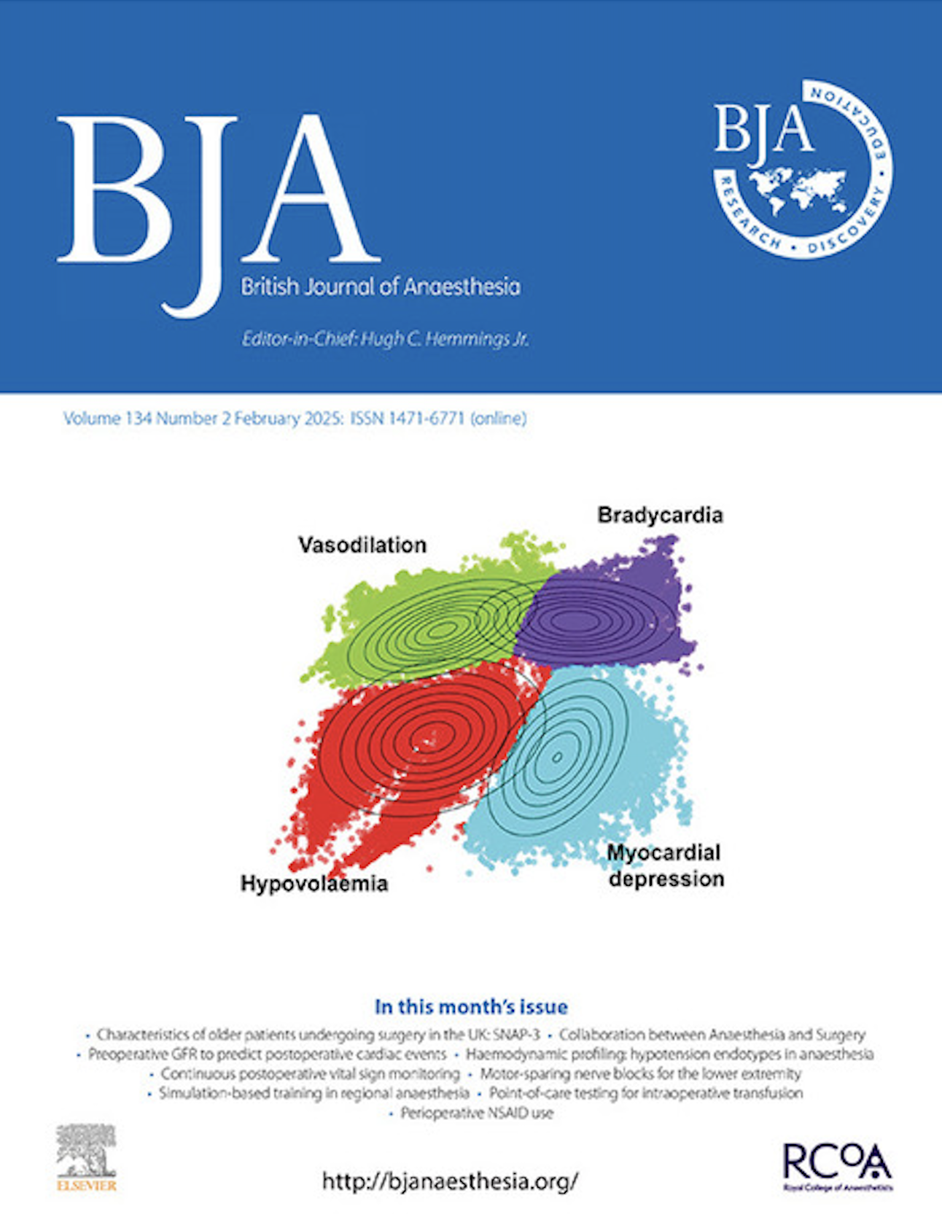
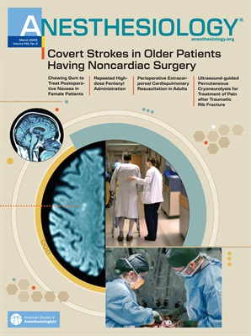
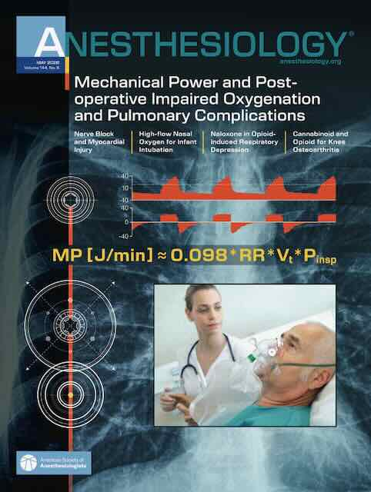
And that’s all folks…
Selected OUTCOMES RESEARCH covers since 2023

Slide 28
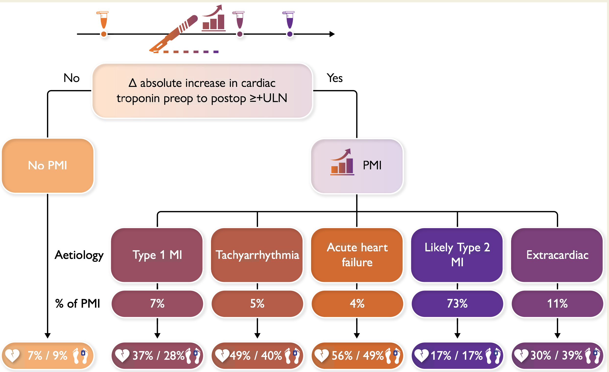
Post-Op Troponin & Short-term Death
Peulach, Eur Heart J 2023
N=7,754
Mostly type 2. Doubles mortality
1-year mortality

