Slide 1

OUTCOMES RESEARCH Consortium
Providing the evidence for evidence-based medicine©

Slide 2
Malignant Hyperthermia
Daniel I. Sessler, M.D.
Vice-president for Clinical and Outcomes Research
Professor of Anesthesiology
UTHealth, Houston
No relevant conflicts
www.or.org

Slide 3
History
Described in humans by Denborough, 1961
Porcine model recognized by Nelson in 1966
  “Porcine stress syndrome” reported in 1953
Caffeine/halothane contracture test
  Developed by Kalow and Britt in 1970
Prevention and treatment by dantrolene
  Recognized by Harrison in 1975

Slide 4
Ryanodine Receptor 1 Genetics
Missense mutation of ryanodine receptor
  Gain-of-function
  Increases calcium release from sarcoplasmic reticulum
CACNA1S variants
  Suppresses voltage-gated calcium regulation
  Increases calcium flux through ryanodine receptor
STAC3 receptor mutations
  Increases calcium storage in sarcoplasmic reticulum
Genetic diagnosis: becoming clinically useful

Slide 5
Ryanodine Receptor Pathology

Slide 6
Epidemiology
Susceptibility
  Mutation of the ryanodine receptor (RYR1) on chromosome 19
  Autosomal dominant: variable penetrance & expressivity
  ≈1 in 1,000 patients is genetically susceptible
Incidence
  ≈2 in 100,000 adult general anesthetics
  Most common in children, but rare at extremes of age
  3 X more common in men
Susceptible patients often fail to trigger
Associated with minor myopathies
  Central core disease, Duchenne’s, King-Denborough, myotonia congenita

Slide 7
Triggers in Humans
Succinylcholine
Volatile anesthetics
  Halothane > isoflurane or enflurane
  Desflurane and sevoflurane
Stress, heat, exercise?
  Alpha (but not beta) agonists trigger swine
  Causes rare crises in patients not exposed to triggers
Psychotropics?
  Neuroleptic malignant syndrome, but not MH
Very rarely presents without exposure to triggering drugs

Slide 8
Clinical Presentation of Crisis
50% had ≥2 previous uneventful anesthetics
  <10% have family history of MH
  Often occurs an hour or more into anesthesia
  Rarely presents within an hour after anesthesia
Most important signs
  Tachycardia (all)
  Hypercarbia (all)
  Rapid temperature increase / hyperthermia (≈70%)
  Generalized muscular rigidity (≈40%)
  Lactic acidosis (≈25%)
Temp monitoring reduces mortality 10-fold!
Larach, et al. A&A, 2010 & 2014

Slide 9
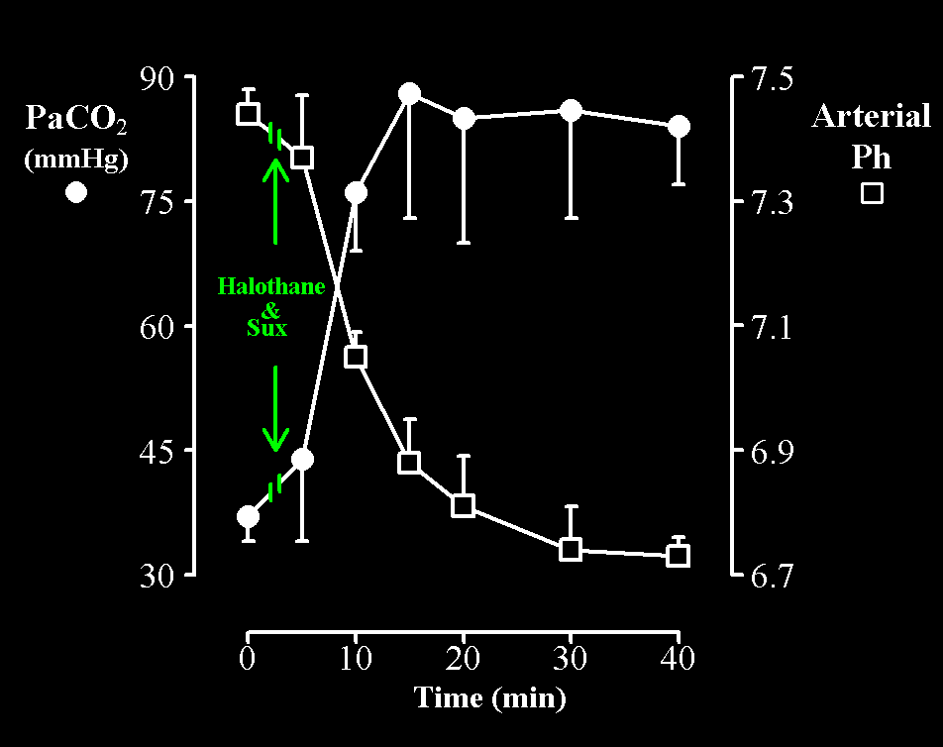
Metabolic & Respiratory Acidosis in Swine

Slide 10
Expected Consequences
Pulmonary
  Tachypnea (from increased PCO₂ and VO₂)
  Arterial oxygenation remains normal
Myocardium normal
  Norepinephrine increases 20-fold
  Hypertension, tachycardia, ventricular arrhythmias
Renal: oliguria from myoglobinuria
Hepatic: hyperkalemia from glycogen use
Disseminated intravascular coagulation

Slide 11
Treatment
1) Discontinue triggering drugs
  ≈Rare mortality if anesthesia stopped within 10 min
  ≈100% mortality after 2 hours rigid crisis
2) Hyperventilate with 100% oxygen
3) Dantrolene 2.5 mg/kg iv
  Repeat every 30 min until symptoms resolve (≤ 10 mg/kg)
  Continue 1 mg/kg iv every 6 h for 24 h (20% recrudescence)
  Mortality rare with rapid dantrolene treatment
Chilled crystalloid, ≈30 ml/kg
Do not change anesthesia machine, soda lime
  Consider activated charcoal filters
For Help: call 800-MH-HYPER
(Outside US: +1-607674-7900

Slide 12
Dantrolene
A diphenylhydantoin
  Half-life 4-8 hours
  Metabolized to 5-hydroxydantrolene which also is active
  Must be dissolved in sterile water, takes 1.5 minutes to dissolve
Mechanism of action
  Decreases calcium-induced calcium release from SR
Primary antiarrhythmic
Toxicity
  Occasional profound muscle weakness
  Synergistic toxicity with diltiazem

Slide 13
Active Cooling Generally a Low Priority
Chilled saline ≈30 ml/kg is most effective practical and safe cooling method

Slide 14
Caffeine/Halothane Test
Available in just a few North American centers
Requires ≈4 g fresh muscle
  Femoral and lateral femoral cutaneous nerve block
  Children >2 yrs, unless other myopathies suspected
North American protocol
  > ≈0.5 g contracture after 3% halothane
  ≥ 0.2 g contracture with 2 mM caffeine
  ≥ 1 g contracture with 1 mM caffeine and 1% halothane
Only widely-accepted test
  Sensitive, not specific

Slide 15
Monitoring During Crisis
Arterial blood gases
  Ventilate to reduce respiratory acidosis (i.e., 15 L/min)
  Bicarbonate if respiratory acidosis controlled
Urine for myoglobin
  Give fluids and diuretics to maintain renal function
Serum potassium
  Initially high, then low
  Treatment usually not required
Plasma [CK] correlates with severity of crisis
  Sample every 6 h for 24 h

Slide 16
Safe Elective Anesthesia
Premedication to decrease stress
Activated charcoal filter on anesthesia machine
Any regional technique
  All local anesthetics are safe
Balanced general anesthesia
  Propofol, opioids, nitrous oxide
  Non-depolarizing muscle relaxants
  Barbiturates, benzodiazepines, hypnotics
  Ketamine, etomidate
Allow mild hypothermia

Slide 17
Masseter Muscle Rigidity
Teeth clenched: mouth cannot be opened
“Stiffness” ≠ spasm
  ≈1% of children given halothane/succinylcholine
  2.8% during strabismus repair with halothane/sux
  Rare in children not given succinylcholine
  Rare in adults (even with succinylcholine)
Etiology unknown
  Extreme fasiculation?
  50% of patients with spasm susceptible to MH

Slide 18
Management of Masseter Spasm
Don't give more succinylcholine!
  Ventilate using mask
Discontinue triggering drugs
Monitoring
  Arterial blood gas, end-tidal CO₂
  Core temperature
  Urine for myoglobin, creatine kinase
CK > 20,000 = MH or myopathy

Slide 19
Conundrum
Cancel case?
Keep patient in hospital?
  Usually, but not absolutely required
  Monitor for several hours in PACU
Refer for Biopsy?
  Yes

Slide 20
Summary
Triggers
  Volatile anesthetics and succinylcholine
Presentation
  Tachycardia (all)
  Respiratory acidosis (all)
  Rapid increase in Temperature or hyperthermia (≈70%)
  Generalized muscular rigidity (40%)
  Lactic acidosis (25%)
Treatment
  1) Discontinue triggering drugs
  2) Hyperventilate
  3) Dantrolene 2.5 mg/kg iv PRN

Slide 21
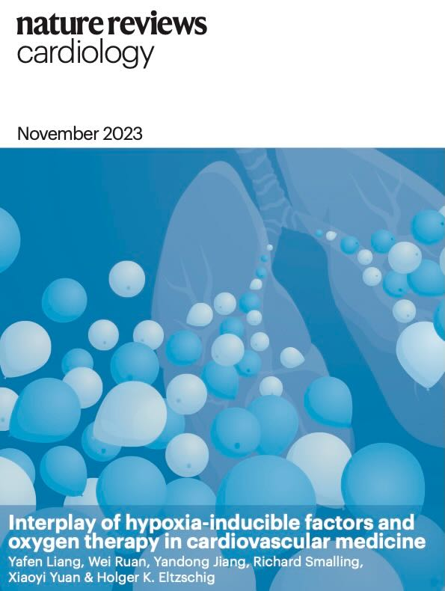
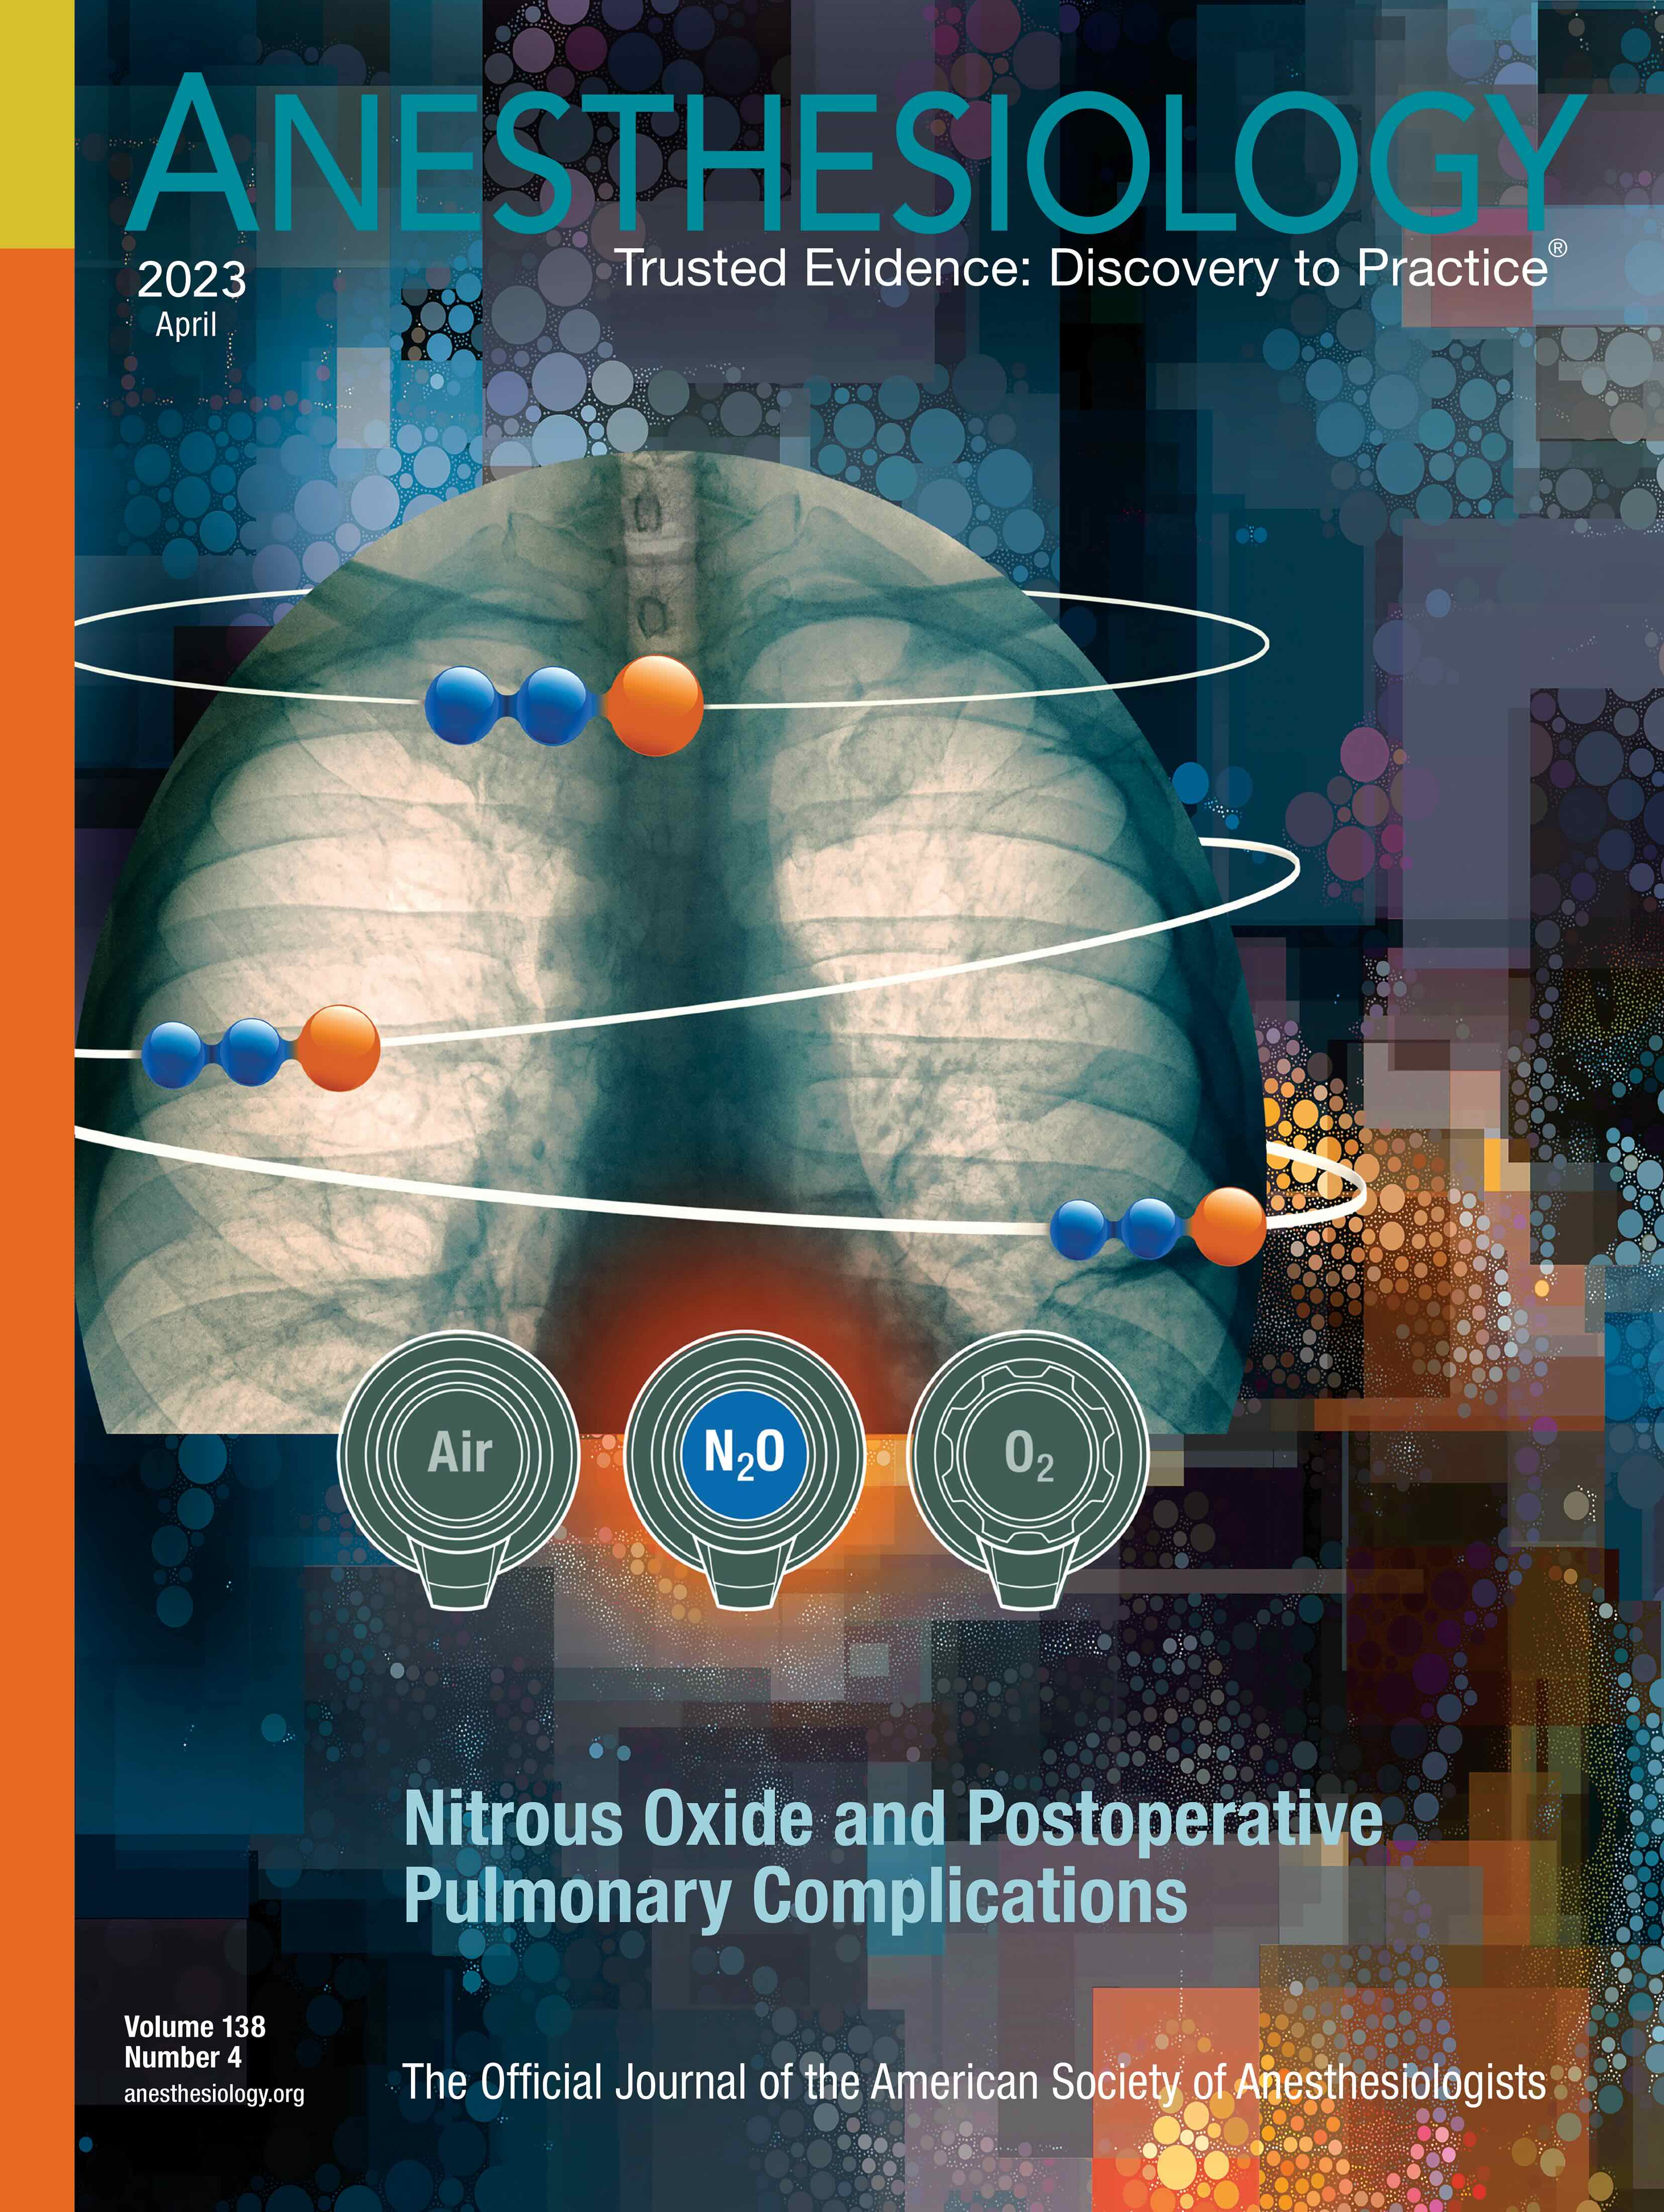
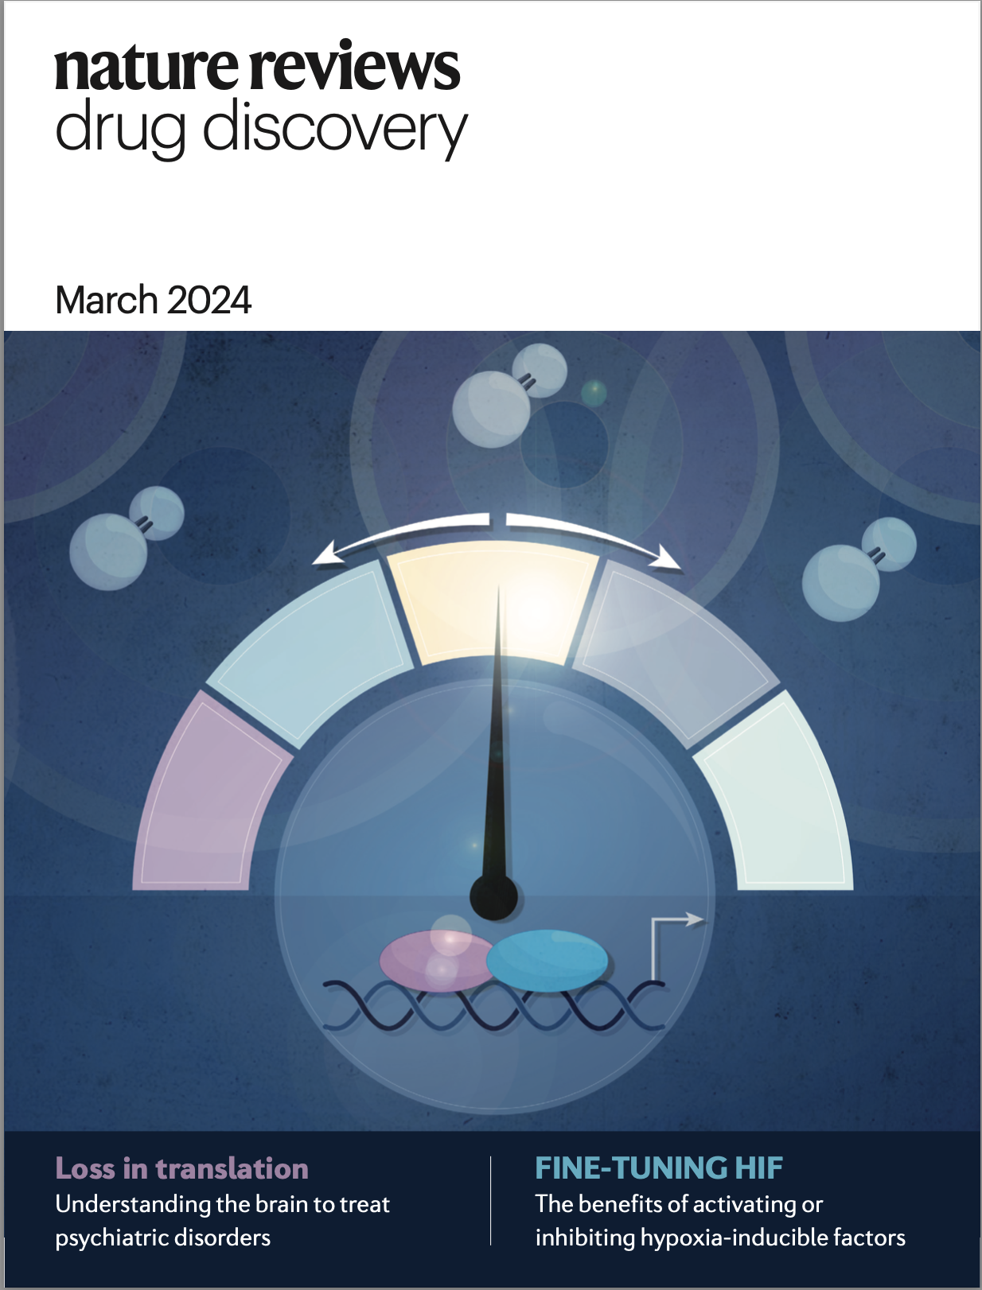
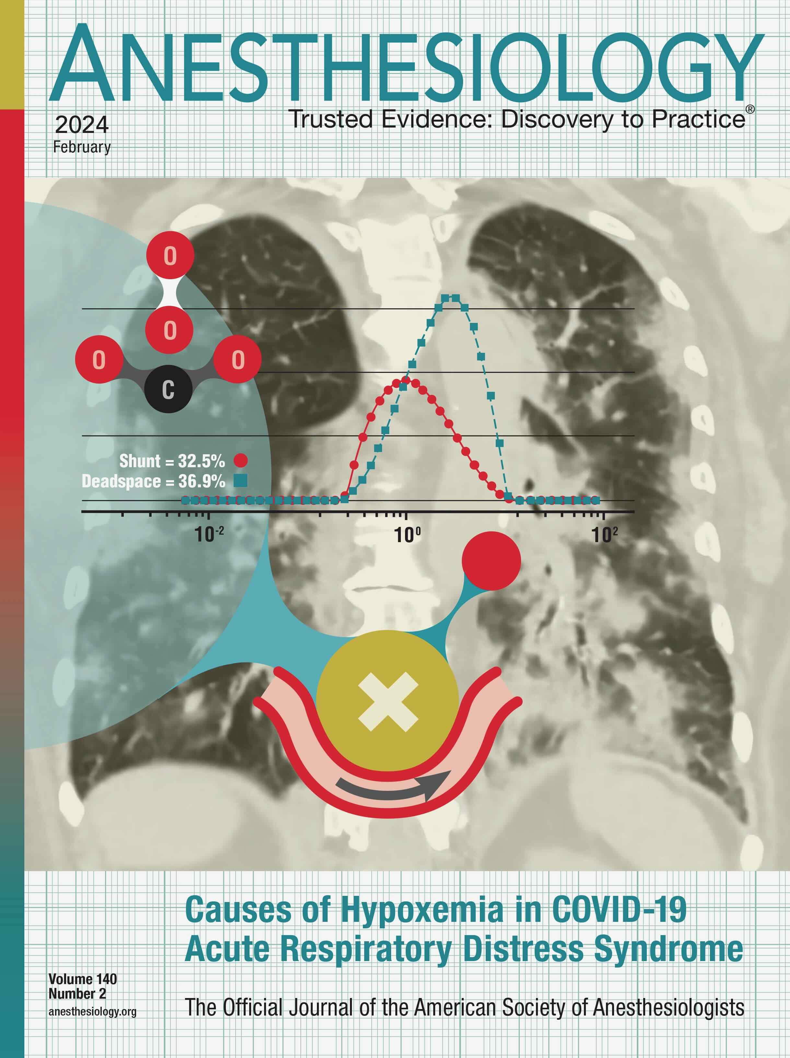
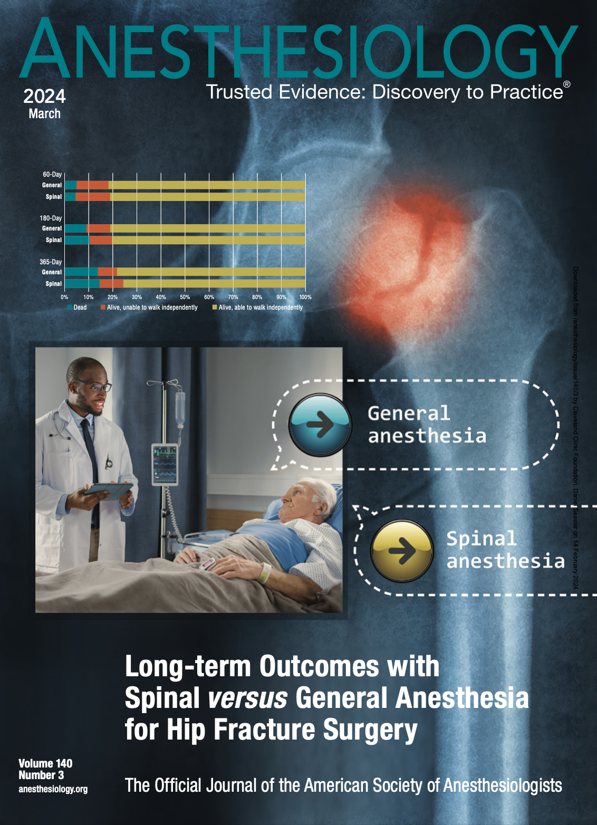

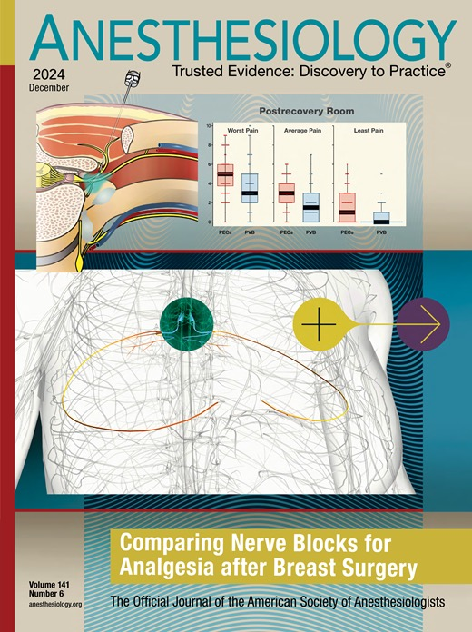
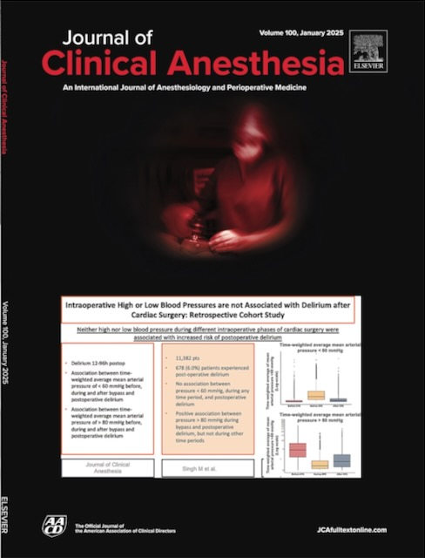
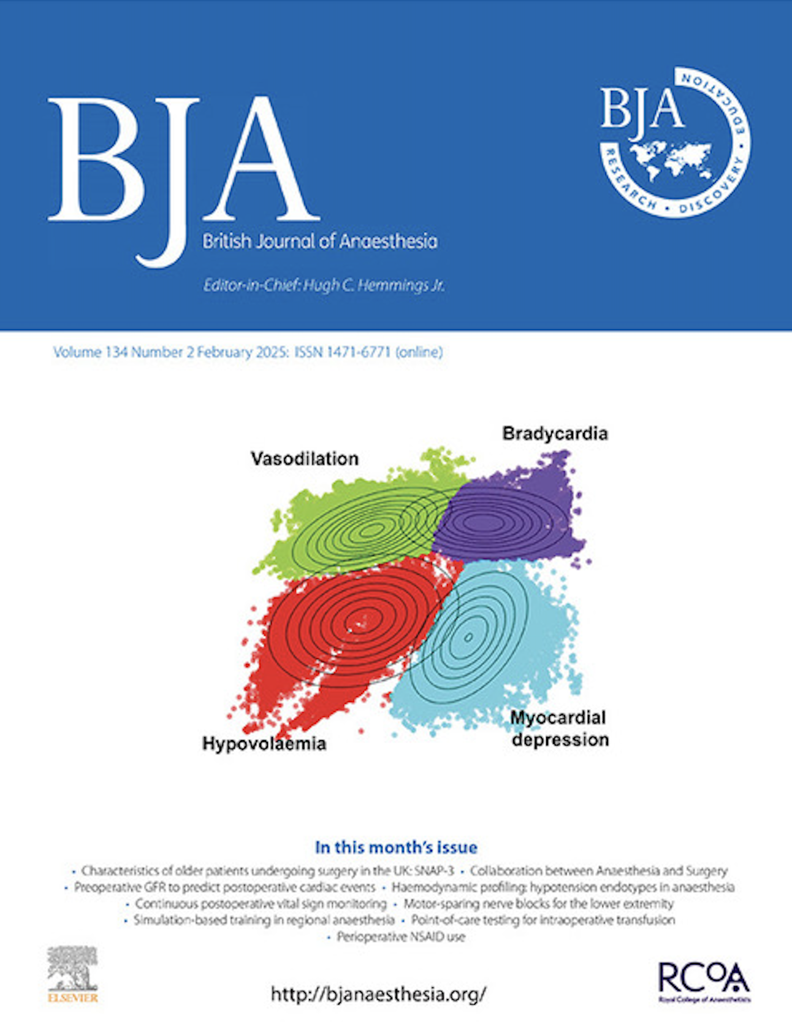
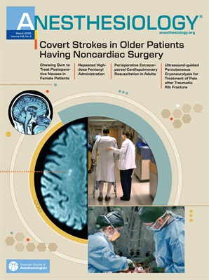
And that’s all folks…
Selected OUTCOMES RESEARCH covers since 2023

