Slide 1

OUTCOMES RESEARCH Consortium
Providing the evidence for evidence-based medicine©

Slide 2
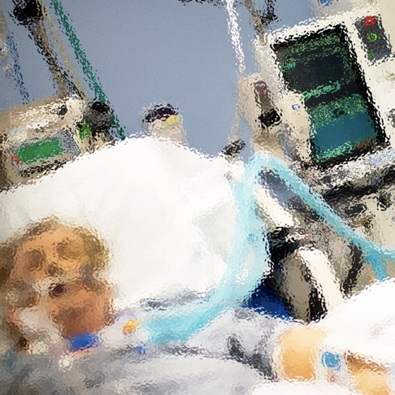
Postoperative Delirium
Daniel I. Sessler, M.D.
Vice-president for Clinical Research
Professor of Anesthesiology
UTHealth, Houston
No relevant conflicts
www.OR.org DS@OR.org

Slide 3
DSM‐V Criteria for Delirium
An acute disturbance of attention and cognition that occurs after surgery, characterized by a sudden onset and fluctuating course of inattention, disorientation, memory deficit, and impaired psychomotor activity.
My summary: Acute short-lived disturbances in consciousness or thinking

Slide 4
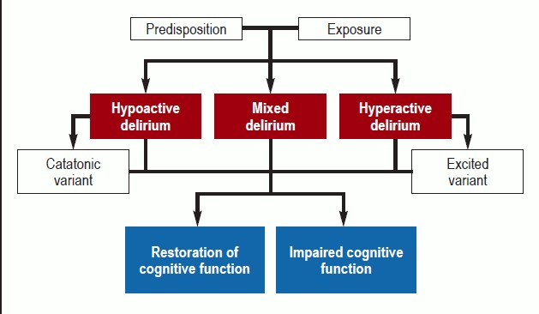
Delirium Sub-types
90%

Slide 5
Diagnosis
CAM
CAM-ICU
3D-CAM
  Disturbance of consciousness
  Inattention
  Disorganization of thinking
  Changed level of arousal
  Each component is scored on a 3-point scale, total score of ≥4 is considered positive for delirium

Slide 6
Delirium Incidence and Associations
Incidence, generally lower in recent reports
Cardiac surgery: 12-27%
General surgery: 4-12%
Orthopedic surgery: 15-30% (highest for hip fractures)
Associations — probably non-causal
Long-term cognitive impairment
Prolonged hospitalization
Frailty and falling risk
Readmission and mortality

Slide 7
Non-modifiable Risk Factors
Risk factor | Odds ratio
Age >70 years | 3.3
Baseline cognitive impairment | 4.2
Medical comorbidities (COPD, DM, HTN) | 2.5
Alcohol abuse | 3.3
Type of surgery (especially cardiac) | 2-4
Occult strokes | 2
Cerebral small-vessel disease | 2
All are also risk factors for prolonged hospitalization, complications, and death

Slide 8
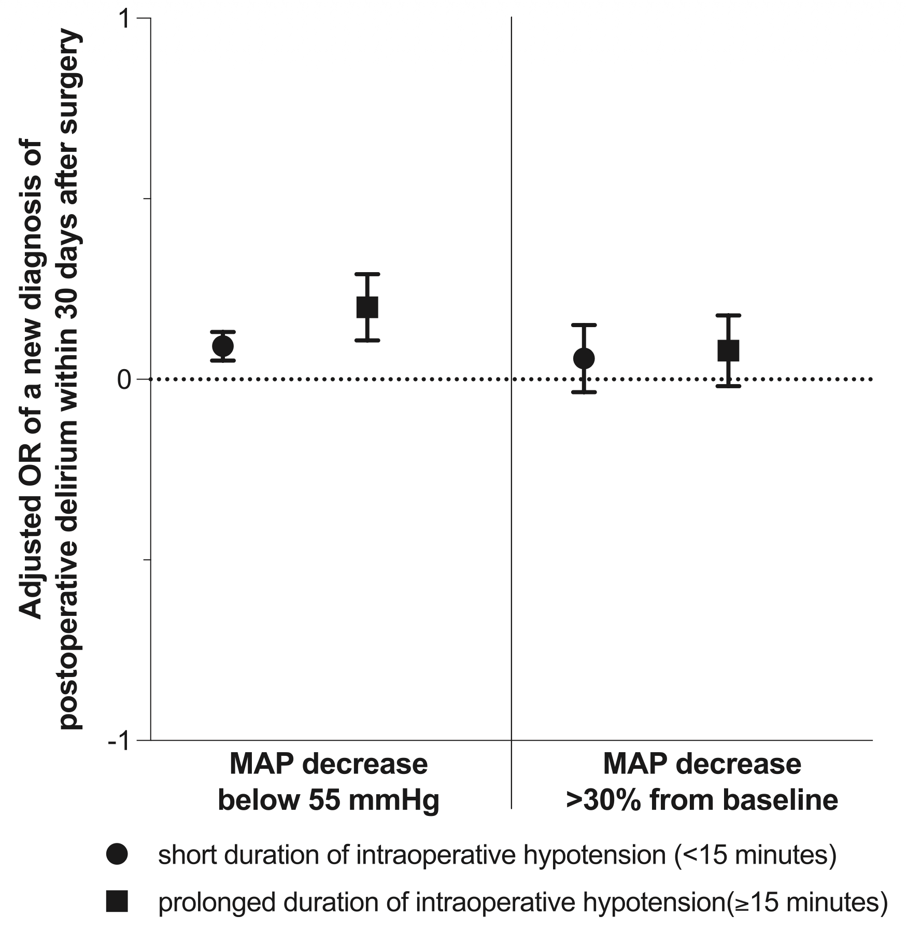
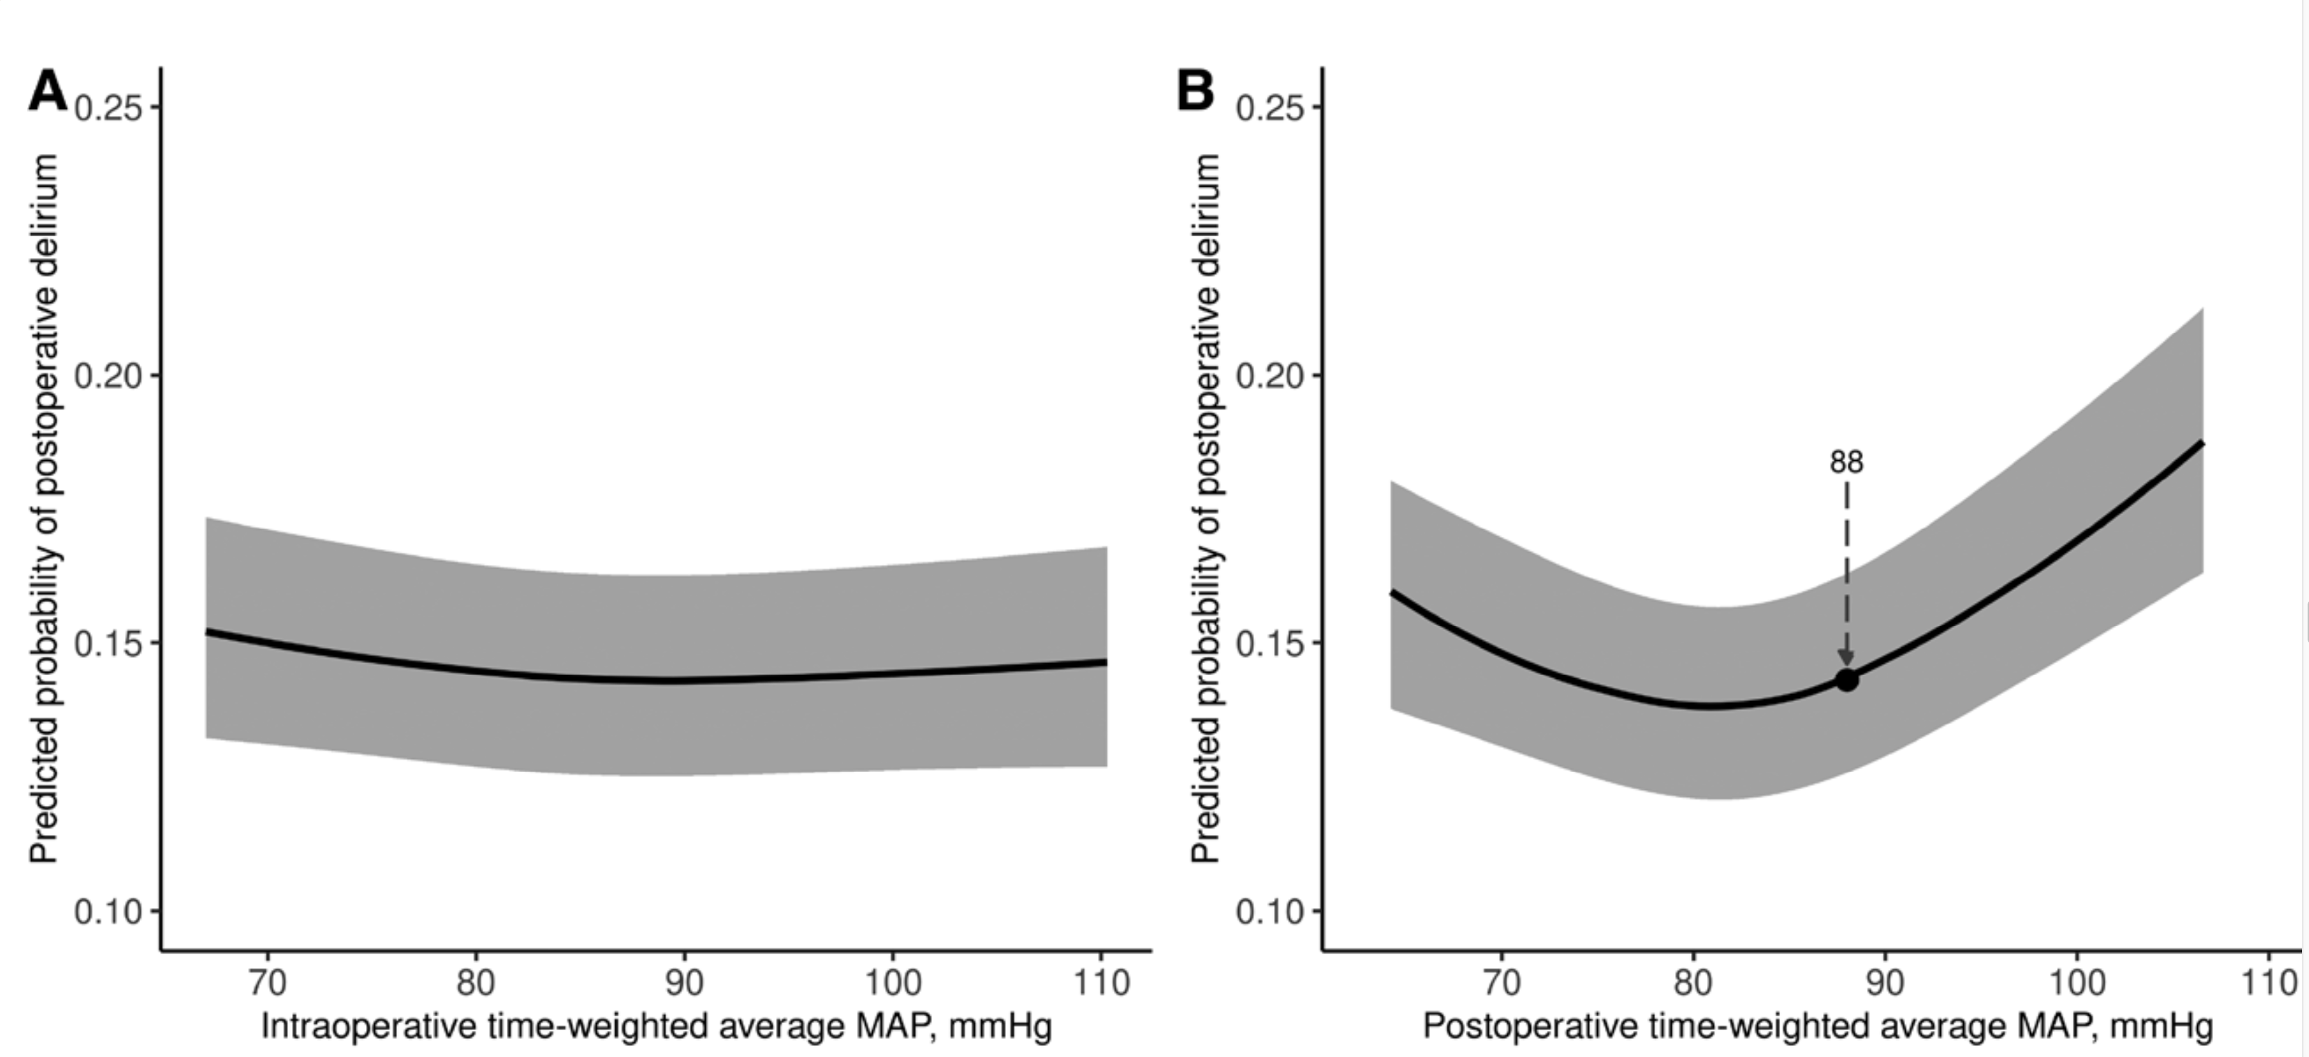
Intraop & Postop Hypotension
Rössler, Anesthesiology 2025
Wachtendorf, A&A 2022

Slide 9
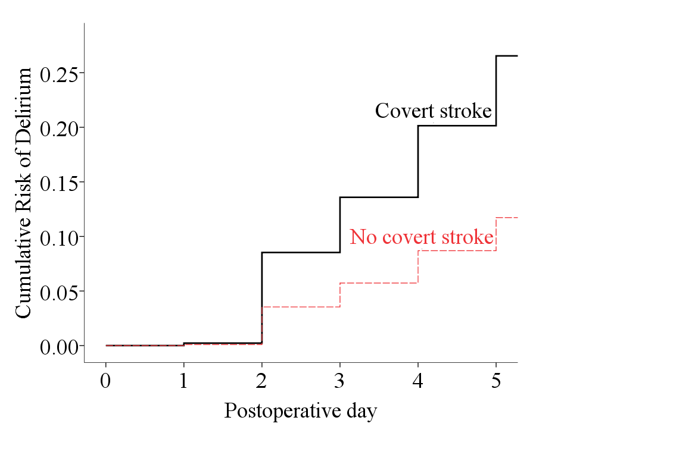
Covert Strokes & Vascular Disease
Prospective cohort,
934 patients, mostly neurosurgical, all with MRIs
Hazard for delirium with strokes: 2.5 (95% CI, 1.6-3.9)
Similar results from NeuroVISION, Lancet 2019. 1114 patients, 78 covert strokes, hazard for delirium 2.2
Preoperative cerebral small-vessel disease also doubles delirium risk (unpublished)
Cui, Anesthesiology 2025

Slide 10
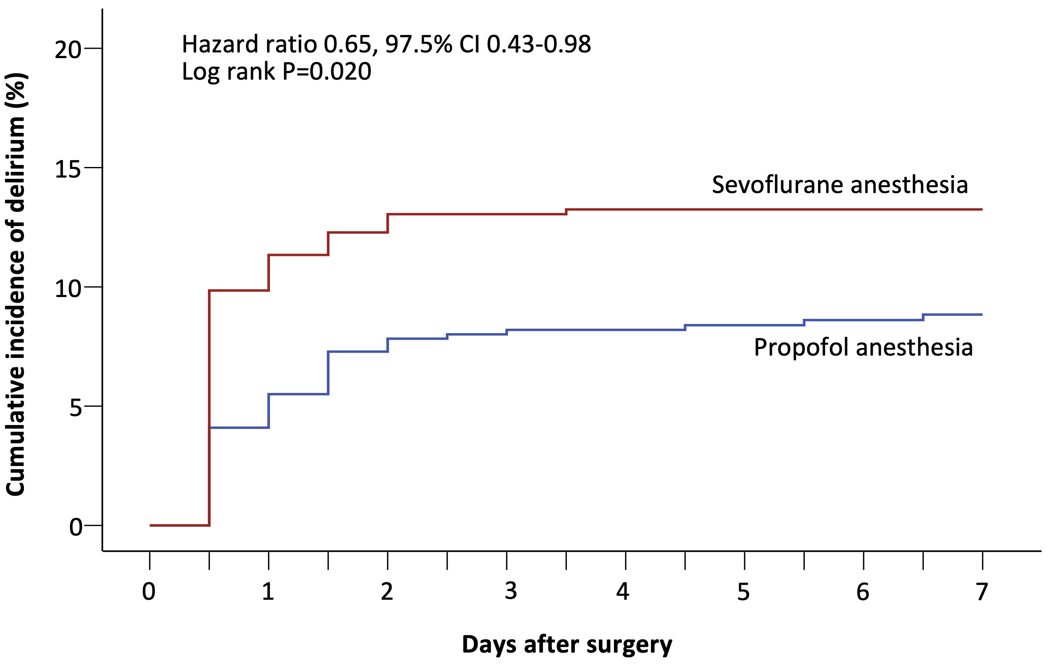
Volatile vs Propofol-based Anesthesia
Randomized trial, N=1228
124 delirium events
NNT = 25
Cao, BJA 2023

Slide 11
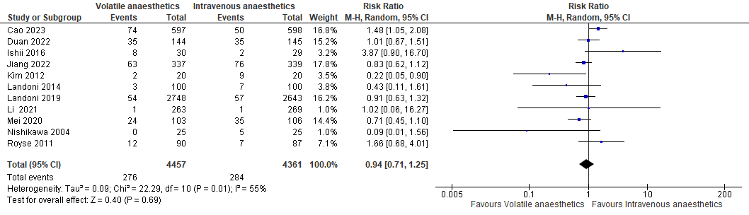
Volatile vs Propofol-based Meta-analysis
Randomized trials, N=8,818; 560 delirium events
Ikram, unpublished

Slide 12
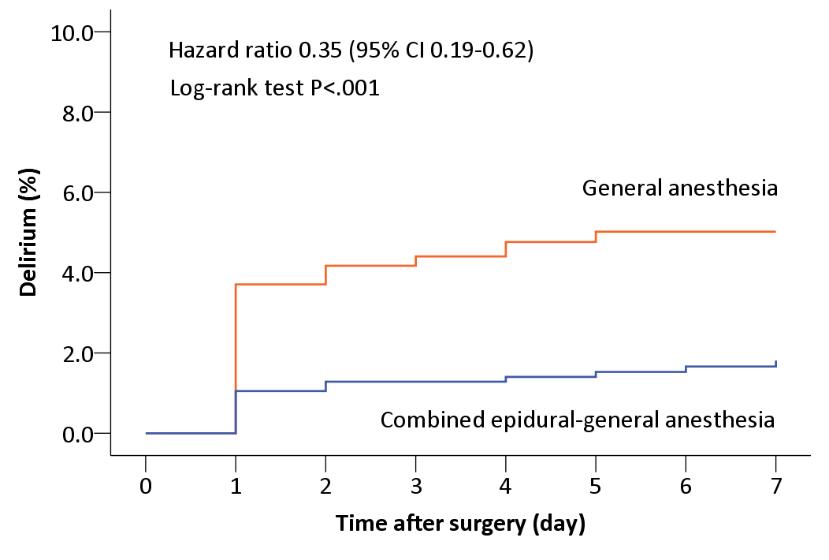
Epidural-general v. General Anesthesia
Randomized trial, N=1802
58 delirium events
NNT = 31
Postop morphine
0 [0, 0] vs
43 [38, 50]
Li, Anesthesiology 2021

Slide 13
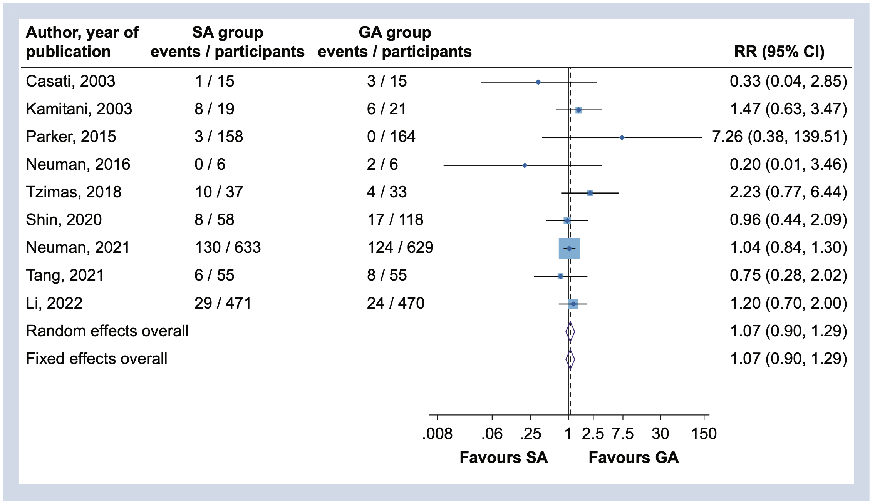
Regional vs General anesthesia
Kunutsor, BJA 2022

Slide 14
Consistency?
Propofol vs. sevoflurane
  35% hazard reduction
Epidural/general vs. GA with postop morphine (43 mg)
  65% hazard reduction
Regional vs general (large trials and meta-analysis)
  No benefit
These results appear inconsistent
  If GA = spinal, how can epidural or propofol be protective?

Slide 15
Depth of Anesthesia: ENGAGES Trial
Randomization (N=1,232); major noncardiac surgery
  EEG Guided v. unguided anesthesia
Exposure details
  Similar volatile anesthetic: 0.7 (guided) vs 0.8 MAC
  Burst suppression: 7 vs 13 minutes
  BIS <40: 32 vs 60 minutes
Similar incidence of delirium
  Guided: 157/604 (26%)
  Unguided: 140/609 (23%)
Wildes, JAMA 2019

Slide 16
Depth of Anesthesia: ENGAGES Canada
Randomization (N=1,140); cardiac surgery
  EEG Guided v. unguided anesthesia
Exposure details
  Similar volatile anesthetic: 0.65 (guided) vs 0.8 MAC
  EEG suppression: 4 vs 12 minutes
Similar incidence of delirium
  Guided: 102/562 (18%)
  Unguided: 103/569 (18%)
  No difference in any other outcome
Deschamps, JAMA 2024

Slide 17
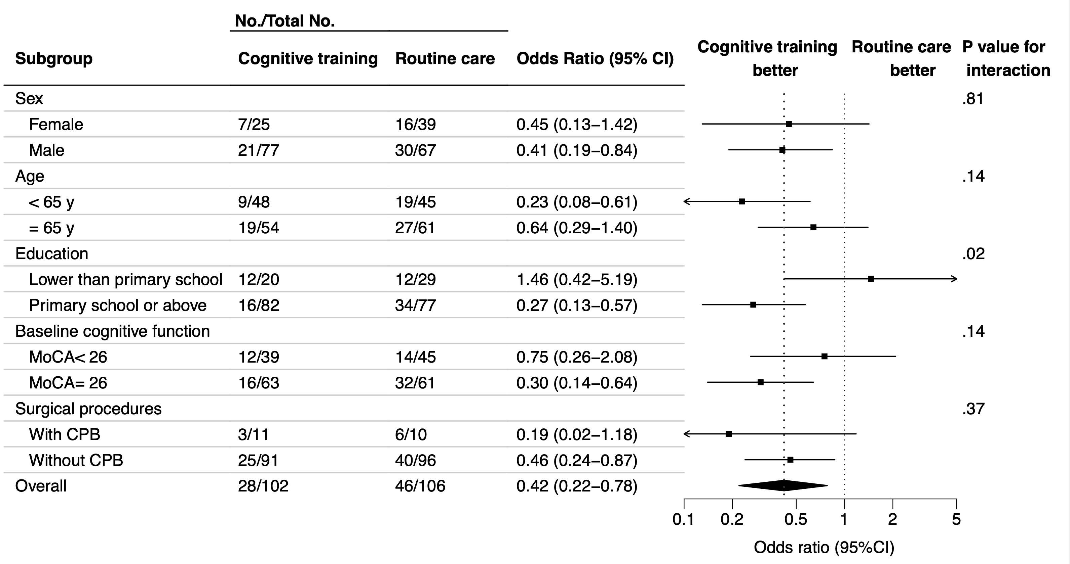
Preoperative Cognitive Training
208 randomized cardiac surgical patients
7 days of in-hospital app-based cognitive training (average 6 hours total)
74 delirium events
OR 0.46 [0.25, 0.82]
Jiang, JAMA Open 2024

Slide 18
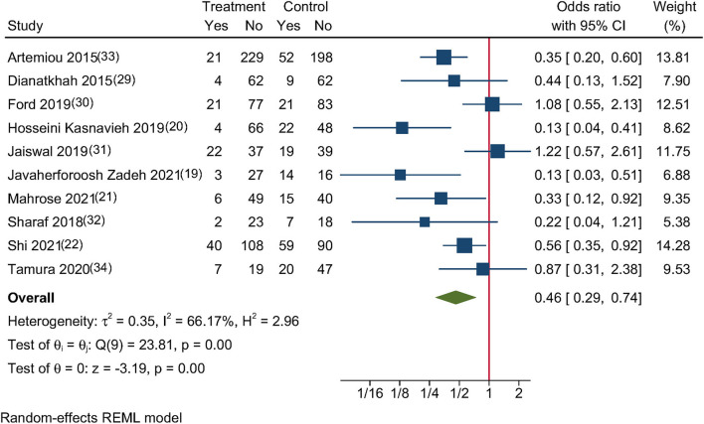
Melatonin (3-5 mg)
Mostly small trials
Han, Front Cardiovasc Med 2022

Slide 19
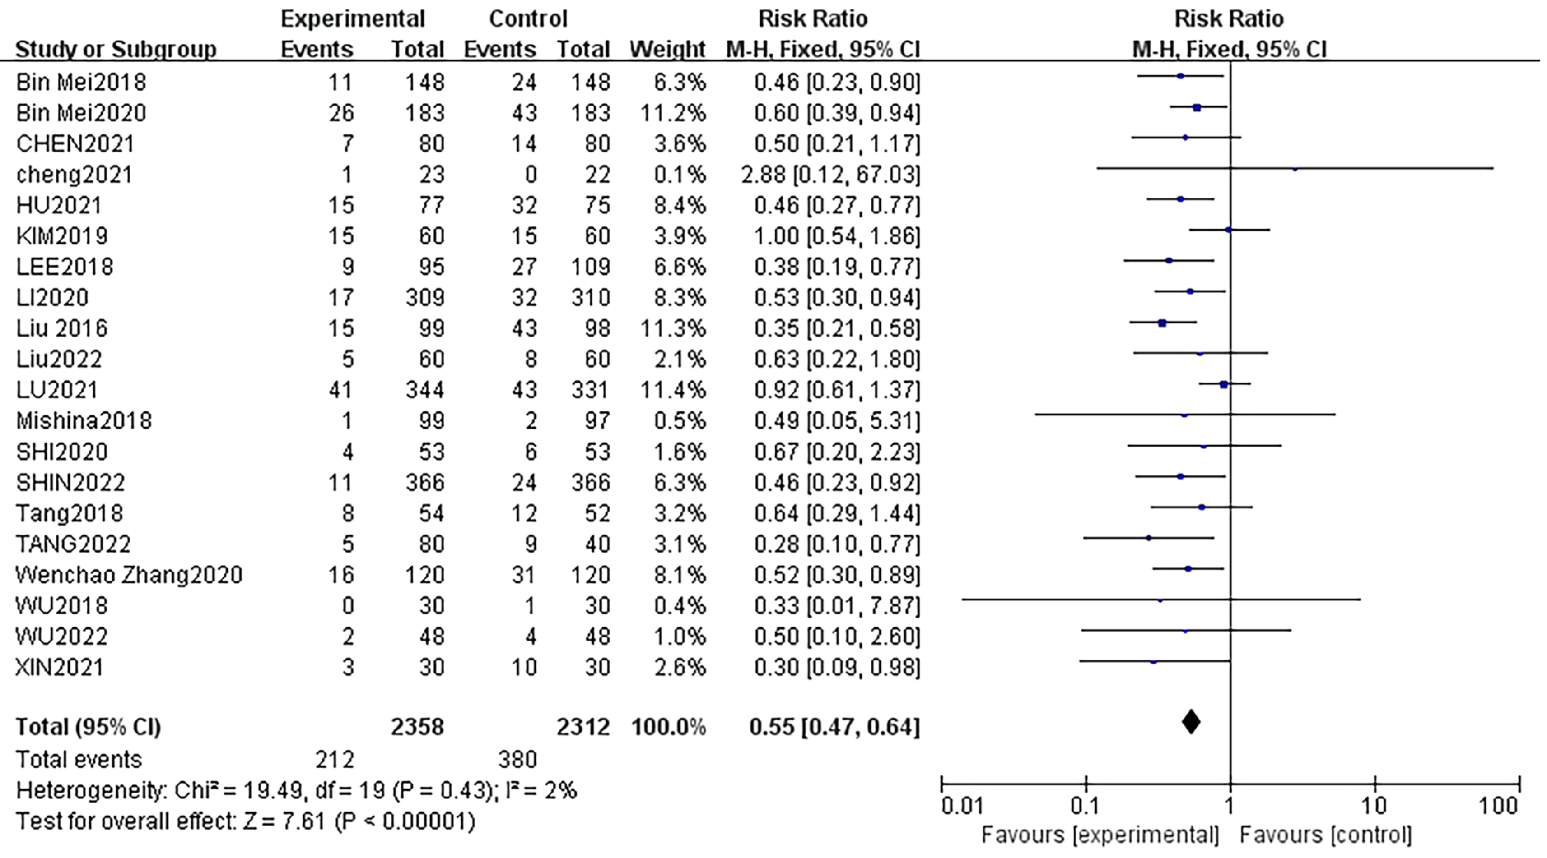
Dexmedetomidine
Wang, D
Eur J Med Res
2024

Slide 20
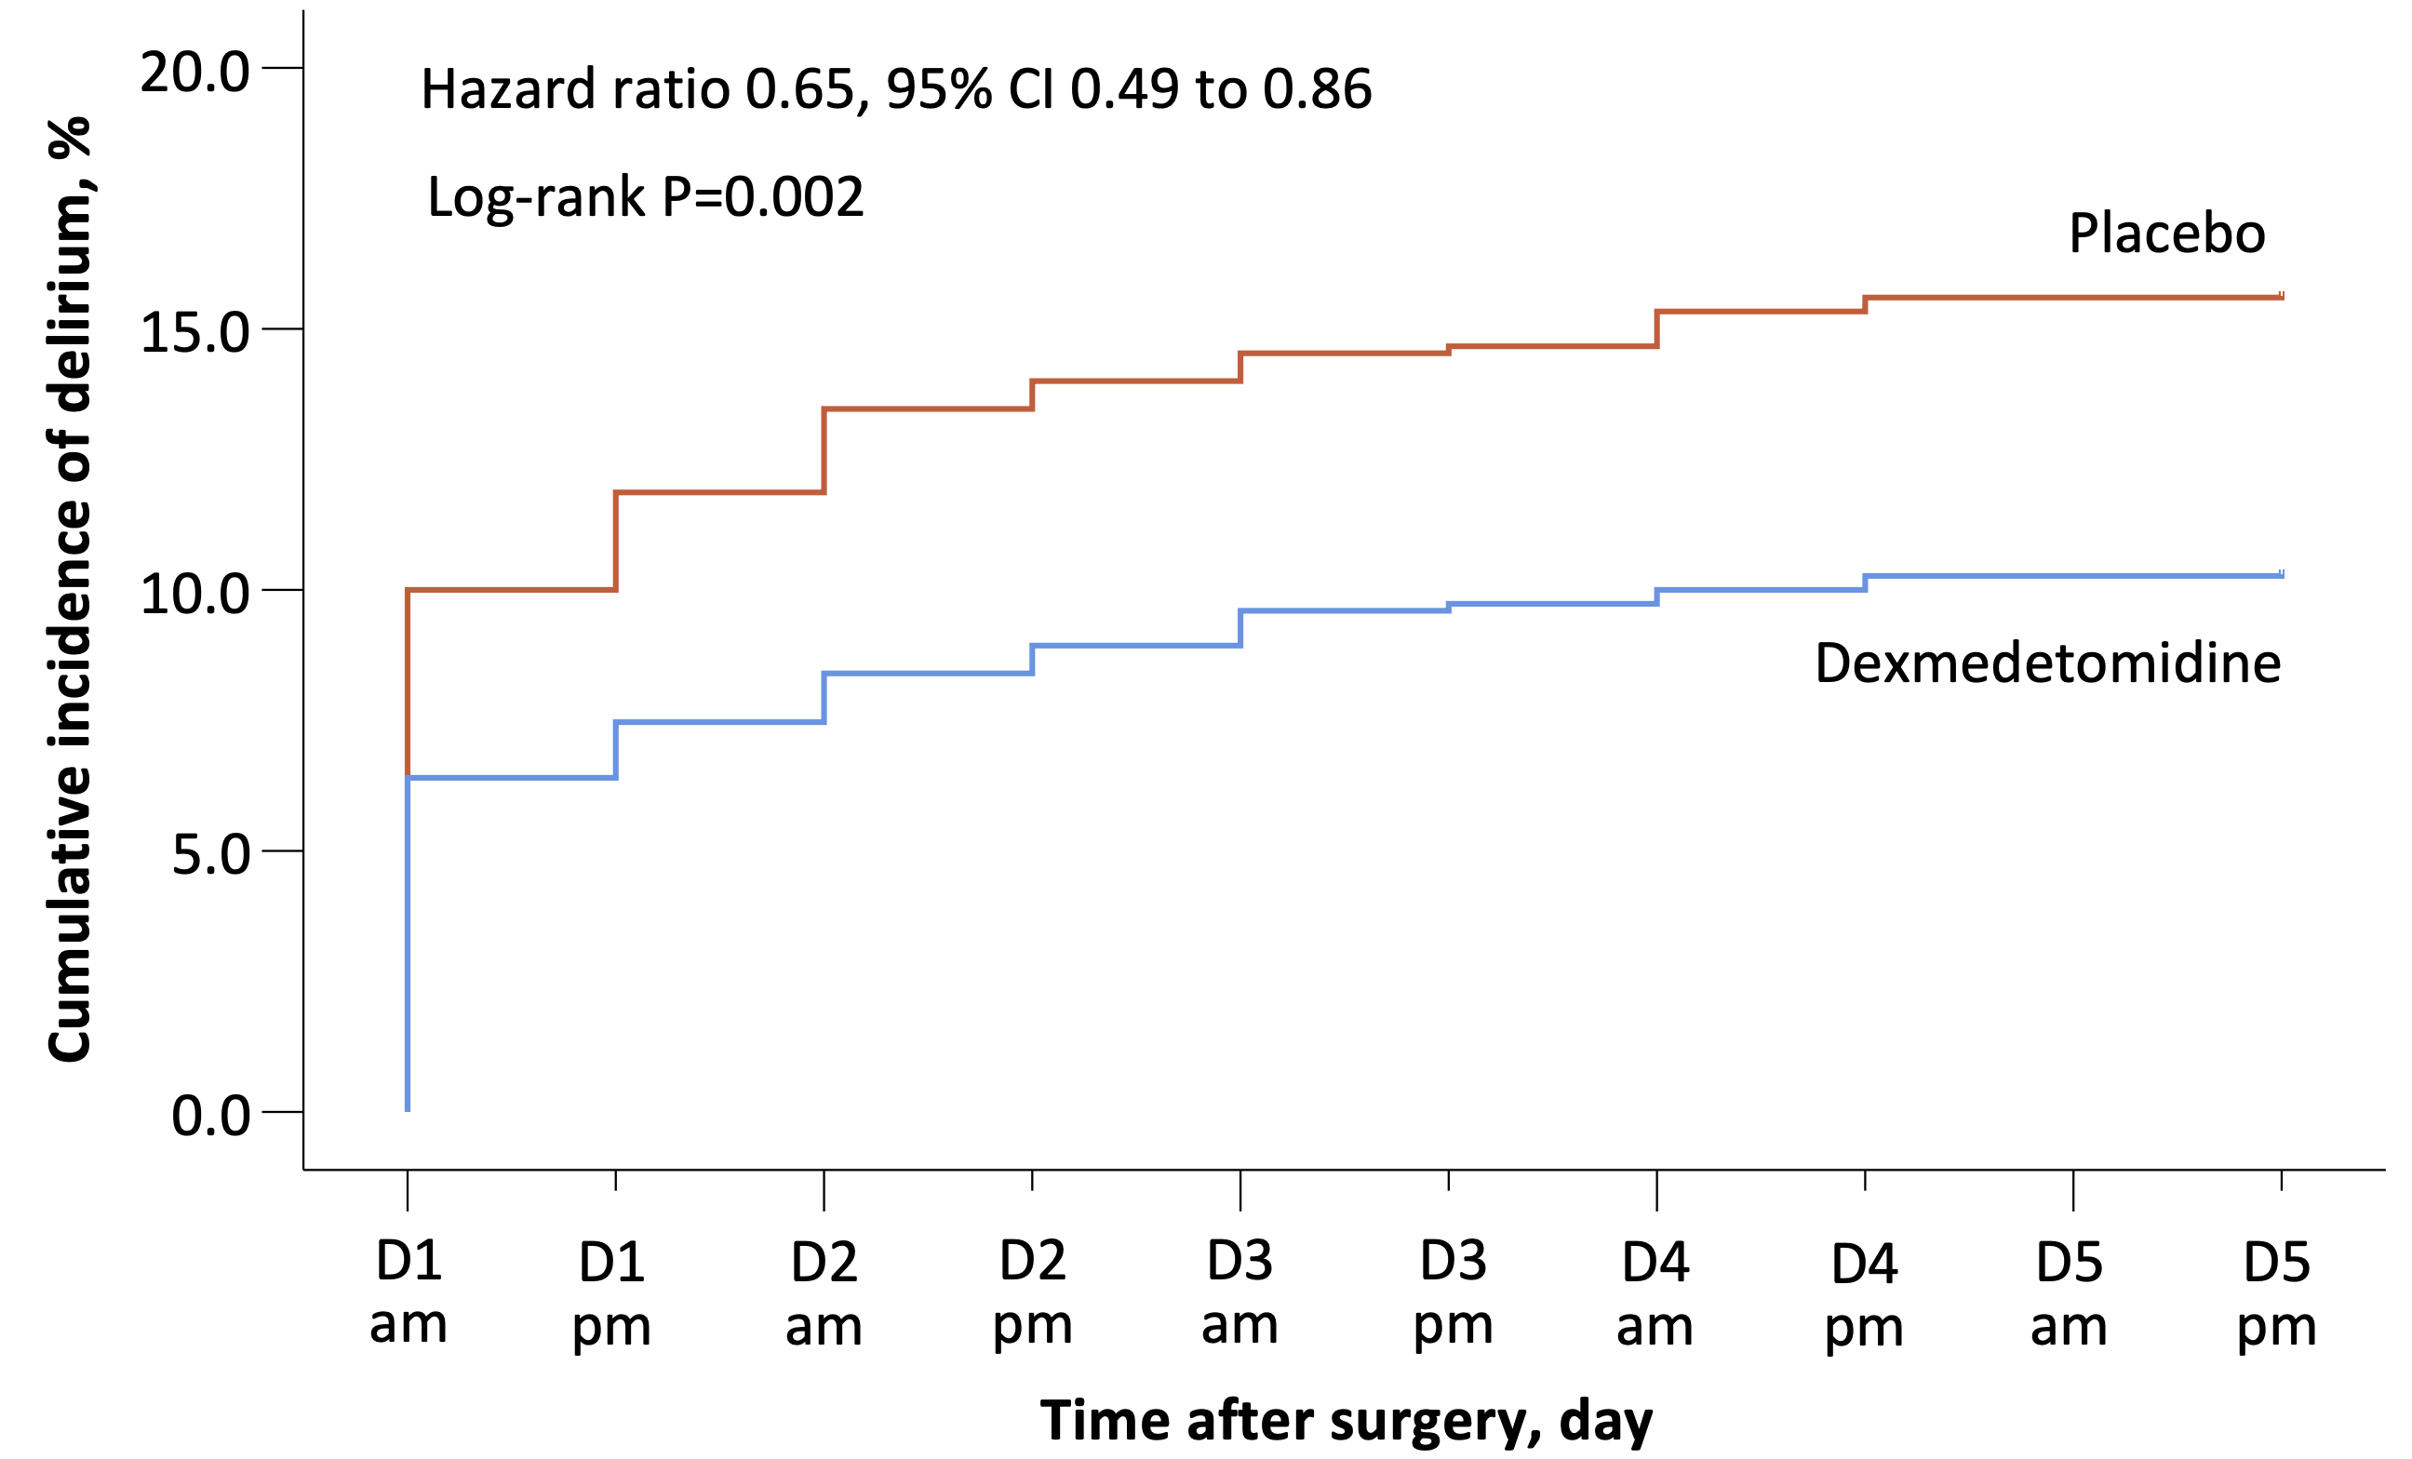
Dexmedetomidine for Non-cardiac Surg
N=1,500; 196 delirium events
Intraoperative & postoperative administration
Neutral results in several smaller trials
Wang D-X, Unpublished

Slide 21
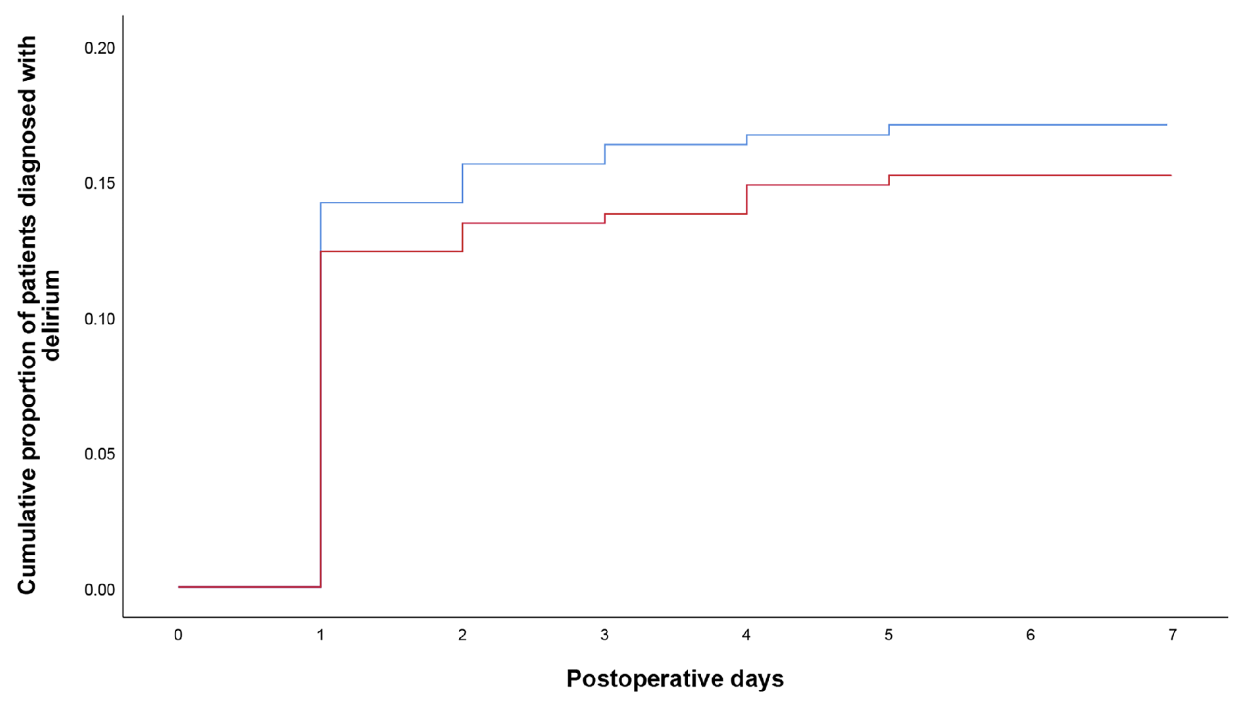
Dexmedetomidine in Cardiac Surgery
Randomized trial, N=652
145 delirium events
P = 0.62
Similar results from DECADE, N=798. Turan, Lancet 2020
Placebo
Dexmedetomidine
Wang, Anaesthesia 2023

Slide 22
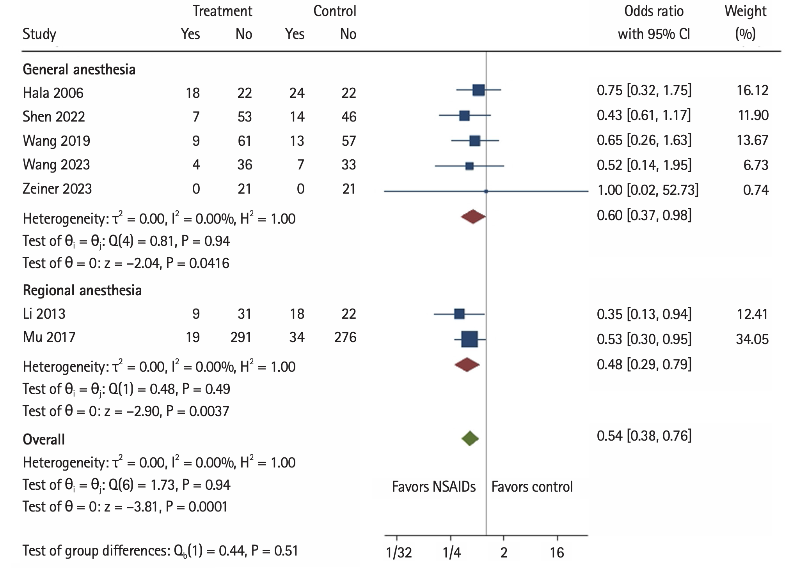
NSAIDs
Tiny studies
Kim, Korean J Anesth 2024

Slide 23
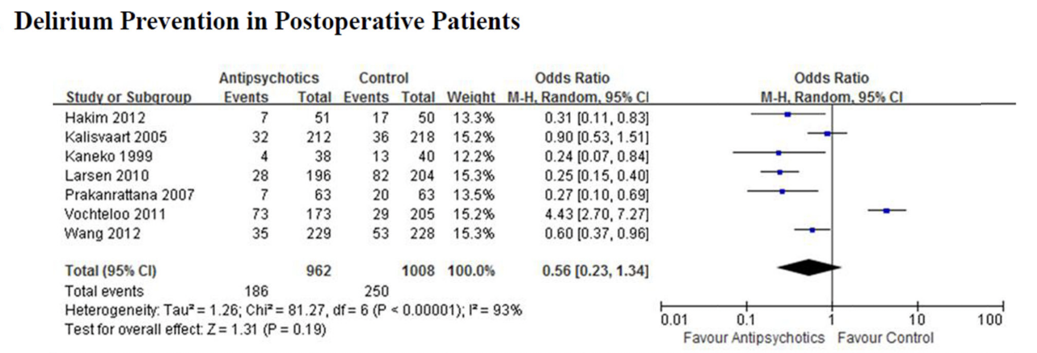
Antipsychotic Prophylaxis
Neufeld et al, J Am Geriatr Soc 2016

Slide 24
Treatments That Apparently Work
Preoperative cognitive training
Melatonin
NSAIDs
Dexmedetomidine for noncardiac surgery
Orientation strategies
  Glasses, hearing aids, clocks, family present
  Hydration, nutrition

Slide 25
Treatments with Unclear Benefit
Minimizing opioids
Good (non-opioid) analgesia
Avoiding sleep deprivation
Normothermia
Extreme hypotension prevention
Antipsychotic prophylaxis

Slide 26
Ineffective Treatments
Propofol versus volatile
Regional (versus GA)
Light anesthesia
Steroids
Avoiding midazolam
Inhaled anti-cholenergics
Ketamine
Tight glucose control
  Possibly worsens delirium

Slide 27
Summary
Delirium is common
  Risk factors are well known, but mostly unmodifiable
Consider treatments with reasonable evidence
  NSAIDs
  Melatonin
  Dexmedetomidine for non-cardiac surgery
Consider logical but unproven strategies
  Good analgesia without excessive opioid
  Avoiding sleep deprivation
  Orientation strategies: glasses, hearing aids, etc.

Slide 28
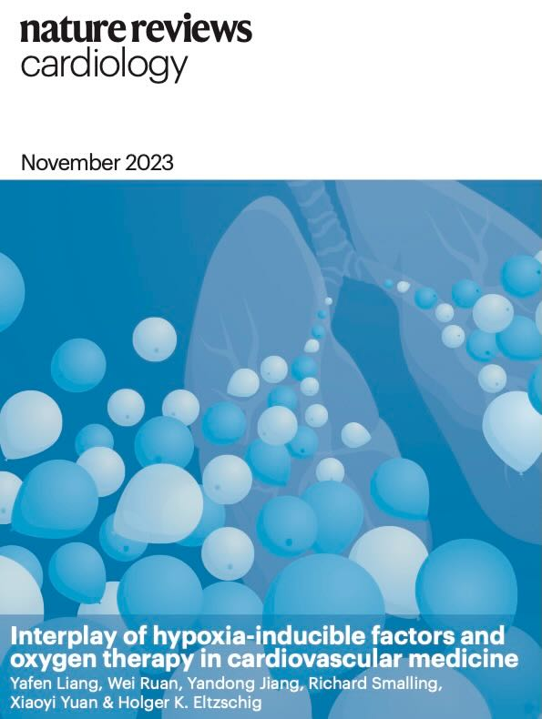
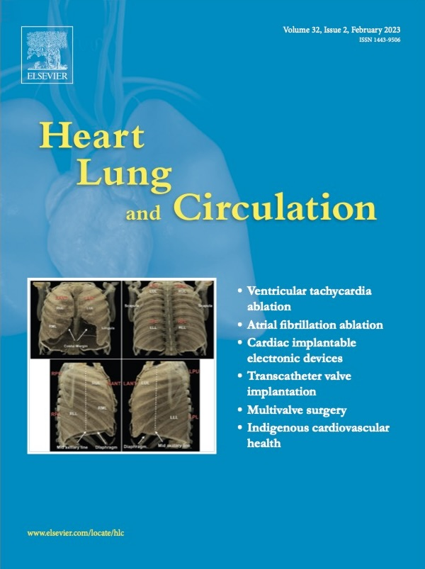
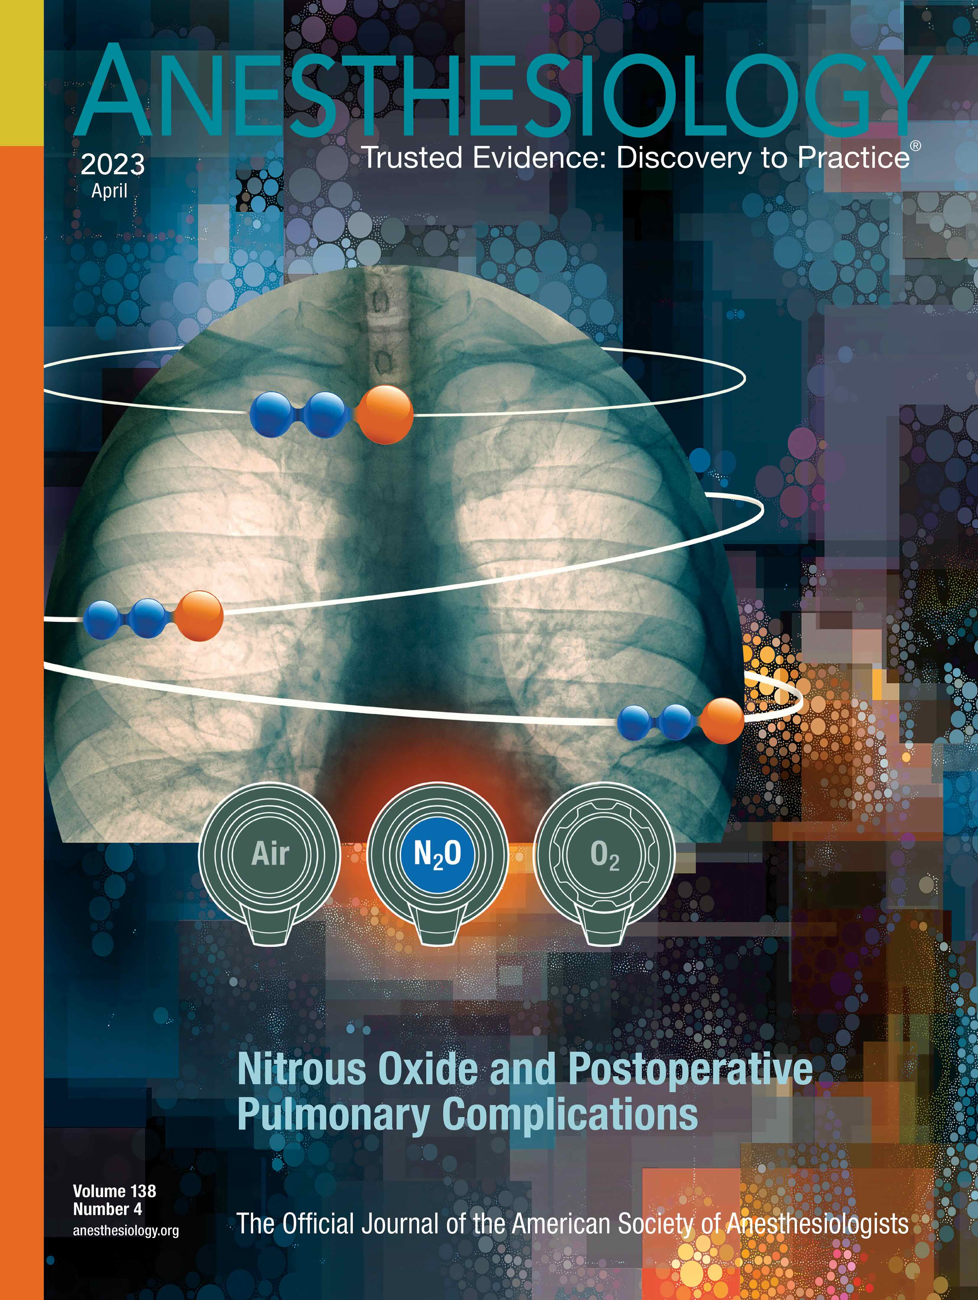
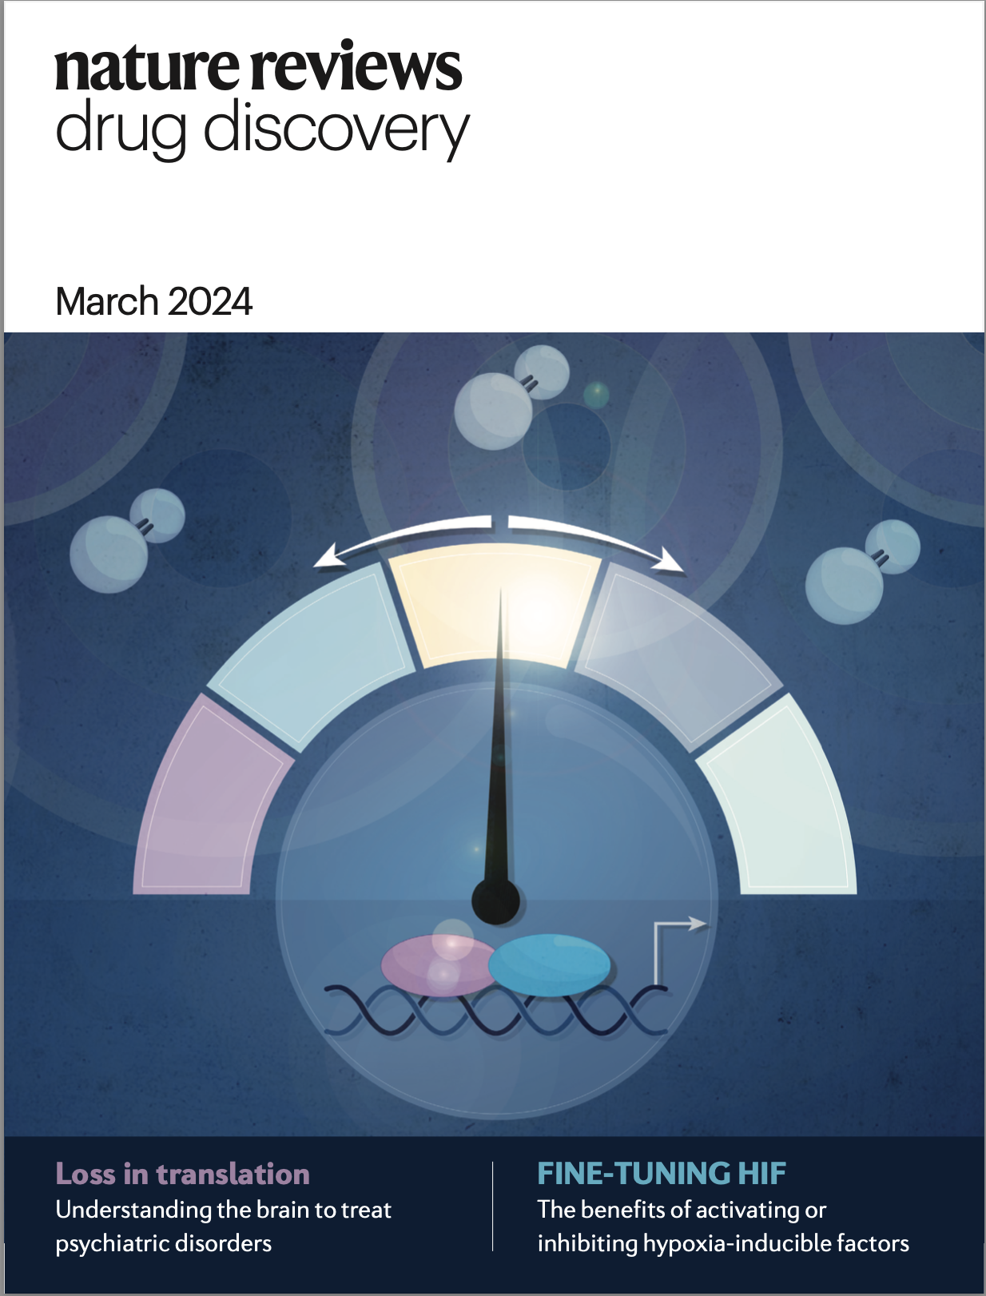
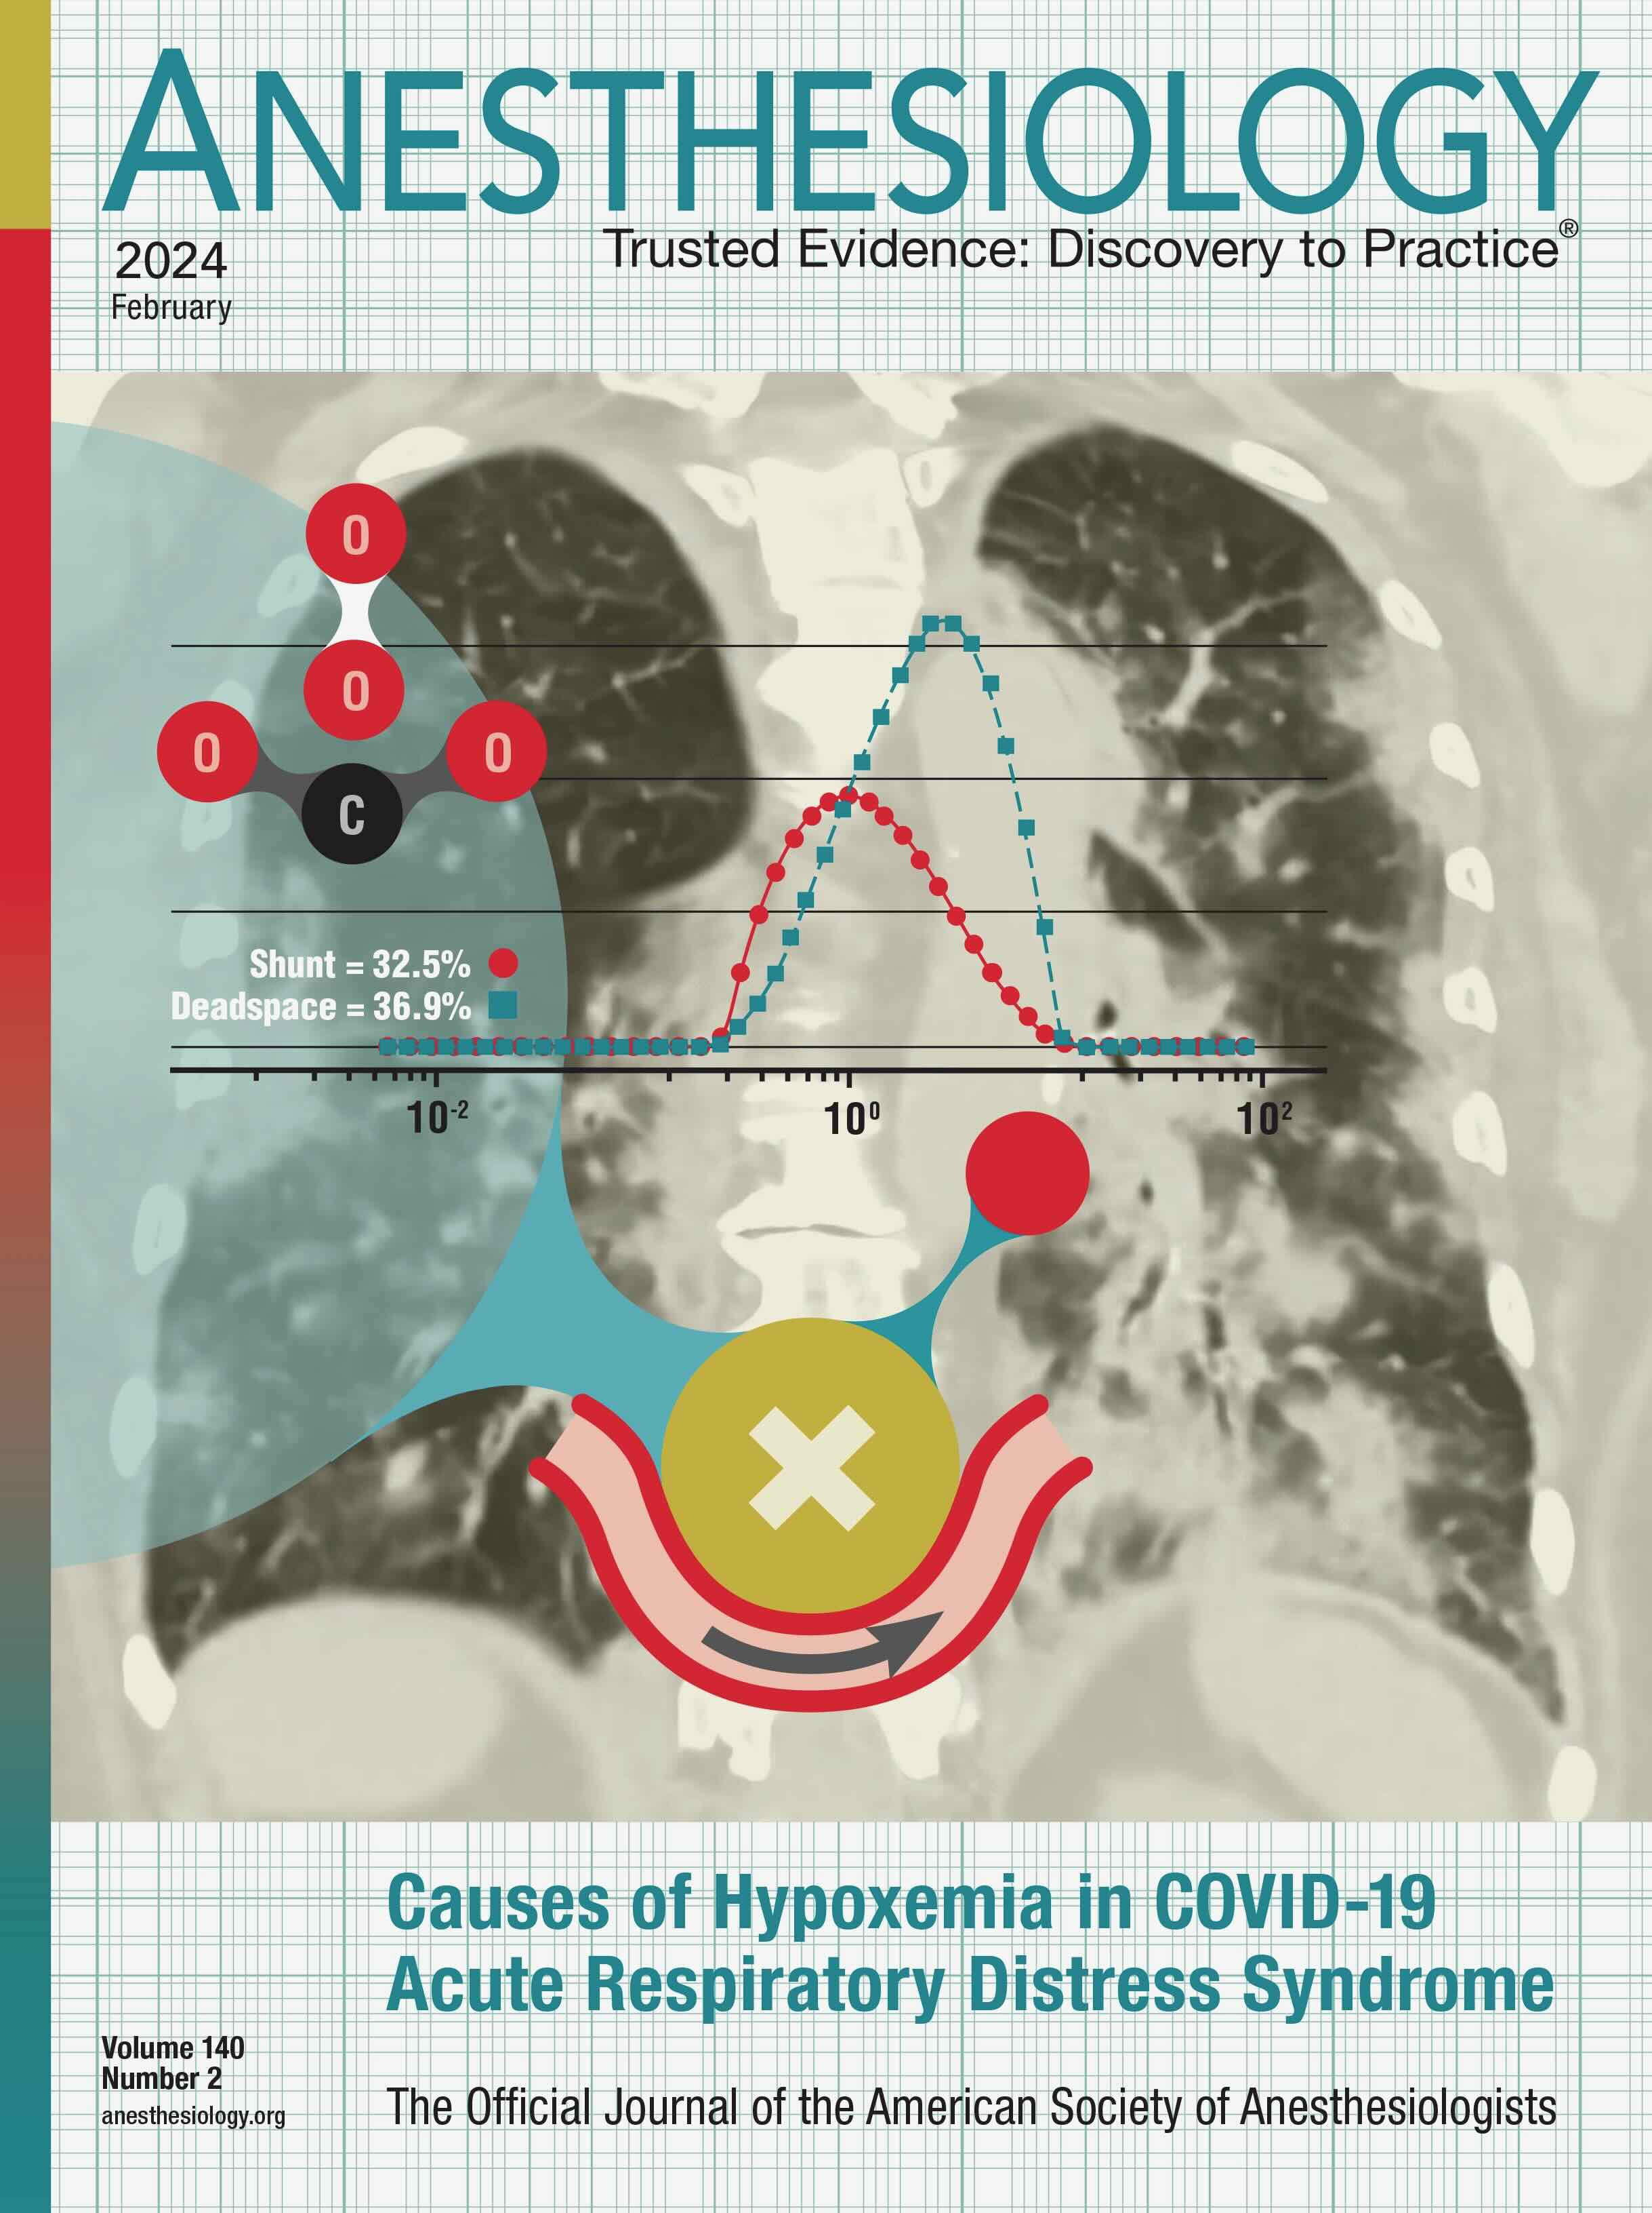
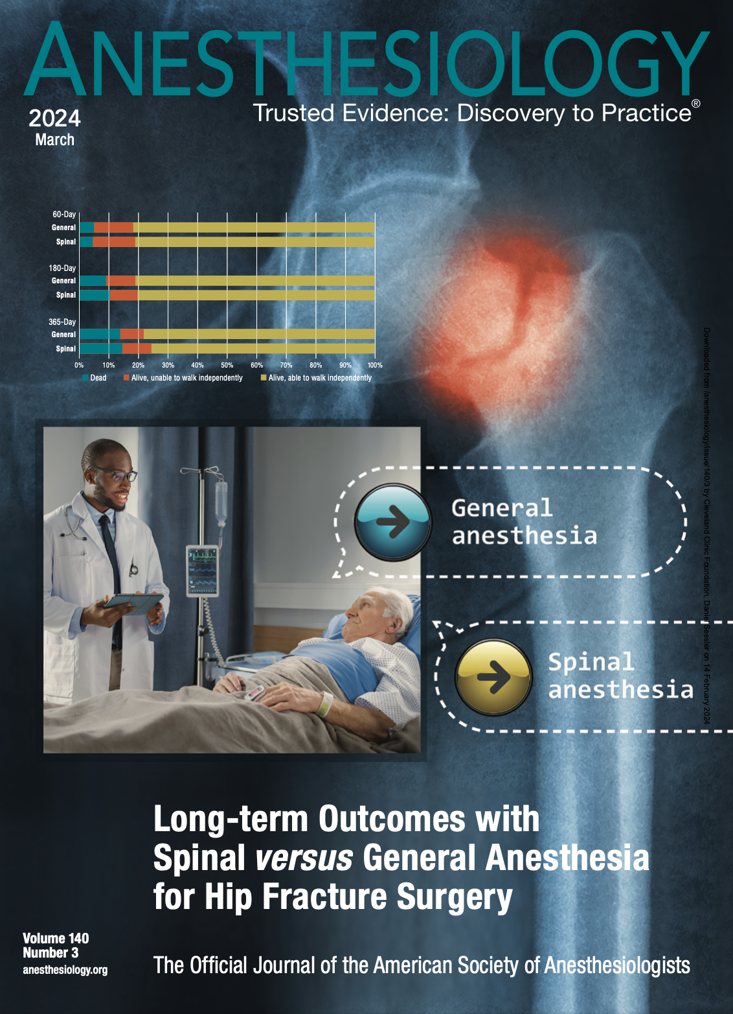
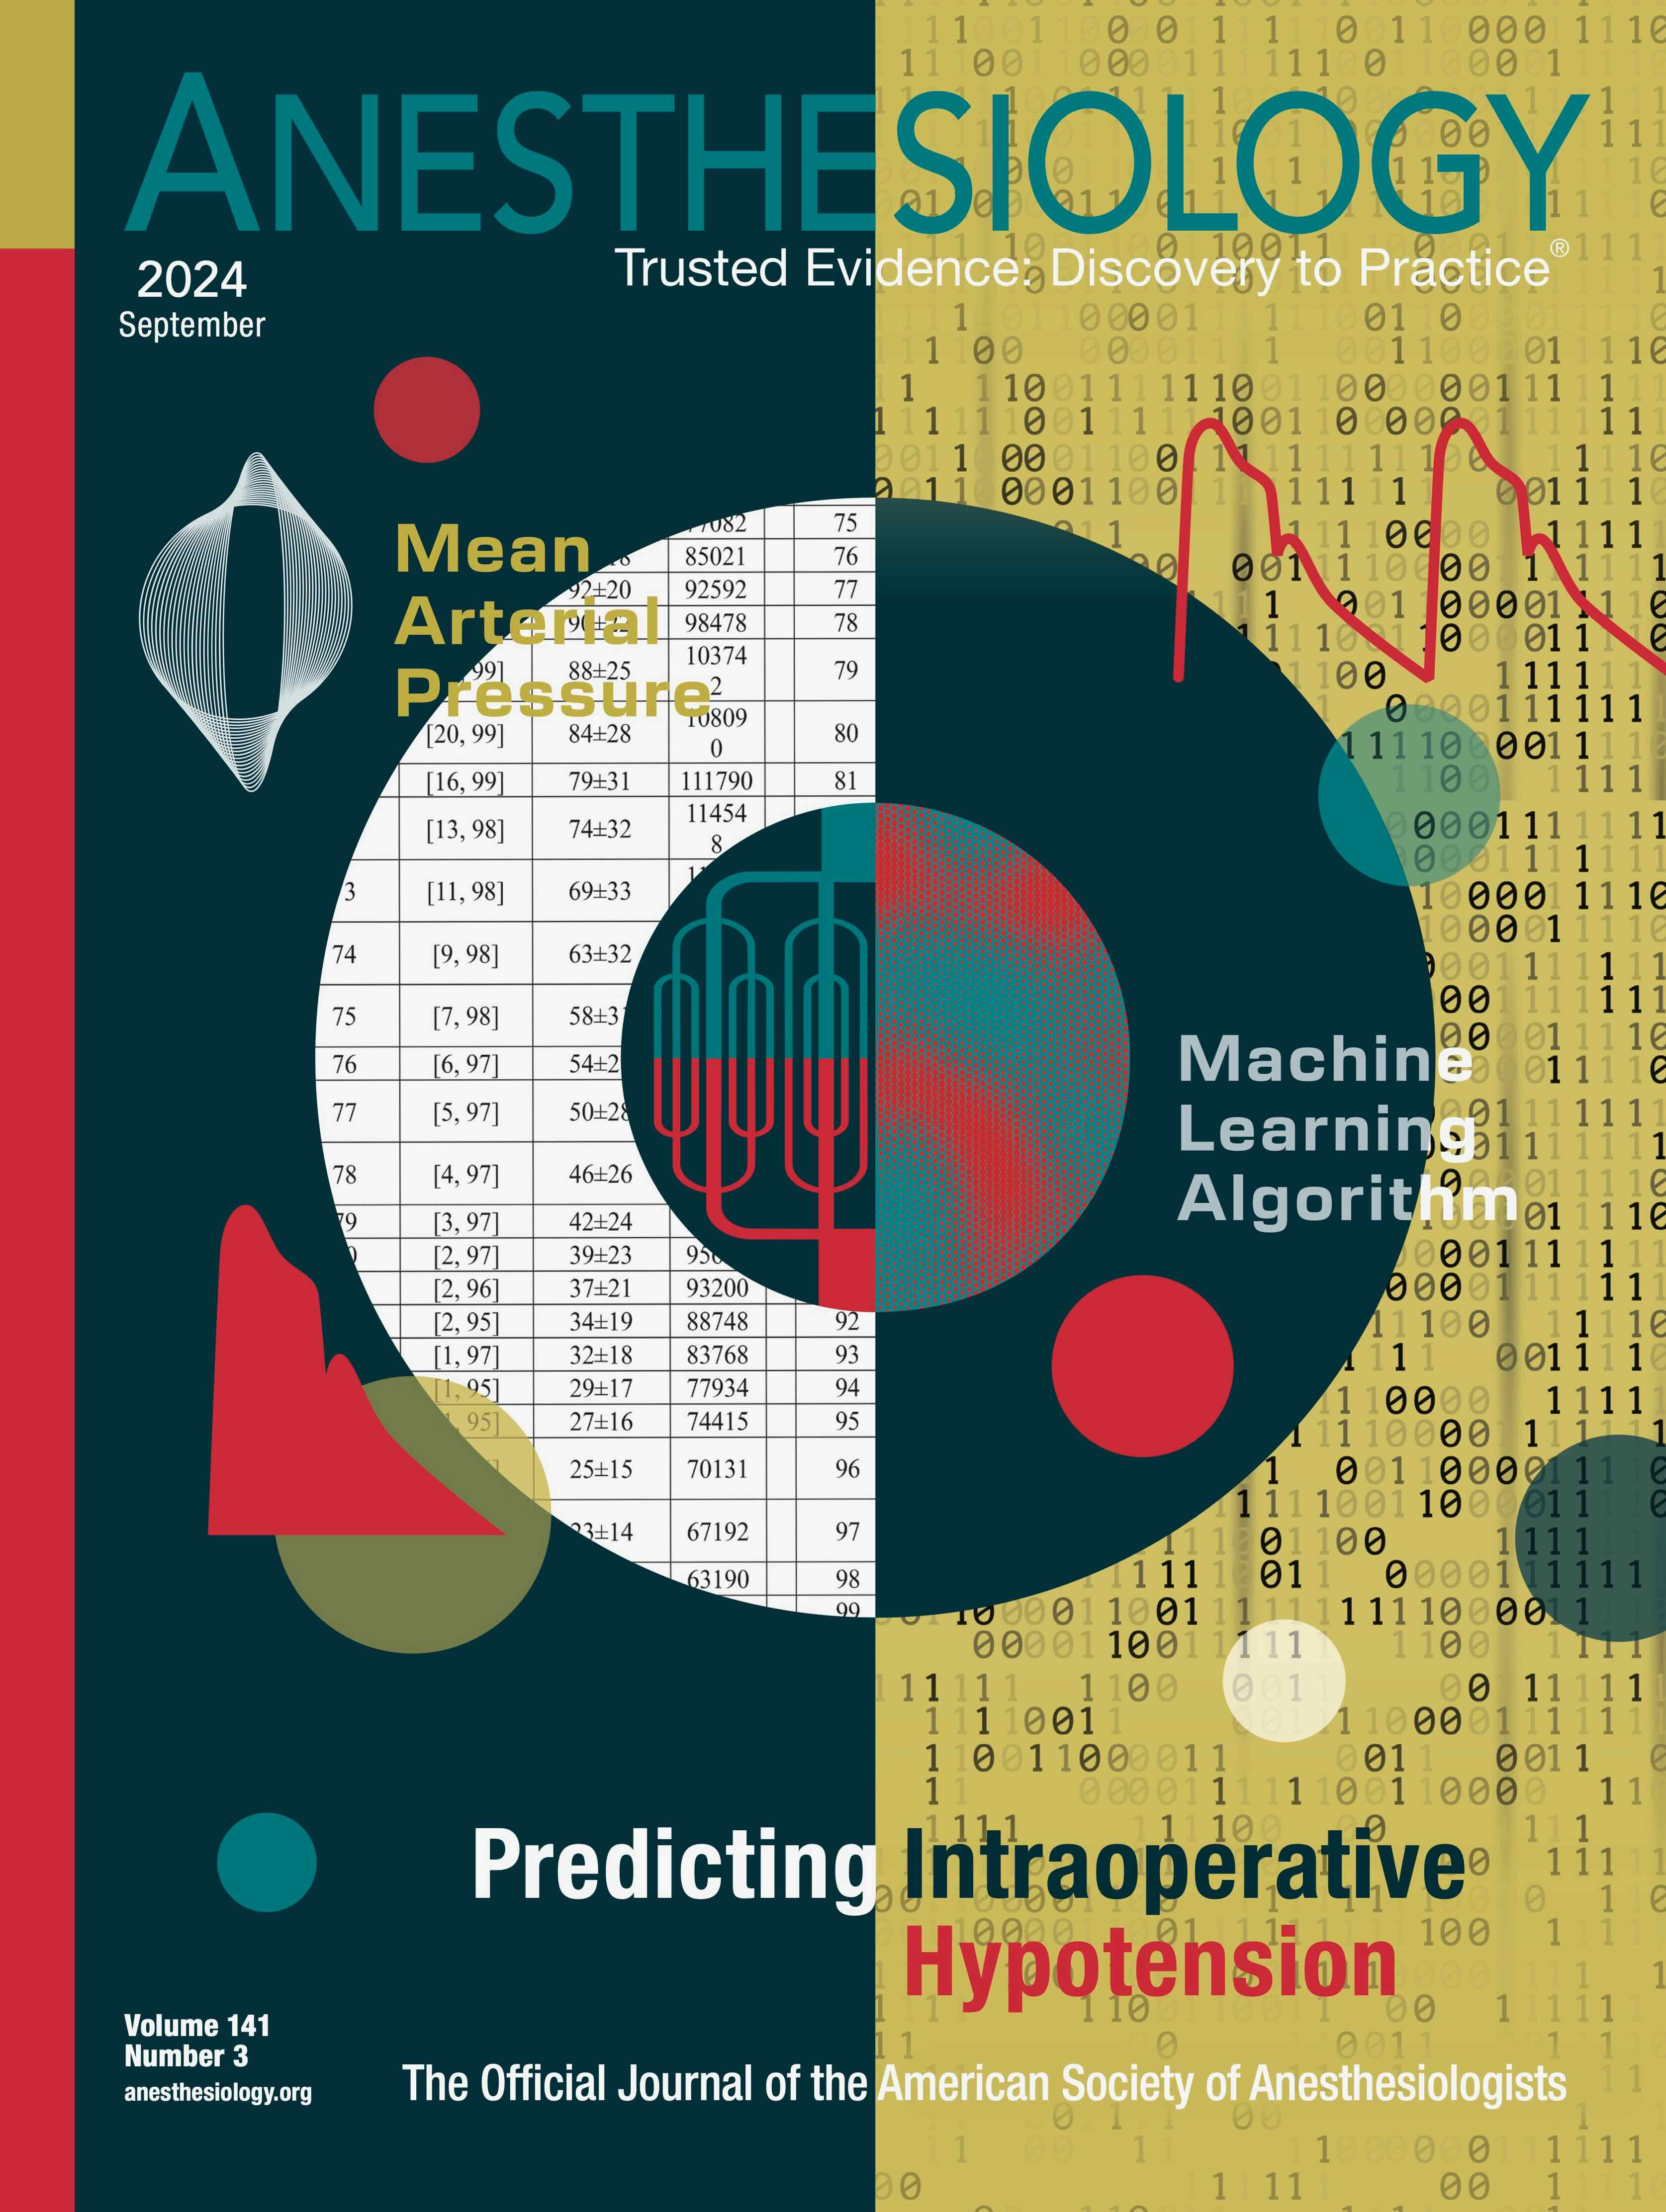
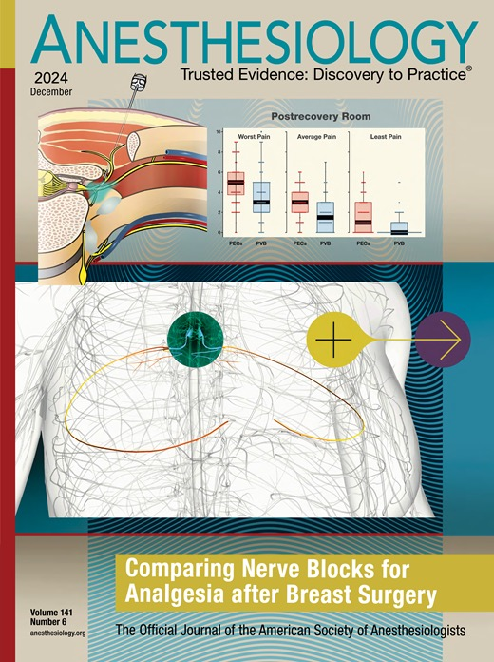
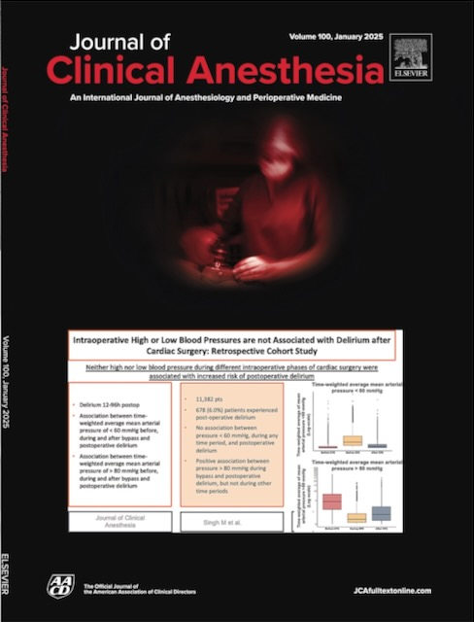

And that’s all folks…
Selected OUTCOMES RESEARCH covers since 2023

Slide 29
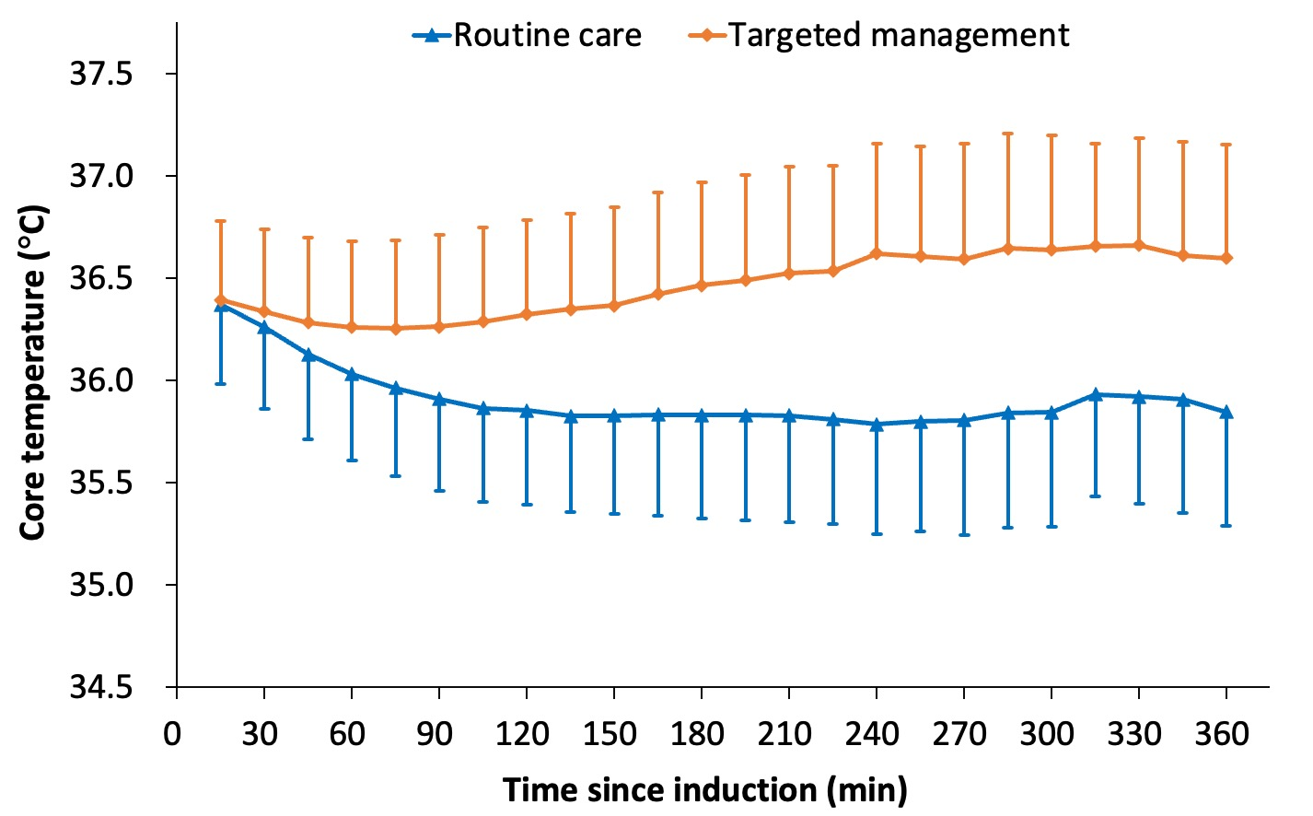
Wang D-X, in Preparation
N=562
Randomized to targeted v. routine thermal management

Slide 30
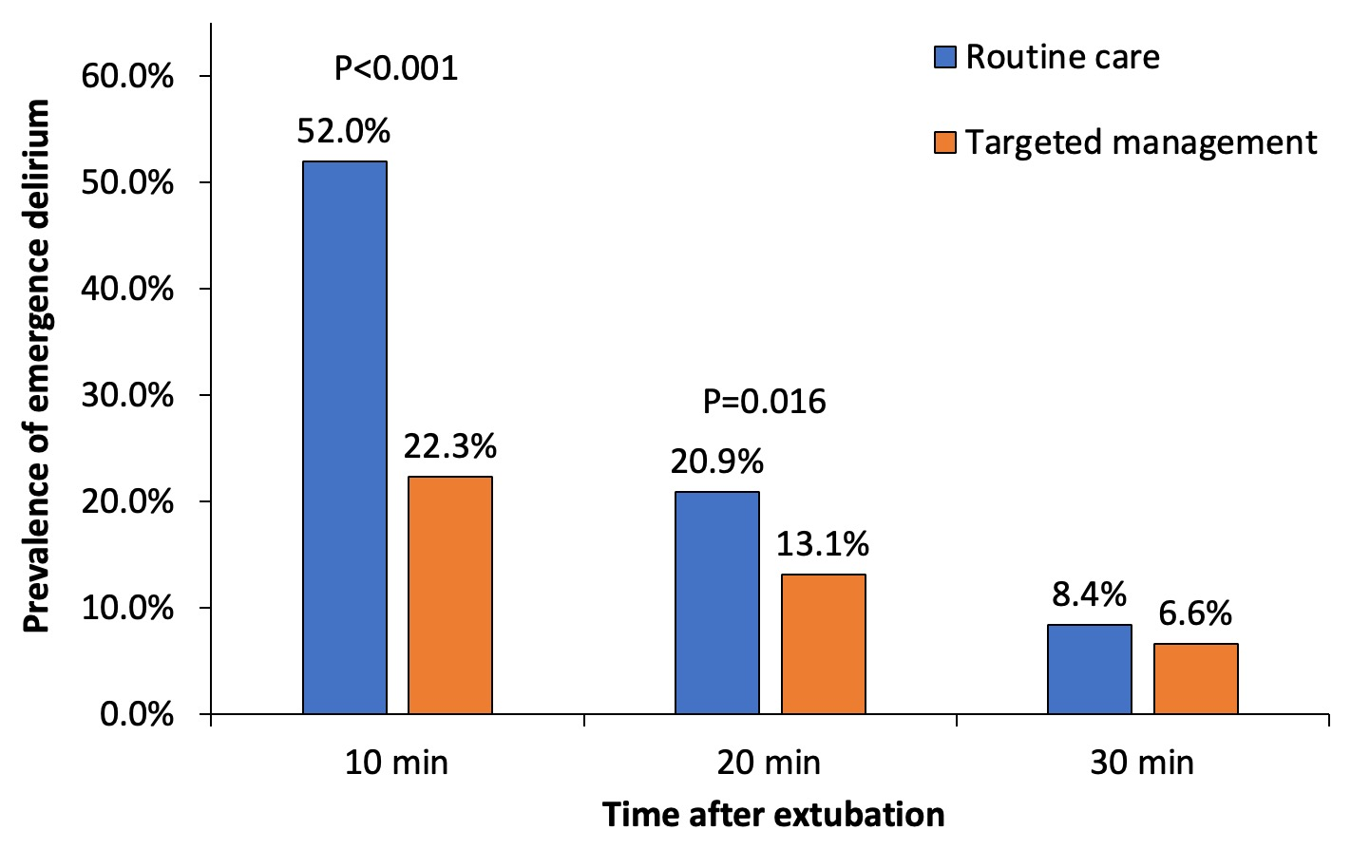
Emergence Delirium
Wang, D-X

Slide 31
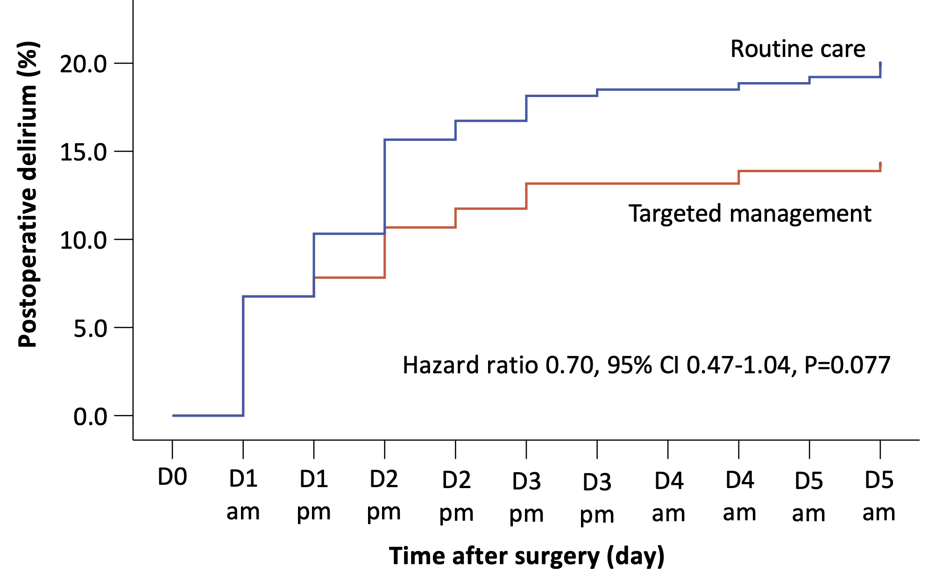
Postoperative Delirium
Wang, D-X

Slide 32
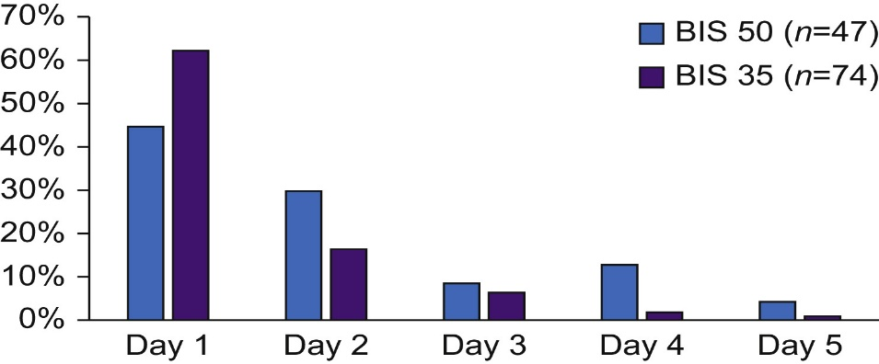
Depth of Anesthesia: BALANCED Trial
Randomized trial, N=655
0.6 vs 0.8 MAC
121 delirium events
Odds 0.58
[0.38, 0.88]
NNT = 11
Percentage of new delirium diagnoses for each group on each day. BIS, bispectral index
Evered, Br J Anesth, 2021

Slide 33
Risk factors (overview)
Pre-operative risk factors
Intraoperative risk factors
Postoperative risk factors
Age over 65
Male sex
Baseline cognitive dysfunction
Comorbid medical conditions
Anxiety/depression
Benzodiazepine use
Sensory impairment
Alcohol use/smoking
Sleep deprivation
Electrolyte abnormalities
Cardiac surgery
Vascular surgery
Emergency surgery
Increased surgical duration
Hypotension/shock
Blood transfusion
Arrhythmias
Hypothermia/hyperthermia
Low hemoglobin
Hypoxemia
Prolonged intubation
Pain
Hypoalbuminemia
Liver failure
Renal failure
Sleep-wake disturbances
Janjua M, statPearls, 2022 Jan

Slide 34
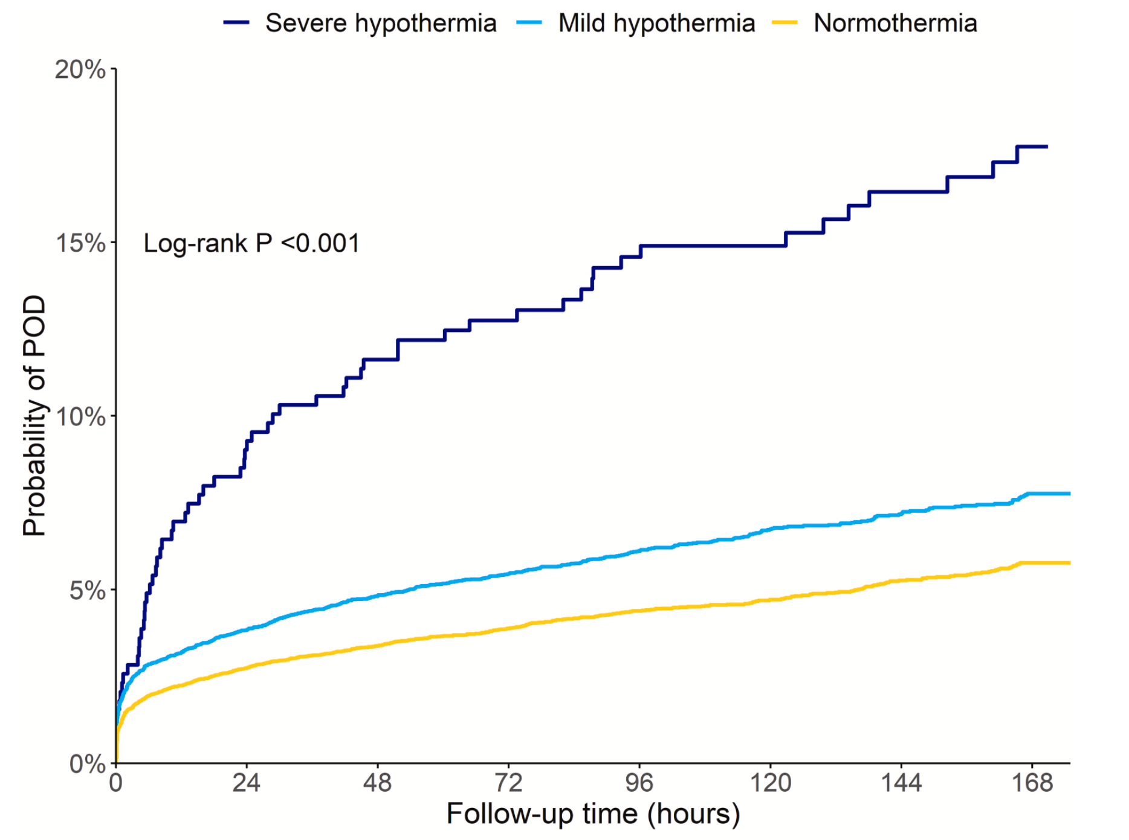
Core Temperature: Ju, JCA 2023
N=27,674
Observational
Severe = 34.8°C
Mild = 35.7°C
Normal = 36.5°C
Probably highly confounded
Severe hypothermia
Moderate hypothermia
Normothermic

Slide 35
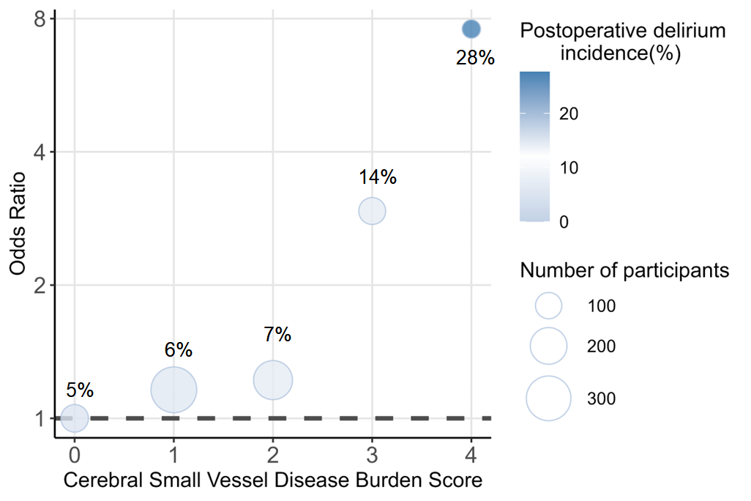
Huang, et al (unpublished)
N=804

Slide 36
Need background for
Avoiding midazolam
Inhaled anti-cholenergics (complication in pulm trial)
Ketamine
Tight glucose control

