Slide 1

OUTCOMES RESEARCH Consortium
Providing the evidence for evidence-based medicine©

Slide 2
Clinical Trials
Daniel I. Sessler, M.D.
Vice-president for Clinical and Outcomes Research
Professor of Anesthesiology and Biostatistics
UTHealth, Houston
No relevant conflicts
www.OR.org DS@OR.org

Slide 3
Randomized Clinical Trials (RCTs)
A type of prospective cohort study
  Defined by investigators controlling the exposure
Highest level of clinical evidence
  Randomization: reduces selection bias & confounding
  Blinding: reduces measurement error
RCTs often correct observational results
Life is short; do things that matter!
  The importance of research is determined by the question, not the results
  Is the question important? Worth years of your life?
  Sufficiently powered to provide clinical guidance?

Slide 4
Types of Trials
Parallel group
Cross-over
Factorial
Cluster
  Conventional (groups distributed in space)
  Multiple cross-over cluster (groups distributed in time)
  Step wedge (progressive implementation)
Platform
Play-the-winner
  Dixon up-and-down
  Biased coin
Etc.

Slide 5
Parallel Group
Enrollment Criteria
Randomize participants
to treatment groups
Intervention A
Intervention B
Outcome A
Outcome B

Slide 6
Cross-over Diagram
Enrollment Criteria
Randomize individuals
To sequential treatment
Treatment A
Treatment B
± Washout
± Washout
Treatment B
Treatment A

Slide 7
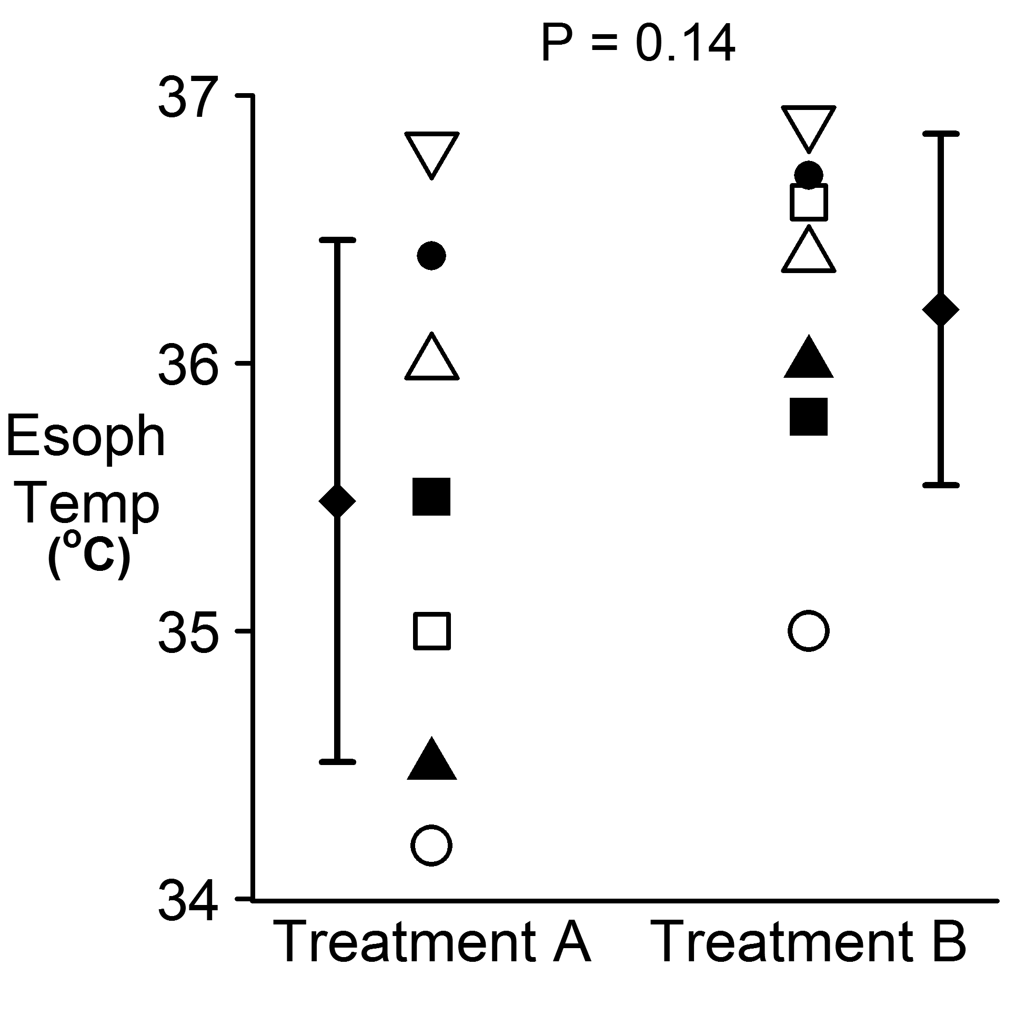
Unpaired Comparison

Slide 8
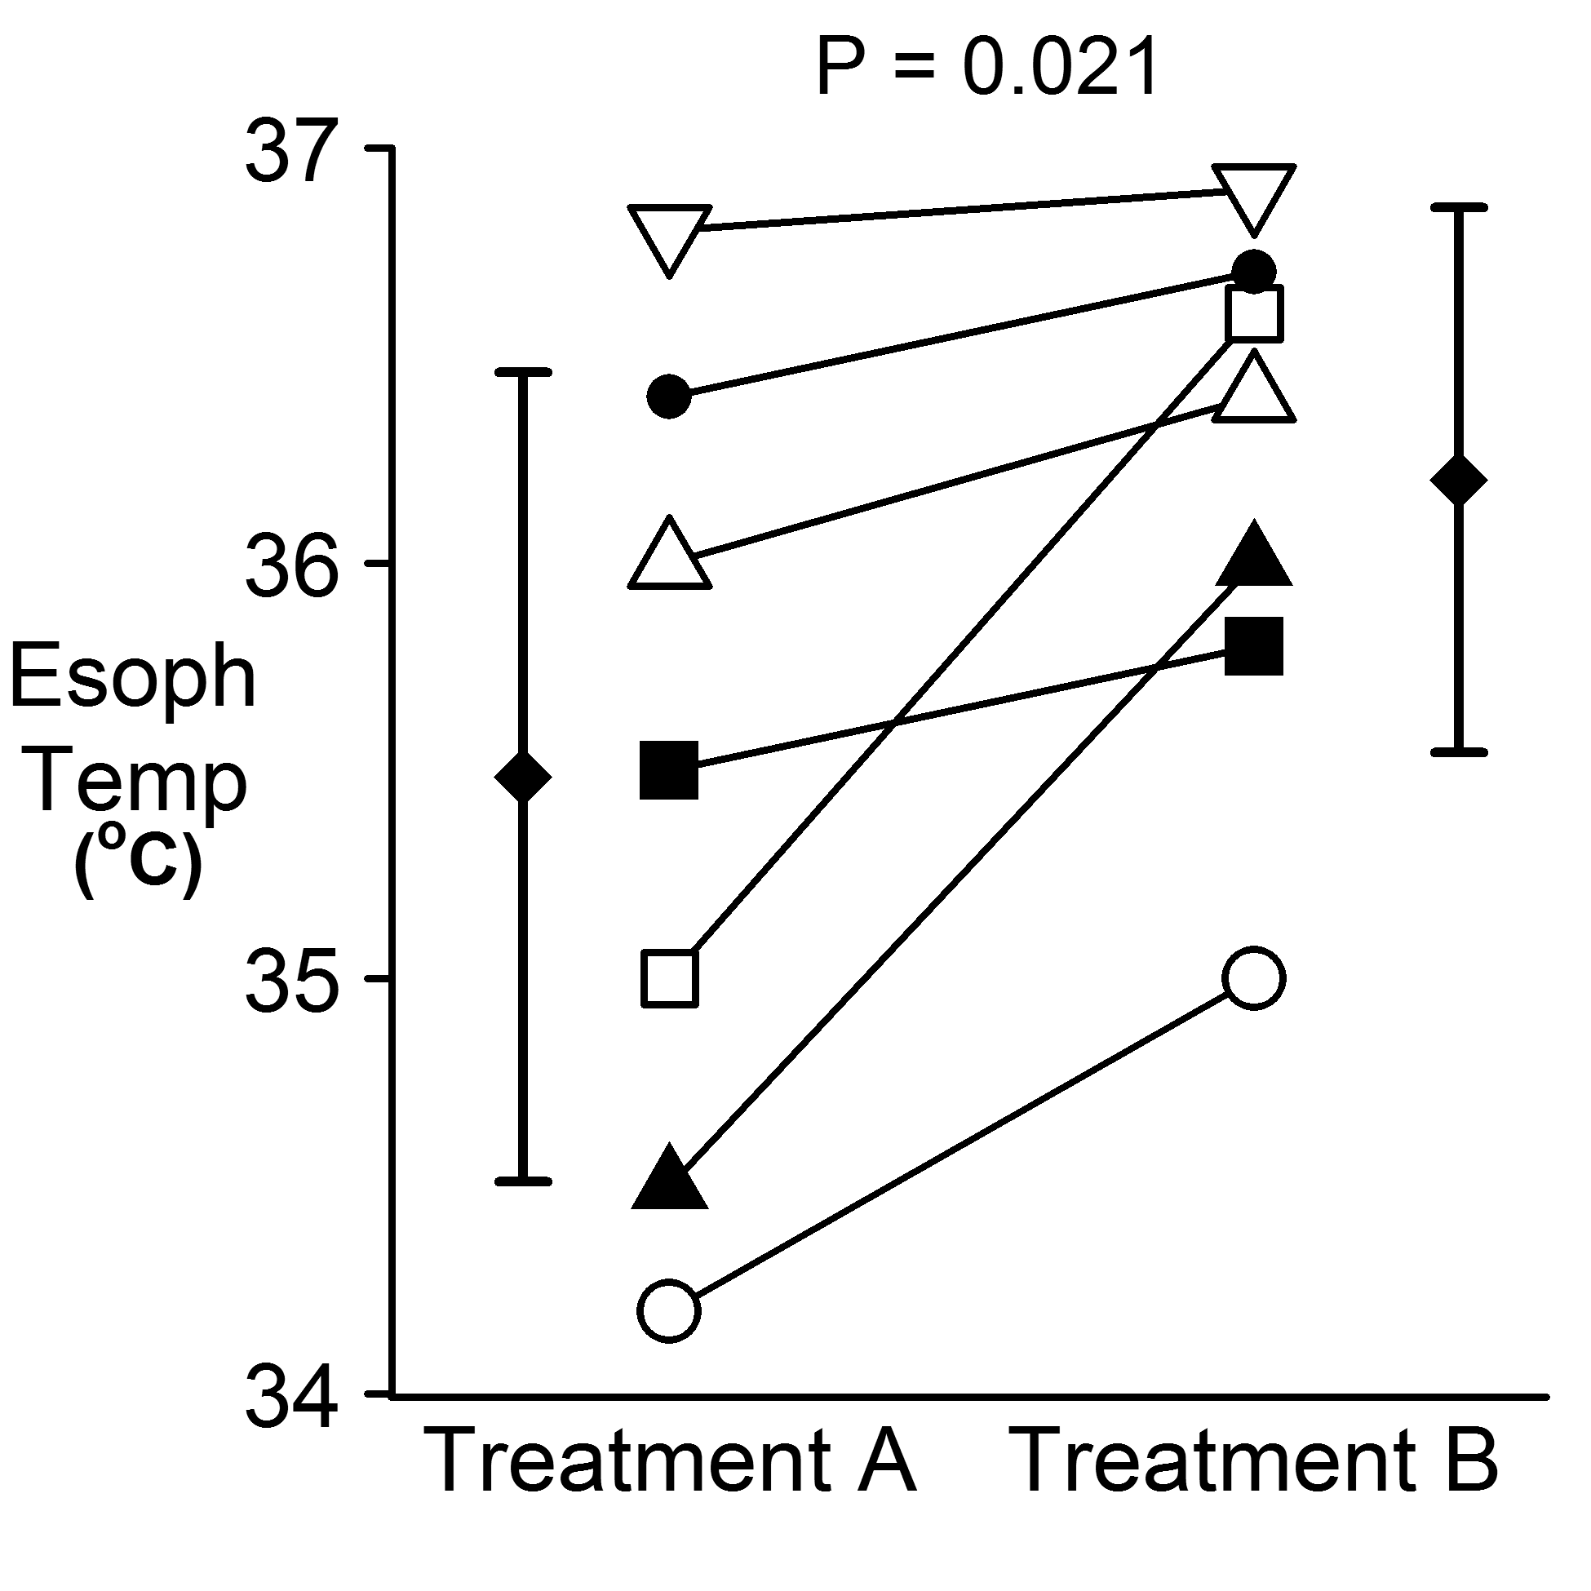
Paired Comparison

Slide 9
Disadvantages of Cross-over Design
Assumes underlying disease state is static
Assumes lack of carry-over effect
  Some treatments have long-term or permanent effect
  Can not be used for one-time treatments such as surgery
May require a treatment-free washout period
Evaluate markers rather than “hard” outcomes

Slide 10
Factorial Trials; Devereaux NEJM 2014
  Clonidine vs. Placebo
Clonidine +ASA | Placebo + ASA
Clonidine + Placebo | Placebo + Placebo
  ASA vs. Placebo
Clonidine +ASA | Placebo + ASA
Clonidine + Placebo | Placebo + Placebo

Slide 11
Factorial Trial Pros & Cons
Advantages
  More efficient than separate trials
  Can test for interactions
Disadvantages
  Complexity, potential for reduced compliance
  Reduces fraction of eligible subjects and enrollment
  Adds ≈10% to sample size for marginal effects
  Rarely powered for interactions
    Testing for interactions by the square of treatments

Slide 12
Comparative Effectiveness Trials
How to find a good trial topic?
  Look for good clinicians doing things differently
  If best treatment were established, everyone would use it
  Various treatments probably differ in safety & efficacy
When best treatments are unclear
  Patients are essentially being treated randomly
  Formal randomization poses little additional risk
  Provides robust evidence
Learning healthcare system!

Slide 13
US Criteria for Waived-Modified Consent
Involvement carries no more than minimal risk
Does not adversely affect the rights and welfare of subjects
The research is otherwise impractical
  Consent introduces privacy risk, selection bias, or alters behaviours
  Makes the research too expensive or slow (debatable)
Data are de-identified to the extent practical
Subjects given pertinent information afterwards when appropriate
45 CFR 46.116 (f); For details and IRB guidance, see Symons, Anesthesiology 2020

Slide 14
Clinician Gatekeeping is Unethical
Gatekeeping definition
  Preventing eligible patients from participating
  Generalized systematic preclusion
Respect for persons
  Gatekeeping denies patients’ autonomy and self-determination, paternalistic
  Patients have the right to participate, even at some risk (altruistic behavior)
  IRBs are expert at assessing risks and potential benefits; most clinicians are not
Beneficence requires research merit
  Gatekeeping introduces selection bias, especially in cluster trials
  Enrollment may be inadequate: decreased power, Type-2 error
Justice
  Gatekeeping risks unfair burden of risks and benefits
Sharkey, J Med Ethics 2010

Slide 15
Types of Modified Consent
Info provided with opt-out (“broadcast consent”)
Simplified consent containing only some elements
Verbal consent
Video explanation with constituting consent
Consent only in treatment group
Complete waiver
Agree

Slide 16
Real-time Randomization, Consent Waived
Conventional design
  33,000-patient trial of older v. newer bank blood
Patients qualify when they meet unpredictable conditions
  Massive intraoperative blood loss
  Intraoperative hypotension
  “Triple Low” of low BP, low EEG power, & low anesthetic
    Screened 37,570 patients to enroll 7,570
  Intraoperative pulmonary hypertension

Slide 17
Cluster Trials
Exposures assigned to groups
  Hospitals
  Nursing units
  Operating rooms, suites
  Individual physicians
Everyone in group treated similarly
  Waived consent thus required
  Analysis can be restricted
Three flavors!

Slide 18
Conventional Cluster Trials
Periods
Ref
Ref
Ref
Ref
Ref
Ref
Ref
Ref
Ref
Ref
Ref
Ref
Ref
Ref
Ref
Clusters
Rx
Rx
Rx
Rx
Rx
Rx
Rx
Rx
Rx
Rx
Rx
Rx
Rx
Rx
Rx

Slide 19
Step-wedge Cluster Trials
Periods
Ref
Rx
Rx
Rx
Rx
Rx
Ref
Ref
Rx
Rx
Rx
Rx
Clusters
Ref
Ref
Ref
Rx
Rx
Rx
Ref
Ref
Ref
Ref
Rx
Rx
Ref
Ref
Ref
Ref
Ref
Rx

Slide 20
Multiple Cross-over Cluster Trials
Periods
Cluster 1
A
B
A
B
A
B
A
B
A
B
A
B
Cluster 2
A
B
B
A
A
B
A
B
B
B
A
A
Cluster 65
B
B
A
A
A
B
B
A
A
B
A
B
  Clusters distributed in time rather than in space

Slide 21
Cluster Trial Challenges
Controlling exposure is tricky
  All relevant clinicians need to be “on board”
  Protocol deviations markedly reduce power
Statistically challenging
  Intra-cluster correlation reduces power
Individuals not randomized
  Hard to exclude specific patients from exposure
Trials usually can’t be blinded
  Even when possible, unblinding an individual unblinds cluster

Slide 22
Cluster Trial Summary
Inexpensive with rapid enrollment
  “Everyone in” approach speeds enrollment
  Allows accrual of large populations at modest cost
Large sample sizes provide robust results
  Reliable estimates of treatment effect
  Even for sparse dichotomous outcomes — the ones we care about
Challenges
  Typically require waived or modified consent
  Controlling exposure is often challenging; everyone needs to be on board
  Hard to blind
Powerful approach for suitable questions!

Slide 23
Composite Outcomes
Any of ≥2 component outcomes, for example:
  Cardiac death, MI, or non-fatal arrest
  Wound infection, anastomotic leak, or abscess
Usually permits a smaller sample size
Characterize multifaceted outcomes

Slide 24
Consider a Treatment for Diabetes
Complication | Outcome | Incidence (%)
Myocardial infarction | Primary | 4
Amputation | Secondary | 2
Renal failure | Secondary | 3
Blindness | Secondary | 1
Composite
Myocardial infarction
Amputation
Renal failure
Blindness
Better characterizes disease complications
Composite incidence ≈8%

Slide 25
Collapsed Composite Requirements
Analysis based on composite incidence
  Irrespective of incidence of various components
  Over-weights more common components
Incidence of each should be comparable
  Other wise common outcome(s) dominate composite
Severity of each should be comparable
  Unreasonable to lump minor and major events
  Death often included to prevent survivor bias

Slide 26
Alternate Analysis Strategies
Component severity-weighted analysis
  Compensates for differing component severity
  Weighting should be formally established be established a priori
Average relative effects analysis
  Compensates for differing component incidence
  Based on average relative risk of each component
  Over-weights sparse components
Usually preferable to restrict composite
  Make common & less serious outcomes secondary

Slide 27
Beware of Component Heterogeneity
Composite analyses assume component homogeneity
Types of heterogeneity
  Quantitative: different magnitudes in same direction
  Qualitative: treatment effect direction differs
Example: beta blocker to reduce MI
  Beta blocker reduces MI by 30%
  But increases stroke
  Requires separate analyses for each component

Slide 28
Subject Selection
Tight criteria
  Reduces variability and sample size
  Excludes subjects at risk of treatment complications
  Includes subjects most likely to benefit
  Slows enrollment
  “Best case” result, evaluates efficacy
Loose criteria
  Includes more “real world” participants
  Increases variability and sample size
  Speeds enrollment
  Generalizable result, evaluates effectiveness

Slide 29
Randomization and Allocation
Only reliable protection against
  Selection bias
  Confounding
Conceal allocation
Stratification only necessary for small trials

Slide 30
Blinding / Masking
Only reliable prevention for measurement bias
  Essential for subjective responses
  Careful design required to maintain blinding
Potential groups to blind
  Patients
  Providers
  Investigators, including data collection & adjudicators
Maintain blinding throughout data analysis
  Even data-entry errors can be non-random
  Statisticians are not immune to bias!

Slide 31
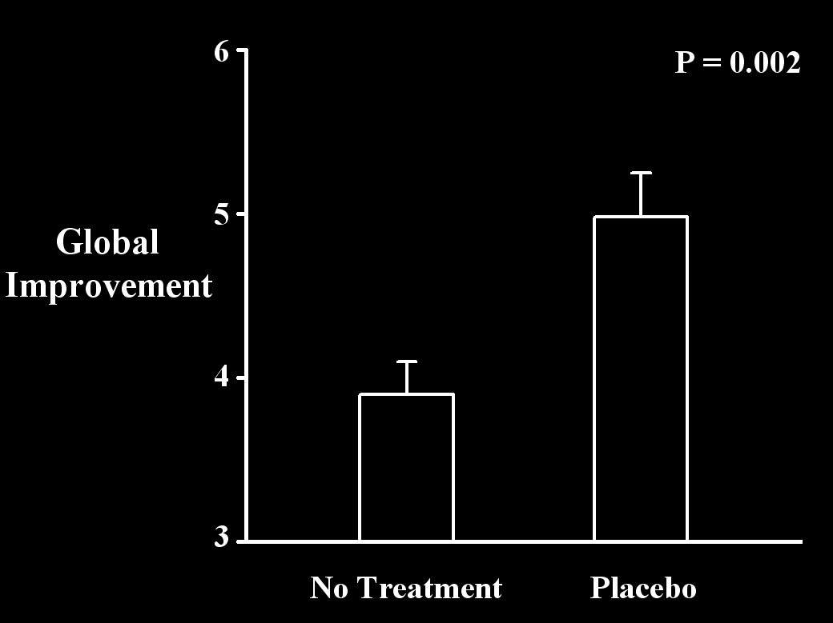
Placebo Effect
Kaptchuk, PLoS ONE, 2010

Slide 32
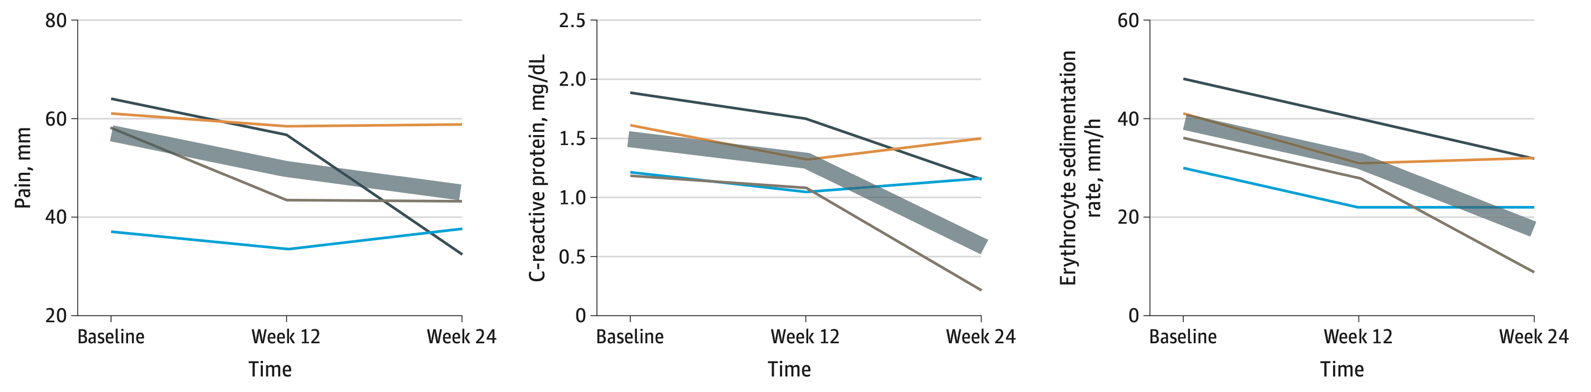
Four Blinded Arthritis Trials
C-reactive Protein
Erythrocyte sedimentation
Pain
From Vollerte, JAMA Network Open 2020

Slide 33
Selection of Outcomes
Surrogate or intermediate
  Presumably related to outcomes of interest
    Bone density for fractures
    Intraoperative hypotension for stroke
  Usually continuous: implies smaller sample size
Major outcomes
  Severe events (i.e., myocardial infarction, stroke, death)
  Usual dichotomous: implies larger sample size
Define Clinically Meaningful Differences a priori

Slide 34
Patient-oriented Endpoints
Designed to be
  Meaningful to patients
  Capture multiple harm / benefit pathways
But often poorly designed catch-all outcomes
Primary and secondary outcomes should be
  Plausible
  Mechanistically and temporally related to intervention
  Well powered

Slide 35
Pysiologically Distal
Examples
  ICU or hospital stays
  Days-at-home-alive
  Hospital readmission
  Patient satisfaction
Thought to reflect “everything that went wrong”
But little connection to intervention-of-interest

Slide 36
Temporally Delayed
Examples
  Quality of life at 30 or 90 days
  Return to work or life routine
Lots of things happen over time
  Mostly unrelated to trial intervention
Significant differences thus rare

Slide 37
Poor Choice for Major Outcomes
Surrogate outcomes are usually
  Physiologically distal
  Temporally distant
Therefore, unlikely to be significant
Okay as exploratory outcomes
Results usually neutral for patient-oriented outcomes

Slide 38
Multiple “Looks”
Type 1 error = 1 – (1 – alpha)^{k} Where k is number of “looks”
Number of “looks” | Alpha error
1 | 0.05
2 | 0.10
3 | 0.14
4 | 0.19
5 | 0.23
10 | 0.40

Slide 39
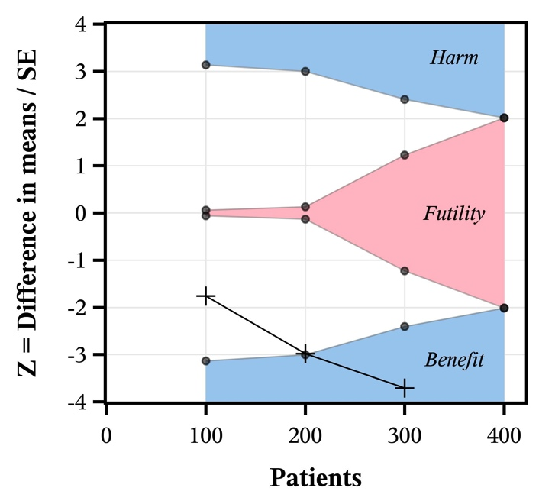
Interim Analyses & Stopping Rules
Reasons trials are stopped early
  Ethics, money
  Regulatory issues
  Drug expiration, personnel
  Other opportunities
Pre-defined interim analyses
  Spend alpha and beta power
  Avoid “convenience sample”
  Avoid ad hoc “looks”
Pre-defined stopping rules
  Efficacy versus futility

Slide 40
Fragile Results
Consider two identical trials of treatment for infarction
Trial | N | Treatment Events | Placebo Events | RR | P
A | 200 | 1 | 9 | 0.11 | 0.02
B | 4,000 | 200 | 250 | 0.80 | 0.02
Which result do you believe?
Which is biologically plausible?
Fragility index: A=2, B=13
“Quantity has a quality all of its own.”

Slide 41
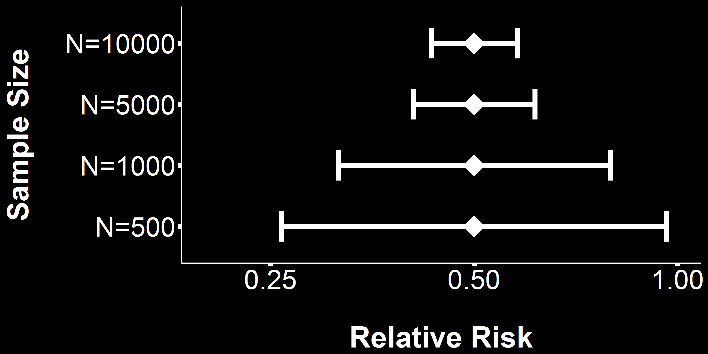
Sample Size and 95% Confidence Intervals
Intervention reduces risk from 10% to 5%

Slide 42
Replication of Trials
P value in original study | Probability of replication, assuming original effects size is correct (%)
0.1 | 37
0.05 | 50
0.03 | 58
0.01 | 73
0.001 | 91
Goodman, Statistics in Medicine, 1992

Slide 43
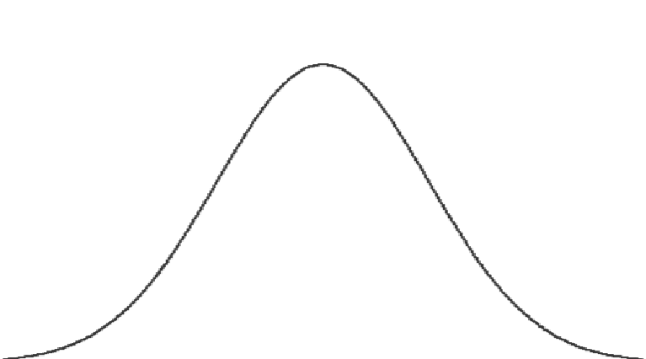
Replication of Studies
Assume the true effect size is the estimate from the first study.
P=0.05
P=0.05
No difference in means
X
H₀: μ1-μ2=0
0
Power=0.5
Hα: μ1-μ2 = Δ _{observed}

Slide 44
Replication of Studies
P=0.0003
No difference in means
H₀: μ1-μ2=0
X
0
Power=0.95
Hα: μ1-μ2 = Δ _{observed}
Notes:
About 3.5 times as many patients needed move P from 0.05 to 0.0003.

Slide 45
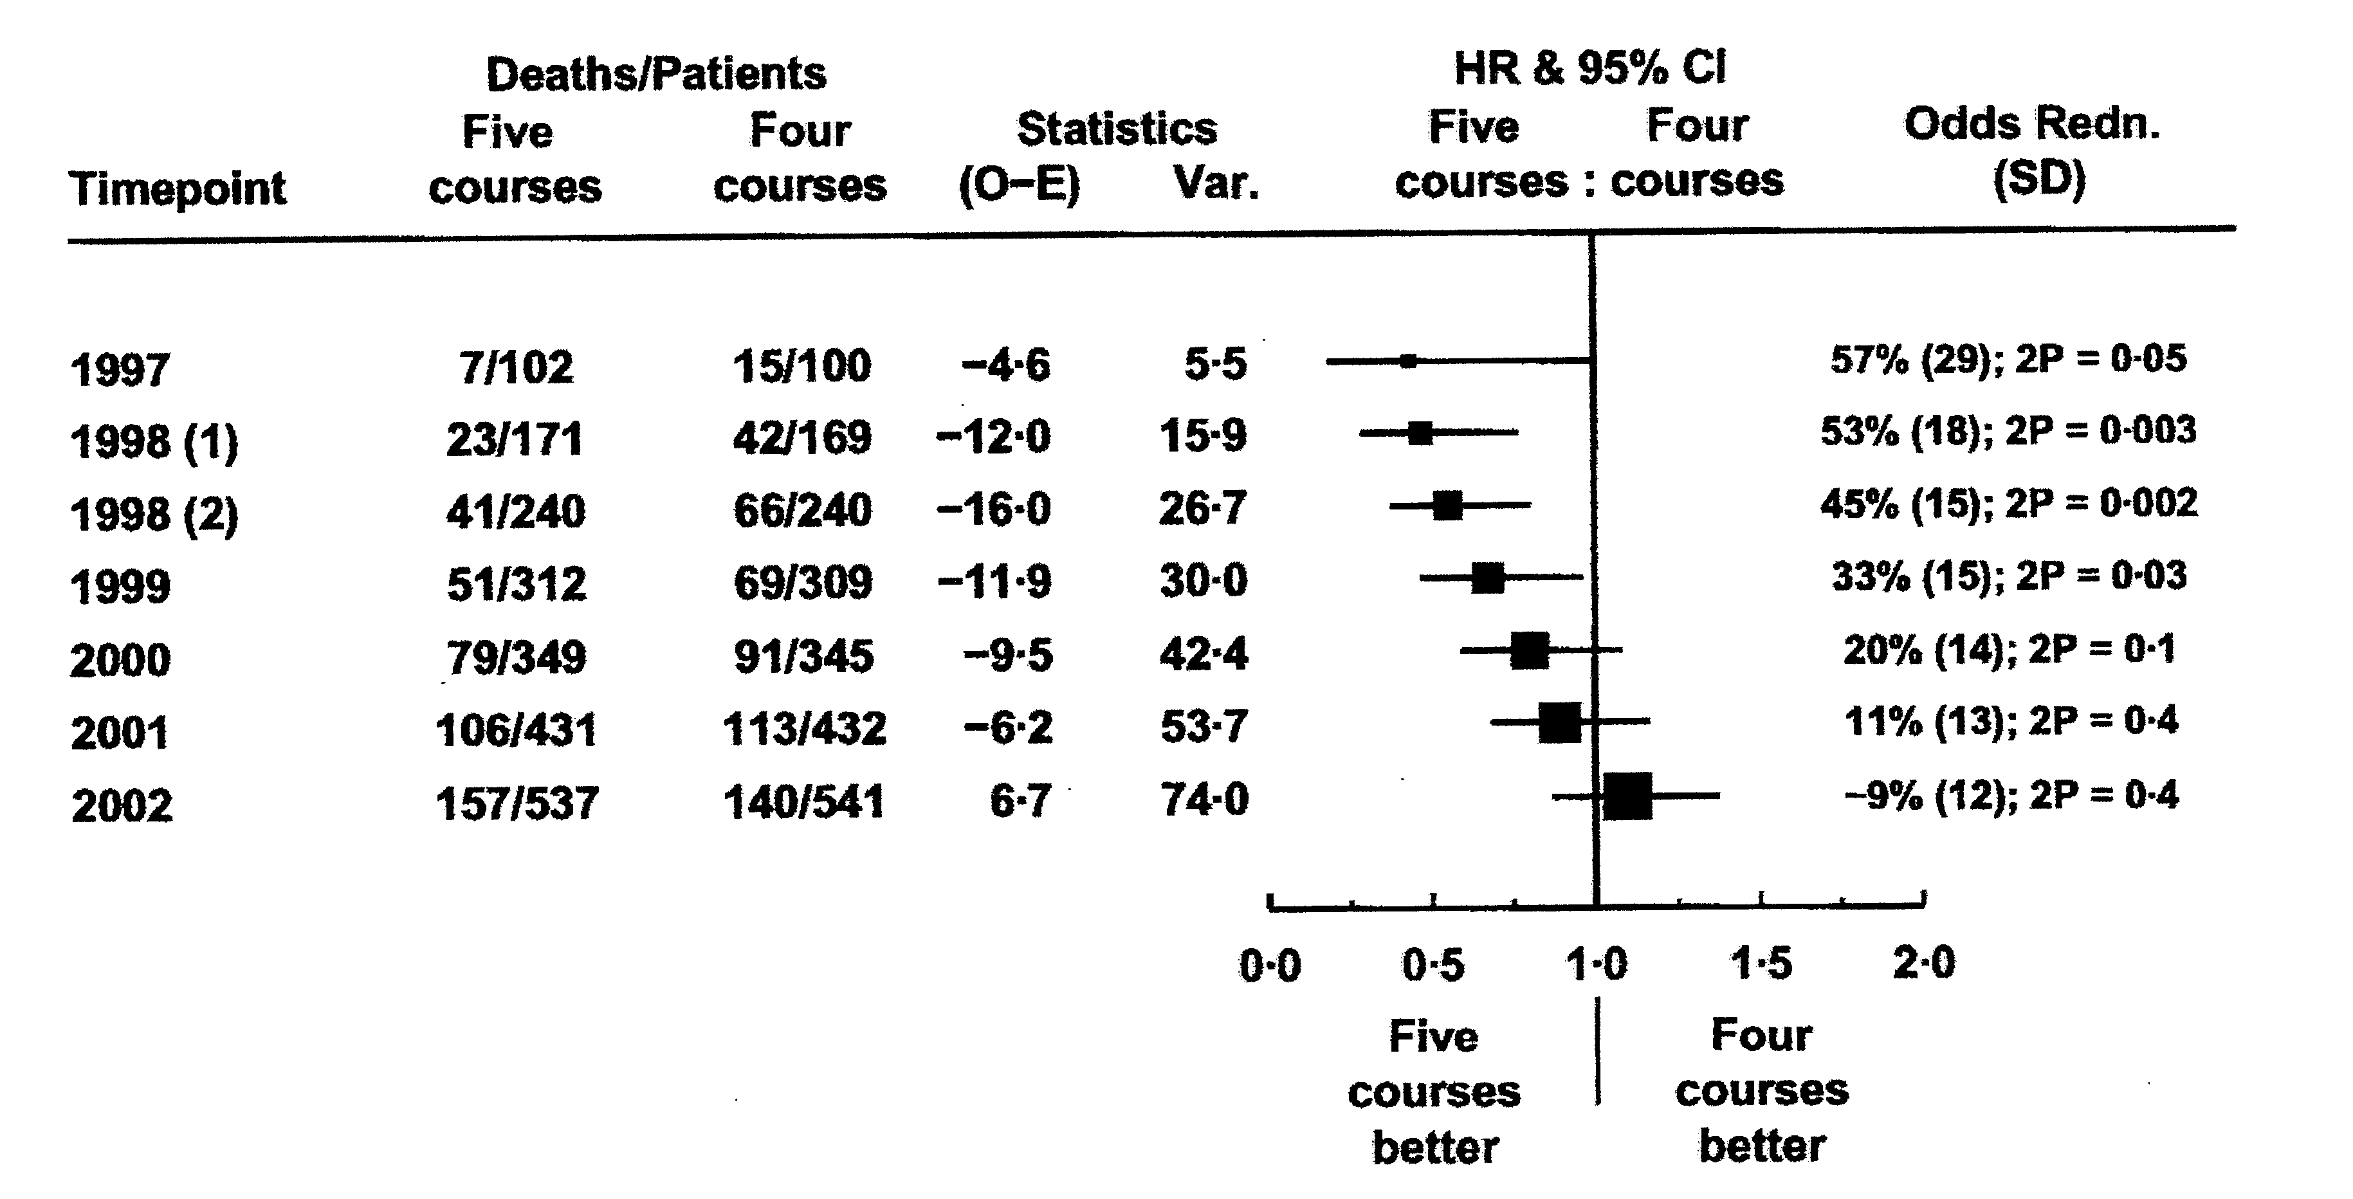

Four versus Five Rx for CML

Slide 46
Problem Solved?

Slide 47
How About Now?

Slide 48
Small Studies Often Wrong!

Slide 49
Small Trials Over-estimate Benefit
Winner’s curse
  Small trials only significant when effect is extreme
  Truly large treatment effects are rare
    Especially for sparse dichotomous outcomes
  Some small-trial results will randomly be extreme
Publication bias
  Significant results most likely to be published
  Literature thus over-weighted for extreme effects

Slide 50
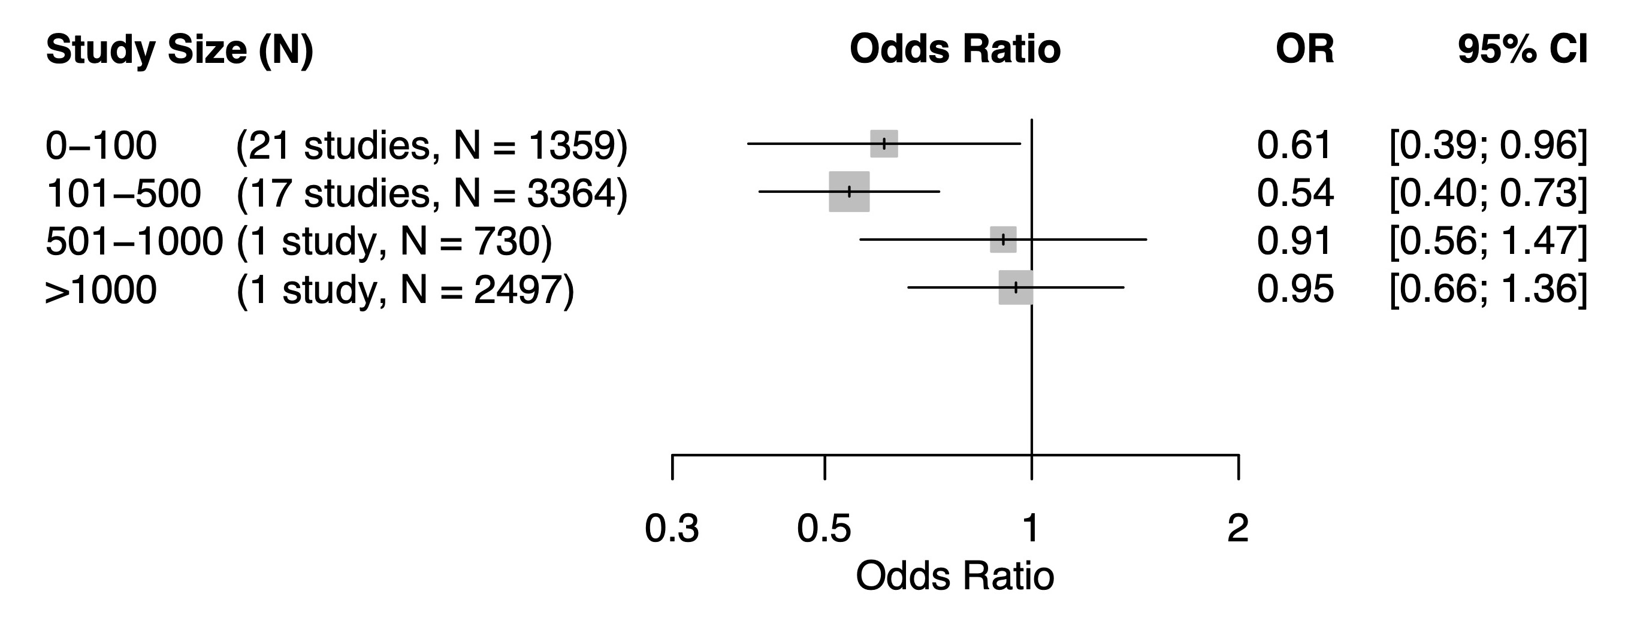
Goal-directed Fluids & Pneumonia
Meta-analysis of 38 trials (N=4,273) got the wrong answer; 2 large trials (N=3,227) got it right
Müller, BJA 2025

Slide 51
Dose-response Matters
Treatment
Effect
Experimental
Reference
Relative Drug Dose

Slide 52
Multi-center Trials
Advantages
  Necessary when large enrollment required
  Diverse populations increase generalizability of results
  Problems in individual center(s) balanced by other centers
    Often required by Food and Drug Administration
Disadvantages
  Difficult to enforce protocol, inevitable differences by center
  Expensive!
“Multi-center” does not necessarily mean “better”

Slide 53
Potential Problems
Insufficient enrollment is the leading cause of failure
Insufficient power is second major cause of failure
  Greater-than-expected variability
  Treatment effect smaller than anticipated
Poor compliance
  Patients, clinicians

Slide 54
Analysis Strategies
The problem
  Randomization or treatment errors
  Poor compliance and patient withdrawal
  Unavoidable problems
    Surgery cancelled
    Randomized treatment not clinically indicated
Intent-to-treat
  Best protection again bias
  Investigator errors or patient non-compliance decreases effect
Treatment Received
  Best-case results

Slide 55
Interpretation of Trial Results
Clinically meaningful reduction
p
Under powered
>0.05
Robustly comparable
>0.05
Robustly comparable
<0.05
Prob True diff
<0.05
Confirmed diff
<0.05
0.6
0.8
1.0
1.2
Relative risk

Slide 56
Well-done Trials Can Still be Wrong
Differing experience with techniques
  Less experience with experimental intervention
  “Rougher” practice worsens outcomes
Ancillary drug use may vary non-randomly
Treatment effect heterogeneity
Dose-response matters
Randomization & blinding does not prevent attrition

Slide 57
Attrition Bias in Randomized Trials
Randomization prevents selection bias & confounding
Blinding prevents most measurement bias, but not attrition bias
  Attrition bias is patient- rather than investigator-initiated
An example of attrition bias
  Trial of a minimally effective analgesic for persistant pain
  Patients assigned to novel treatment drop out non-randomly
  Patient who remain have high pain tolerance and report benefit
  Treatment-group average thus over-states benefit
Intent-to-treat and per-protocol analyses will differ

Slide 58
Gratuitous Advice
Include pilot patients
Read the directions!
  Review the relevant guidelines
  Required items won’t be available unless included in design
Be careful with trial registration; update as necessary
Get professional statistical help a priori
Don’t fudge the sample-size estimate
  The number of patients needed is determined by nature
    Not the amount of funding or when your fellowship ends

Slide 59


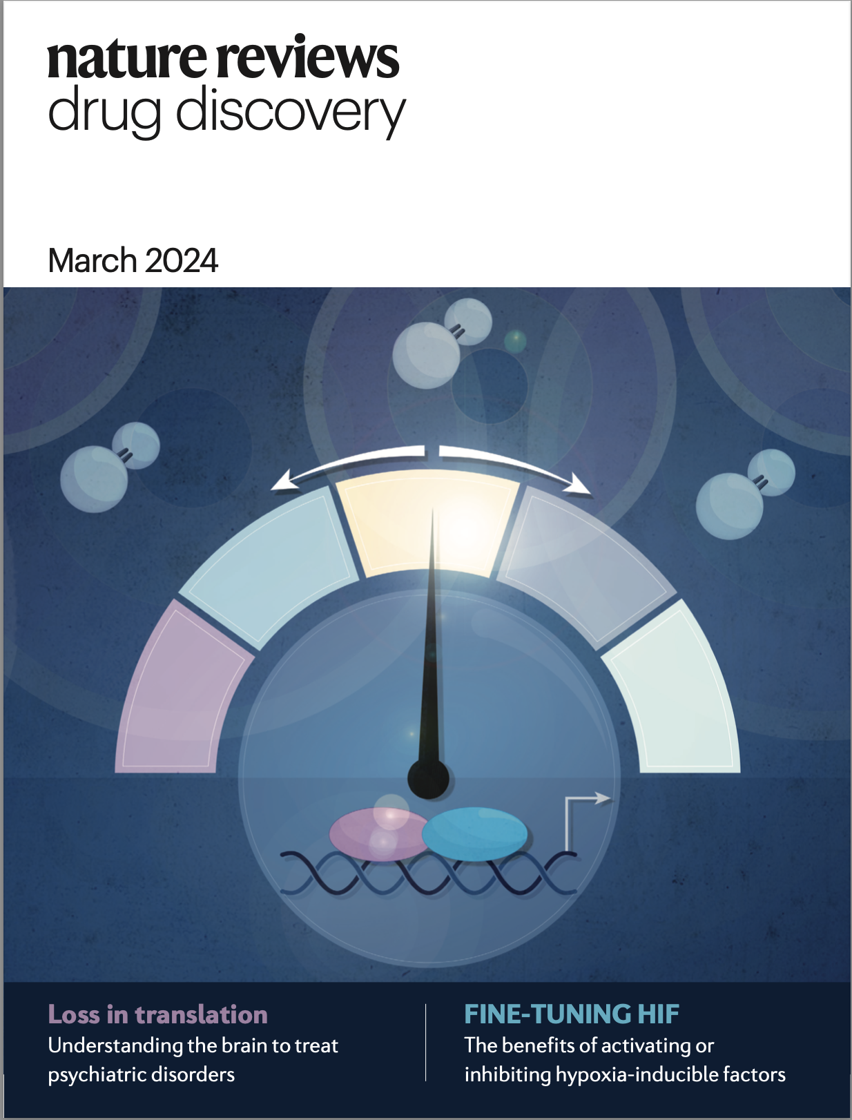
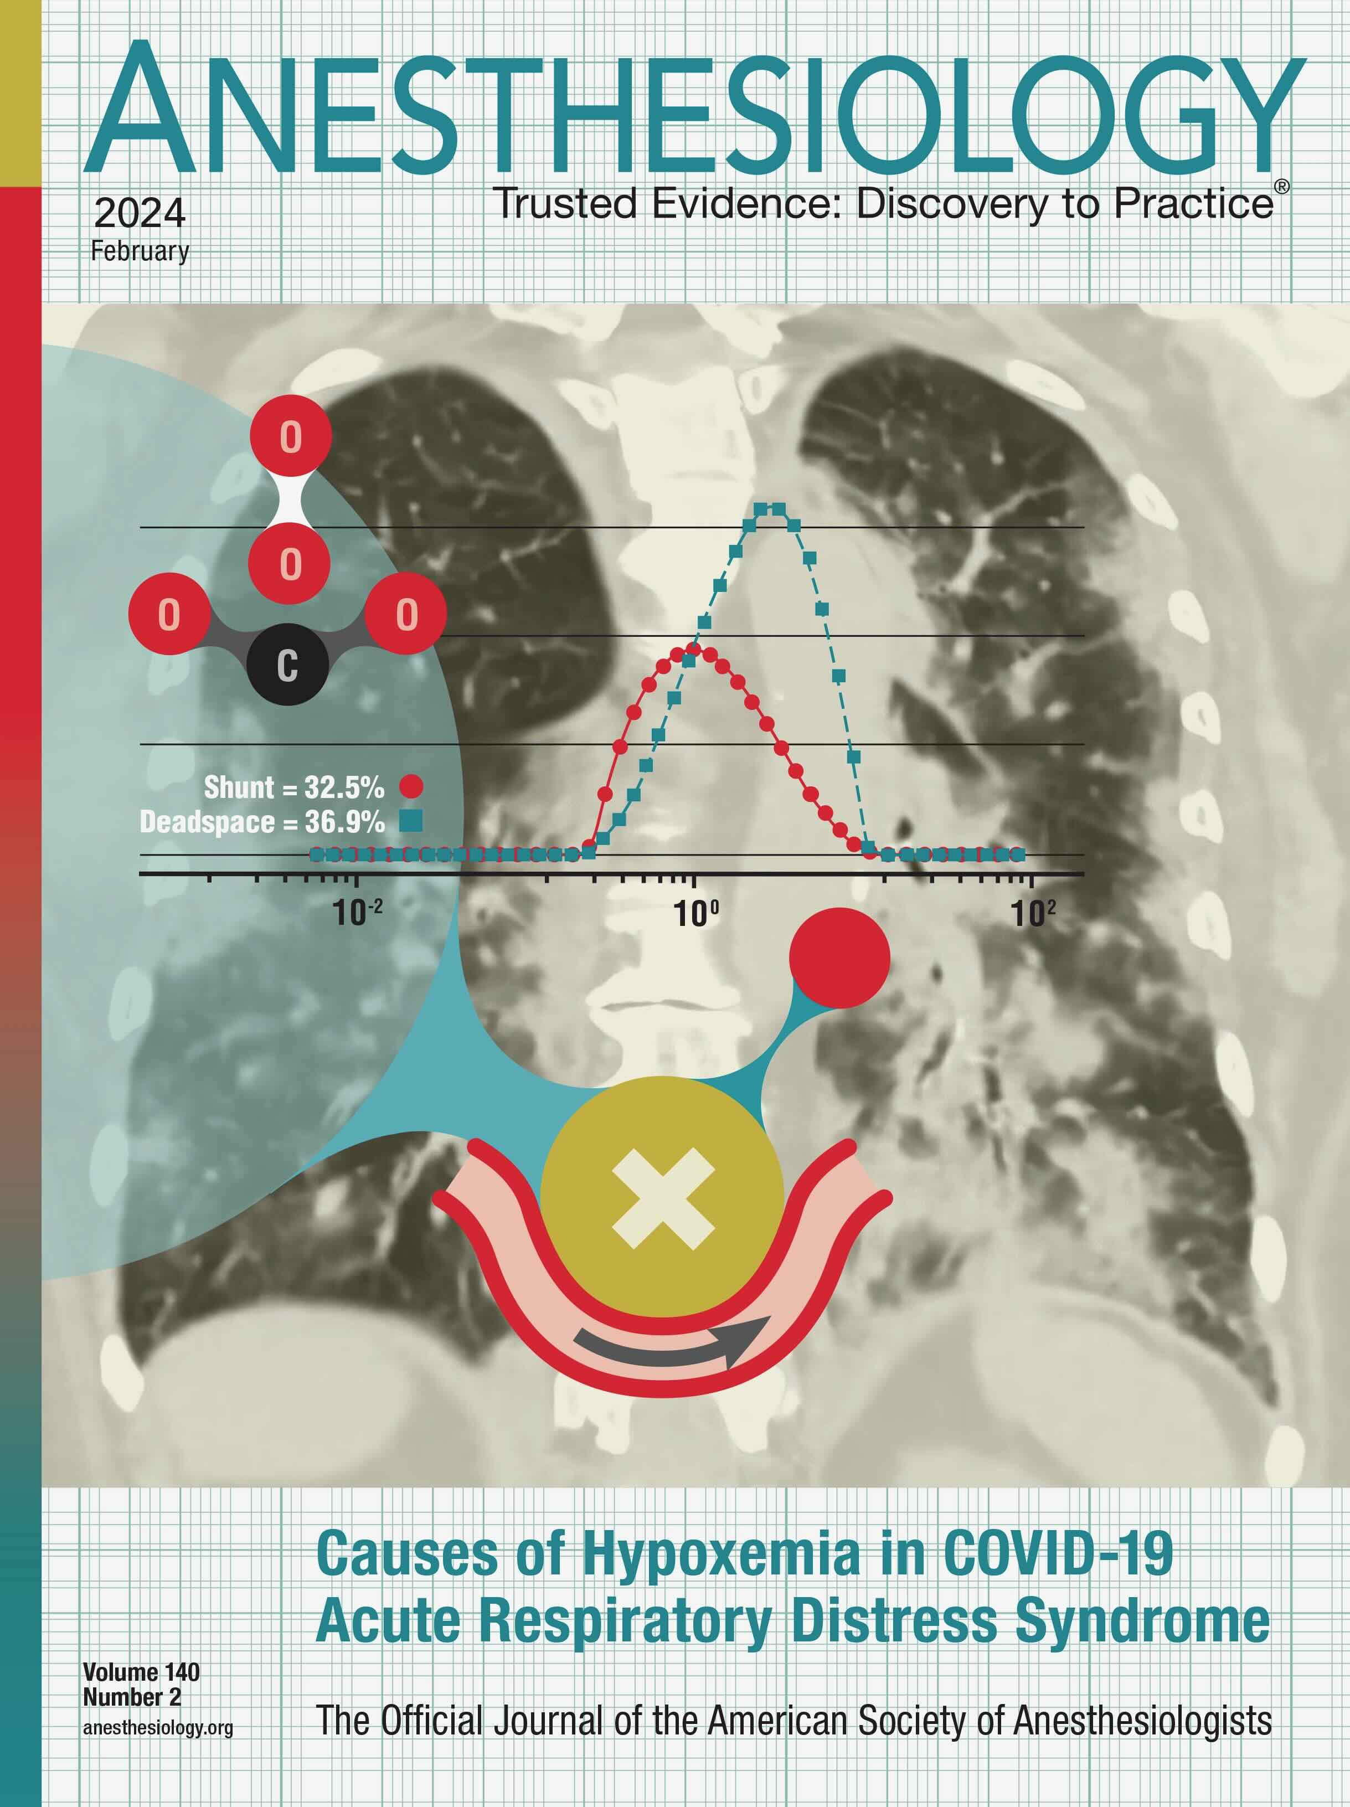
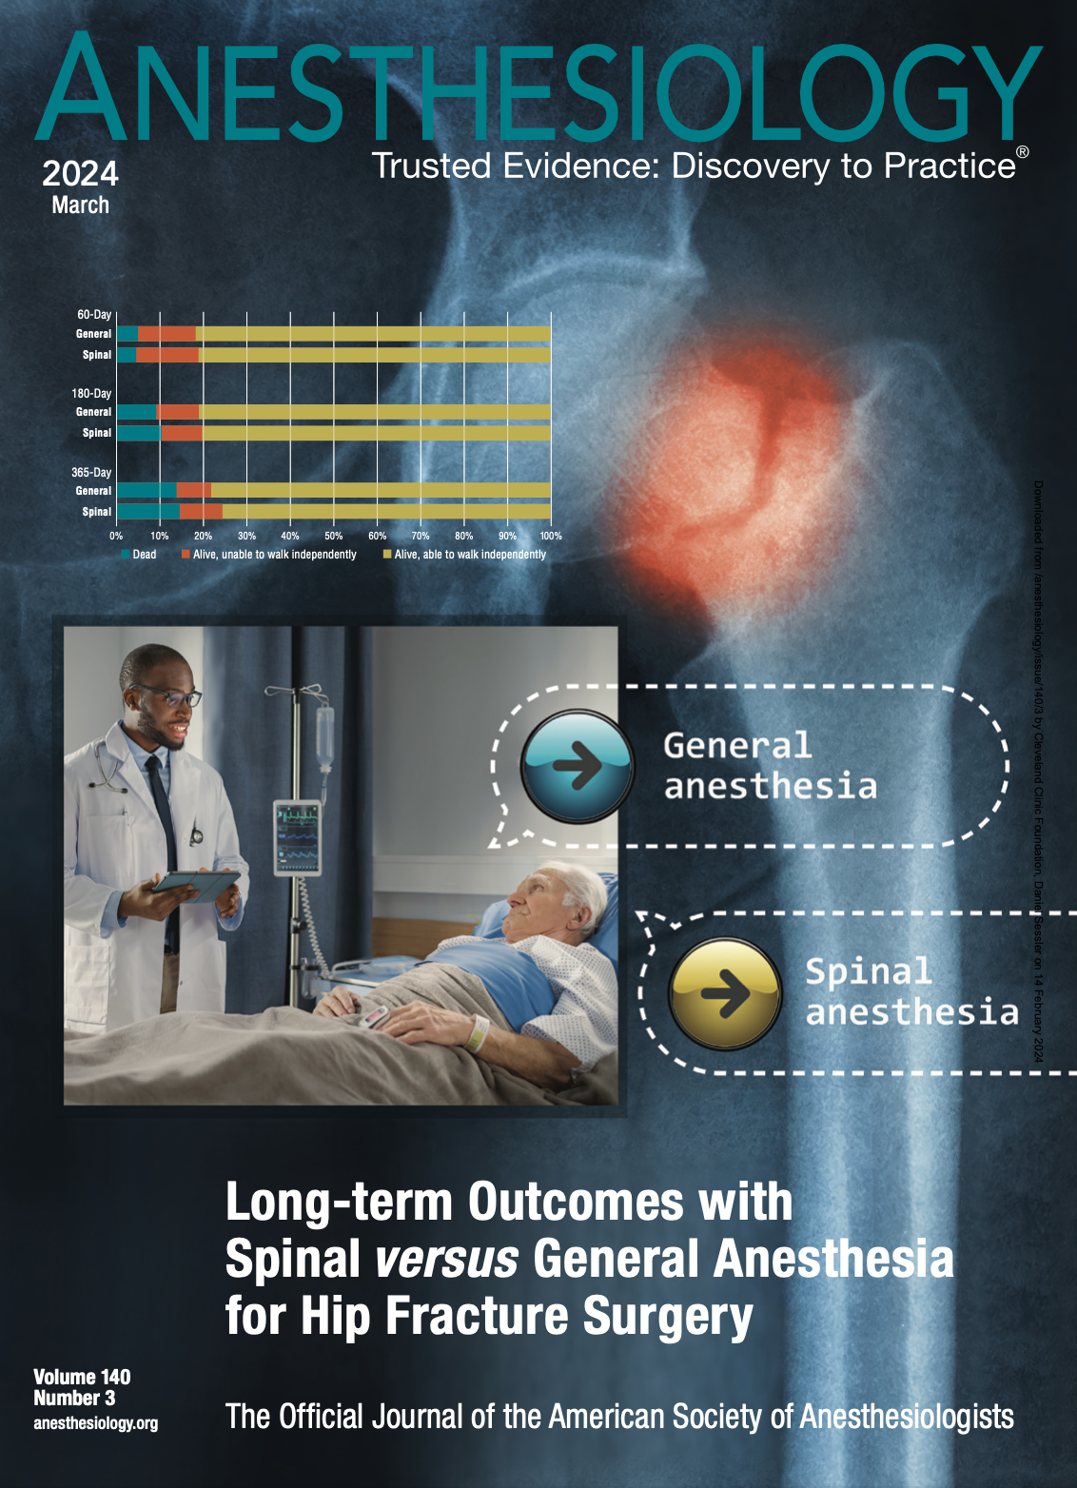




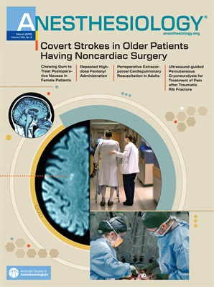
And that’s all folks…
Selected OUTCOMES RESEARCH covers since 2023

Slide 60

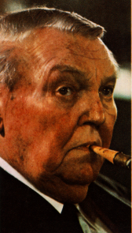

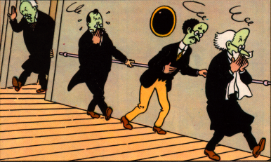
Factorial Outcome Example
Apfel, et al. NEJM 2004
25% RRR
25% RRR
25% RRR

Slide 61
External Threats to Validity
External validity
Internal validity
Population of interest
Subjects enrolled
Selection bias
Eligible Subjects
Measurement bias
Confounding
Chance
?
??
Conclusion

Slide 62
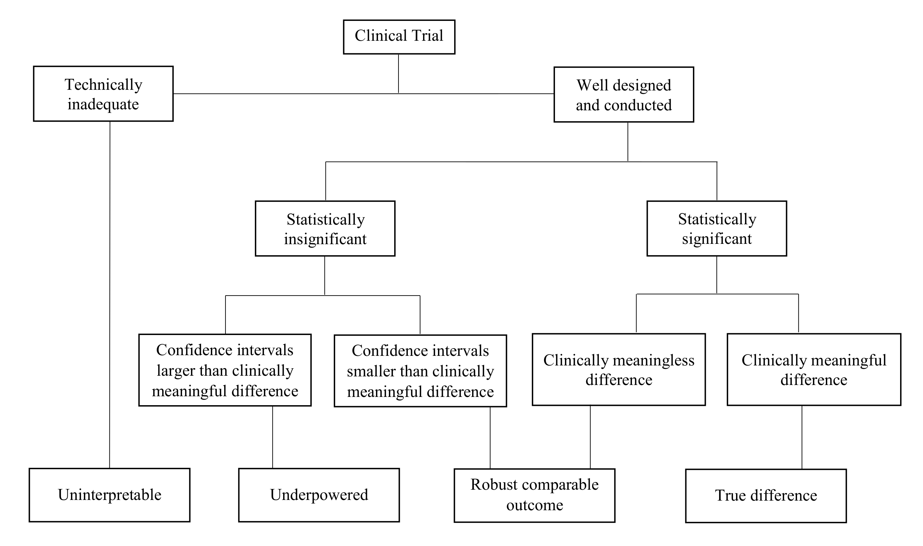

Slide 63
Trial Management
Case-report forms
  Require careful design and specific field definitions
  Every field should be completed
    Missing data can’t be assumed to be zero or no event
Data-management (custom database best)
  Evaluate quality and completeness in real time
  Range and statistical checks
  Trace to source documents
Independent monitoring team

Slide 64
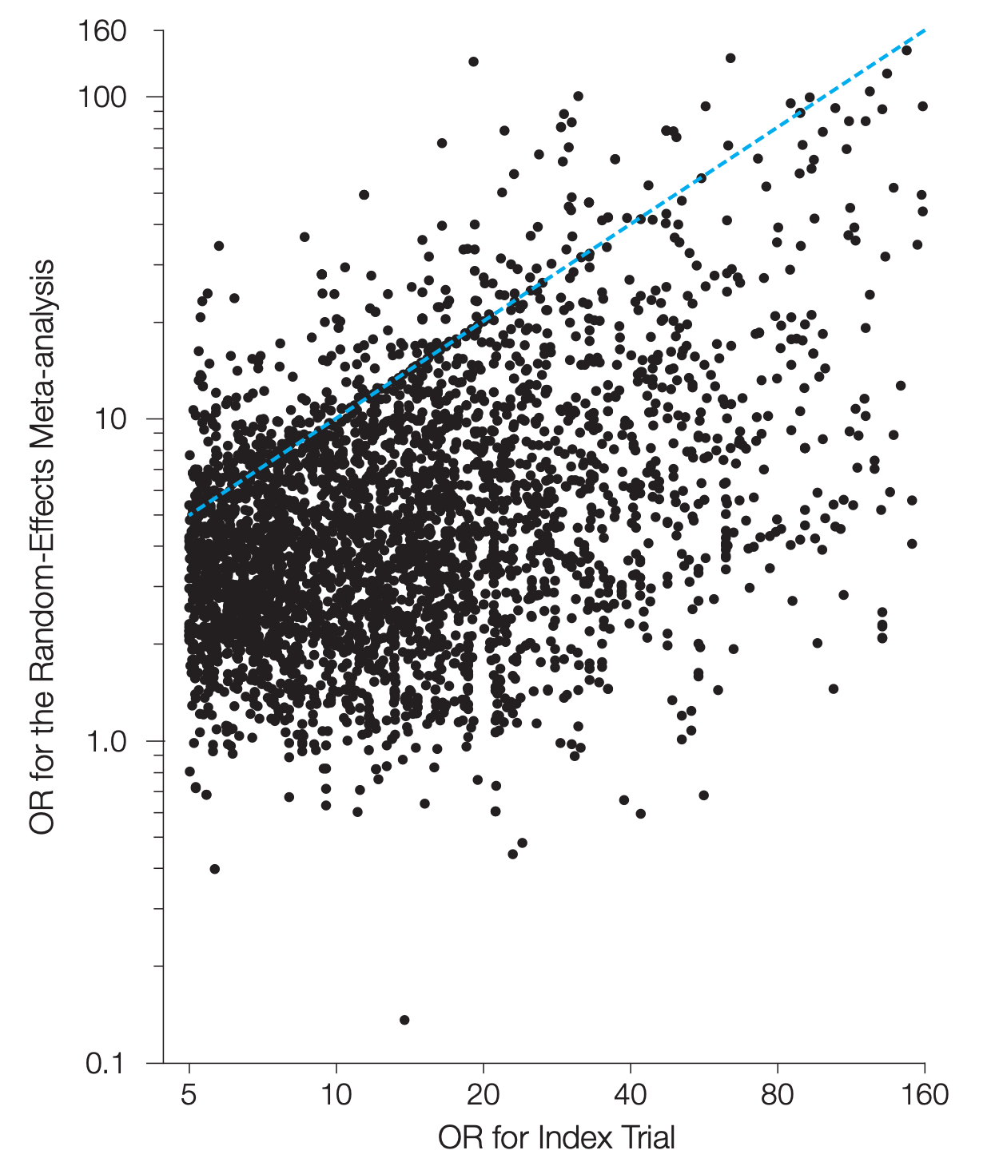
Replication Fails
ORs for index (X axis) v. subsequent trials when initial ORs >2
Blue line shows identical ORs
90% of subsequent trials had smaller ORs
Median OR decreased 3-fold
Note log scale Y axis
Pereira, JAMA 2012

Slide 65
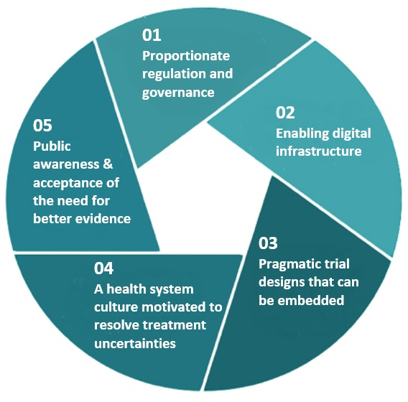
Comparative Effectiveness Trials
Learning healthcare system
Learning healthcare systems
Evaluate routine treatments
All within standard-of-care
  Reasonable people doing things differently
  No existing clear evidence
Consent waived or modified

