Slide 1

OUTCOMES RESEARCH Consortium
Providing the evidence for evidence-based medicine©

Slide 2
Anesthesia & Cancer Recurrence
Daniel I. Sessler, M.D.
Vice-president for Clinical and Outcomes Research
Professor of Anesthesiology
UTHealth, Houston
Providing the evidence for evidence-based medicine©

Slide 3
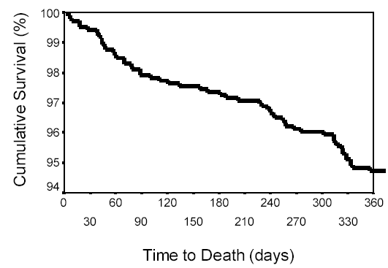
Causes of Long-term Mortality
5-10% one-year mortality in patients ≥65 yrs
Cause of Death | %
Cancer | 52%
Cardiovascular | 17%
Renal/Liver Failure | 5%
Respiratory Failure | 4%
Pulmonary Emboli | 2%
Sepsis/Infection | 2%
Monk, A&A 2005
Monk, A&A 2005

Slide 4
Cancer Surgery
Cancer recurrence is usually lethal
Surgery remains primary treatment
  Releases tumor cells into blood stream
  There is always minimal residual disease
Natural killer (NK) cells are major defense
Surgery and anesthesia impair NK Cell function
  Neuroendocrine stress response to surgery
  Volatile anesthetics
  Opioids

Slide 5
Regional Analgesia Protective?
Regional anesthesia & analgesia
  Reduces stress response to surgery
  Reduces or eliminates general anesthetics
  Obviates need for postoperative opioids
All three help preserve NK cell function
Hypothesis:
  Regional analgesia reduces cancer recurrence

Slide 6
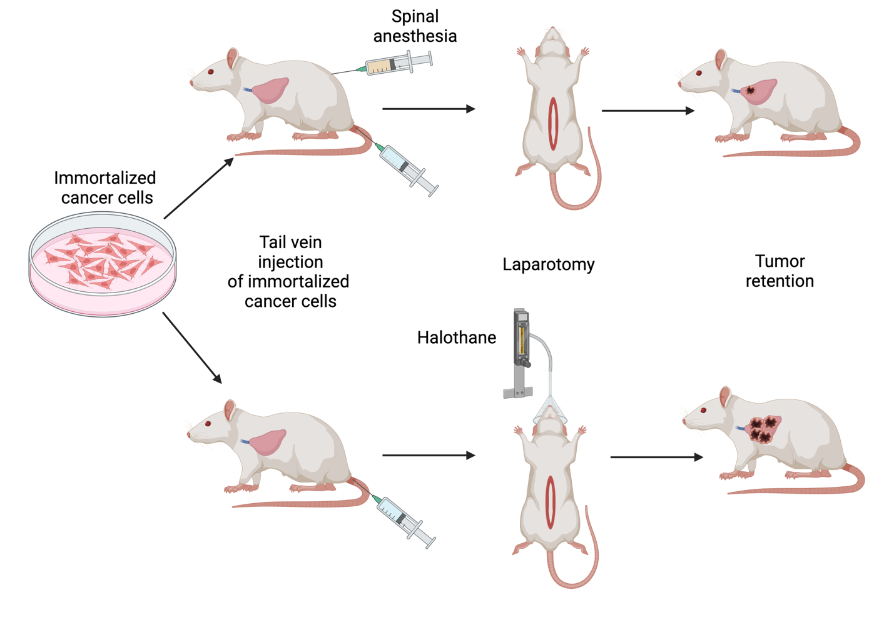
Rodent Model

Slide 7
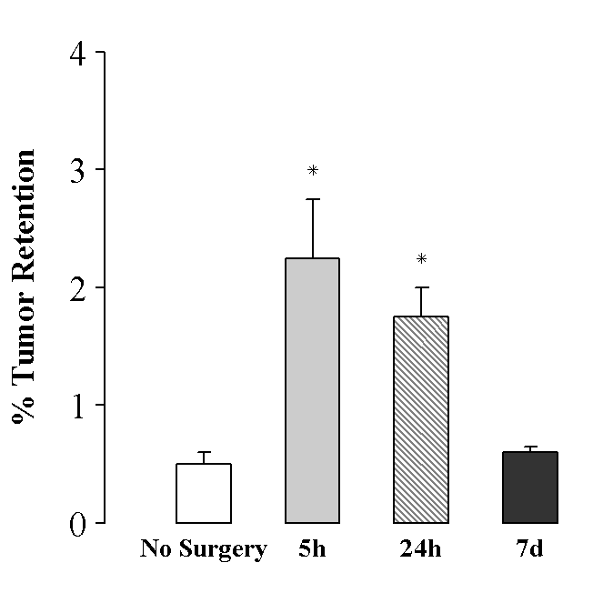
Natural Kill Activity
Surgery in Rats
Reduced NK Activity
  In blood
  In the spleen
Increased lung metastases
Ben-Eliyahu, Int J Cancer 1999

Slide 8
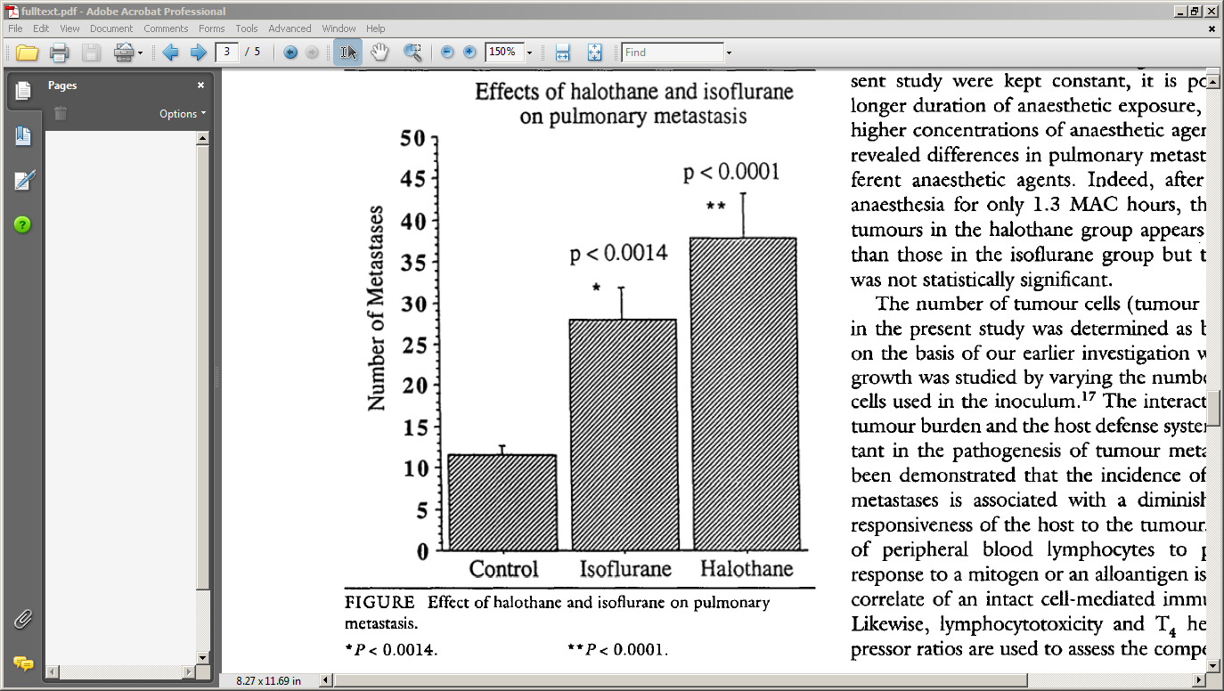
Anesthesia Increases Tumor Retention
Moudgil, CJA 1997

Slide 9
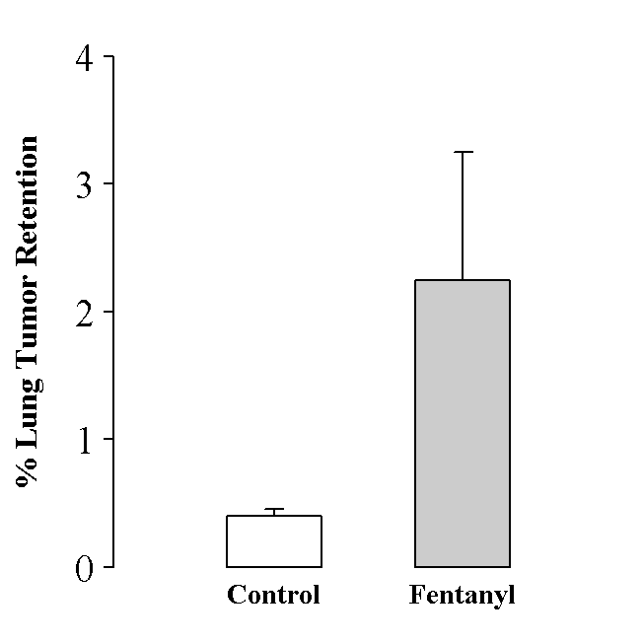
Opioids are Immunosuppressant
Lung tumor retention
Central pathway
  Glucocorticoid release
Peripheral pathways
  Reduced NK cell activity
  Impaired antibody production
  Decreased cytokine release
  Decreases T-lymphocyte proliferation
Shavit, Neuroimmunomodulation 2004

Slide 10
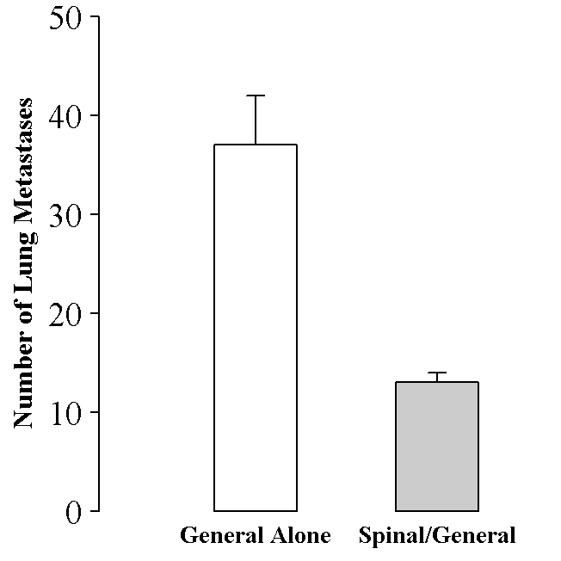
Rats: Bar-Yusof, Anesthesiology 2001
Bar-Yusof, Anesthesiology 2001

Slide 11

Paravertebrals & Breast Cancer
Retrospective analysis of mastectomies for CA
  50 had combined GA & paravertebral analgesia
  79 had general and morphine analgesia
Exadaktylos, Anesthesiology 2006

Slide 12
Epidurals & Prostate Cancer
Retrospective analysis of 225 prostatectomies for CA
  102 had combined general & epidural analgesia
  123 had general and morphine analgesia
Epidurals associated with 57% [17-78%] fewer recurrences
Biki, Anesthesiology 2008

Slide 13
Negative Retrospective Results
Gottschalk:, Anesthesiology 2010
  Colectomy for colon cancer
    256 epidural vs. 253 general anesthesia
Forget, EJA 2011
  Epidural analgesia for prostate cancer
    578 epidural vs. 533 general anesthesia
Day, BJA 2012
  Laparoscopic colectomy
  107 epidural; 144 spinal; and 173 general alone
Cata, RAPM 2016
  Breast cancer surgery, propensity matched n=198/group
  ± paravertebral blocks
And many others…

Slide 14
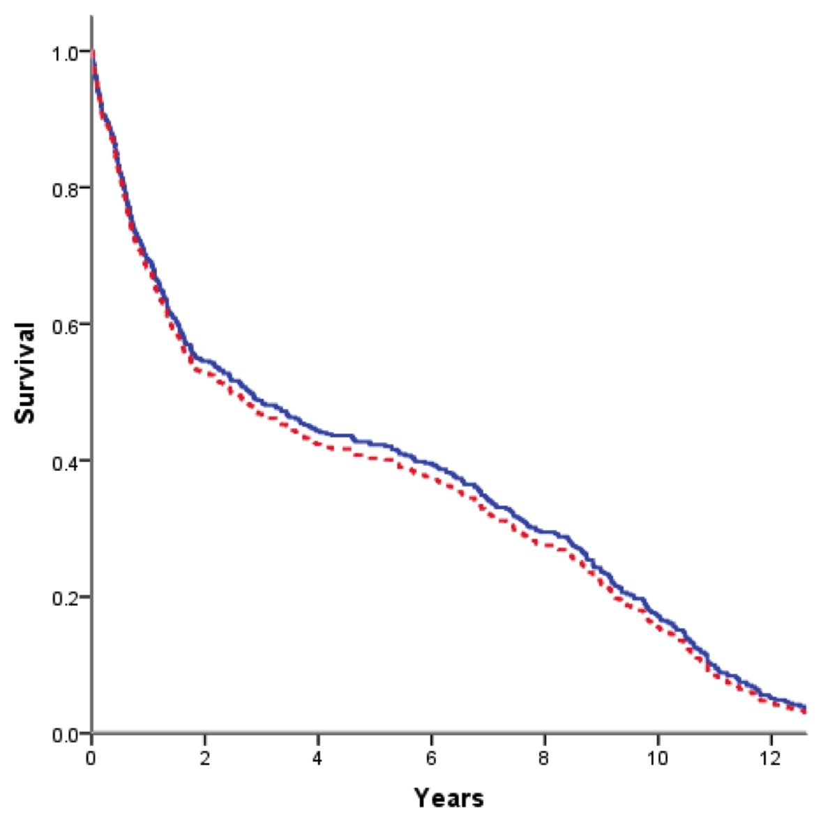
MASTER Trial Follow-up
Myles, BMJ, 2011
Epidural (n=230)
Also negative:
Tsui 2010
Christopherson 2008
General (n=215)
Notes:
Two other small randomized trials (re-analyses of previous studies): Christopherson and Tsui

Slide 15
Breast Cancer Trial Hypotheses
Primary hypothesis
  Recurrence of breast cancer is lower with paravertebral A&A than with GA and opioid analgesia
Secondary hypothesis
  Paravertebral A&A reduces persistent pain
Inclusion
  Unilateral breast cancer without known metastases
  Mastectomy or local excision & axillary dissection
    With or without prior or planned chemotherapy or radiotherapy
Exclusion
  Free flap reconstruction

Slide 16
Randomization and Enrollment
General anesthesia & opioid analgesia
  Sevoflurane anesthesia & PCA morphine analgesia
Paravertebral A&A
  Paravertebral
    5-level blocks (T1-T5) or Paravertebral catheter at T3
  Propofol sedation/anesthesia
2,076 patients enrolled between 2007 & 2013
  Stage: 1=40%, 2=40%, 3=20%
  Mostly modified radical mastectomy or wide excision
Stopped after 2nd interim analysis per protocol

Slide 17
Anesthetic Use
Pain scores low in both groups (≈1/10 vs. ≈3/10)
Little opioid use in either group

Slide 18
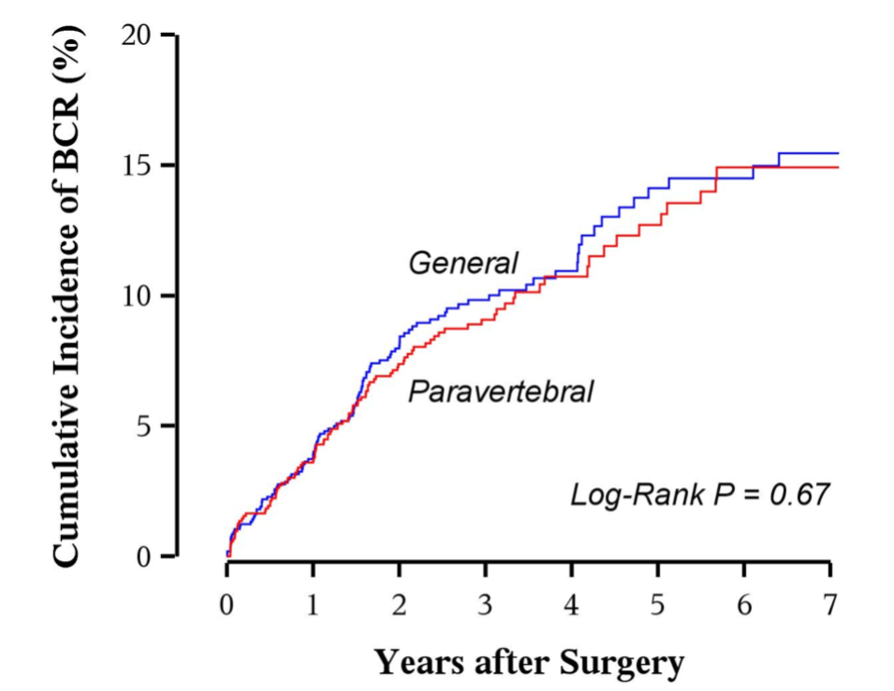
Breast Cancer Recurrence
Adjusted HR: 0.97 (0.74, 1.27)
No difference in mortality
No difference in persistent pain: 52% at 6 months & 27% at 12 months
Sessler, Lancet 2019

Slide 19
Sub-group Analyses

Slide 20
Breast Cancer Summary
Paravertebral A&A did not reduce
  Breast cancer recurrence
  Persistent postoperative pain
Relatively small operations, low pain scores
  Little opioid use, presumably low inflammation and surgical stress
Regional analgesia should be evaluated for
  Large operations requiring high opioid doses
Similar results reported in 526 women randomized to pectoral nerve blocks, Yu, BMC Surg 2022

Slide 21
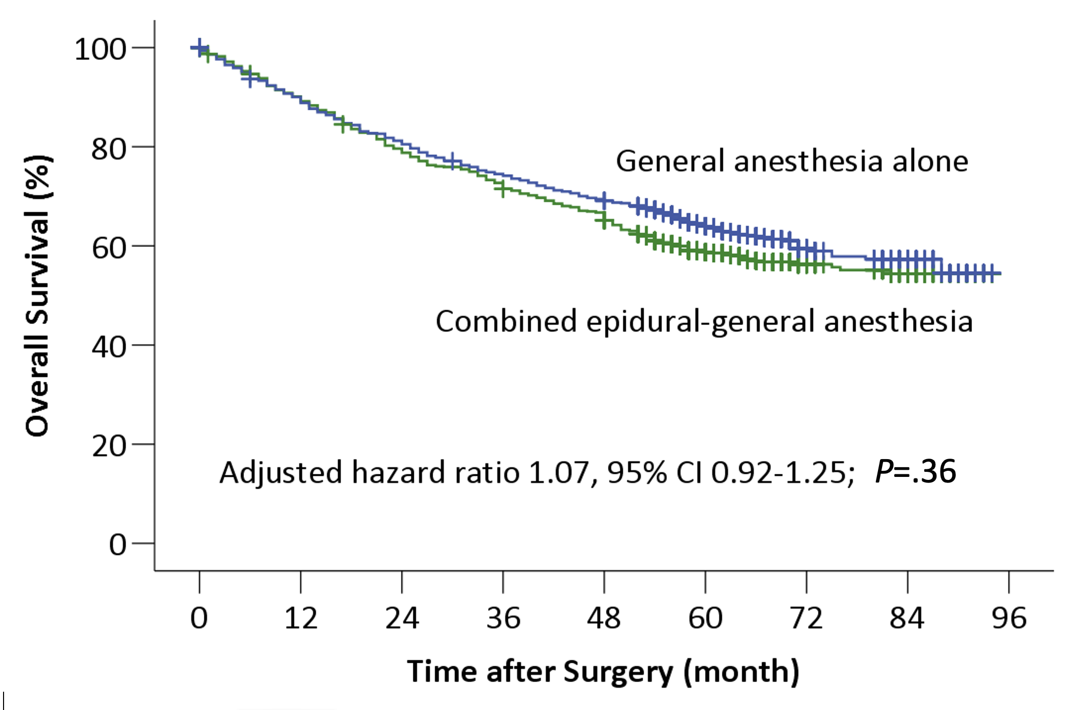
Major Abdominal Surgery
1,802 randomized patients
Major thoracic or abdominal cancer surgery
Epidural vs. combined epidural & GA
Du, Anesthesiology 2021

Slide 22
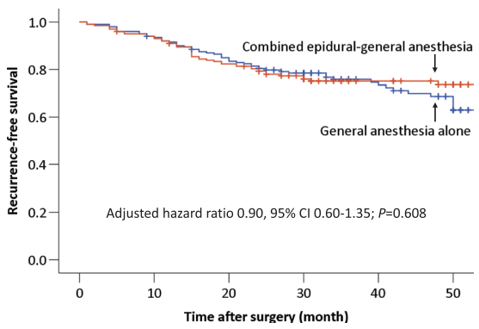
Lung Cancer Resection
400 randomized patients
Epidural vs. combined epidural & GA
11% reduction in opioid use
Xu, Anesthesiology, 2021

Slide 23
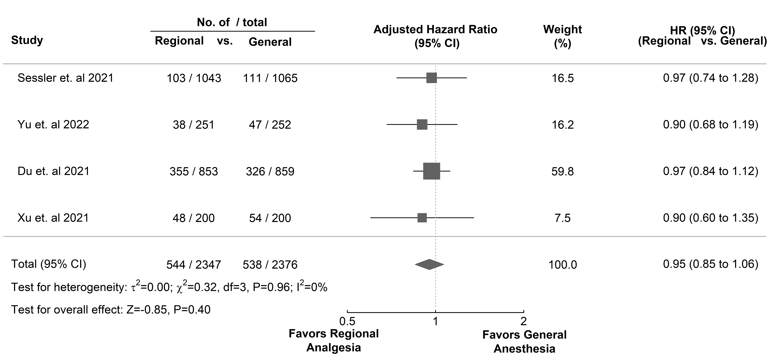
Regional Anesth & CA Recurrence

Slide 24
TIVA vs Volatile Anesthesia
Volatile anesthesia
  Impairs natural killer cell function
  Increases proliferation, migration in cancer cells
  Reduces neutrophil motility
Propofol may improve natural killer cell function
Wigmore, Anesthesiology 2016
  ≈8,000 patients, retrospective
  Volatile vs. propofol anesthesia for cancer surgery
  Hazard for 1-year mortality: 1.46 (1.29 to 1.66

Slide 25
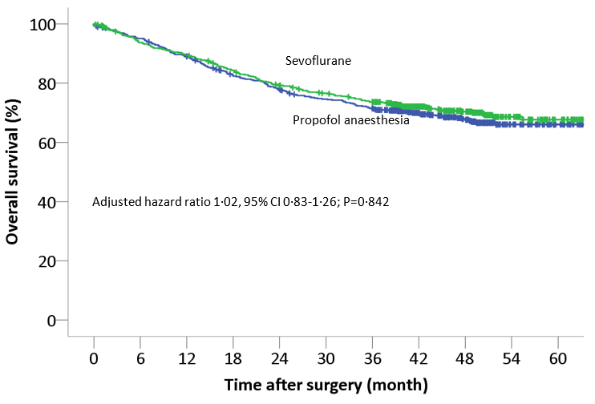
Overall Survival in TIVA vs Volatile
1,228 patients, elective cancer surgery
Multi-center, randomized
Cao, BJA 2023
_______________
Similar results N=1,766) from Bennett-Guerrero, Anesthesiology 2026

Slide 26
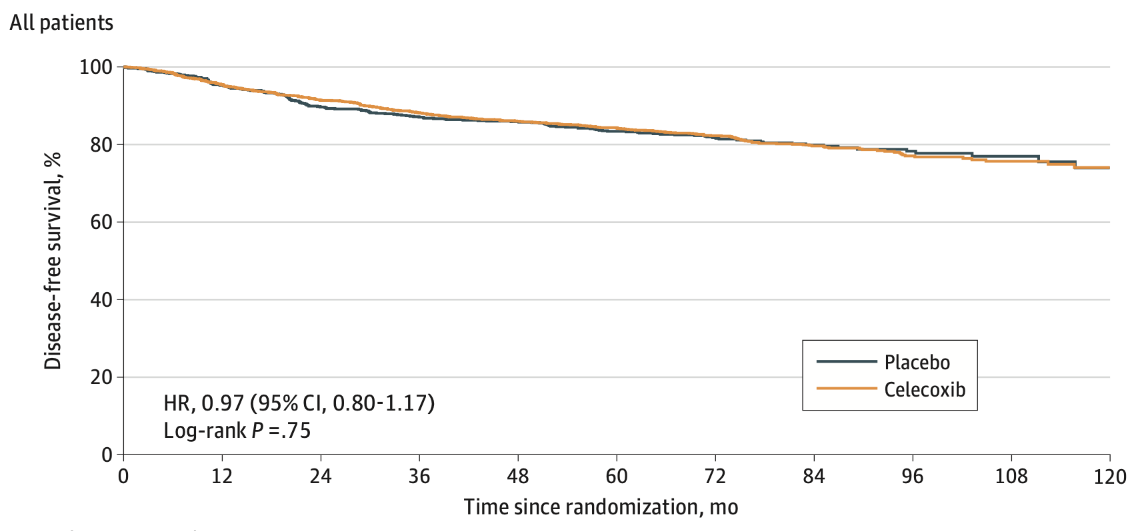
Disease-free with Celecoxib X 2 Yr
2,639 pts, elective breast surgery, Coombes, JAMA Onc 2023

Slide 27
Overall Summary
Three compelling mechanisms protect NK function with regional analgesia
  Reduced surgical stress response
  Decreased need for volatile anesthetics
  Decreased opioid use
All potentially improved by regional and propofol anesthesia
In vitro and rodent results were impressive
  Sub-optimal model
Clearly fails in humans. No benefit for:
  Regional vs GA: 4 major trials with a total of 4,770 patients
Regional analgesia and TIVA have many benefits
  Reducing cancer recurrence is not among them!
Also, no benefit from propofol v. sevoflurane or celecoxib v. placebo

Slide 28








And that’s all folks…
Selected OUTCOMES RESEARCH covers since 2022

Slide 29
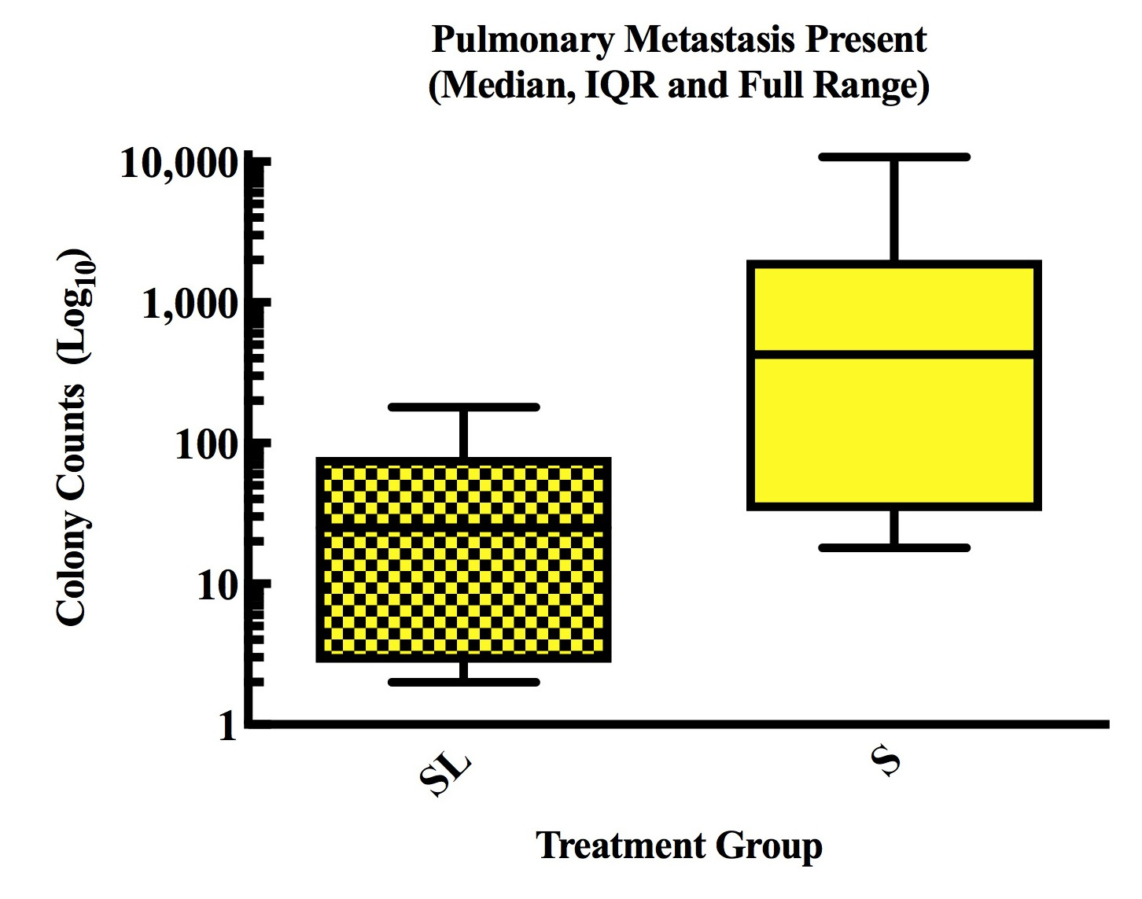
Cancer Recurrence with Lidocaine
Intravenous Lidocaine
  May inhibit extracellular-signal-regulated kinase (ERK) pathway
  ERK leads to proliferation, cell survivability
  Upregulated in metastatic cancer cells
Large randomized trial in progress
  Sevoflurane v. propofol/lidocaine
  VAPOR-C, Riedel & colleagues
Johnson, BJA 2018, study in mice
Lidocaine
Saline

